Slide 1


Slide 2


Slide 3
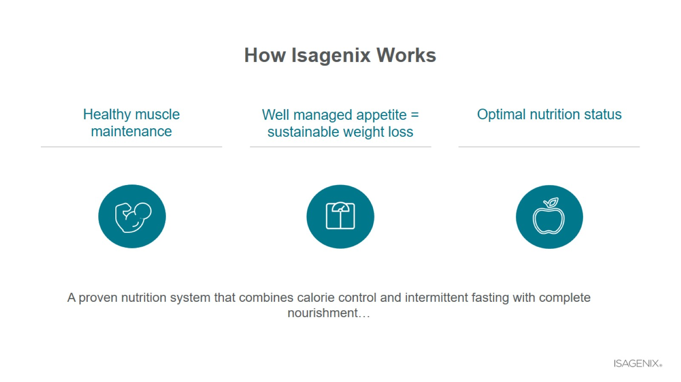
How Isagenix Works

Slide 4

Our Core Products

Slide 5
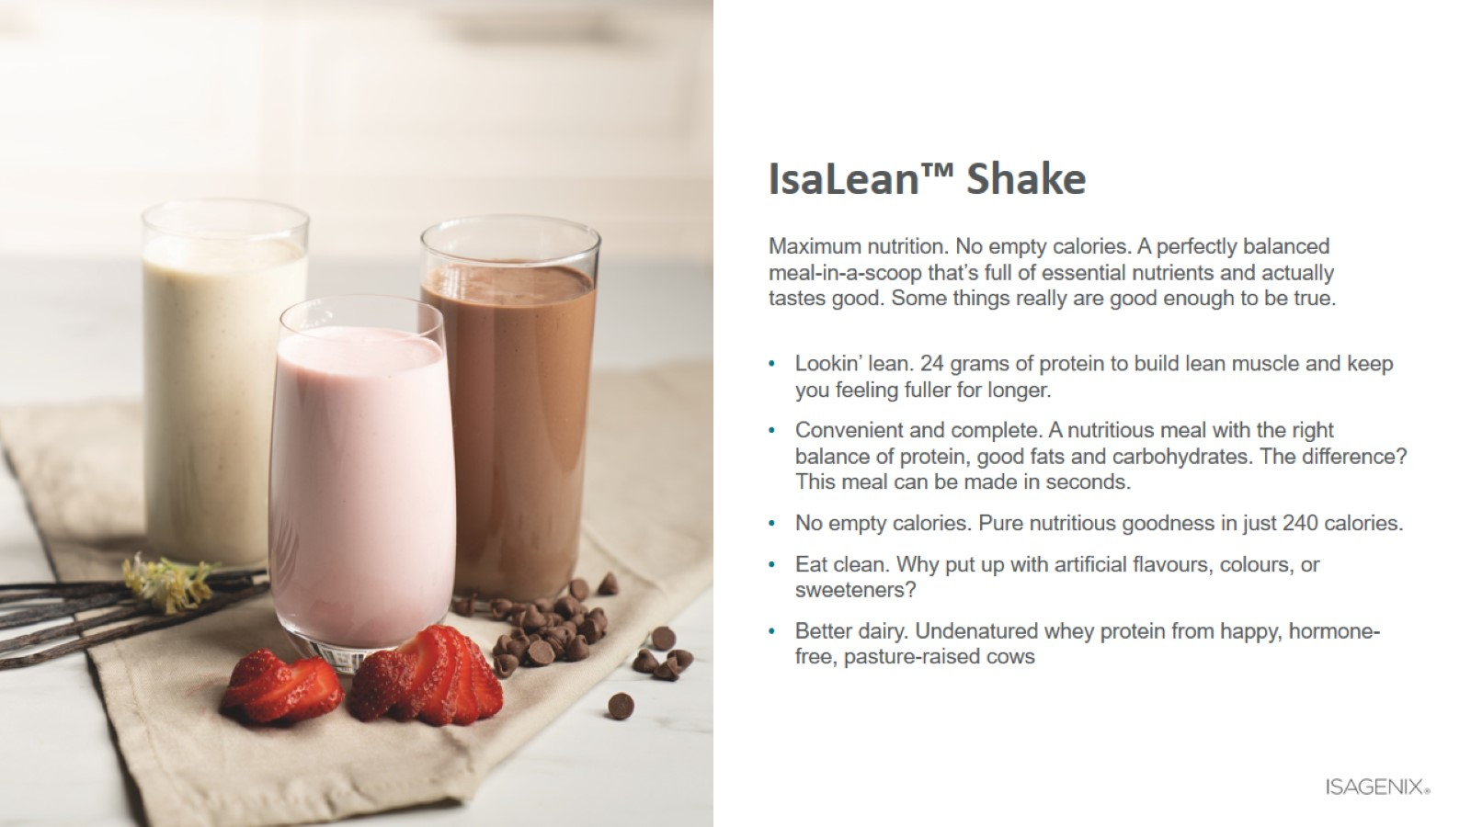
IsaLean™ Shake

Slide 6
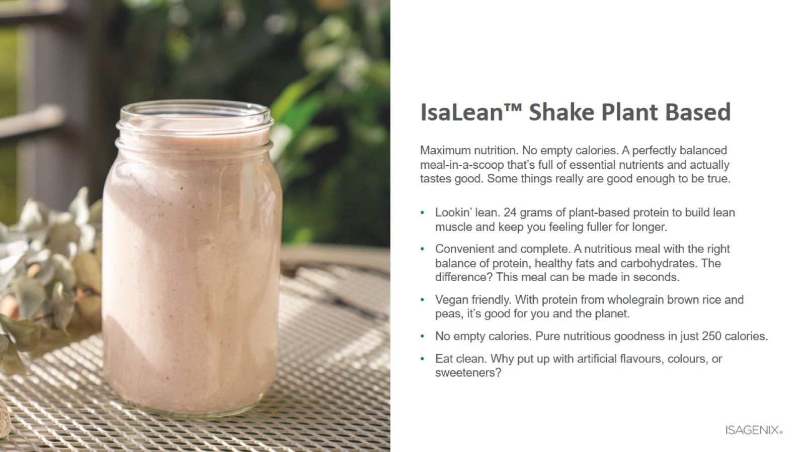
IsaLean™ Shake Plant Based

Slide 7

Nourish For Life™

Slide 8
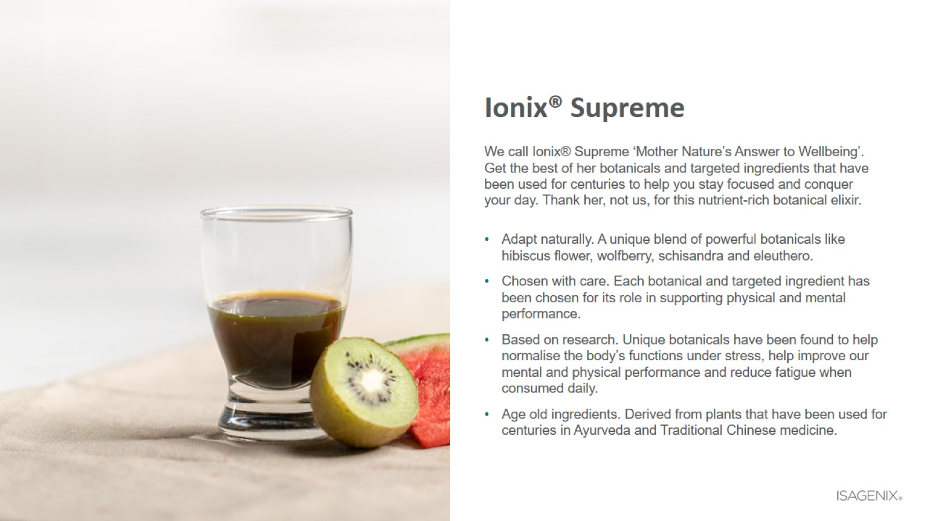
Ionix® Supreme

Slide 9

Healthy Snacking

Slide 10
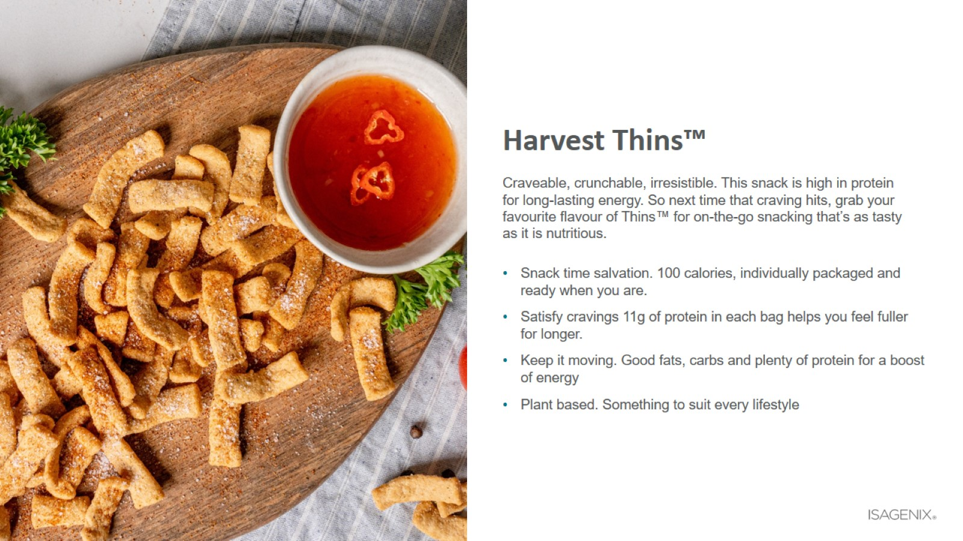
Harvest Thins™

Slide 11
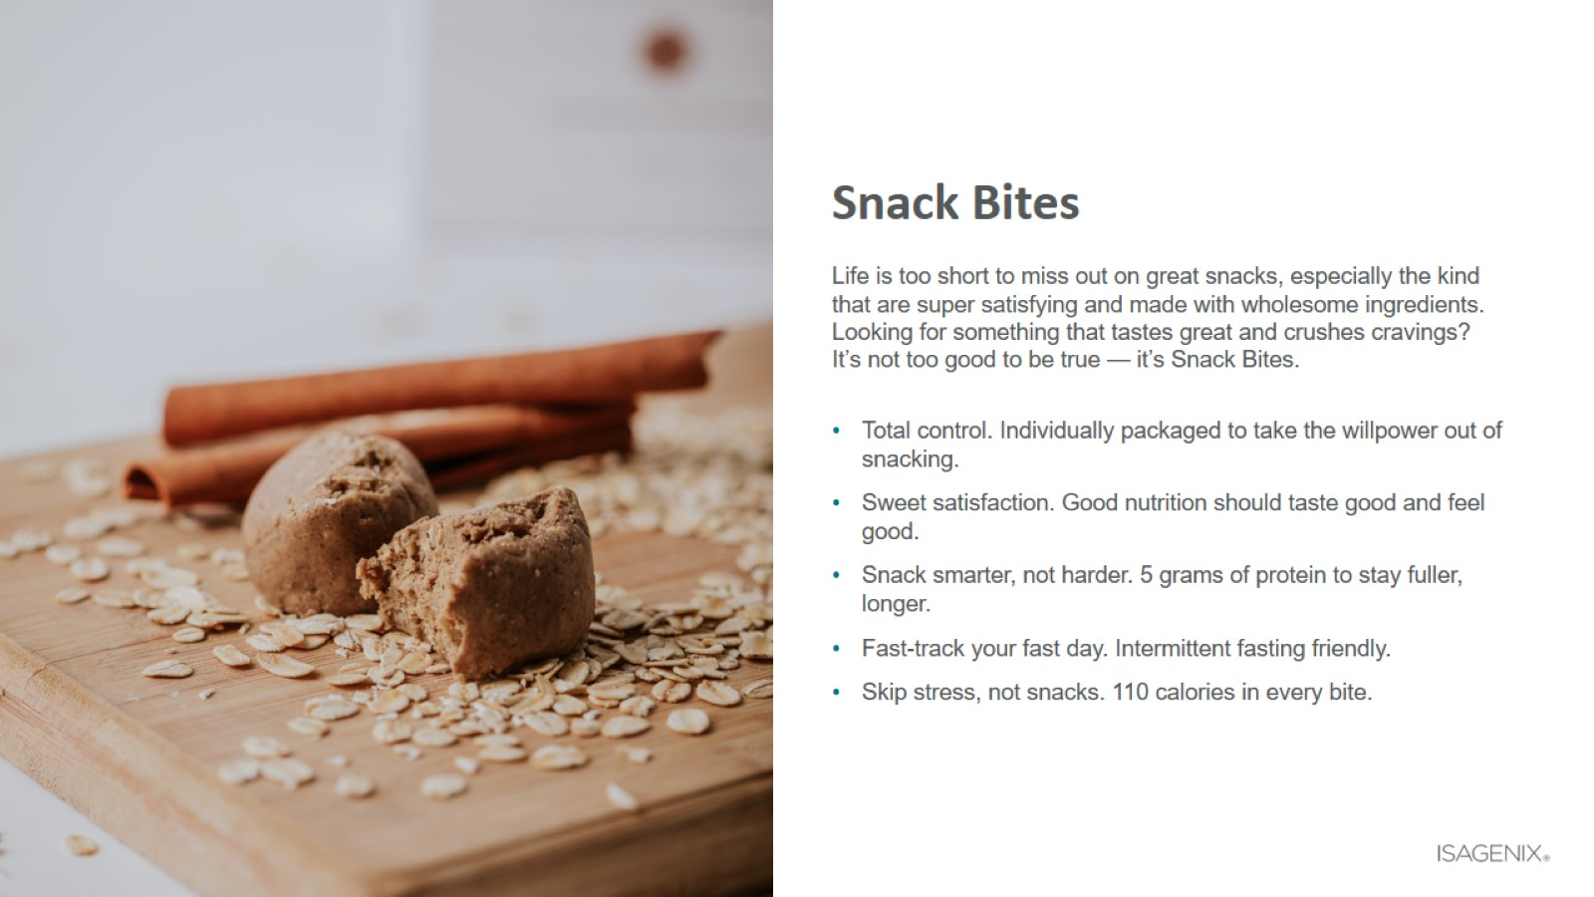
Snack Bites

Slide 12
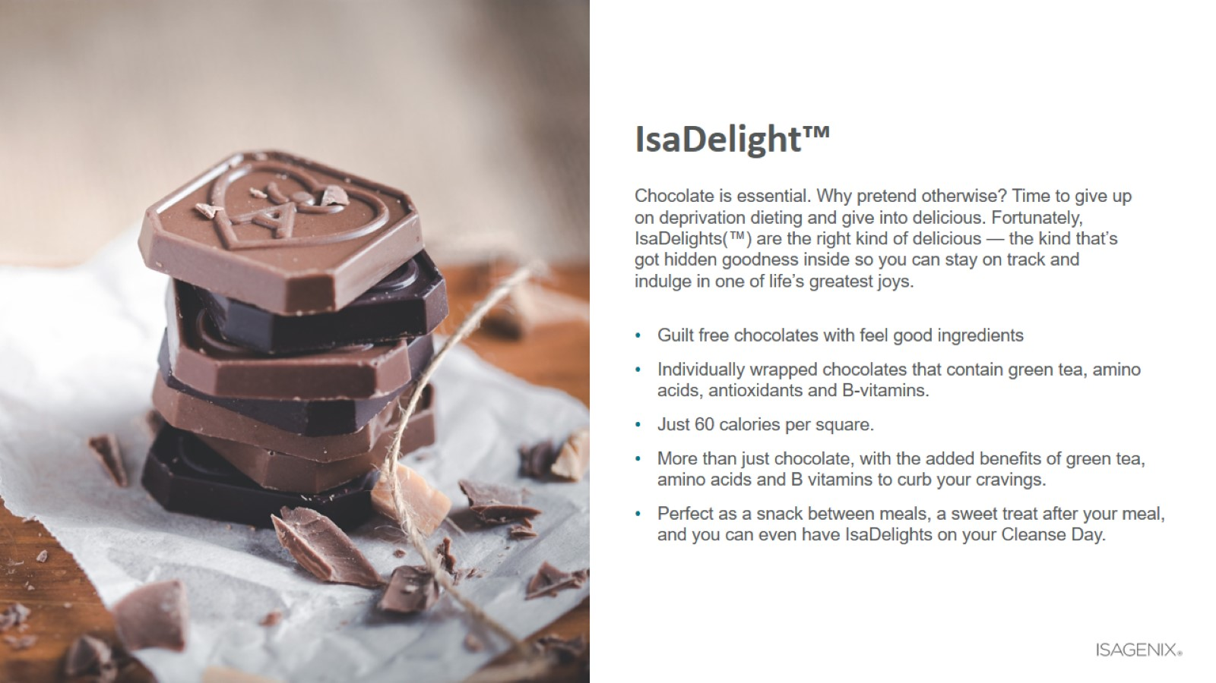
IsaDelight™

Slide 13
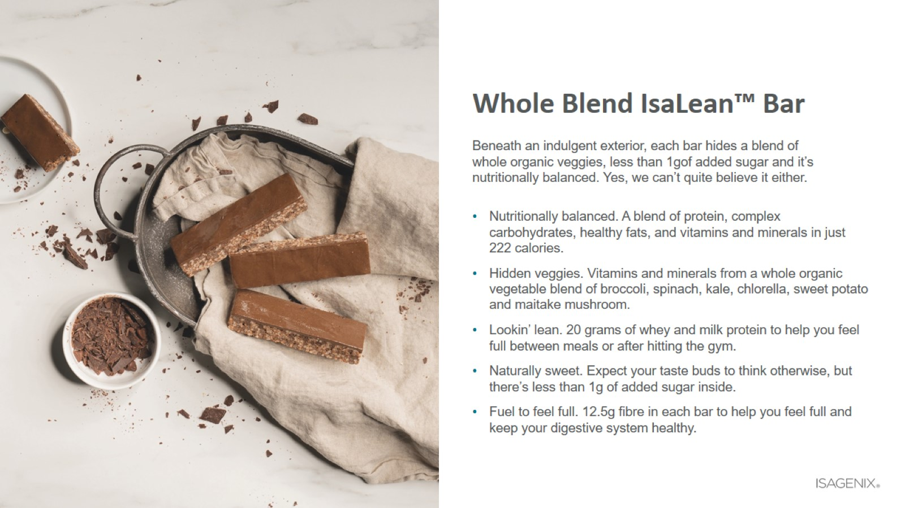
Whole Blend IsaLean™ Bar

Slide 14
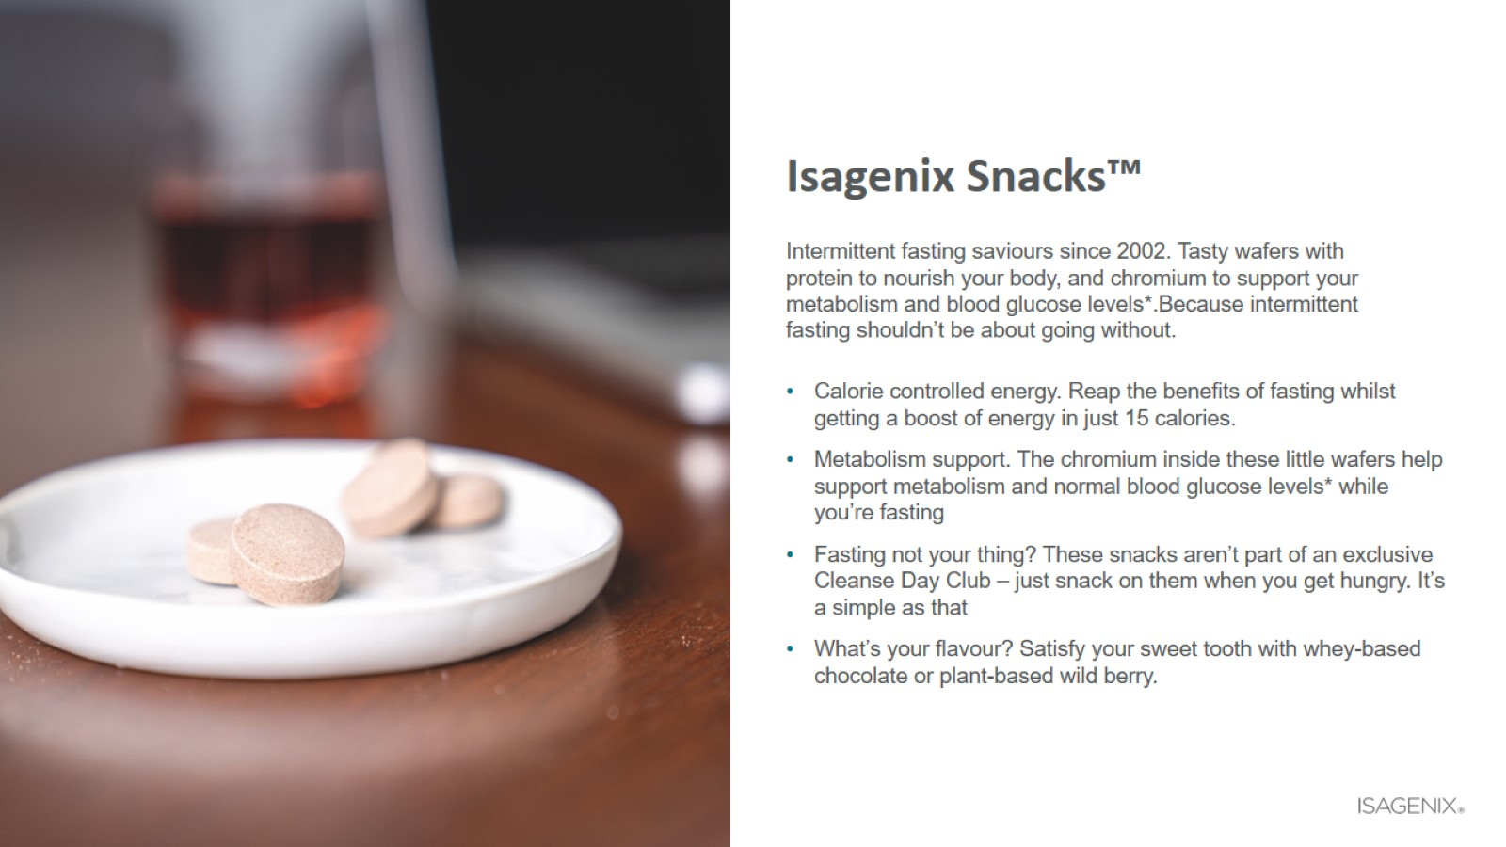
Isagenix Snacks™

Slide 15

Supplement your diet

Slide 16
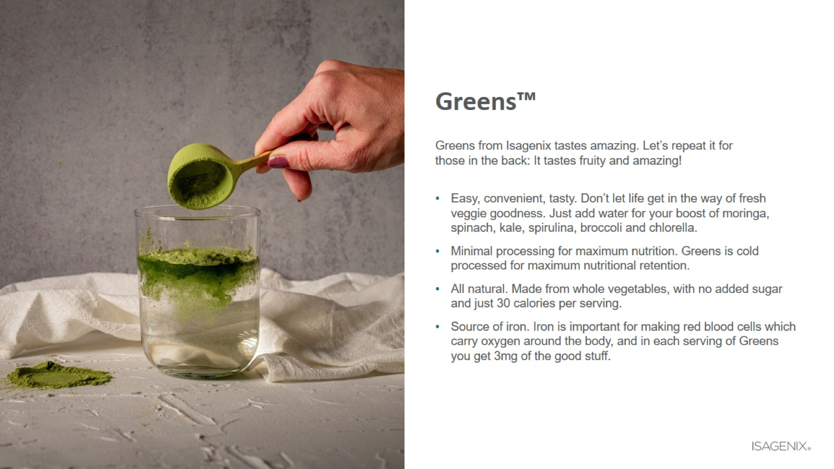
Greens™

Slide 17
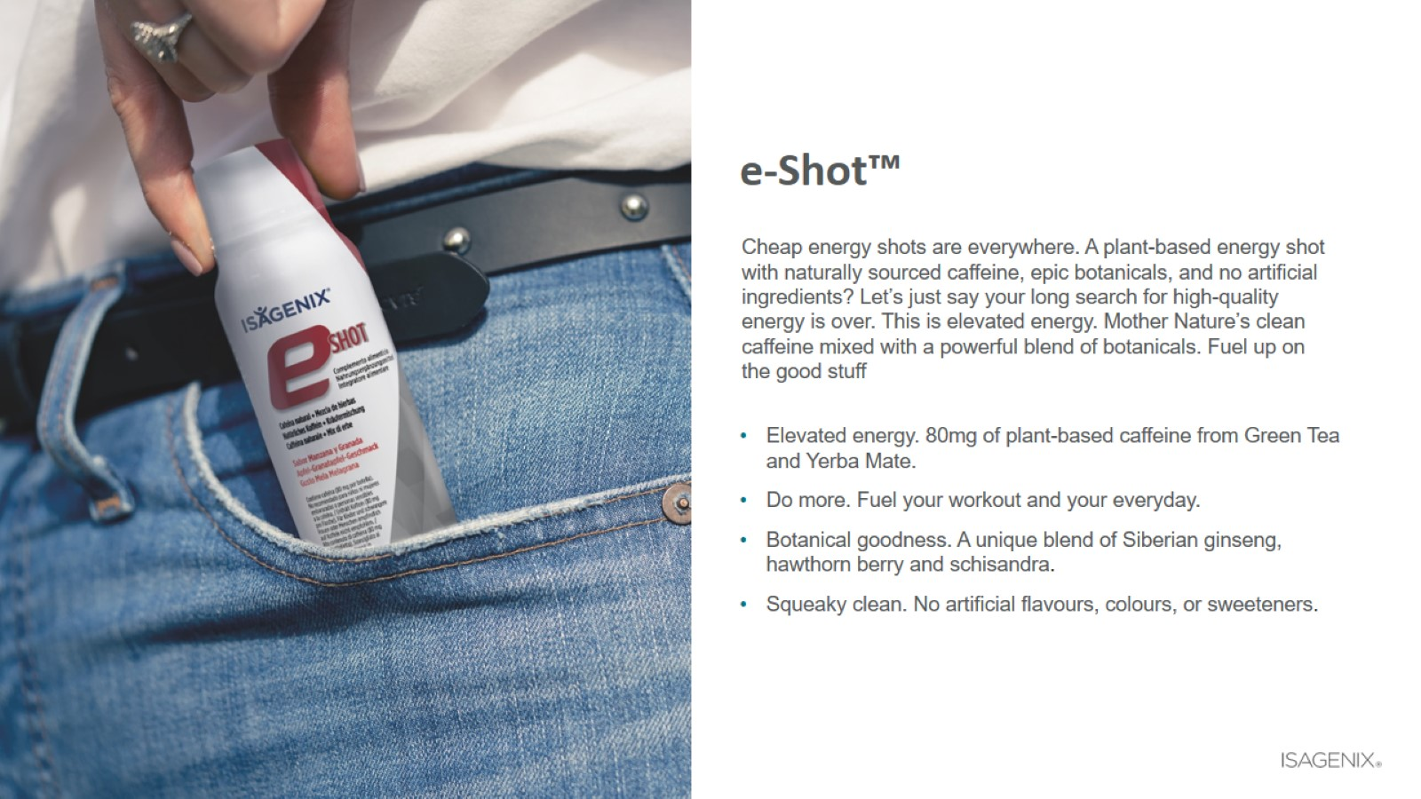
e-Shot™

Slide 18
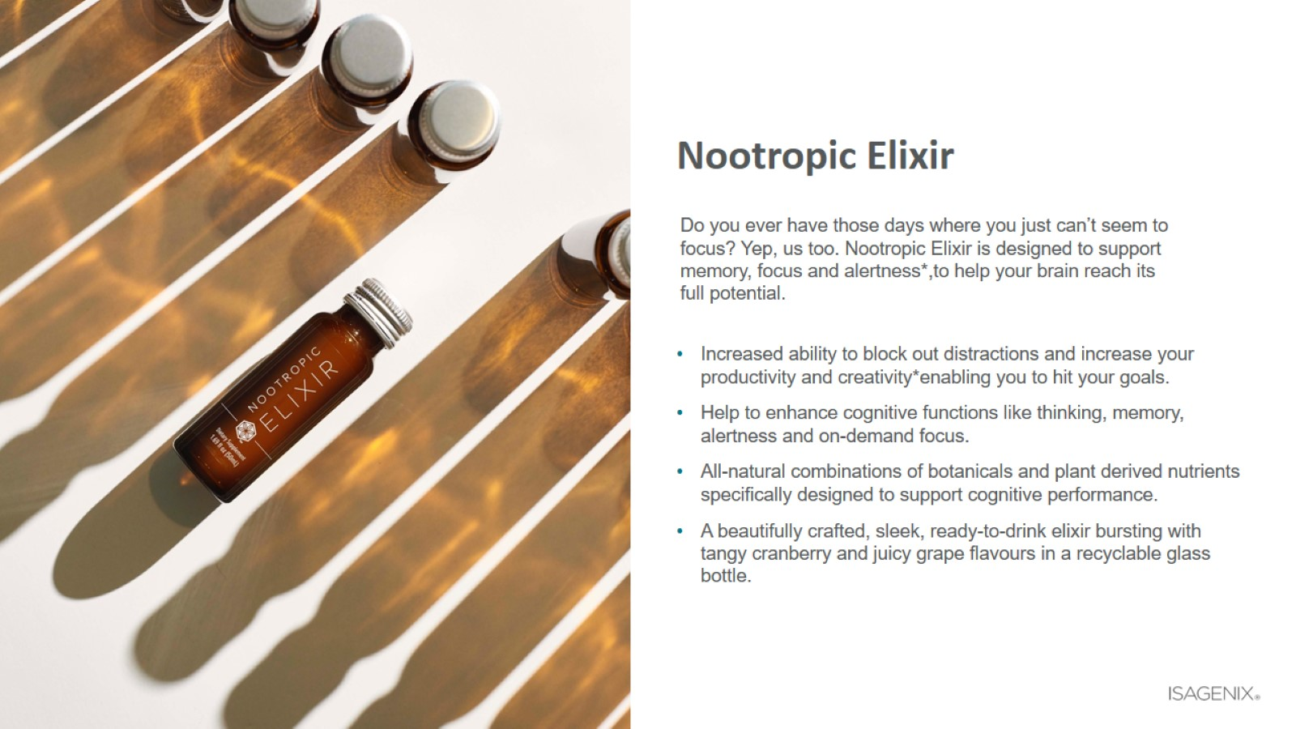
Nootropic Elixir

Slide 19
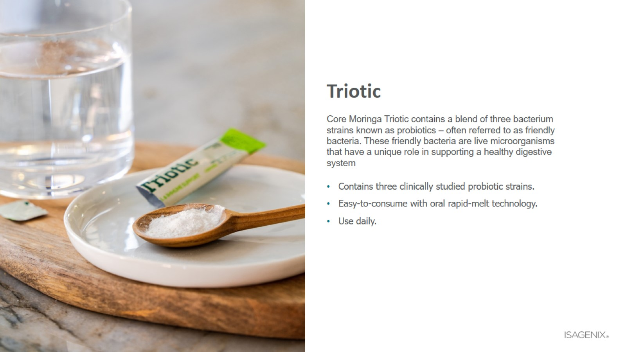
Triotic

Slide 20
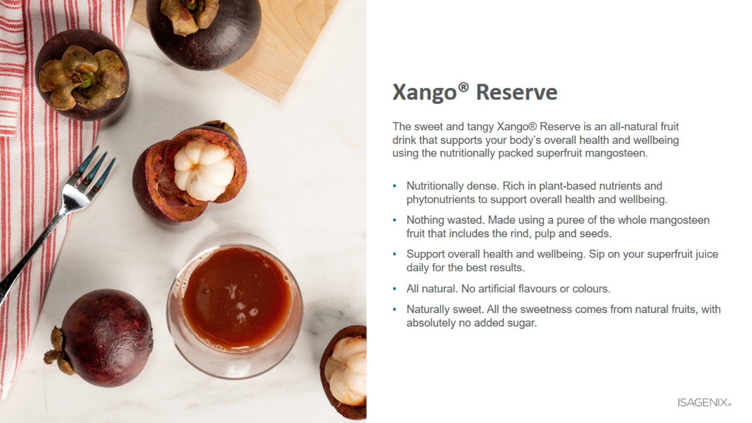
Xango® Reserve

Slide 21
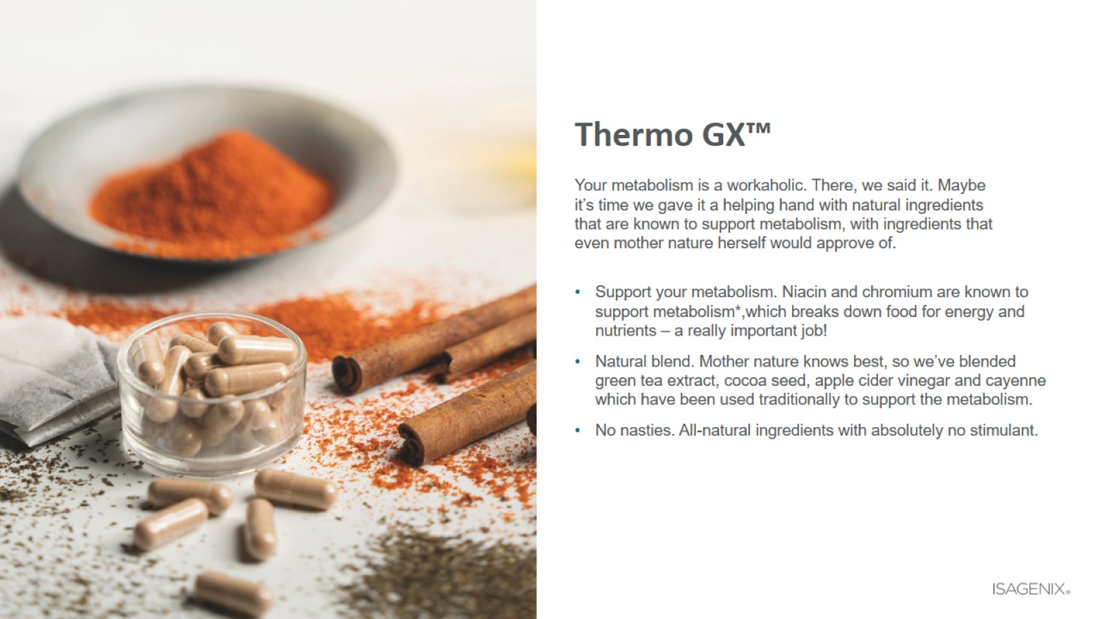
Thermo GX™

Slide 22
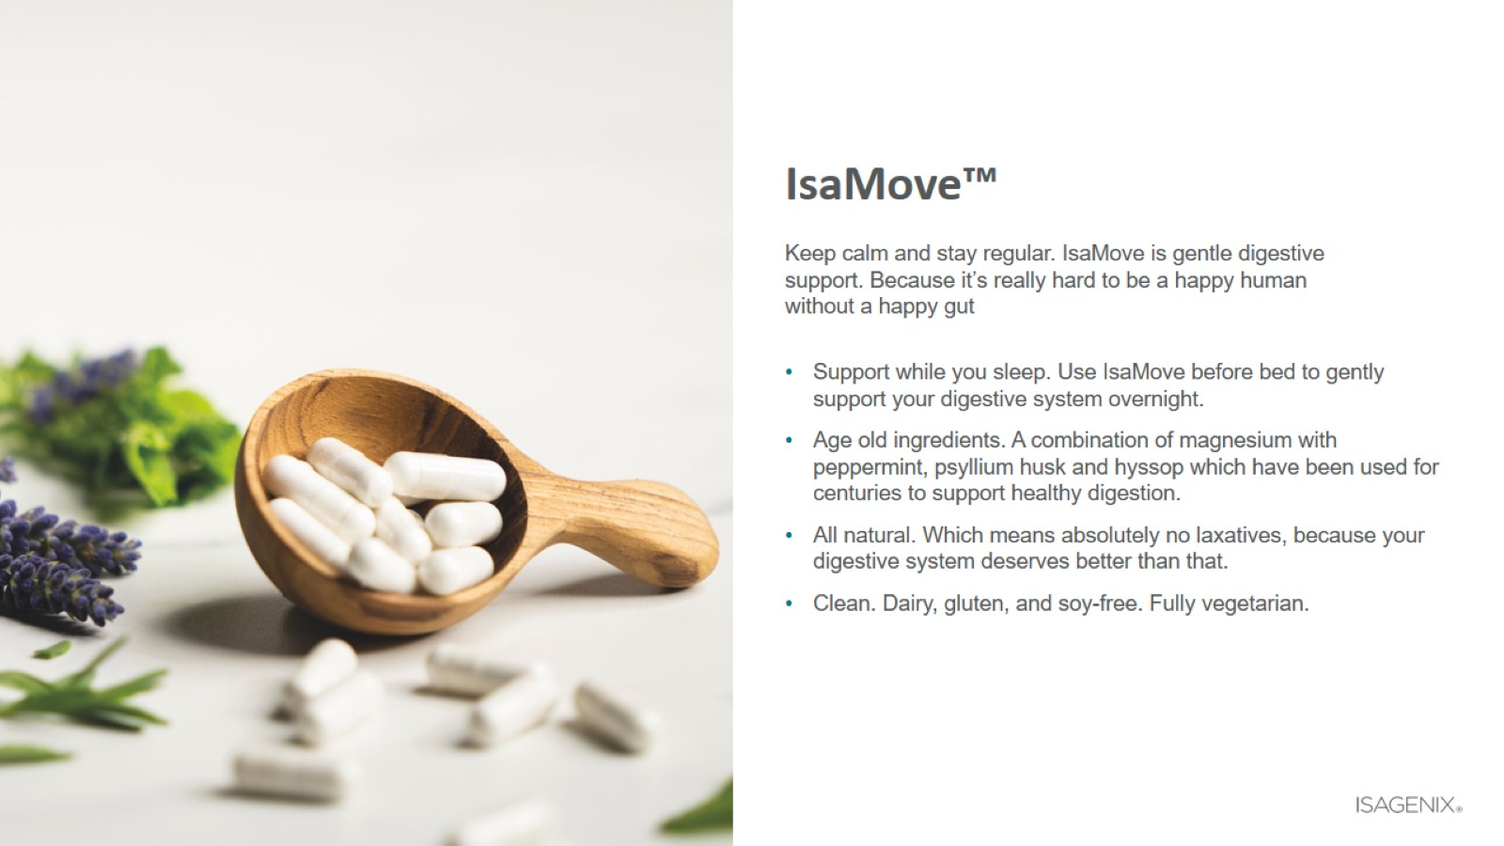
IsaMove™

Slide 23

Natural Beauty

Slide 24
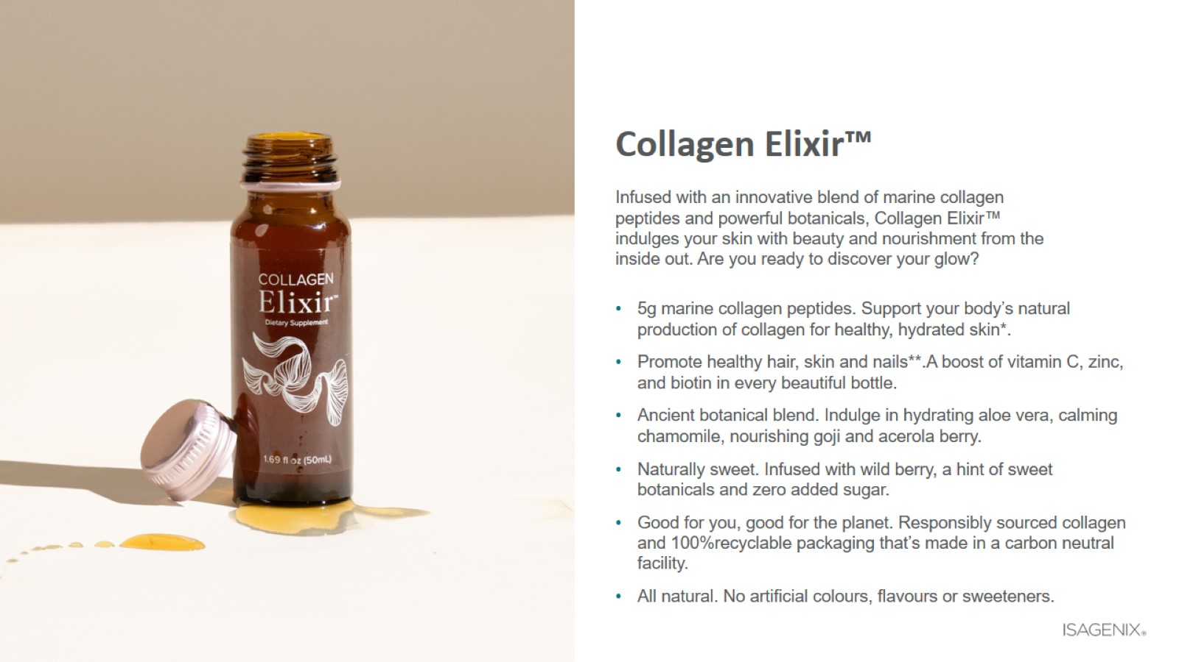
Collagen Elixir™

Slide 25
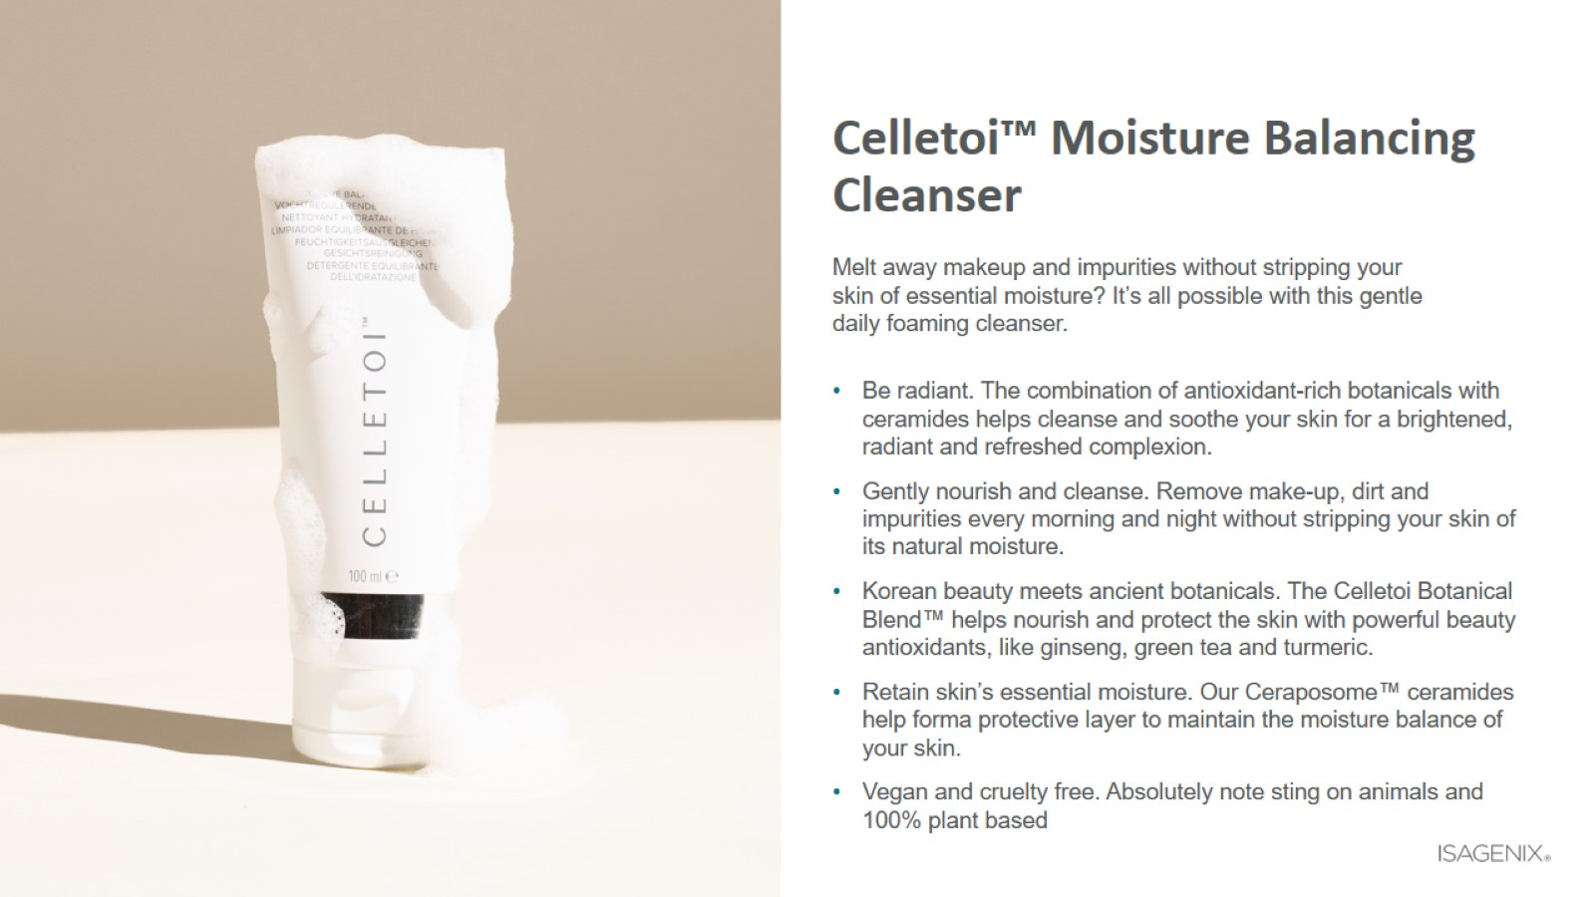
Celletoi™ Moisture Balancing Cleanser

Slide 26

Celletoi™ Advanced Youth Serum

Slide 27
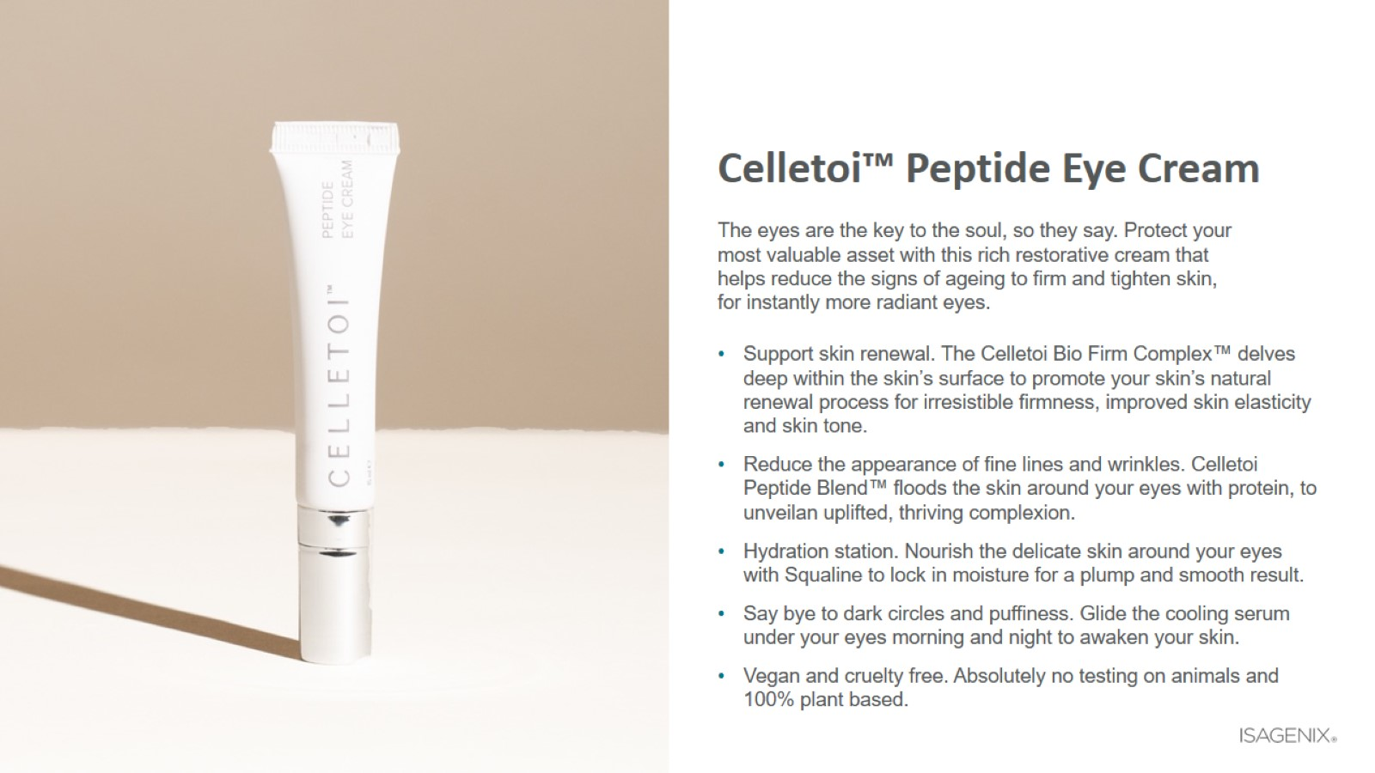
Celletoi™ Peptide Eye Cream

Slide 28
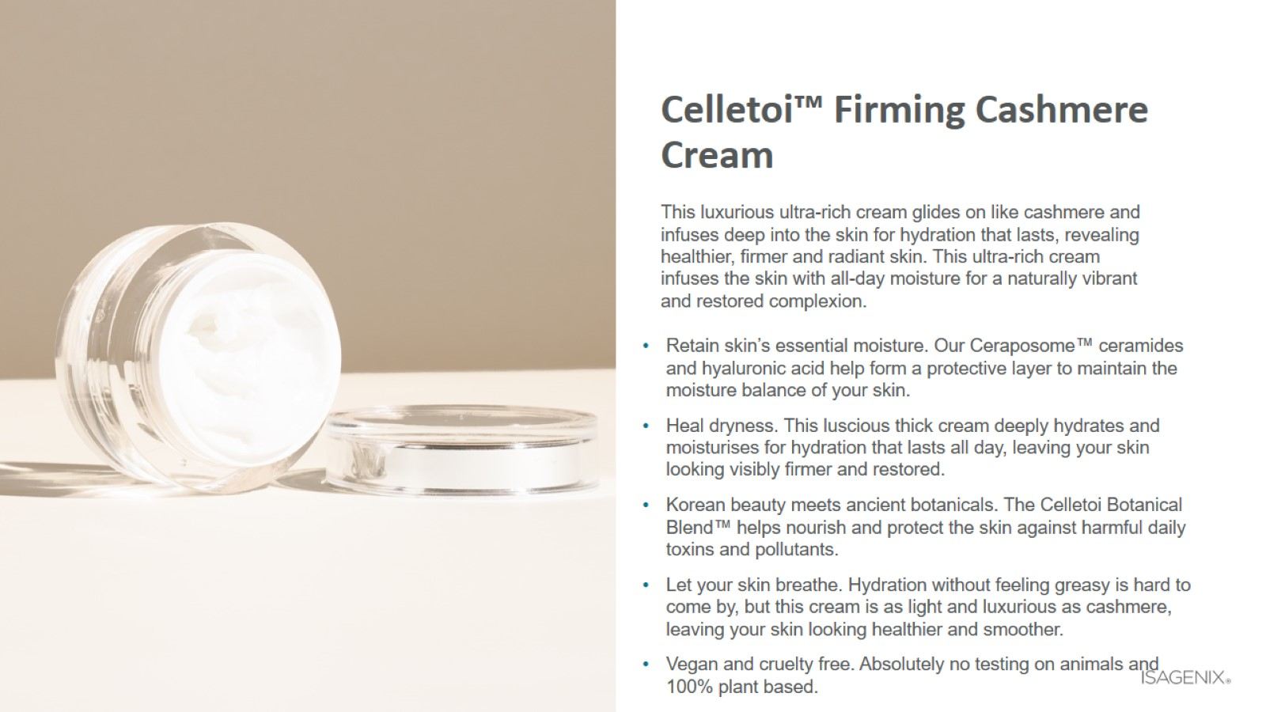
Celletoi™ Firming Cashmere Cream

Slide 29

Energy and Performance

Slide 30

AMPED™ Nitro

Slide 31
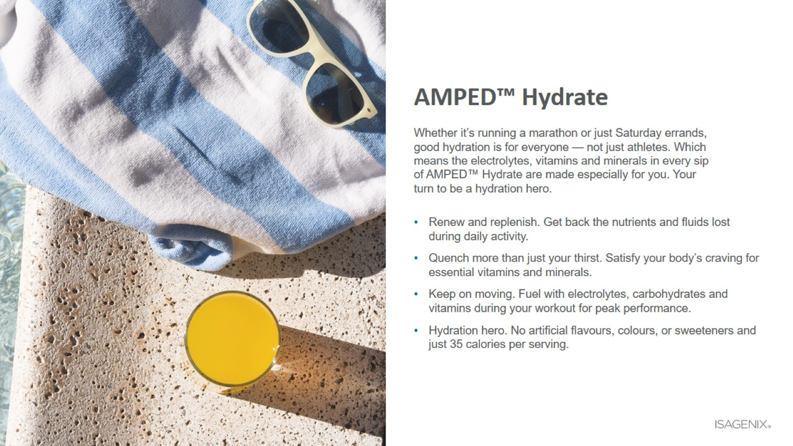
AMPED™ Hydrate

Slide 32

AMPED™ Post-Workout

Slide 33
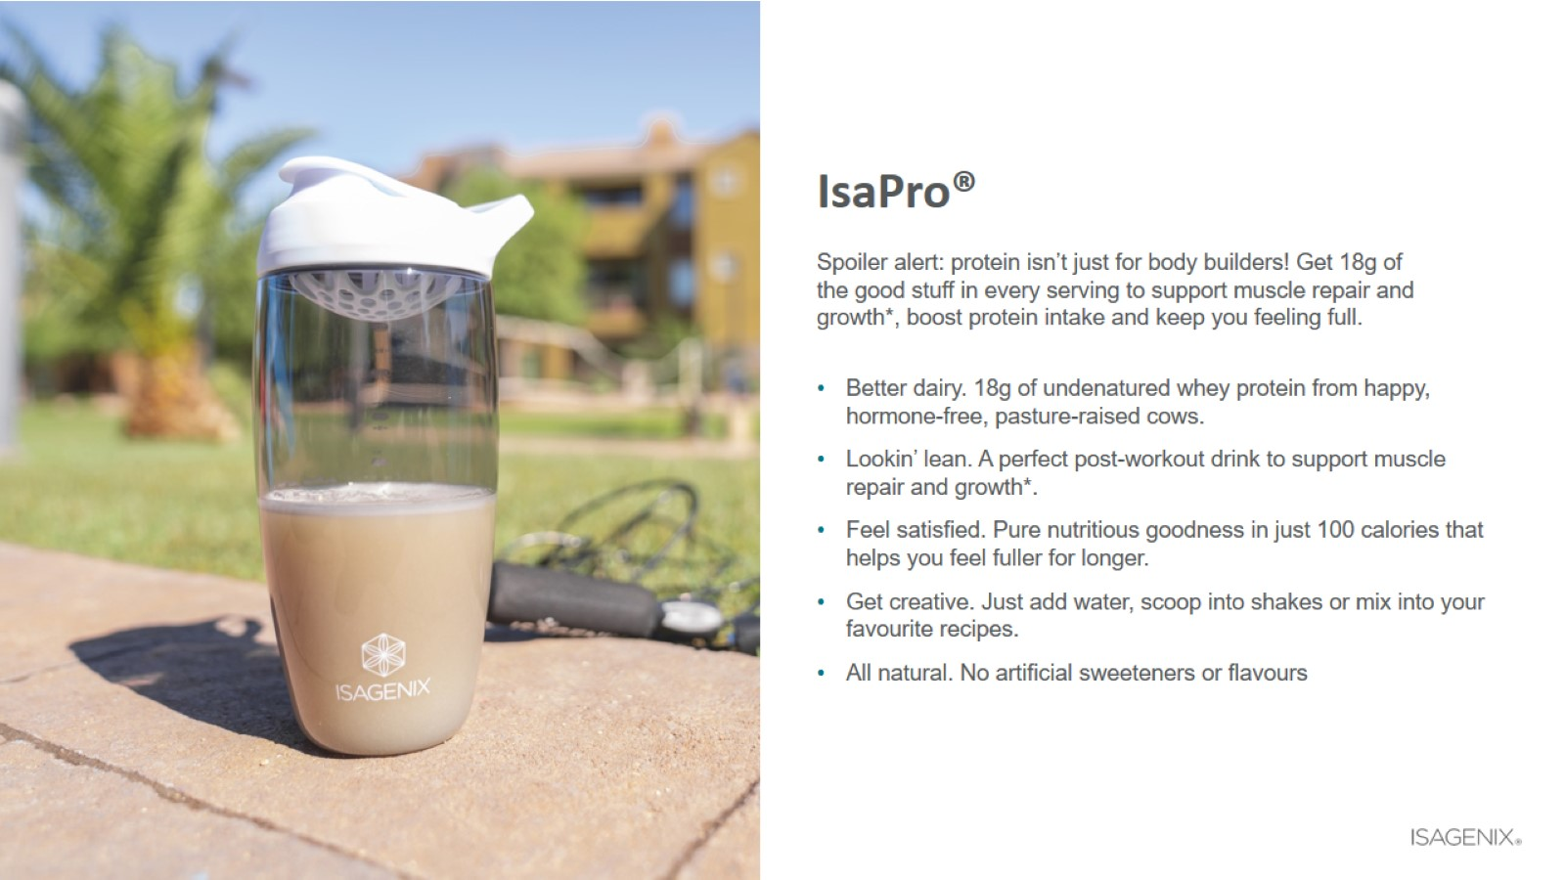
IsaPro®

