Slide 1


Slide 2

Modern living leaves our bodies deficient.

Slide 3
So, we turn to vitamins to ensure proper nutrition.

Slide 4

WE Needed to fortify our foods
1933
Vitamin D is added to milk. Rickets incidences decline dramatically before the end of the 1930’s.
1998
Folic acid fortification of grain products rapidly led to a 35% drop in neural tube birth defects.
1924
Iodine added to salt. Goiter and otter iodine deficiency diseases are practically eliminated.
1941
Flour is enriched with thiamin, riboflavin, niacin, and iron, dramatically reducing or eliminating deficiency diseases like pellagra.
Conventional vitamins and minerals helped to eradicate nutrient deficiencies, but they’re not the whole story when it comes to optimal wellbeing.

Slide 5
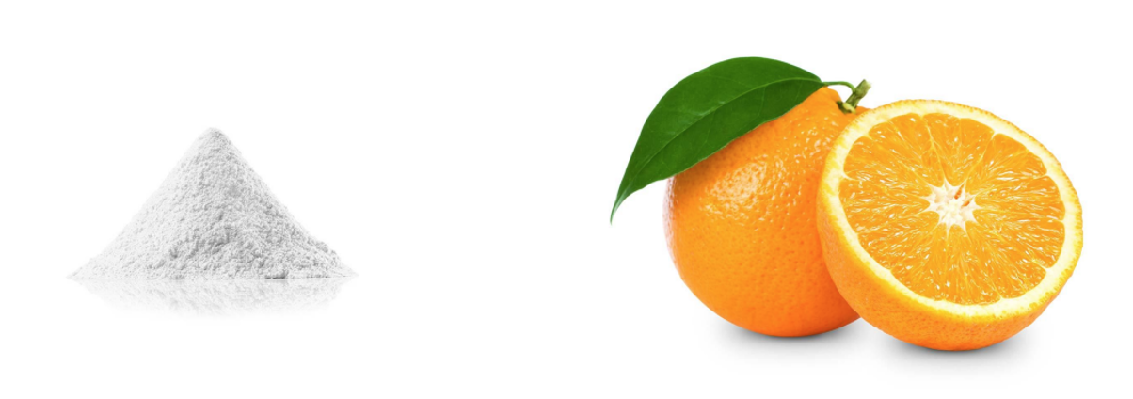
WHICH SOURCE WOULD YOU prefer?
Created Vitamin C
(Ascorbic Acid)
Whole Food Sourced

Slide 6
But, Unlike Weight Loss,
with Vitamins, There’s Been Little to No True Innovation
in 60 Years!

Slide 7
LEADING Innovation
Grass Fed Whey Protein
Intermittent Fasting
Adaptogens
Liquid Collagen
NAD
Simple. Proven. Natural.

Slide 8

WHY NATURAL VITAMINS NOW? ?
The global natural vitamins market is projected to reach 16B by 2030.
Plant-based vitamins accounted for more than 30% of the market share in 2021.
Consumers are increasingly perceiving natural products as safer and more sustainable versus synthetic.
There’s a seismic market shift towards wellness culture, holistic health, whole food-based solutions, and transparency in product ingredients.

Slide 9
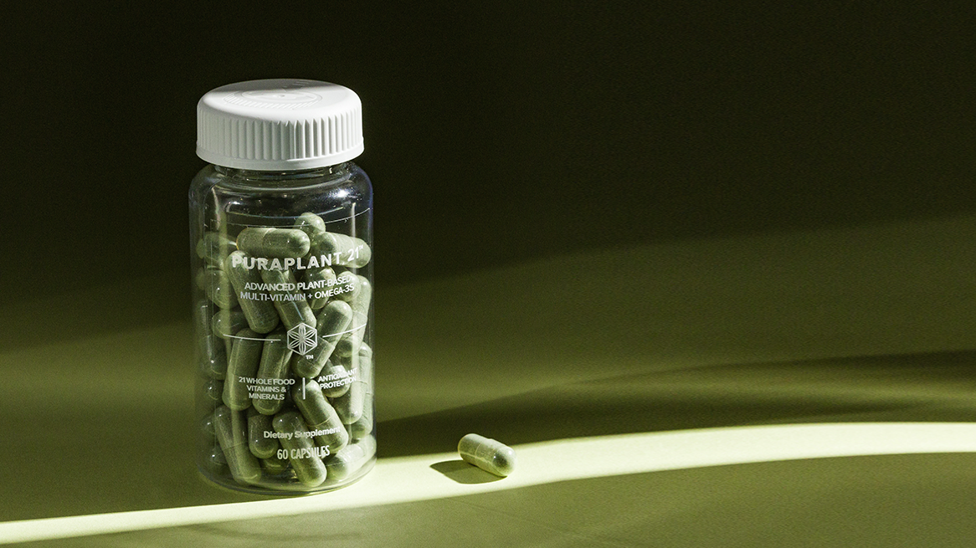
INTRODUCING
PuraPlant 21
Tm

Slide 10

Not All Vitamins
Are Created Equal.

Slide 11
SYNTHETIC Vitamins
A
B1
B2
B3
B5
B6
B7
B9
B12
C
D
E
K
199

Slide 12
NATURALLY SOURCED Vitamins
A
B1
B2
B3
B5
B6
B7
B9
B12
C
D
E
K
199

Slide 13
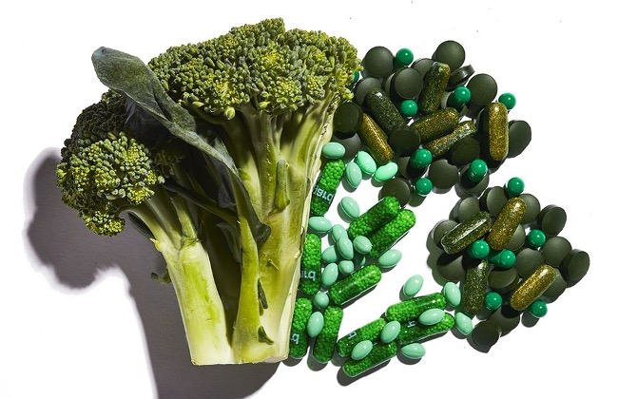
LEADING Innovation
Microencapsulation allows the naturally occurring vitamins from whole foods to be stabilized to preserve vitamins + vitamer diversity.

Slide 14
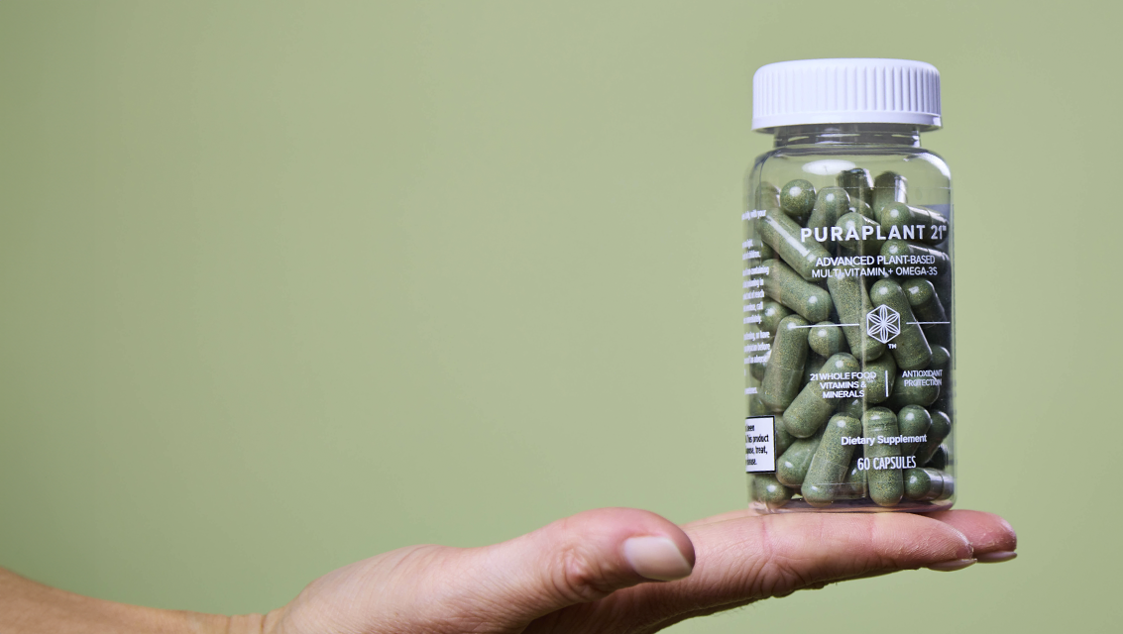
PuraPlant 21
Tm
Features + Benefits
Slow release of nutrients
Easier to digest
Higher bioactivity
Offers broad spectrum vitamins and minerals
Optimal biodiversity and efficacy
Improves absorption of several nutrients
Preserves vitamers for more nutrient diversity
Provides the building blocks of good whole-body nutrition
Expertly formulated
Tailored dosages

Slide 15
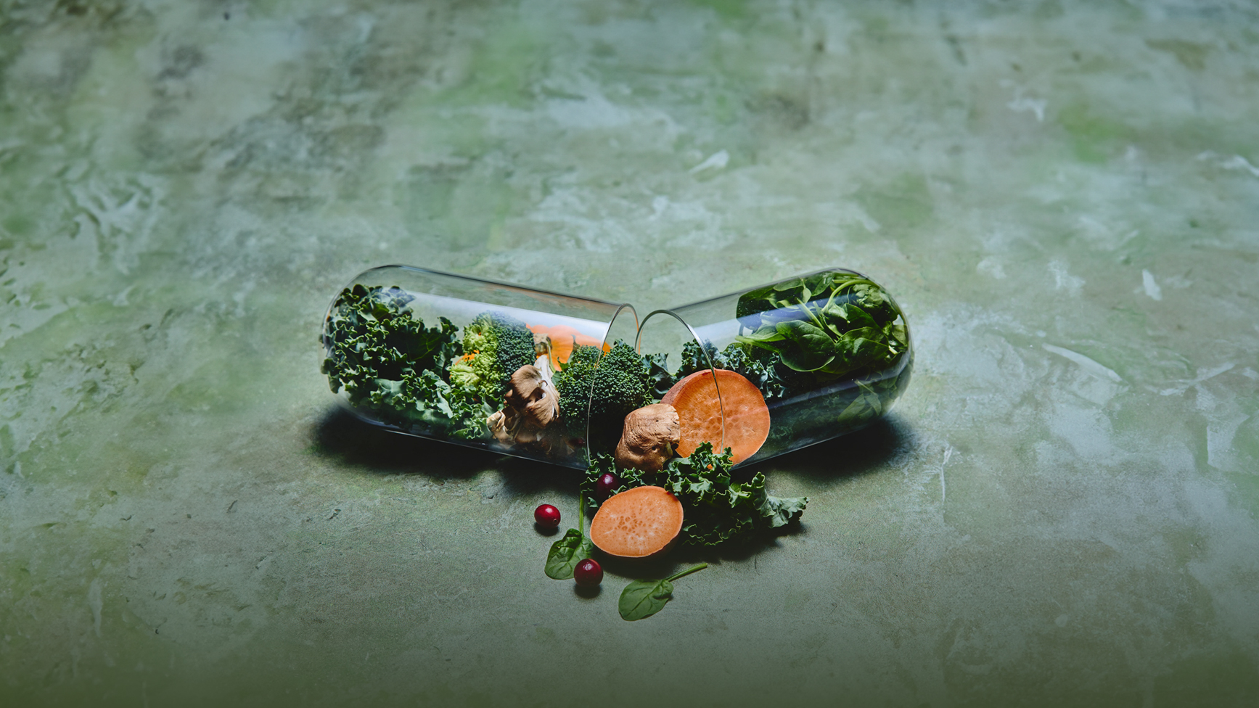
PuraPlant 21
Tm
Features + Benefits
Vitamins
B Vitamins
(Vitamin B12, B6, Thiamin, Riboflavin, Niacin)
Pantothenic Acid
Folate
Biotin
Vitamin E
Vitamin A
Vitamins C
Vitamin D3 & D2
Vitamin K1
MINERALS
Iron
Selenium
Copper
Iodine
Molybdenum
Manganese
Specialty Ingredients
Omega 3
Lutein

Slide 16
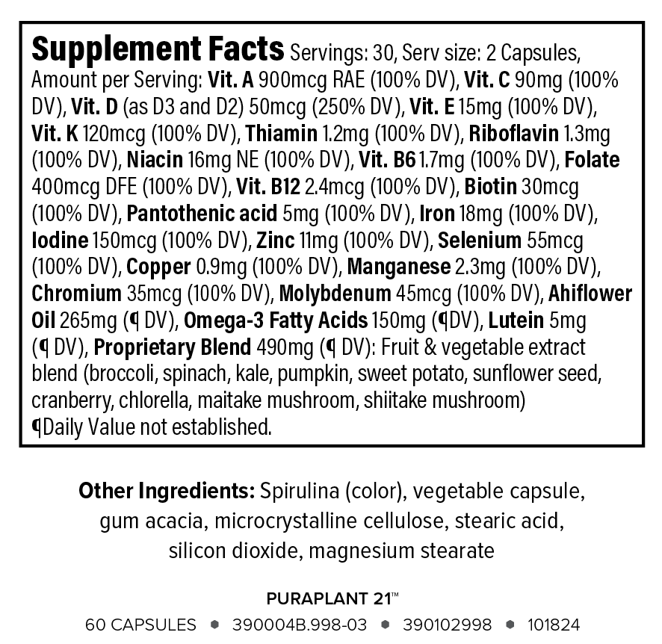
CLEAN Label
199

Slide 17

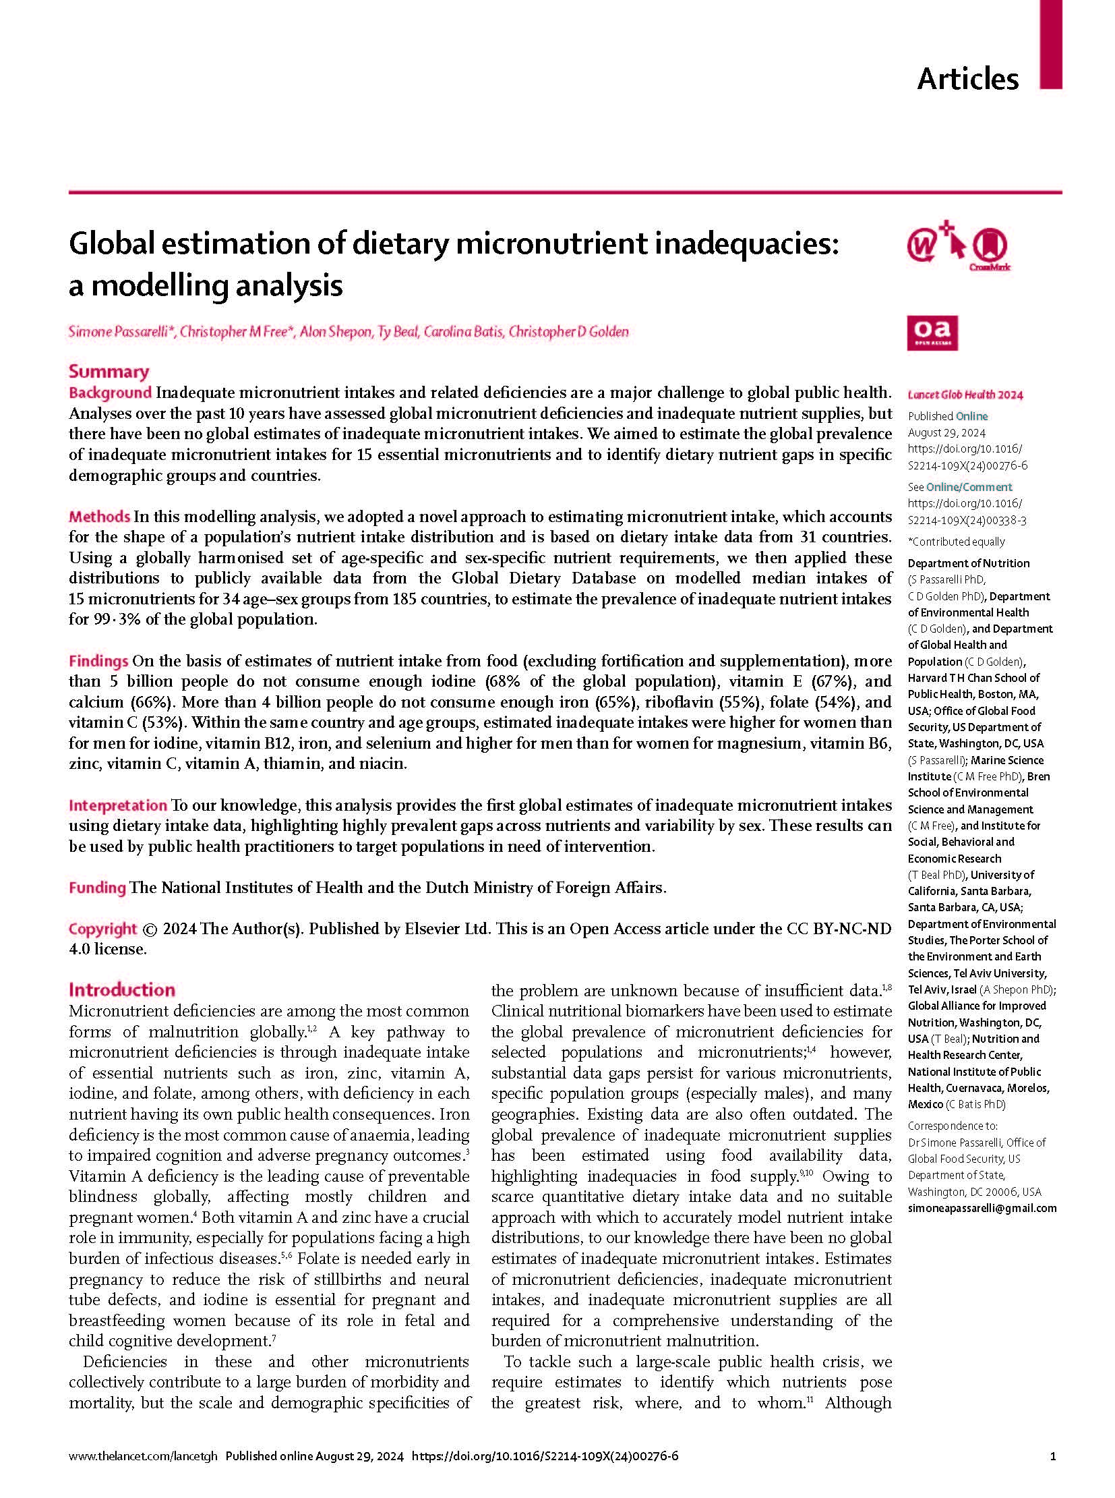
Most of the global population (>72%) has inadequate intake of at least one micronutrient, including coding, iron, Vit E, calcium, folate, riboflavin, Vit C, B6

Slide 18
US tobacco companies…have electively disseminated fat-carbohydrate-sodium (HPF) products into the US food system between 1988-2001 and have become highly prevalent in US food today

Slide 19
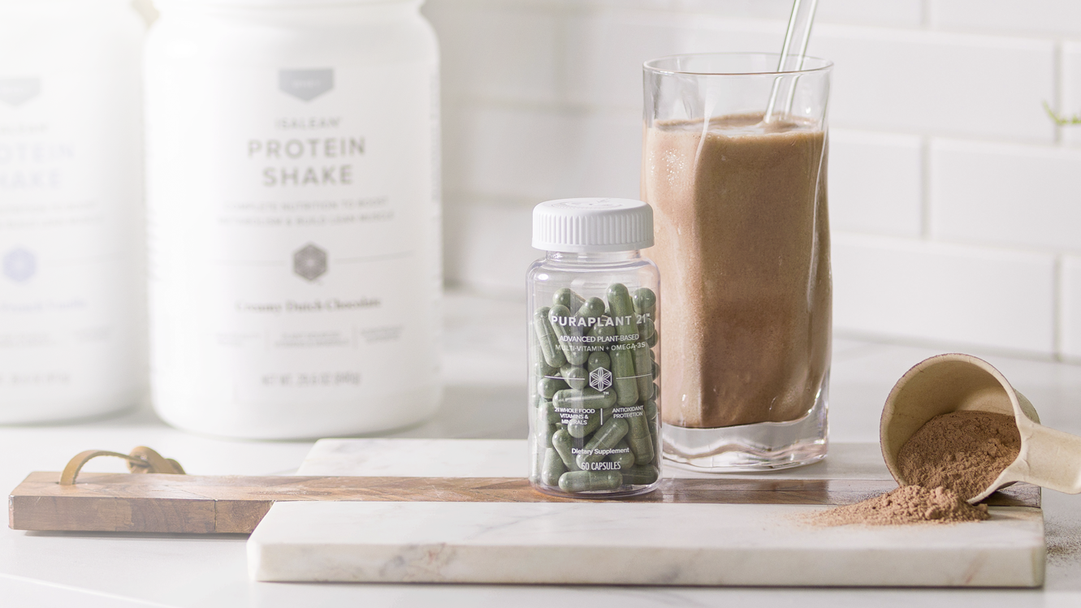
Upgrade
Your Vitamins in Two Ways

Slide 20

Now with Whole Food Vitamins.
ISALEAN® PROTEIN SHAKE…
24 vitamins and minerals from whole-food sources
Kosher certification
SAME clinically studied benefits you know and love:
Undenatured Whey
Branched-Chain Amino Acids
Active Enzymes & Fiber
Clean Ingredients

Slide 21
FEATURING Premium Whey Protein
DAIRY
Undenatured Whey
20% whey
Rich in Essential Amino Acids + Whole Food Sourced Vitamins
Liquid remaining
after milk has been
curdled and strained
to remove the curds
80% CASEIN
199

Slide 22
The Isagenix Edge

Slide 23

30-Day Reset
Foundation of Wellness

Slide 24
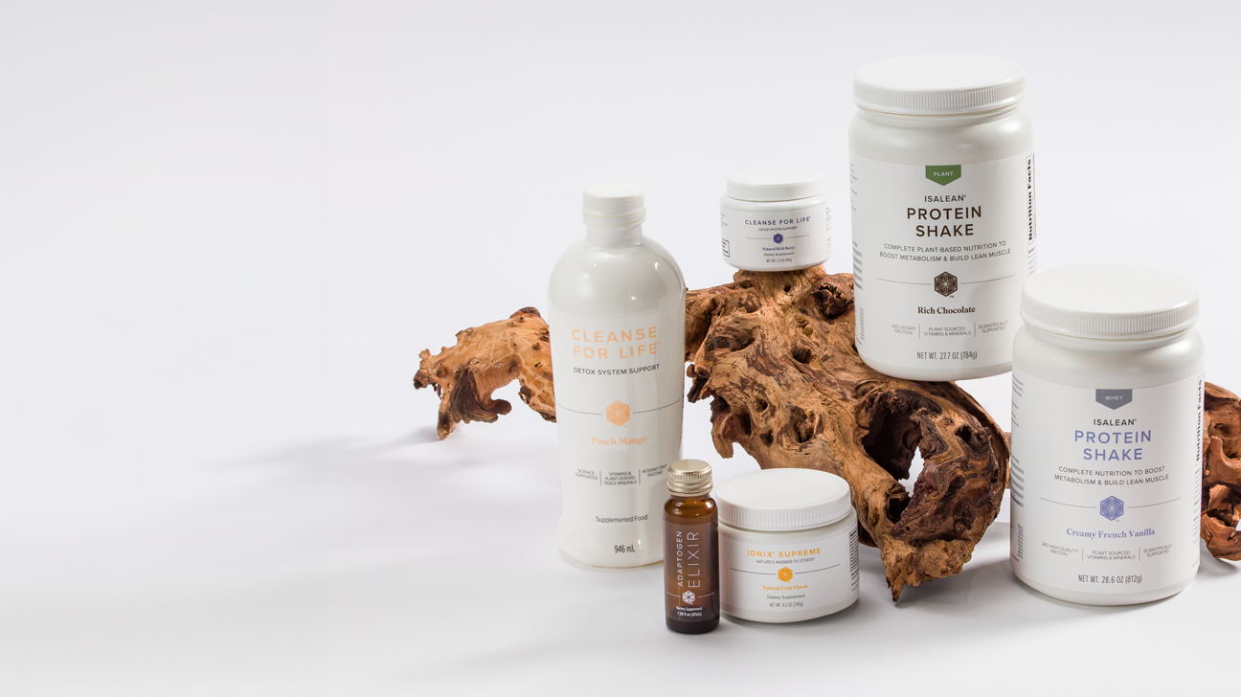
A System Built for Success.
Premium Protein: To boost lean muscle
Nutritionally Supported Fasting: To achieve lasting weight management + enhanced longevity
Adaptogens: To balance stress

Slide 25


Longevity = Aging
(HEALTH SPAN)
LIFE SPAN

Slide 26
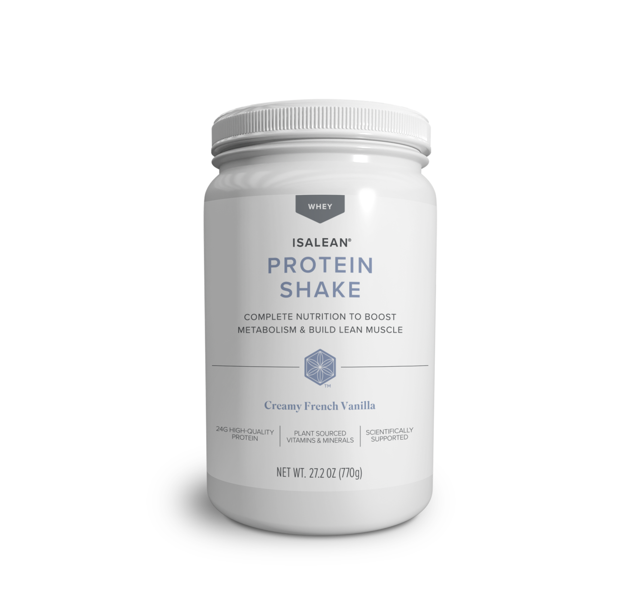
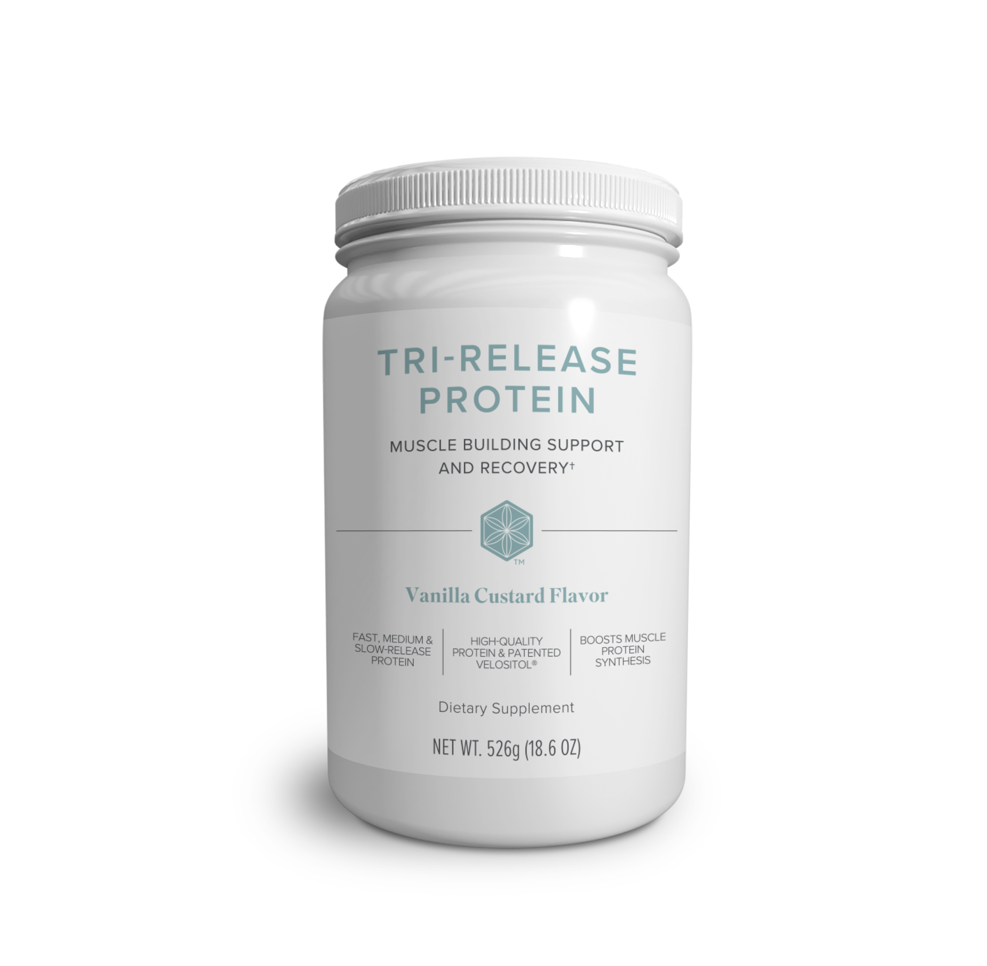
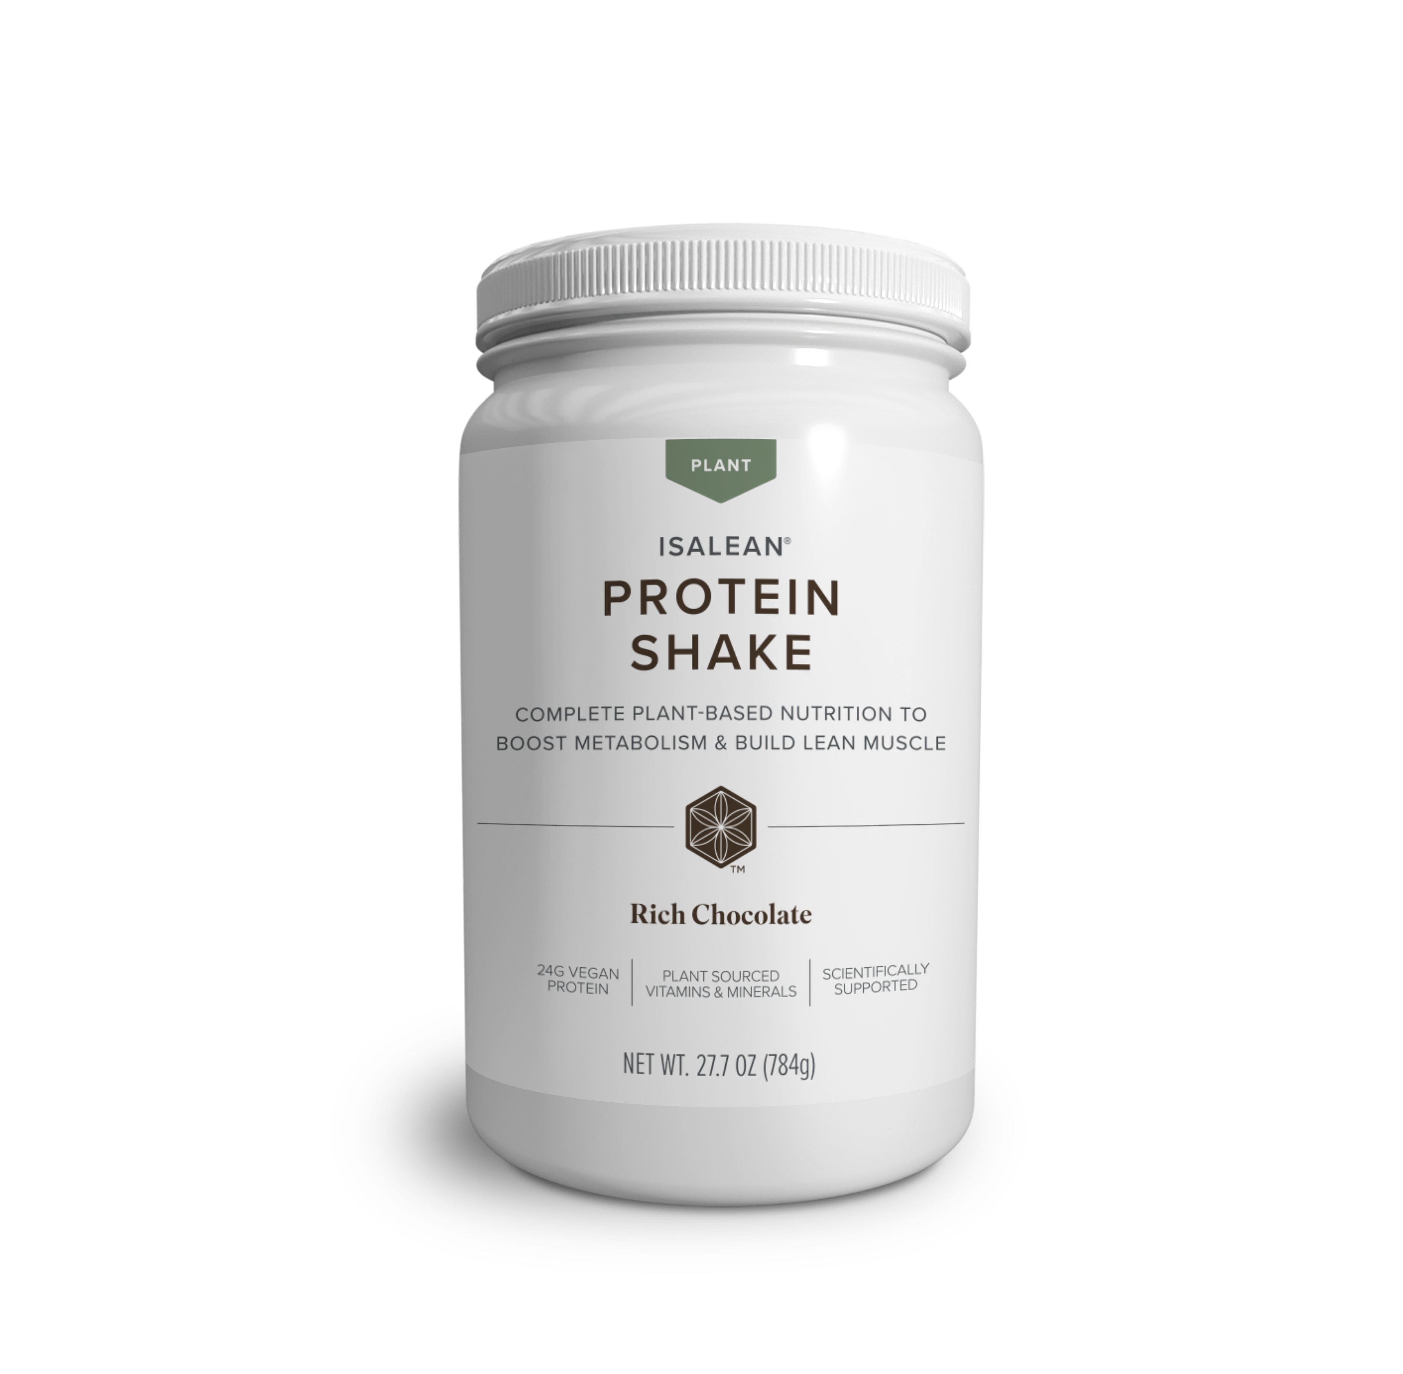
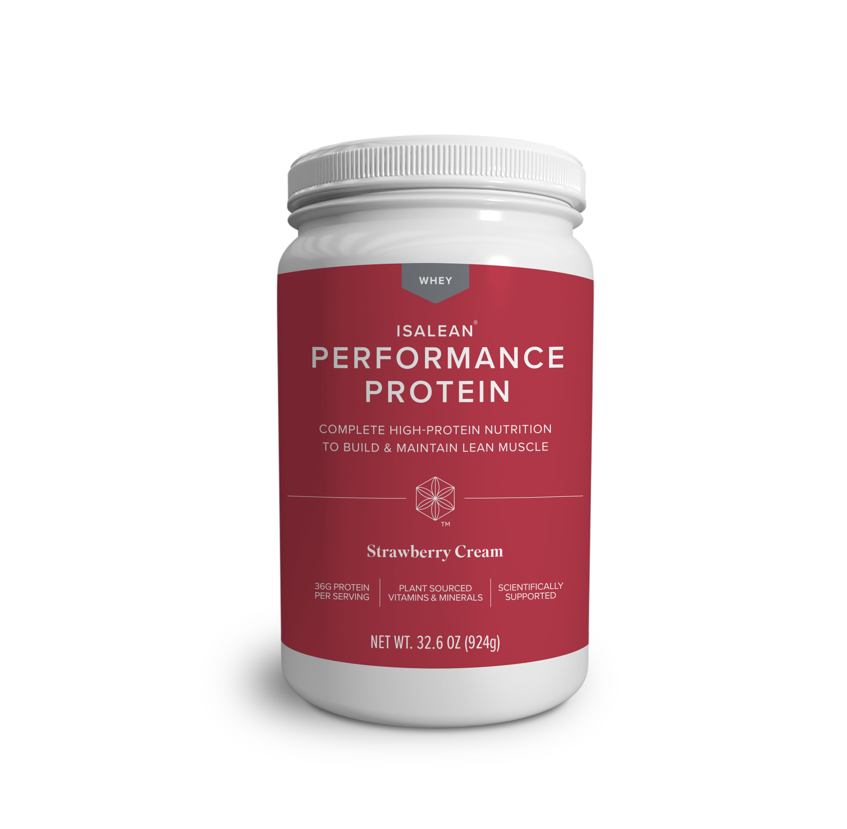
PREMIUM PROTEIN Portfolio
199

Slide 27

Independent, Scientific Research with
Esteemed Universities
University logos are trademarks™ or registered® trademarks of their respective holders. Use of them does not imply any endorsement by them.

Slide 28

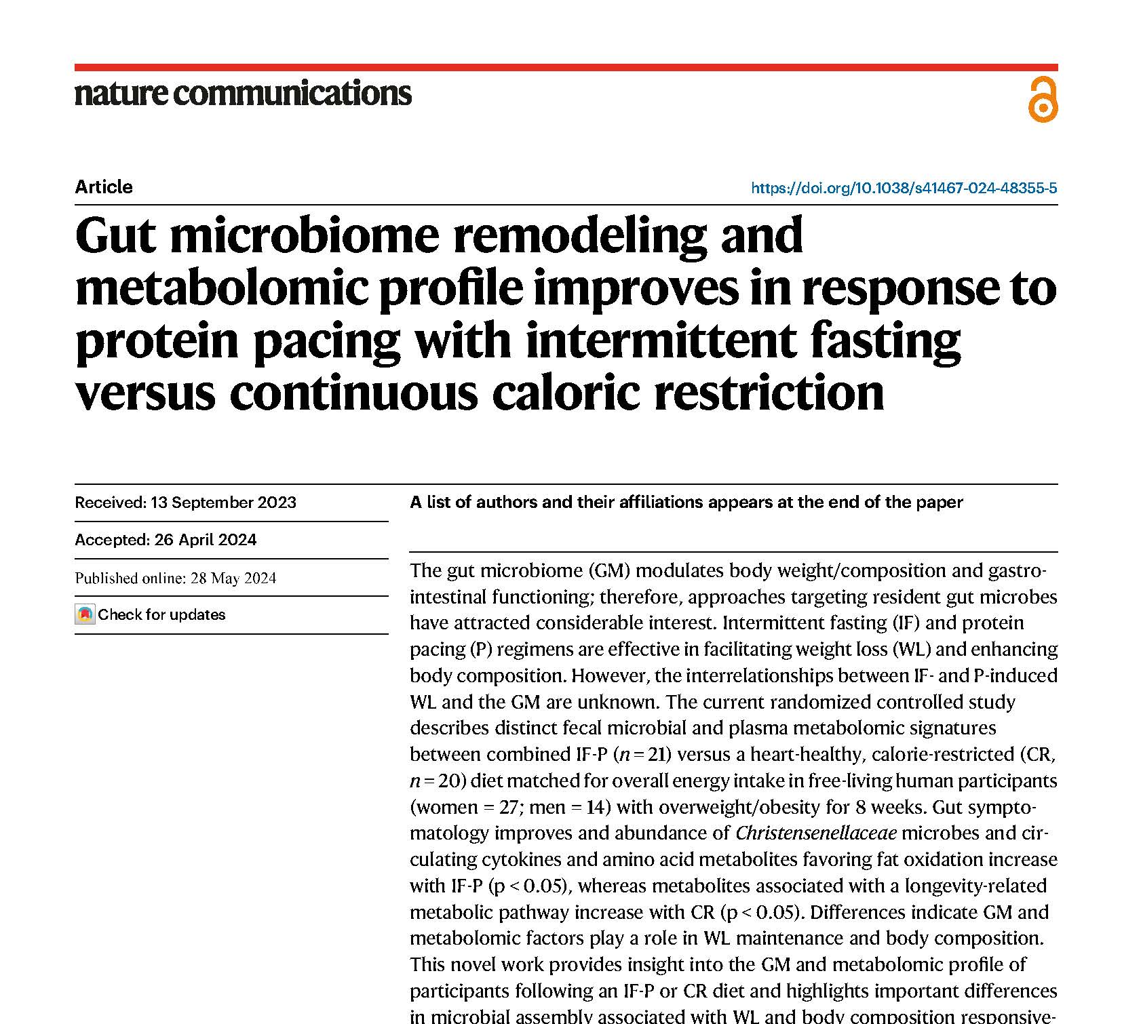
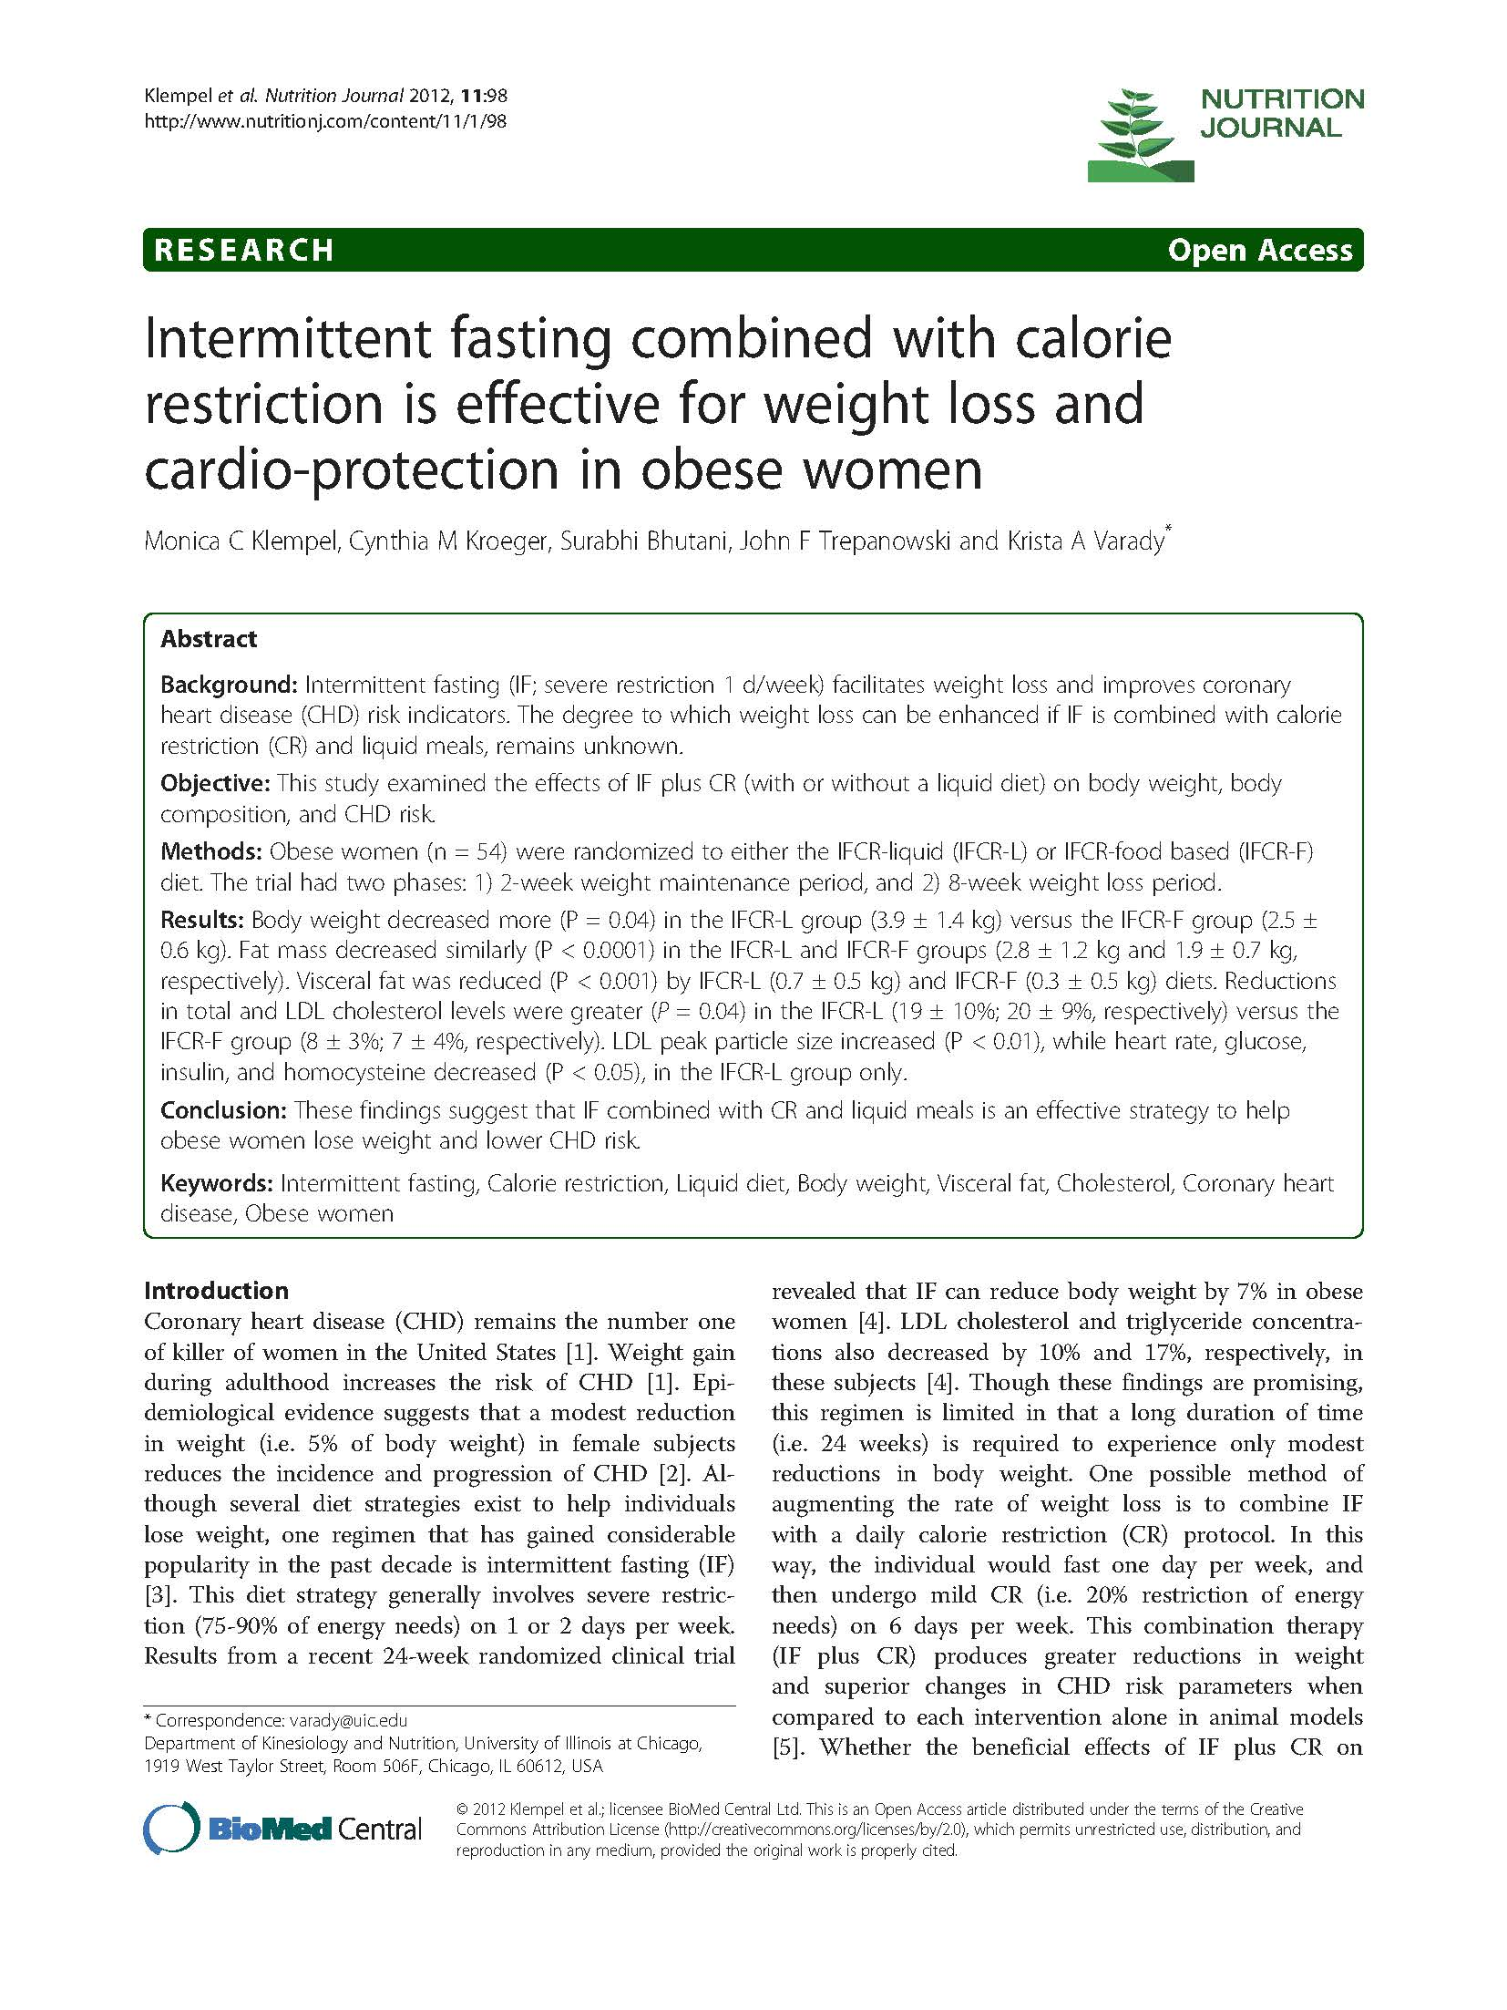
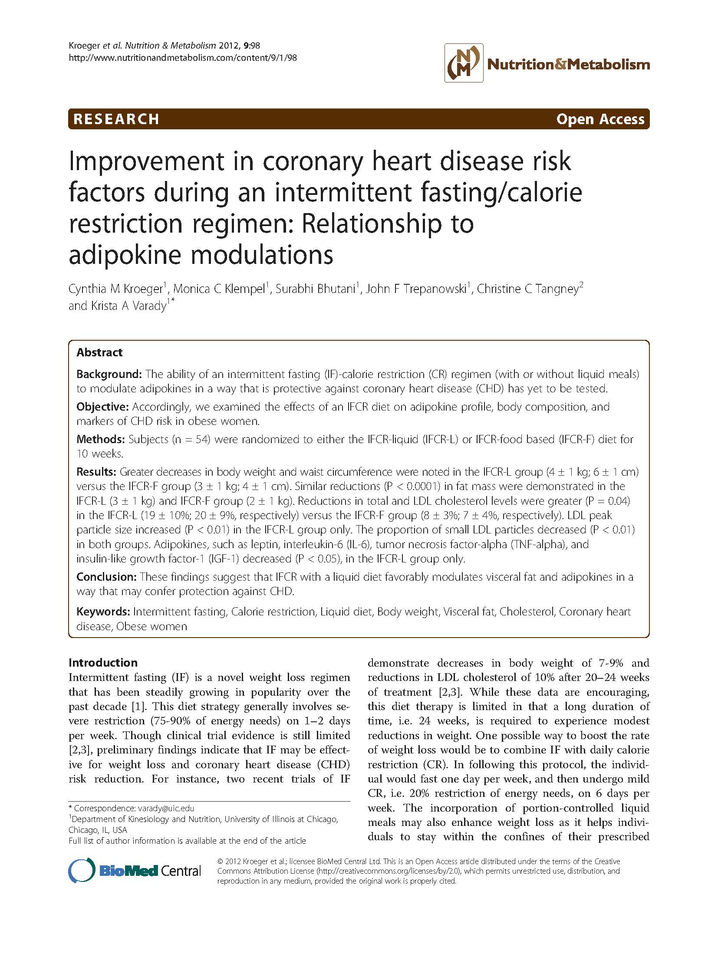
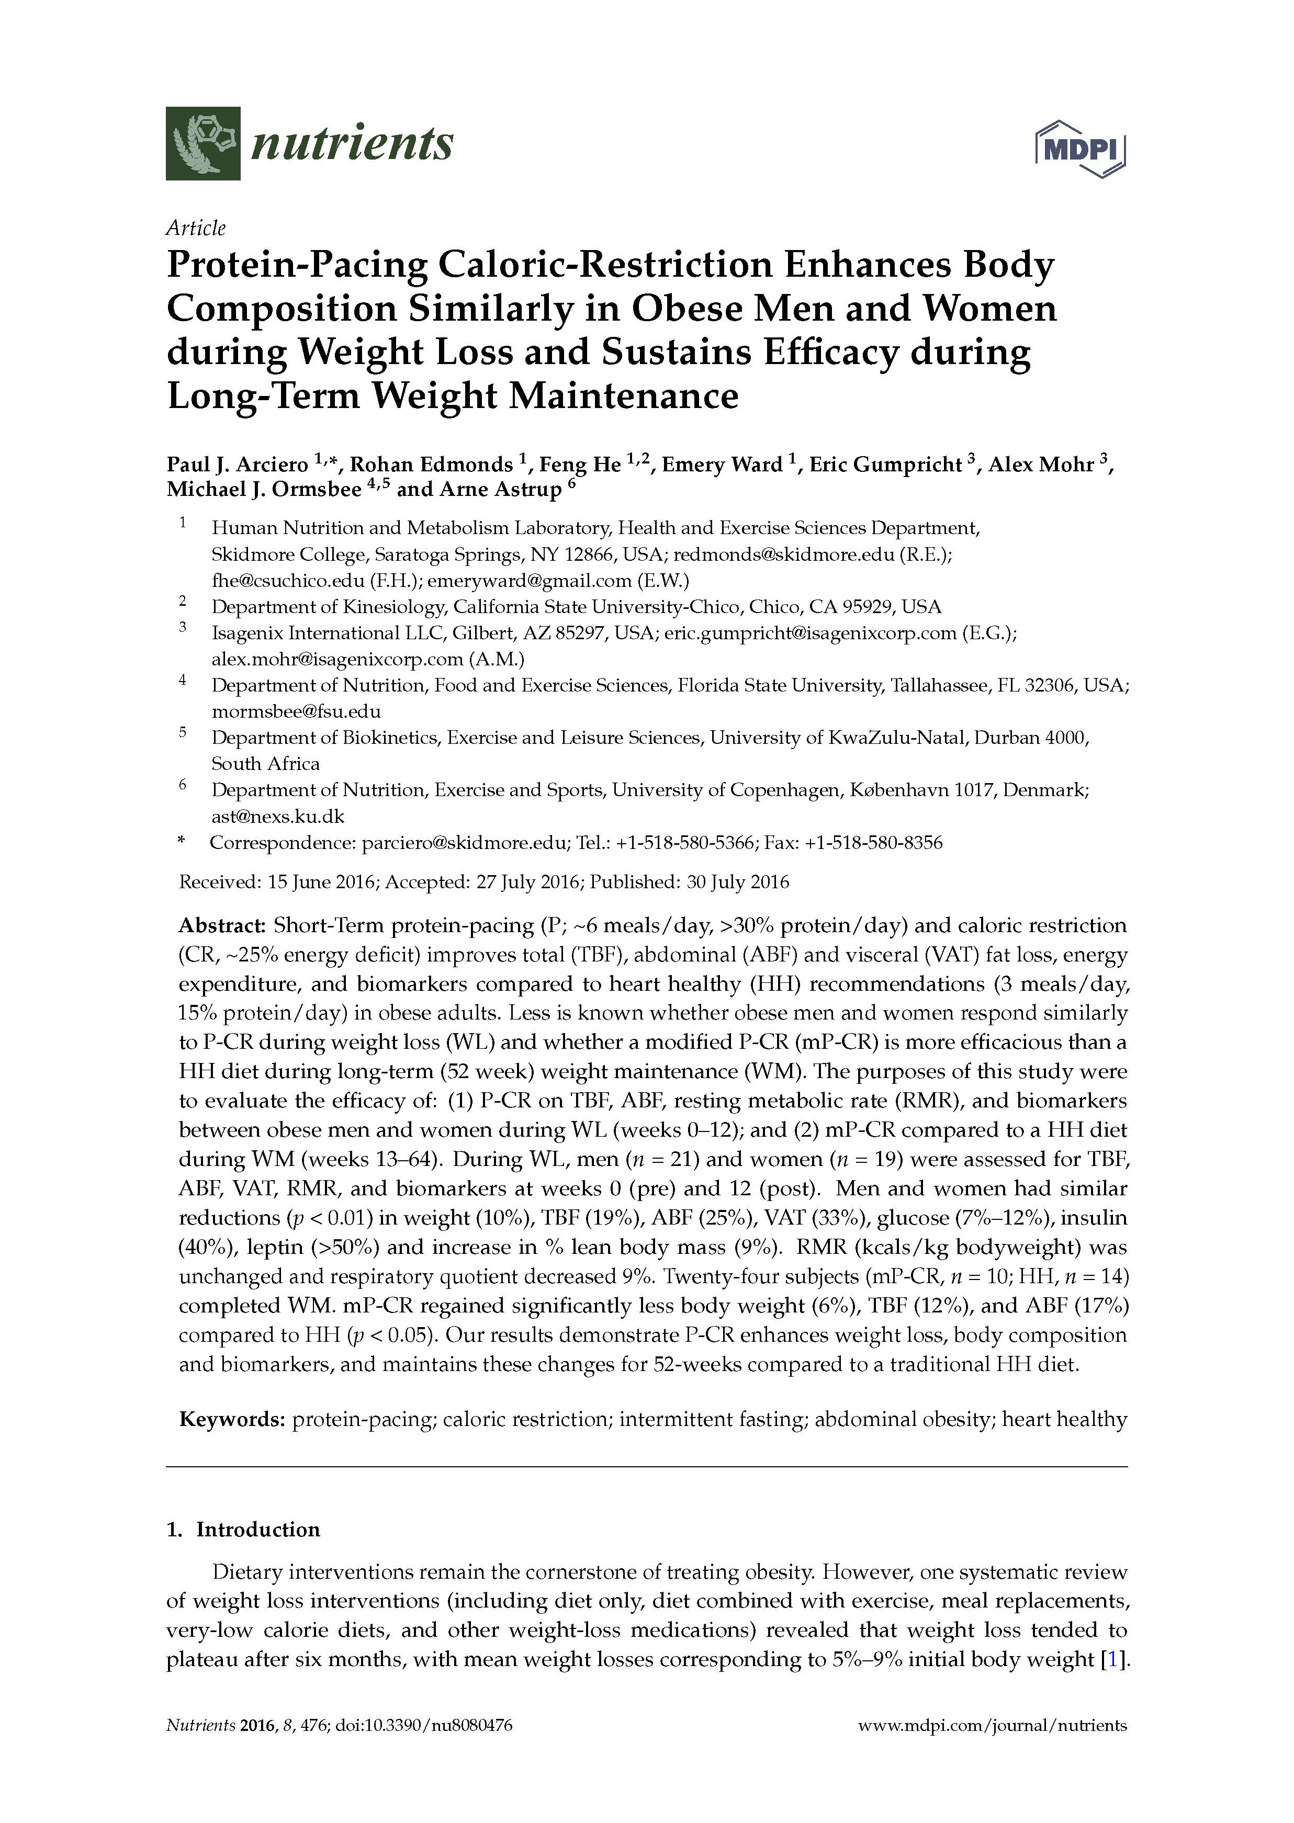
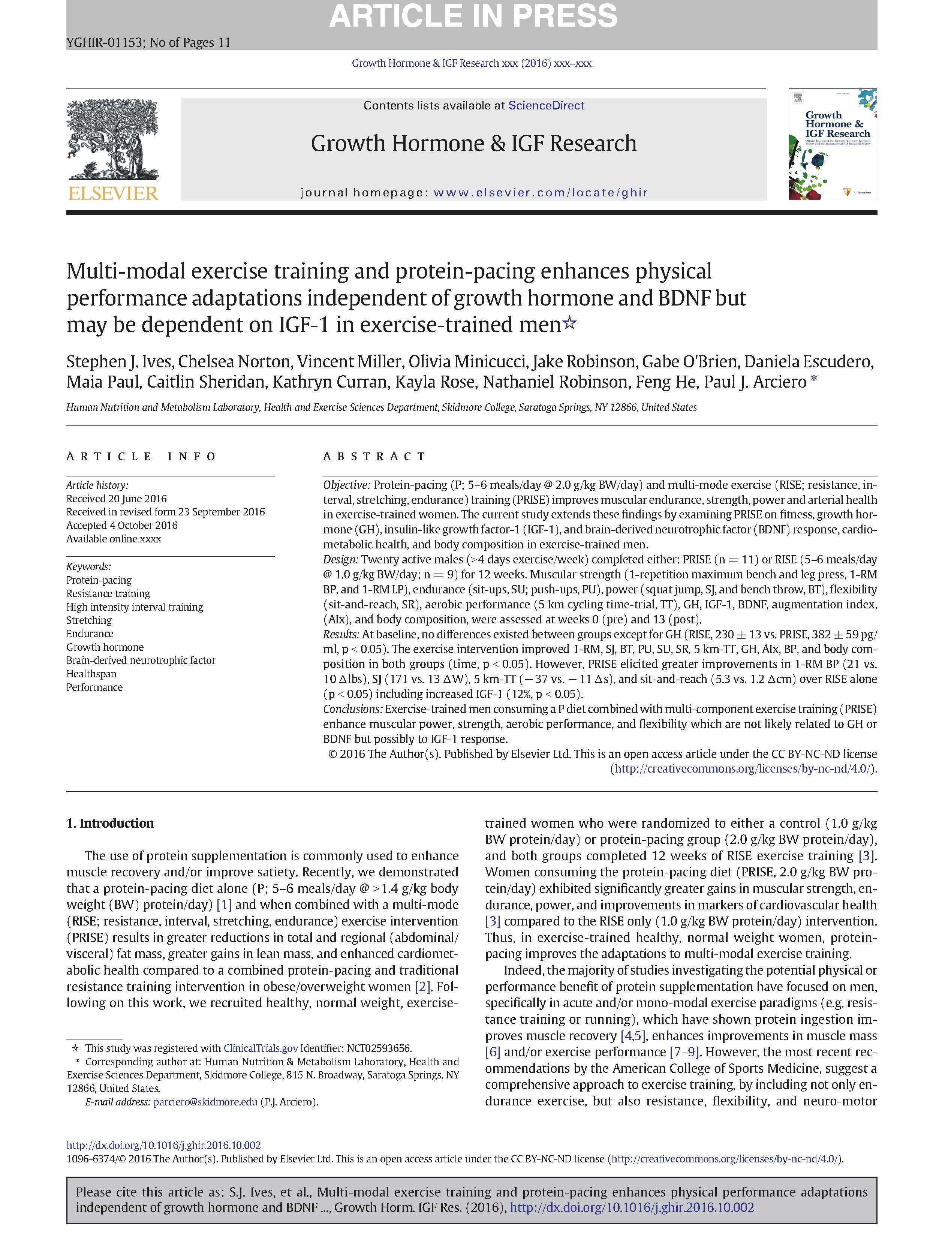
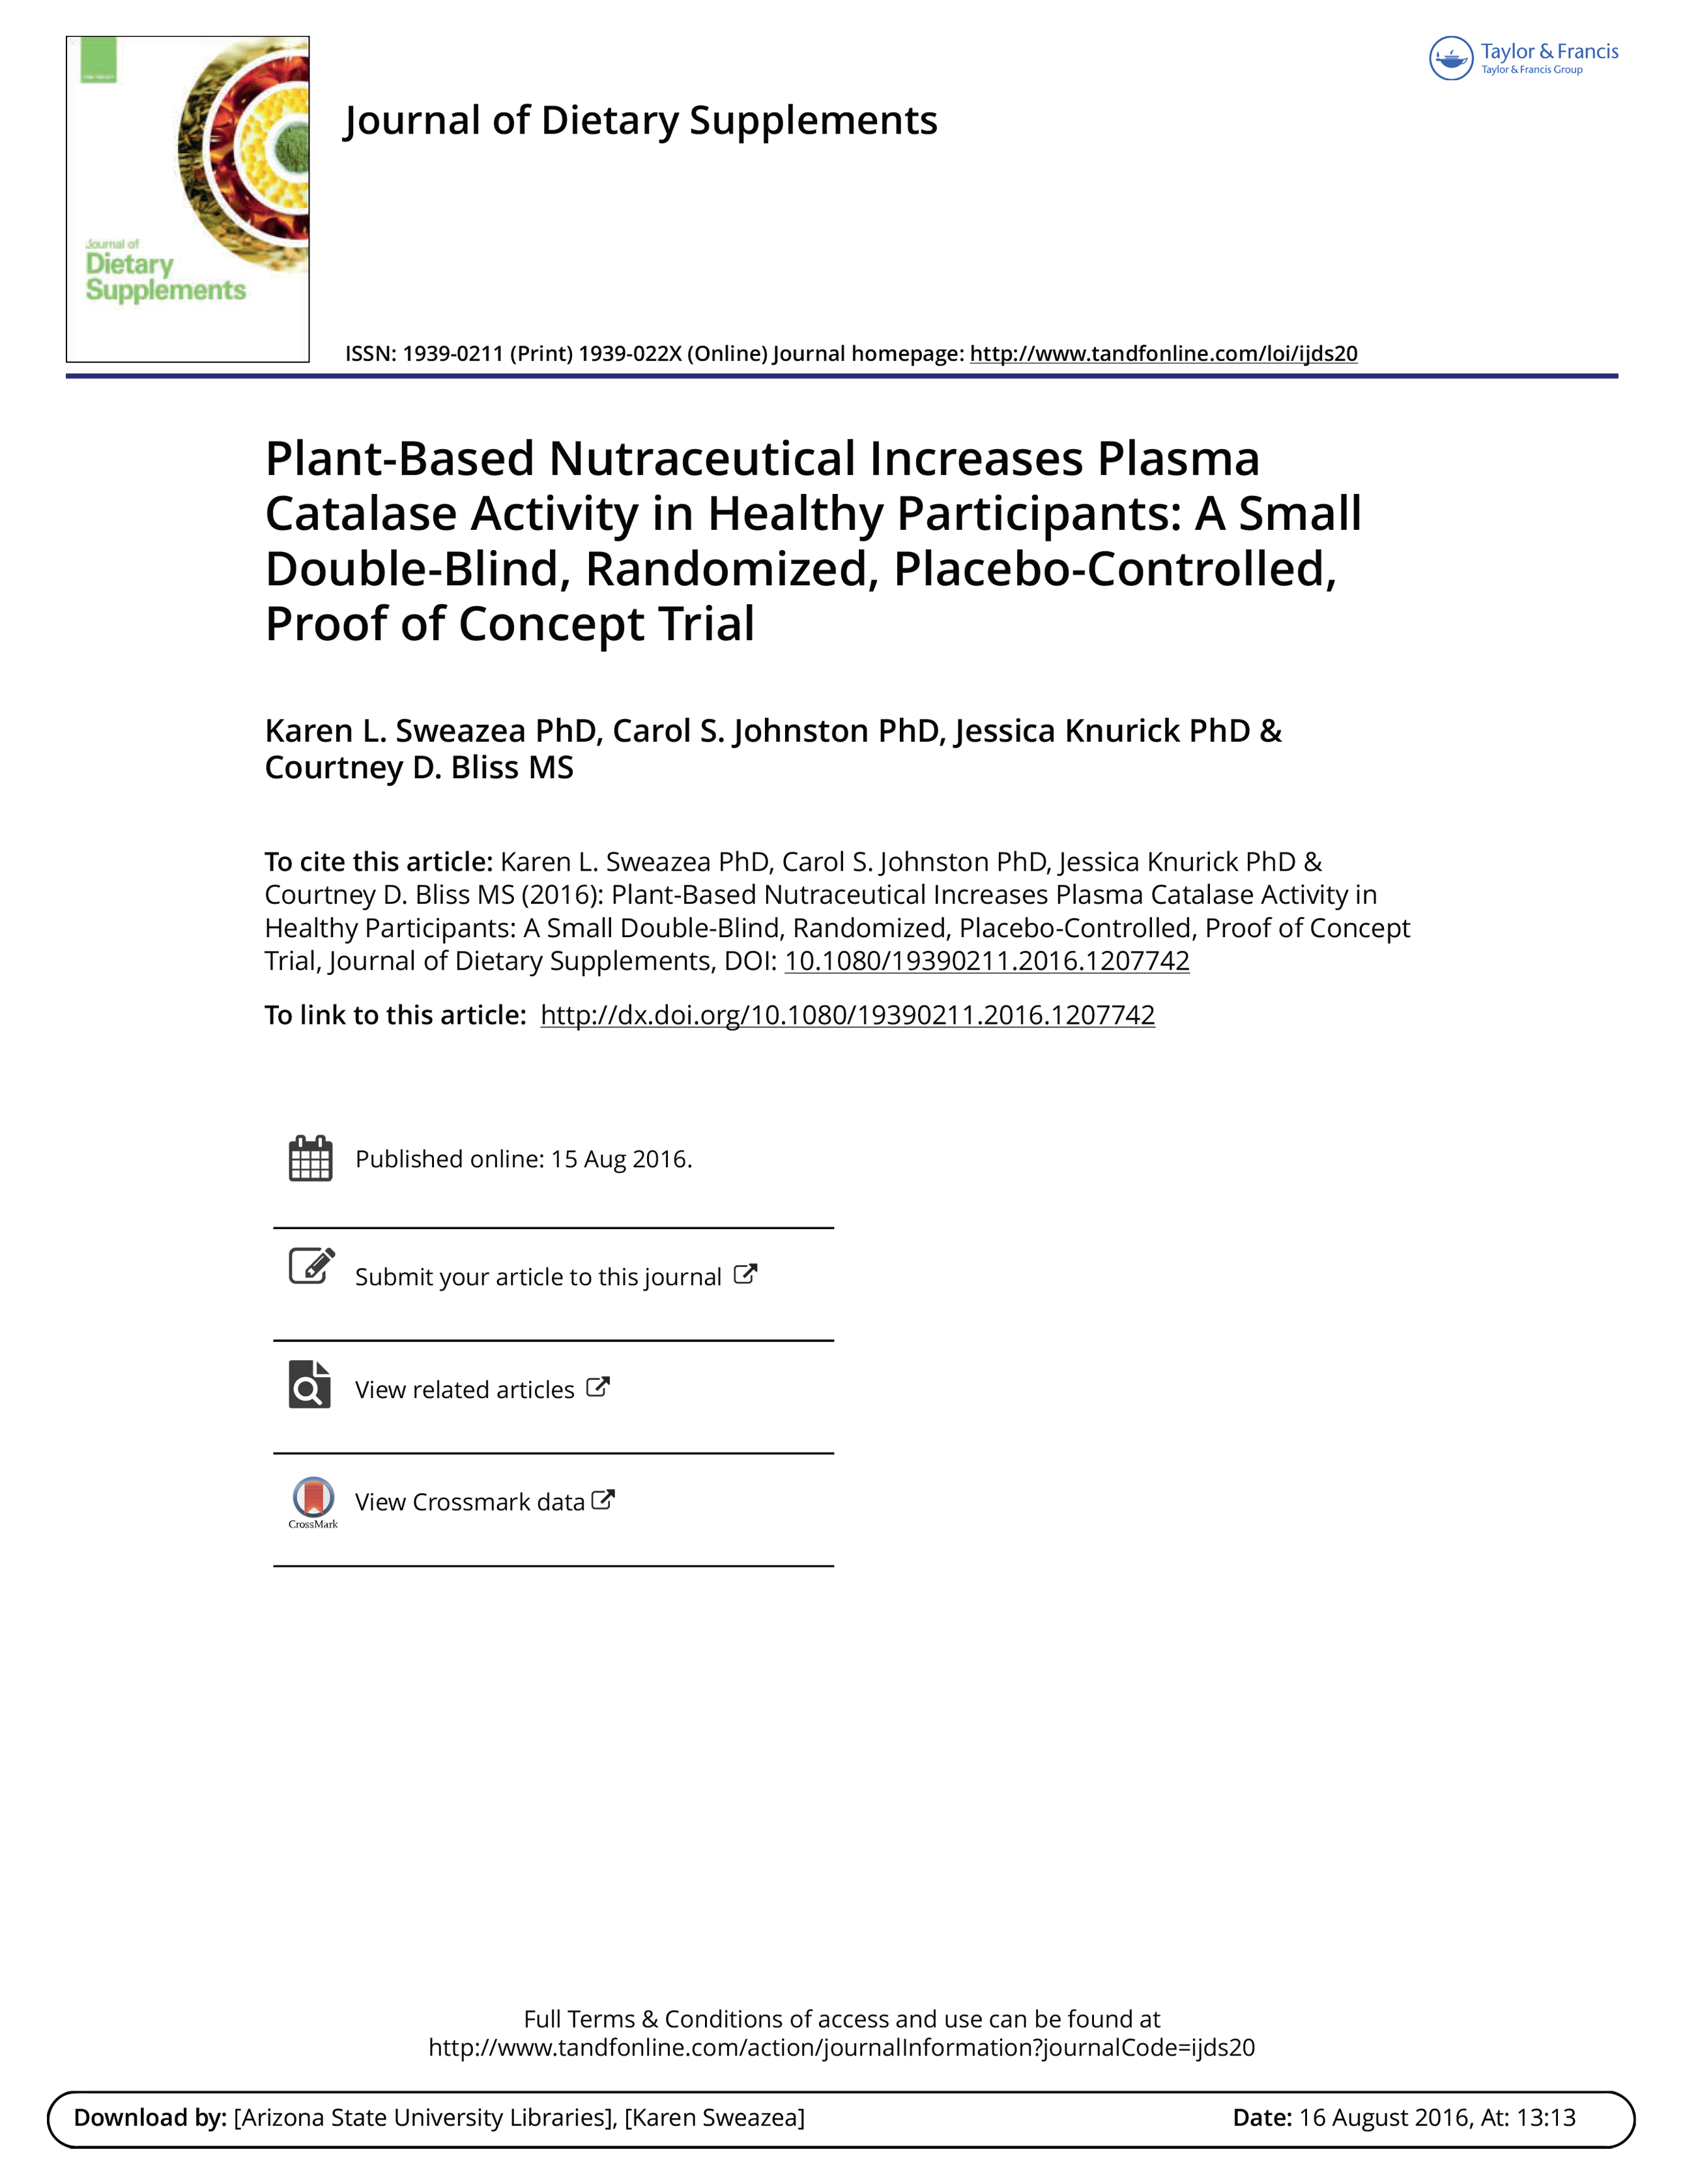
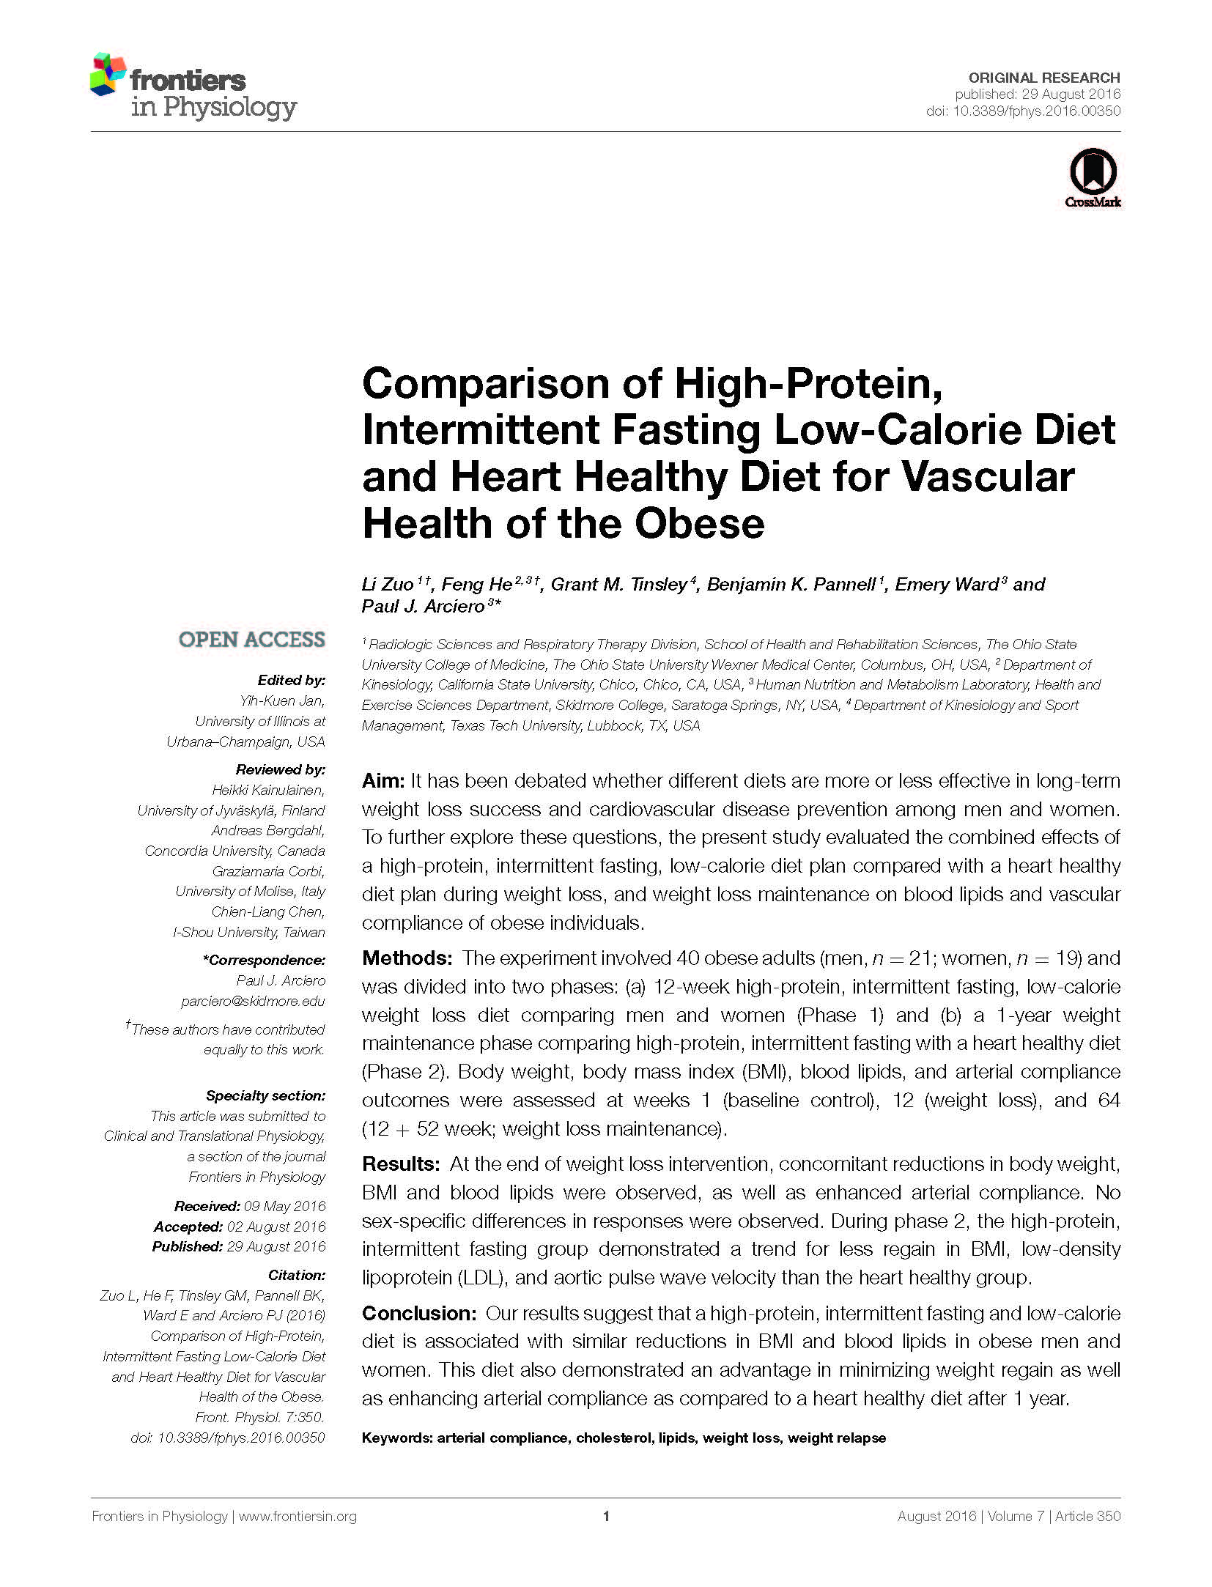
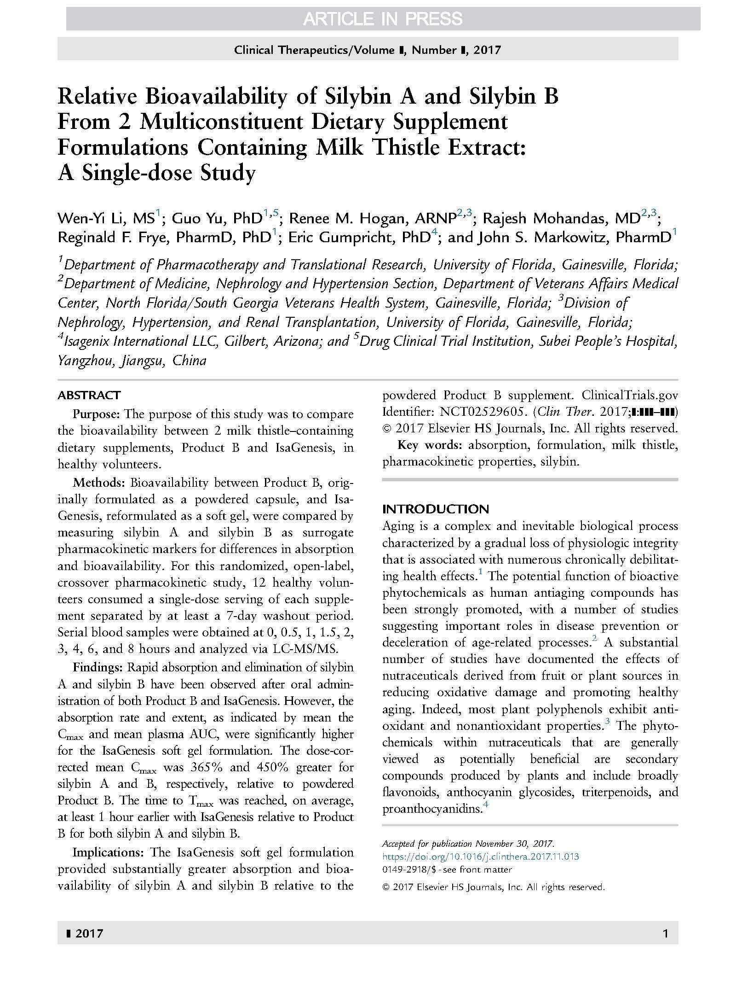
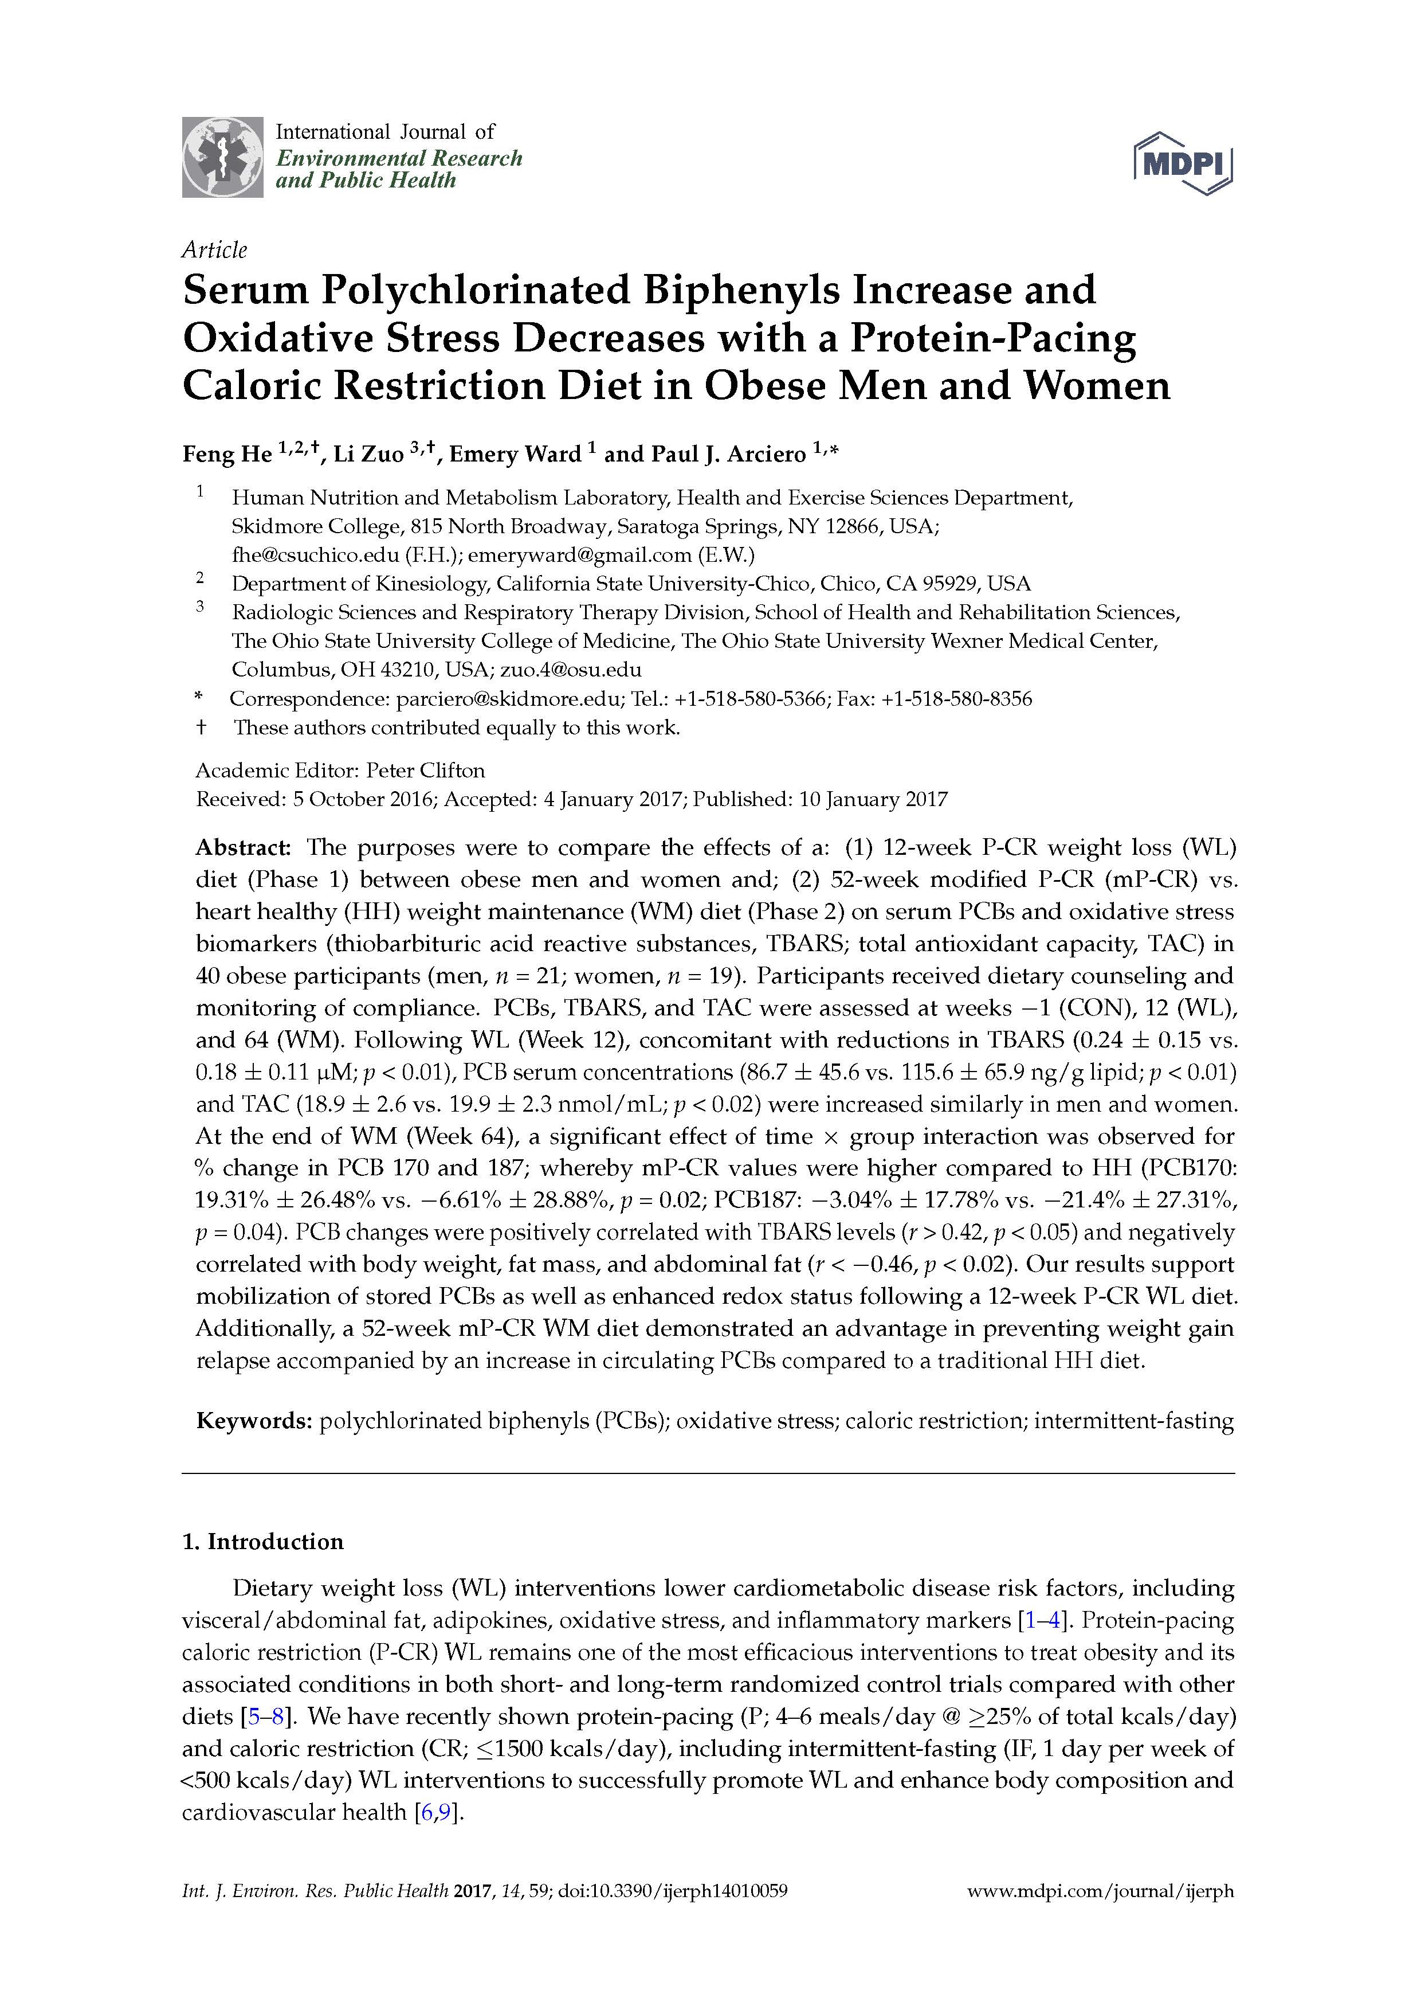
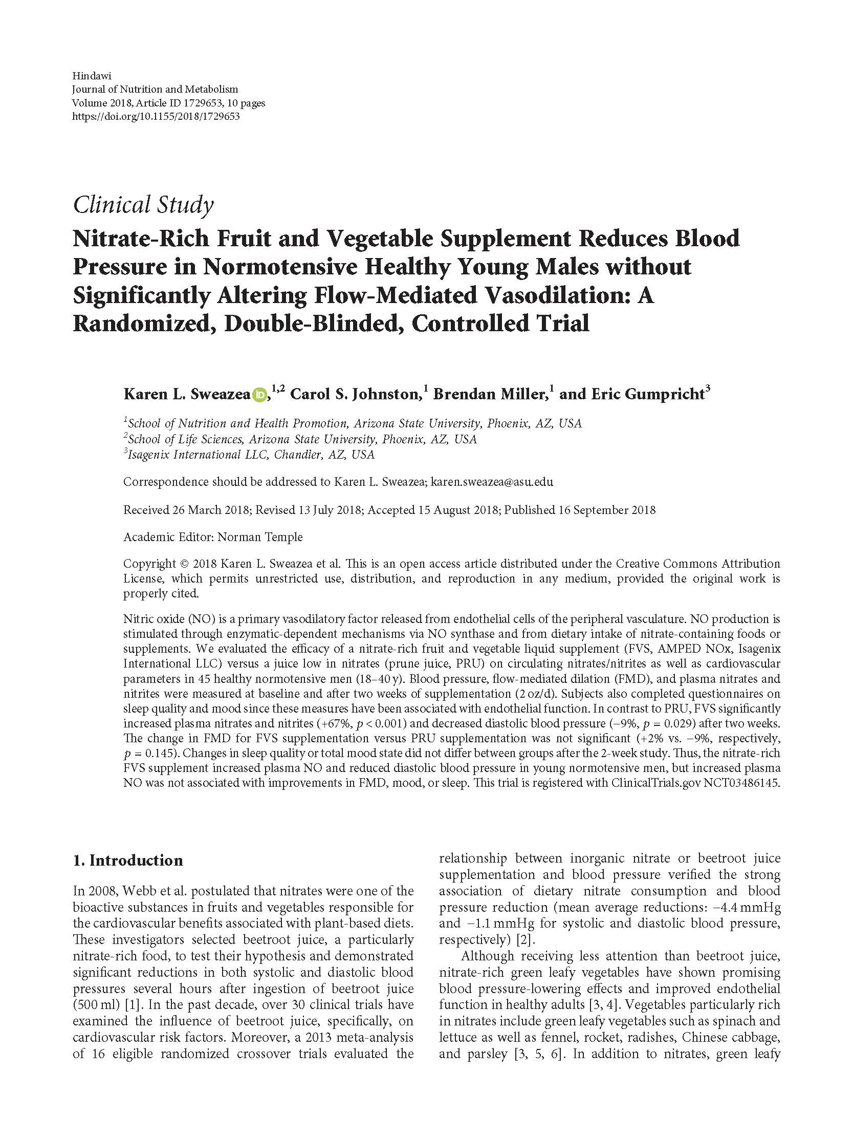
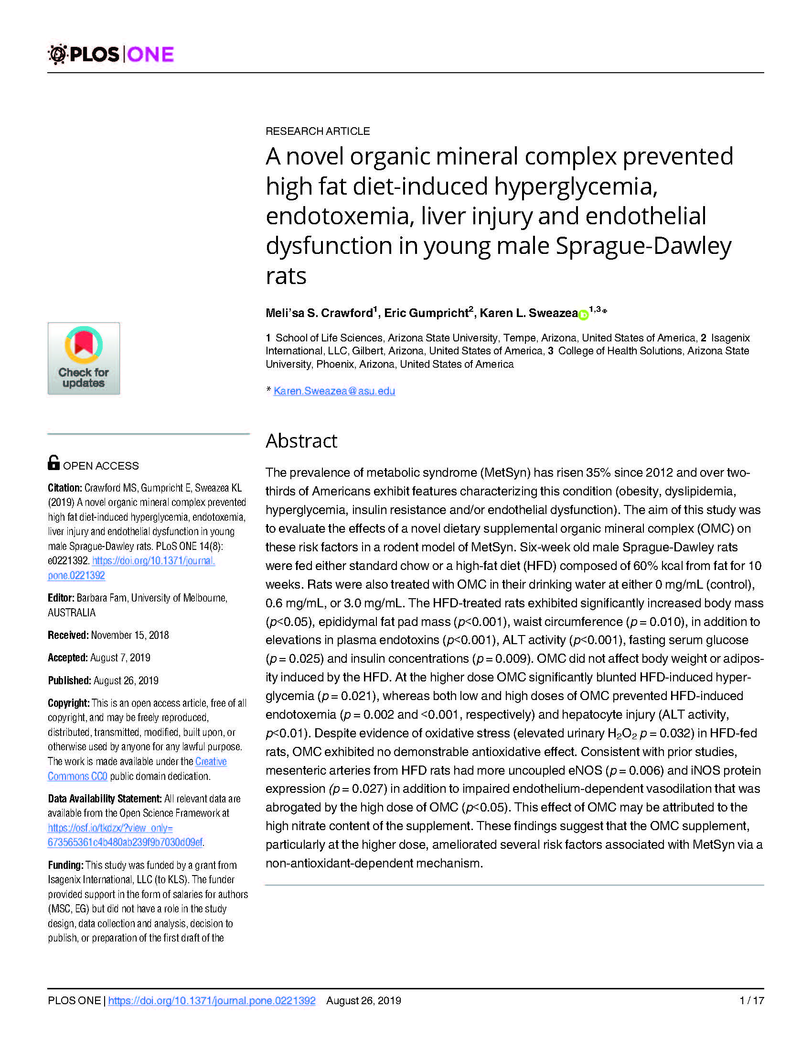
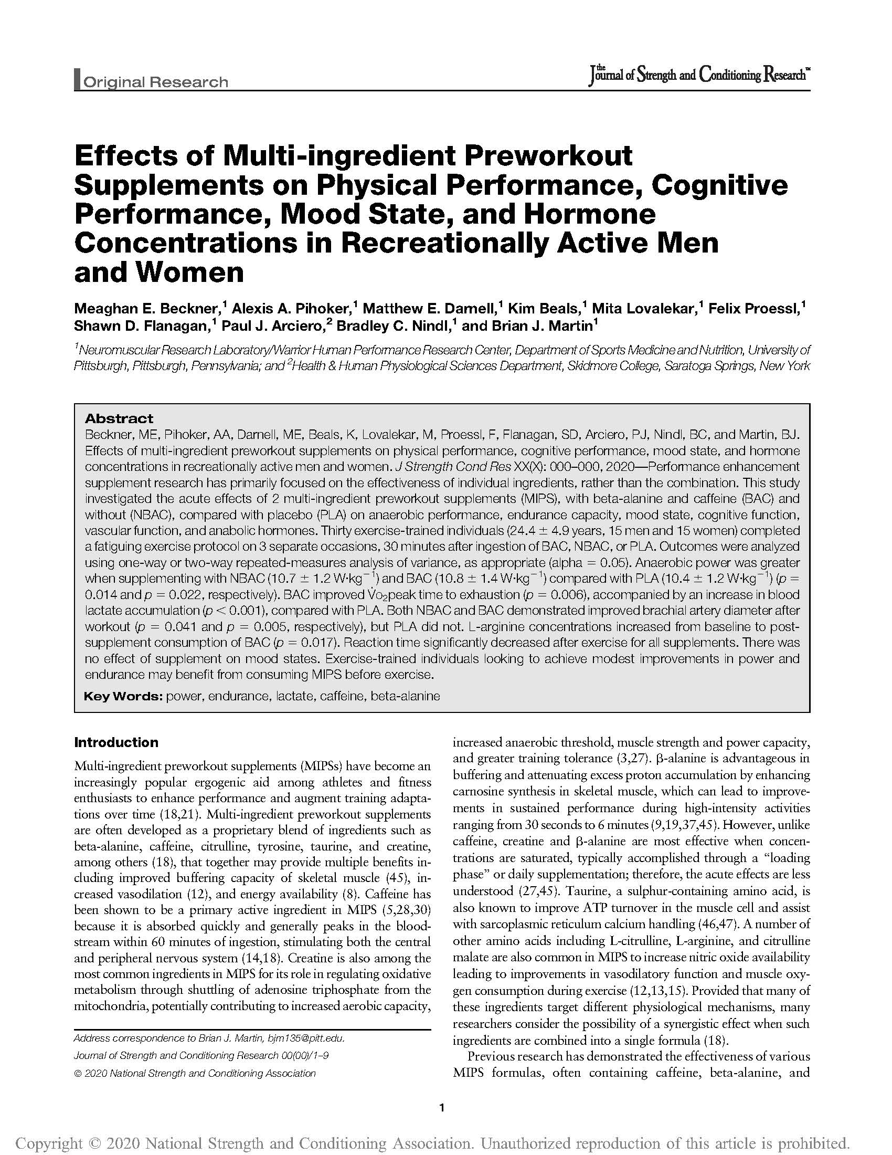
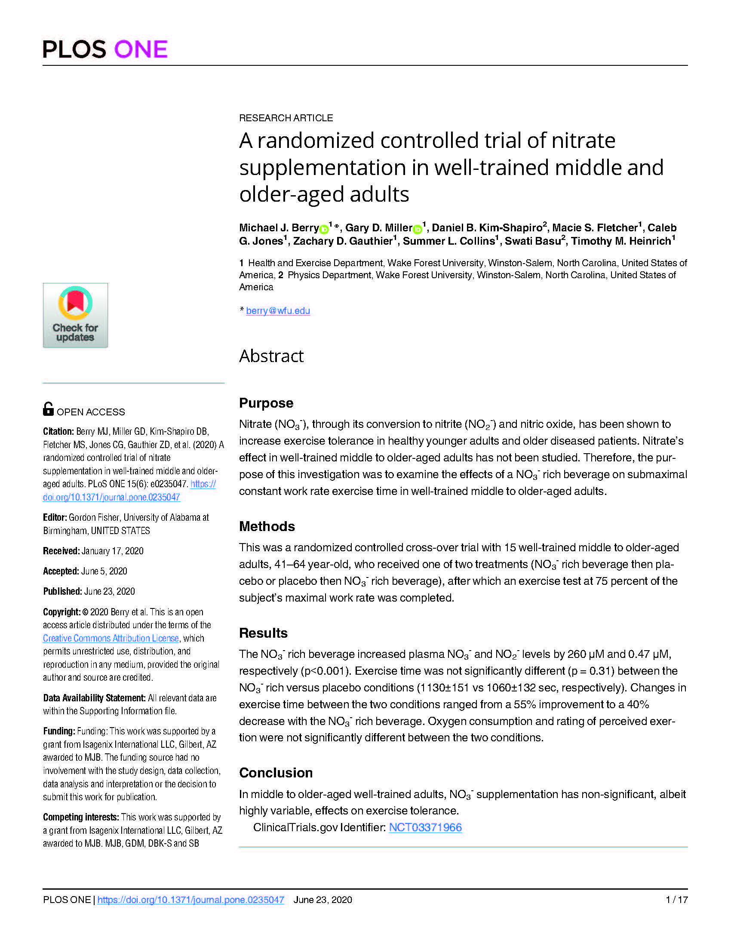
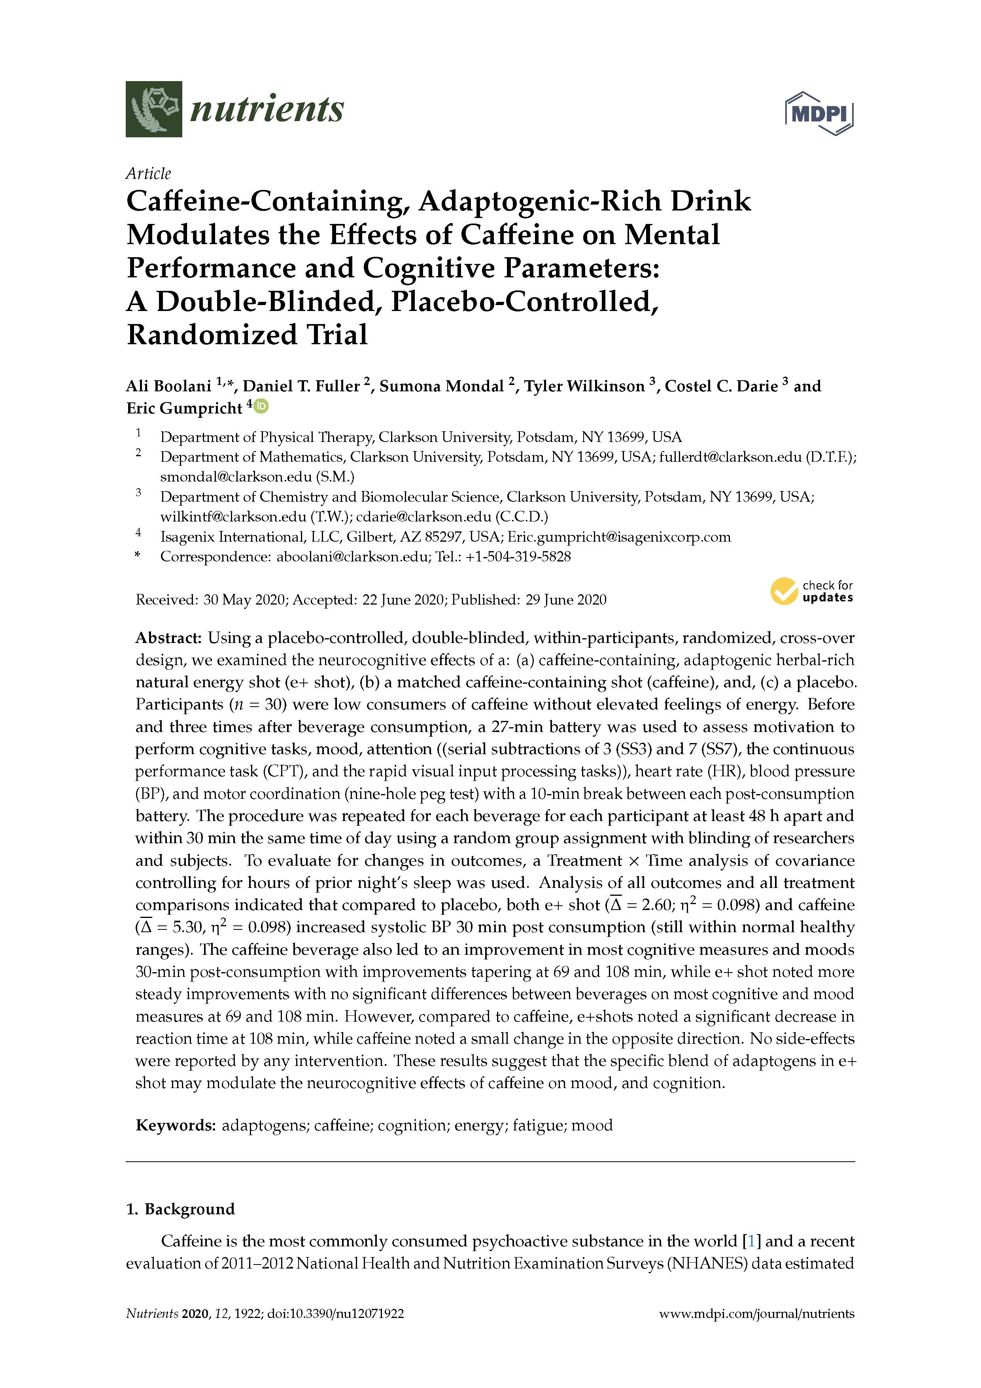
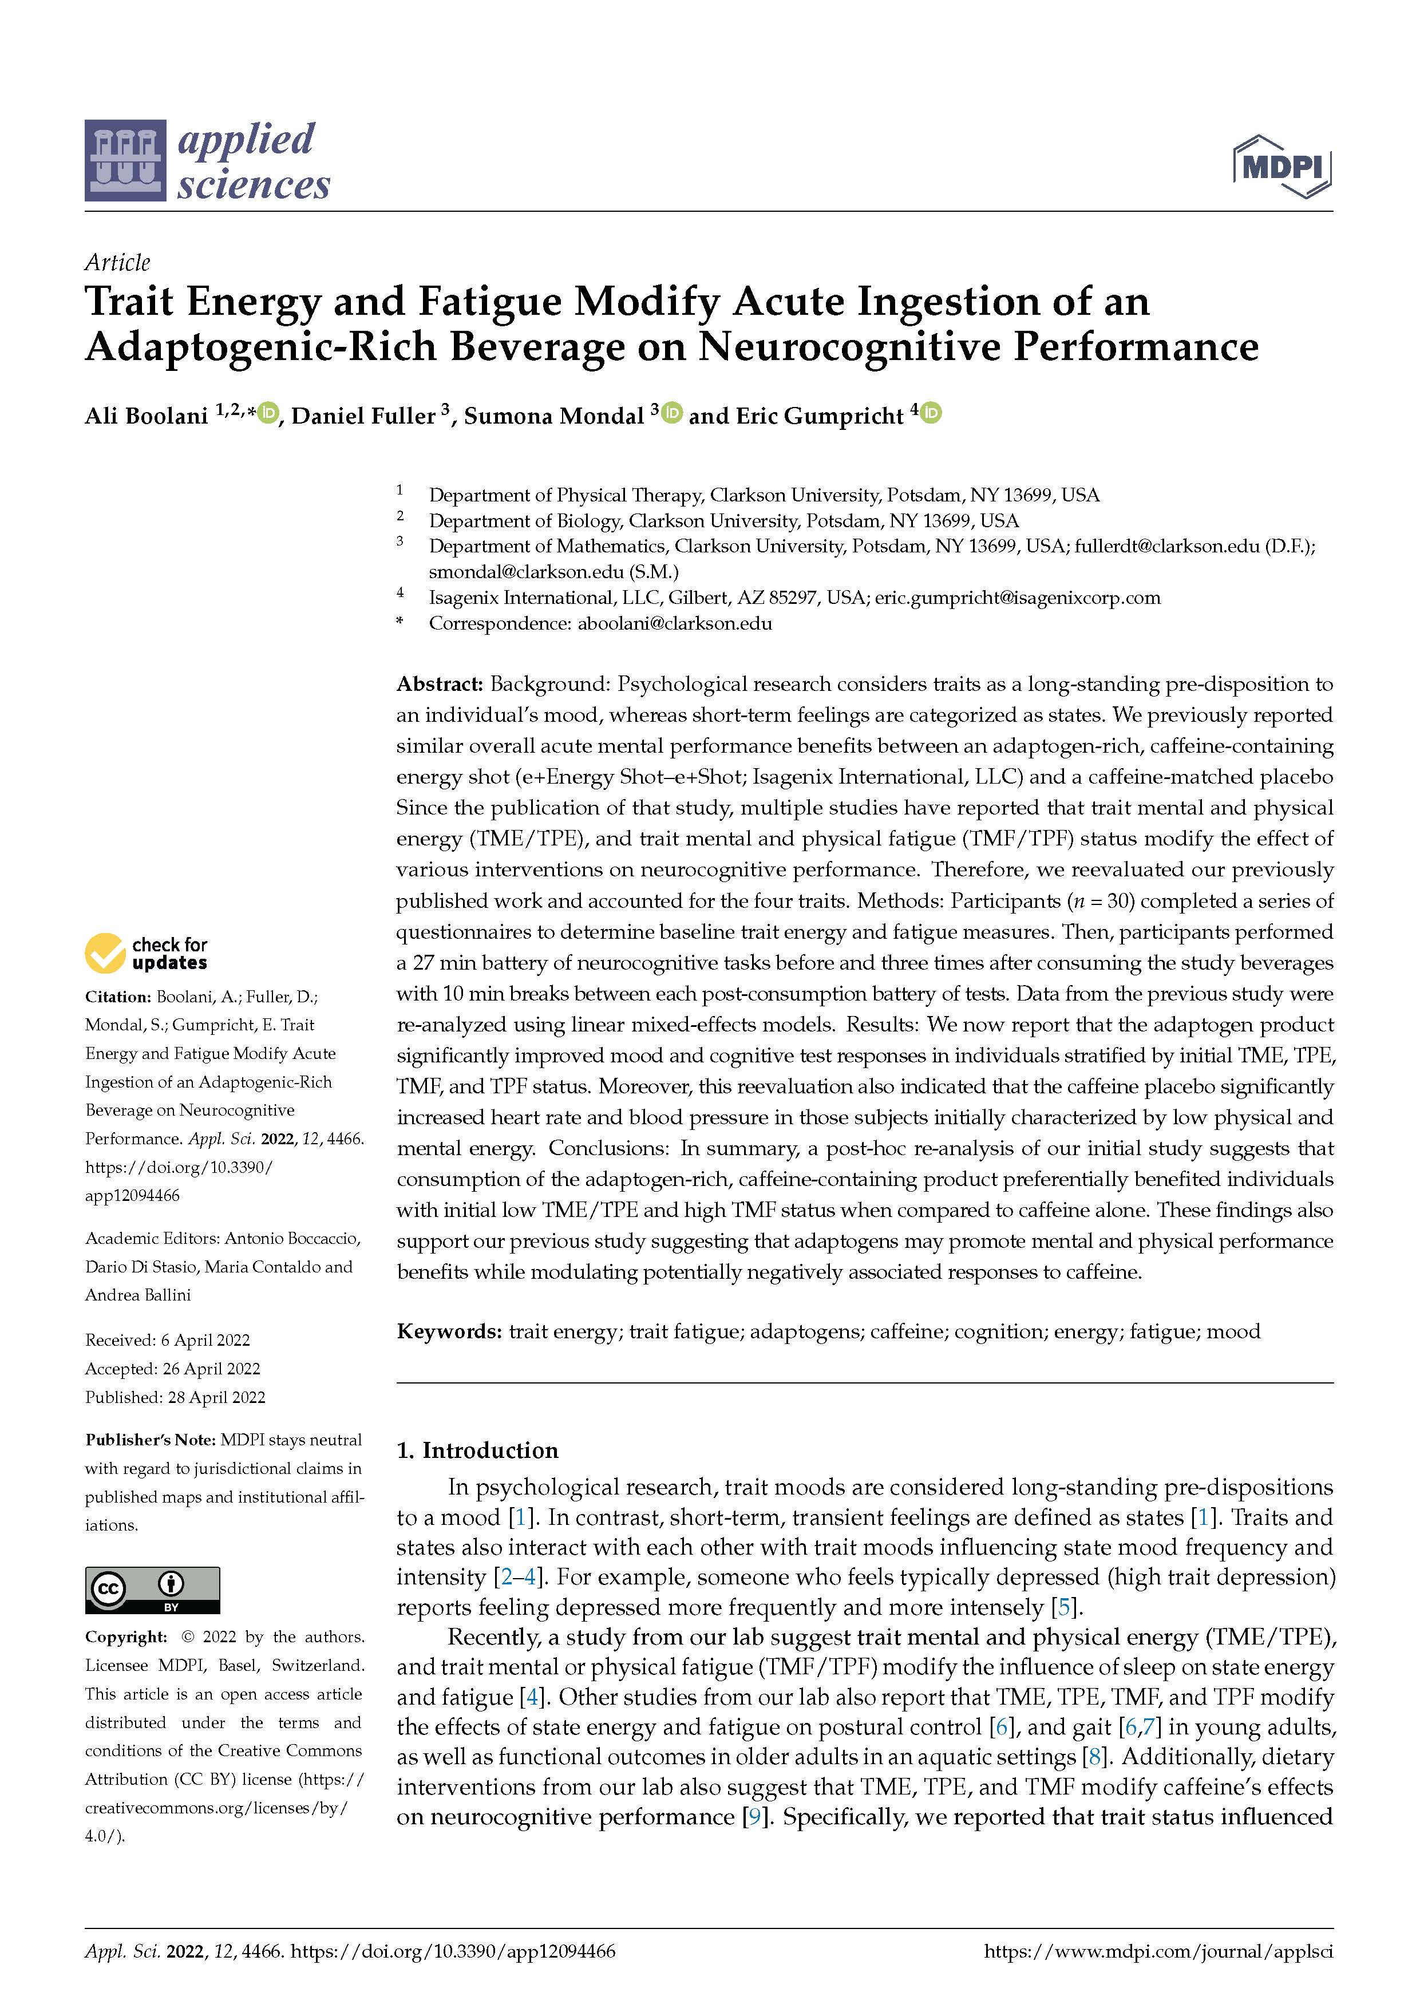
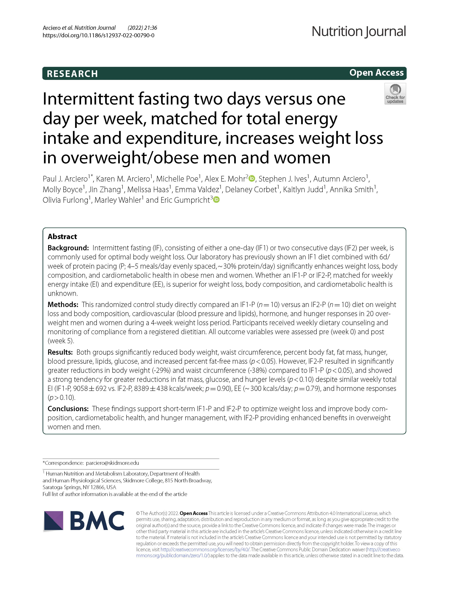
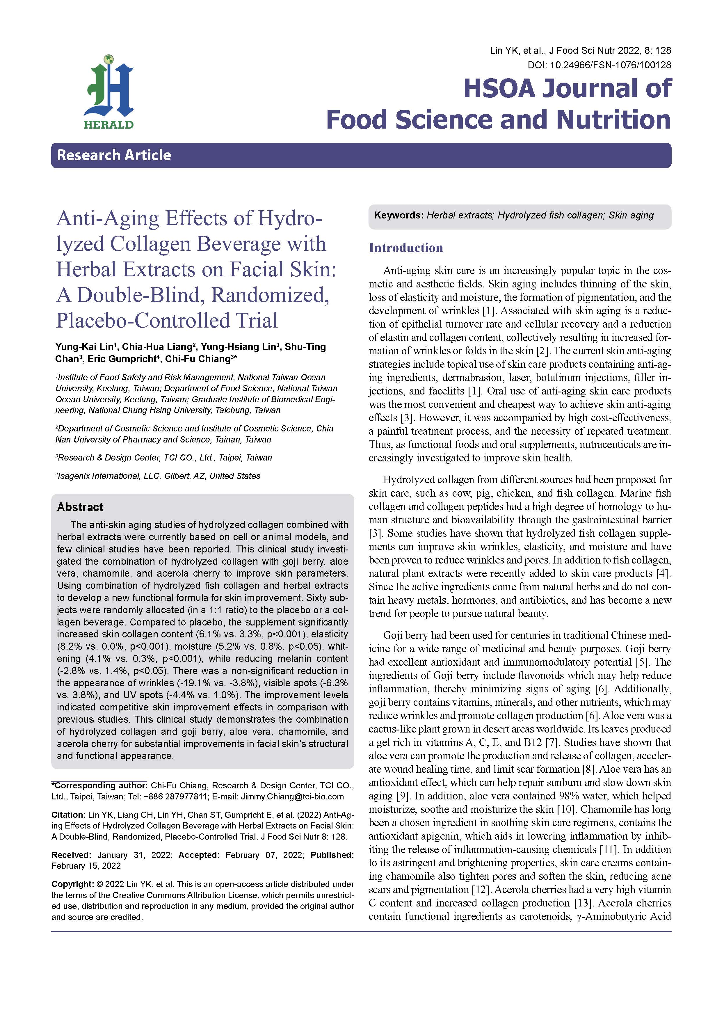
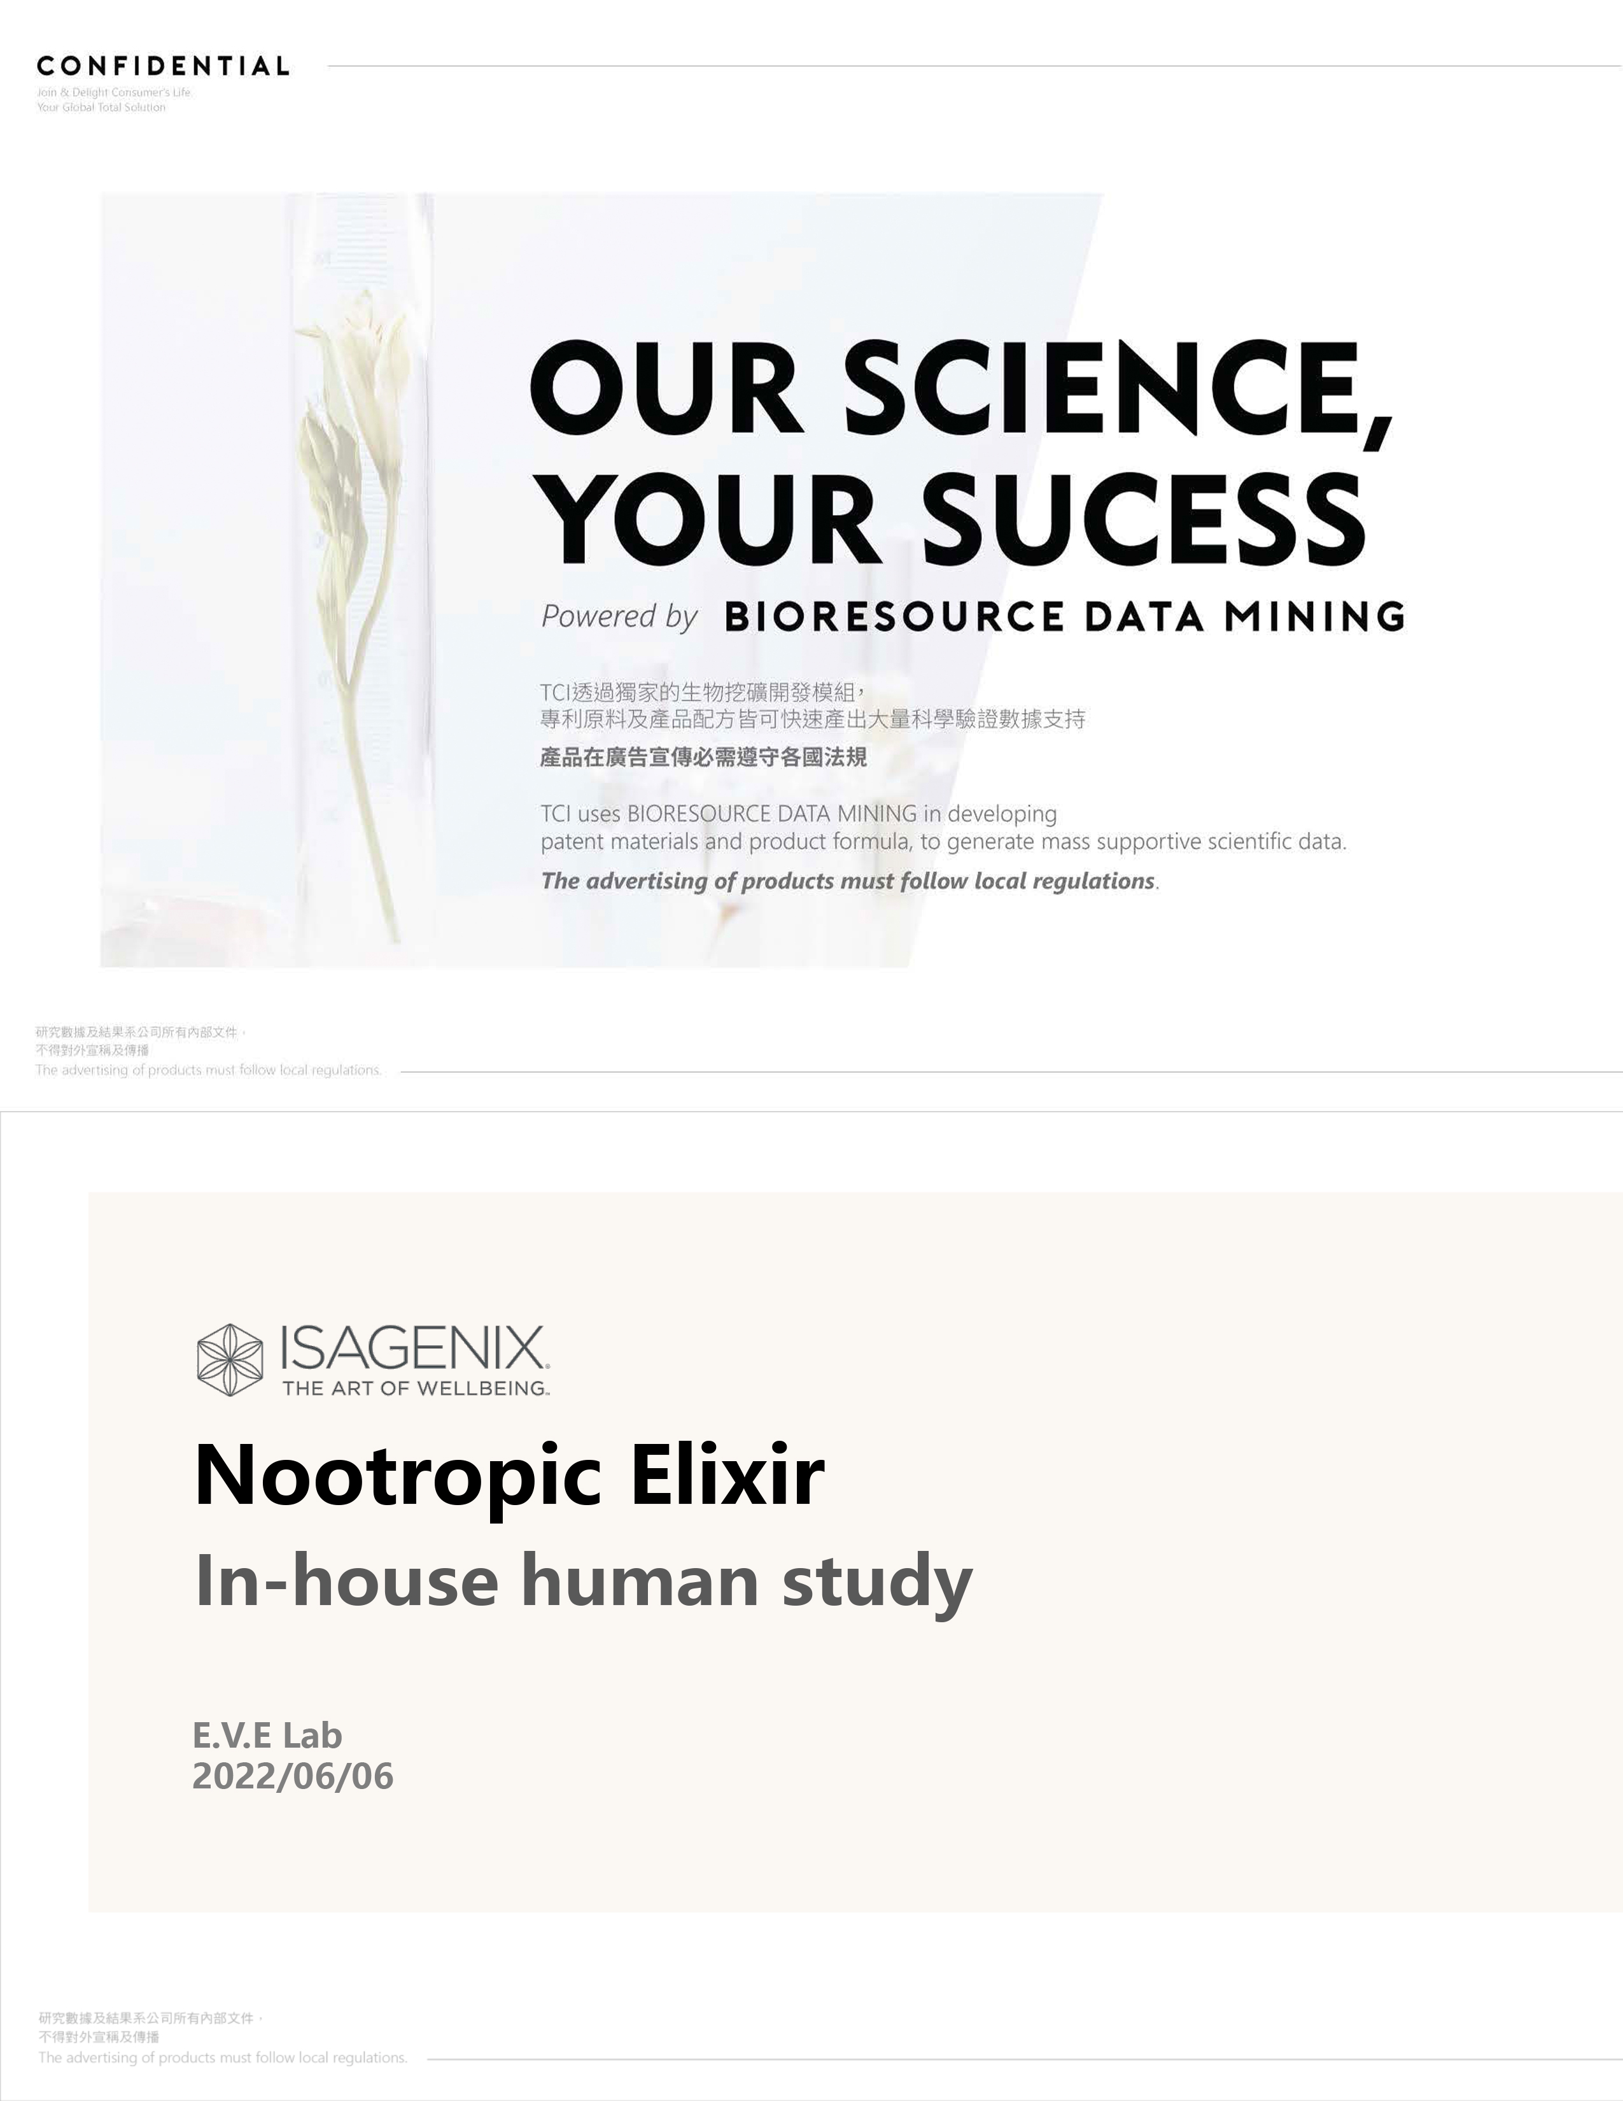
PEER REVIEWED Publications
2012
2012
2016
2017
2017
2017
2018
2019
2020
2020
2020
2022
2022
2022
2022

Slide 29









Clinically Proven to…
BURN
FAT
FIGHT CRAVINGS
MANAGE
STRESS
SLEEP
BETTER
IMPROVE
NUTRITION
CLEANSE
SAFELY
INCREASE
% OF LEAN BODY MASS
CELLULAR
STRESS
LOWER VISCERAL FAT

Slide 30


Key findings after 8 weeks
of following the Isagenix Weight-Loss System compared to a heart-healthy diet
UNIVERSITY OF ILLINOIS AT CHICAGO
Weight Loss
Study
56%
More
Weight loss
Better improvements in cardiovascular health markers
Publications in: Nutrition Journal and Nutrition and Metabolism
Access research Fast Facts at IsagenixHealth.net/Research

Slide 31
Weight Loss (Phase 1)
Key findings after 12 weeks of following the Isagenix Weight-Loss System
Skidmore college
33%
9%
24 lb
VISCERAL FAT
Lean Bodyweight percentage
Weight loss
Cardiovascular health markers
significantly improved
Key findings on toxin release:
33% increase in total toxins (PCBs) released and 25% decrease in oxidative stress
Access research Fast Facts at IsagenixHealth.net/Research

Slide 32


Weight
Maintenance (Phase 2)
Key findings after 52 weeks comparing weight maintenance using the Isagenix System vs. heart-healthy diet
Skidmore college
Vs
Isagenix System
Heart-healthy Diet
Maintained weight loss
Continued to lose body fat and abdominal fat
Continued to increase lean body mass percentage
Maintained improved cardiovascular
health markers
Regained weight
Regained body fat
and abdominal fat
Decrease in
lean body
mass percentage
Cardiovascular
health marker
Publications in: Nutrients, Frontiers in Physiology, and International Journal of Environmental Research and Public Health
Access research Fast Facts at IsagenixHealth.net/Research

Slide 33
VISCERAL Fat Loss

Slide 34
% LEAN BODY Mass

Slide 35
GUT HEALTH Symptoms

Slide 36
FEATURED IN Nature Communications
Key Findings:
✓ Changes gut microbiome more positively than a heart-healthy diet
  Better fat-burning & overall metabolic health
✓ Boosts proteins
  Fat burning, weight loss, inflammation & immune response
✓ Fewer digestive issues
  Less bloating, constipation, diarrhea vs. heart-healthy diet

Slide 37
