Slide 1


Slide 2


Slide 3
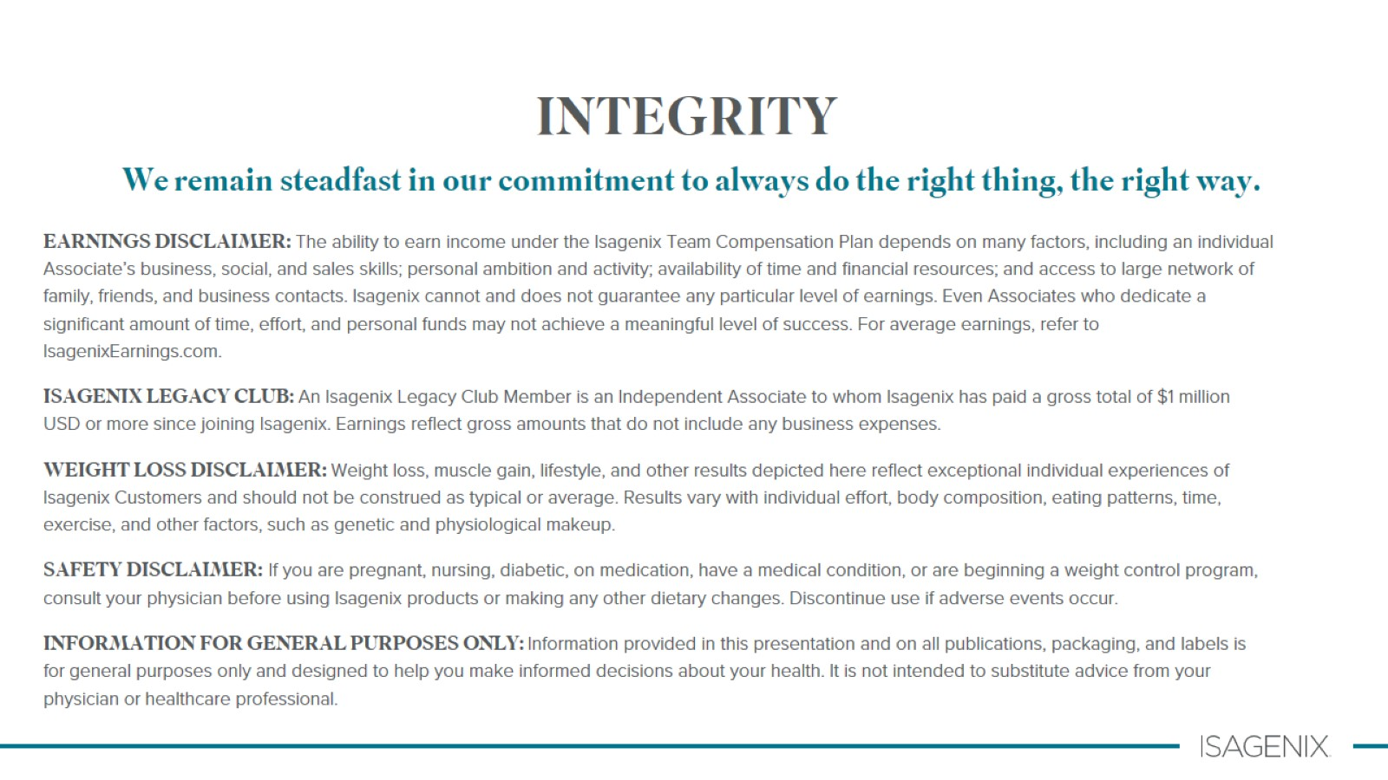
INTEGRITY

Slide 4

What is today about?
Notes:
Facilitator introduce yourself and set the scene for the next few hours

Slide 5
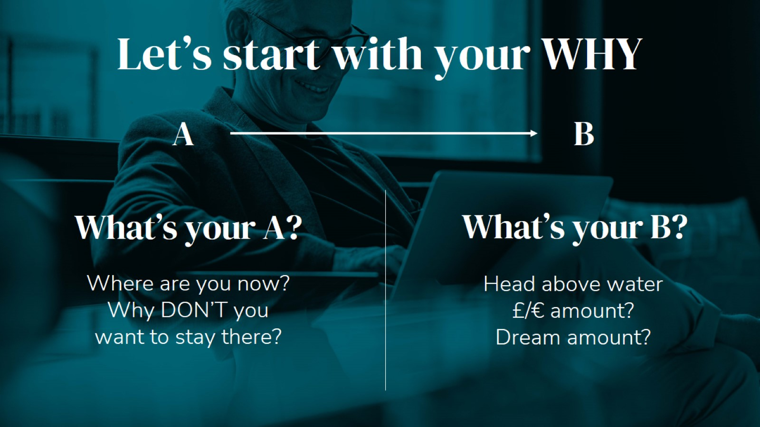
What’s your A?
Notes:
Most people aren’t clear on what they want and don’t want, and have even forgotten how to dream of more.
This is about people getting clear on where they are now and why they don’t want to stay there, and where they want to be, and why.
Add a dollar value to the B numbers

Slide 6
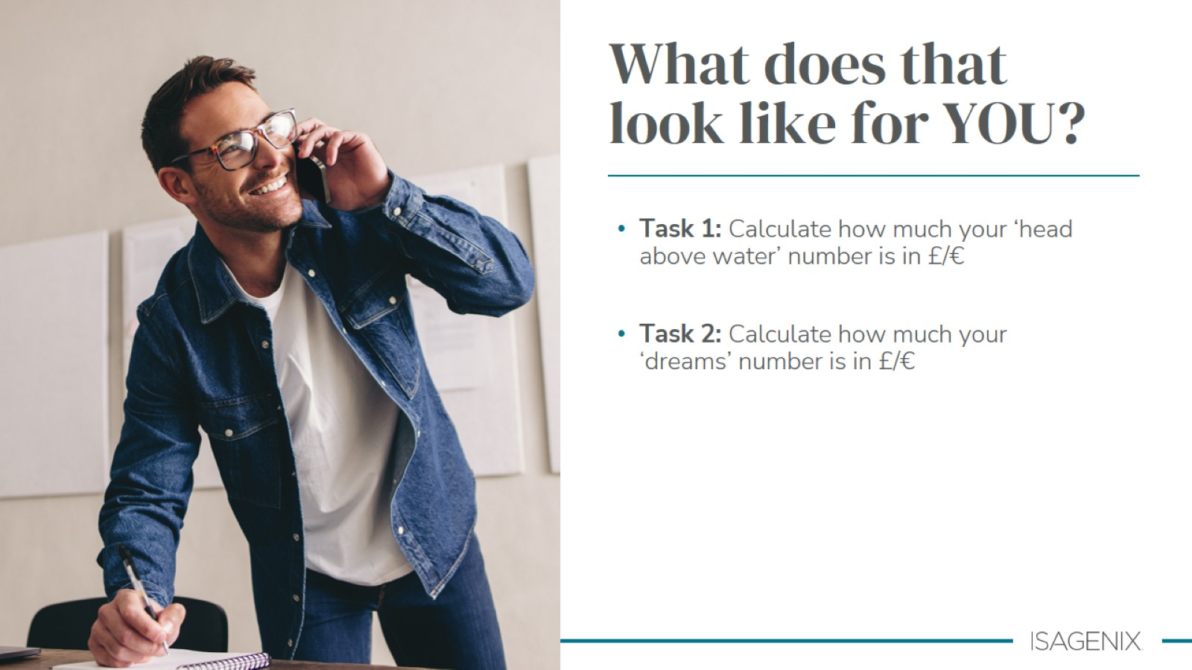

Slide 7
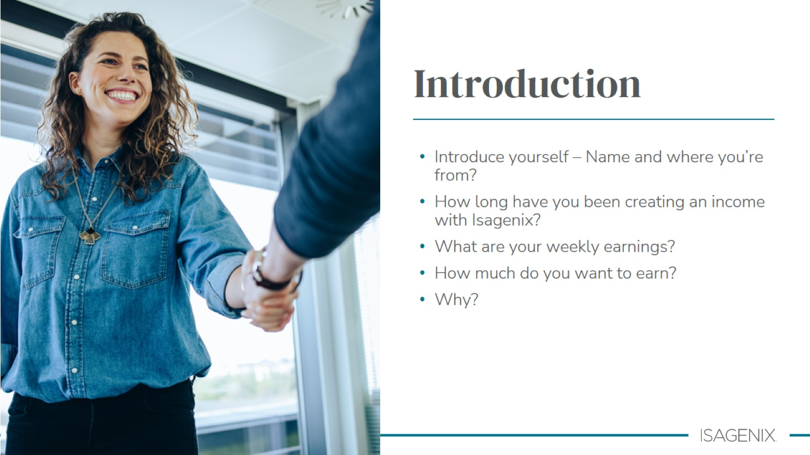
Notes:
Ask each person to introduce themselves and answer the questions above ​

Slide 8
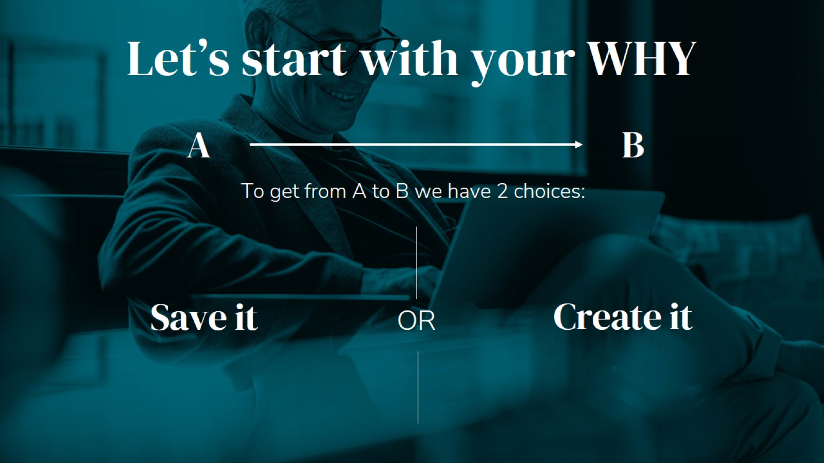
Notes:
Only 2 ways to fund a different life… save it or create it ​

Slide 9

Notes:
Save it – left hand side of Q – 95% of people sit here and share 5% of wealth ​
​
Create it – move to R side of quadrant 95% of wealth sits with 5% of population ​
​
Employed and Self employed – trade time for money (Linear income)​
​
Business ownership - taps into leverage (of other people’s time) and systems to allow scale (Leveraged and Residual Income)​
​
When we have more money than we need to spend each month, we can invest our money to make money (Passive income)

Slide 10

Notes:
All business fall into 2 categories:​
​
DO IT YOURSELF business​
DONE FOR YOU business ​
​
Take a look at the pros and cons of both

Slide 11
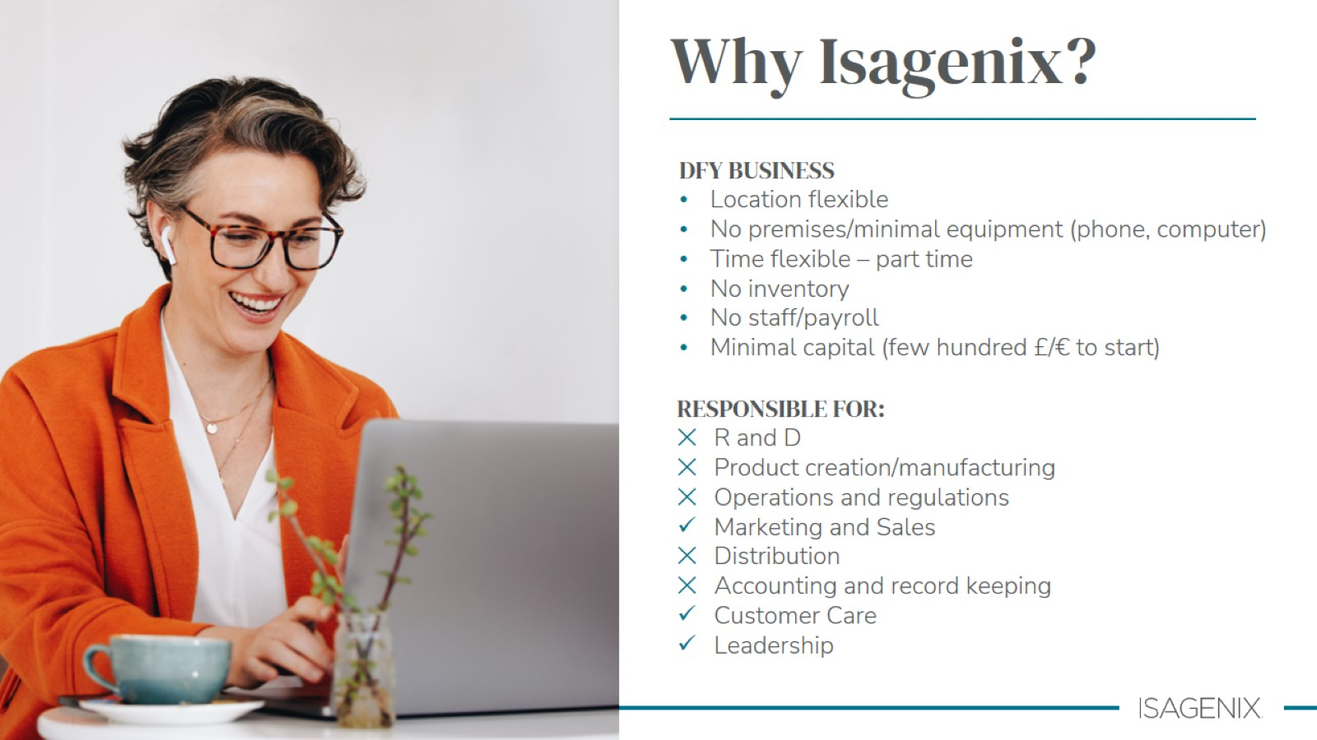
Notes:
All business fall into 2 categories:​
​
DO IT YOURSELF business​
DONE FOR YOU business ​
​
Take a look at the pros and cons of both

Slide 12
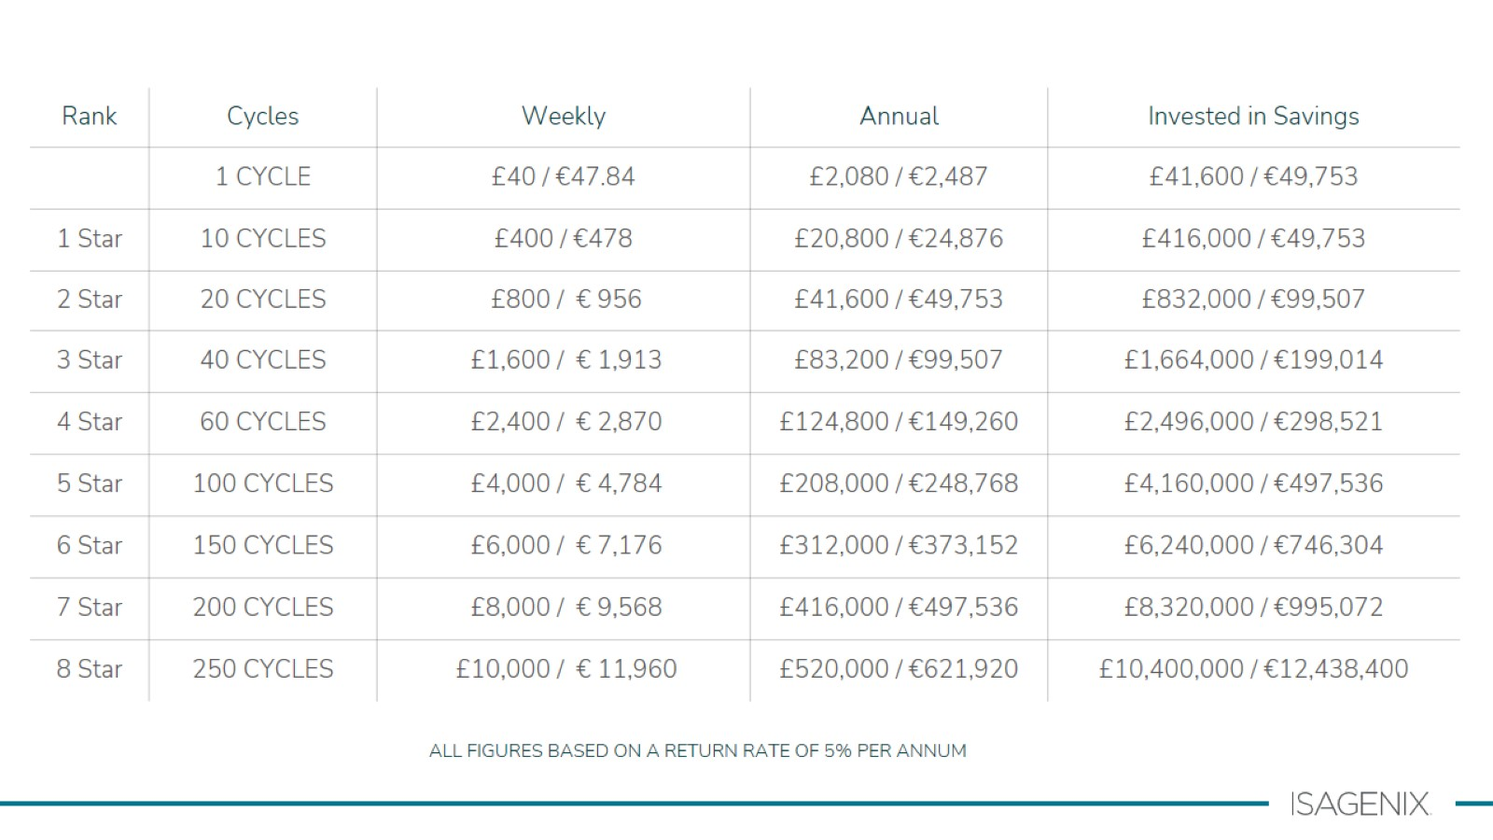
Notes:
This table looks at a 5% ROI compared to earning $ with Isagenix ​

Slide 13
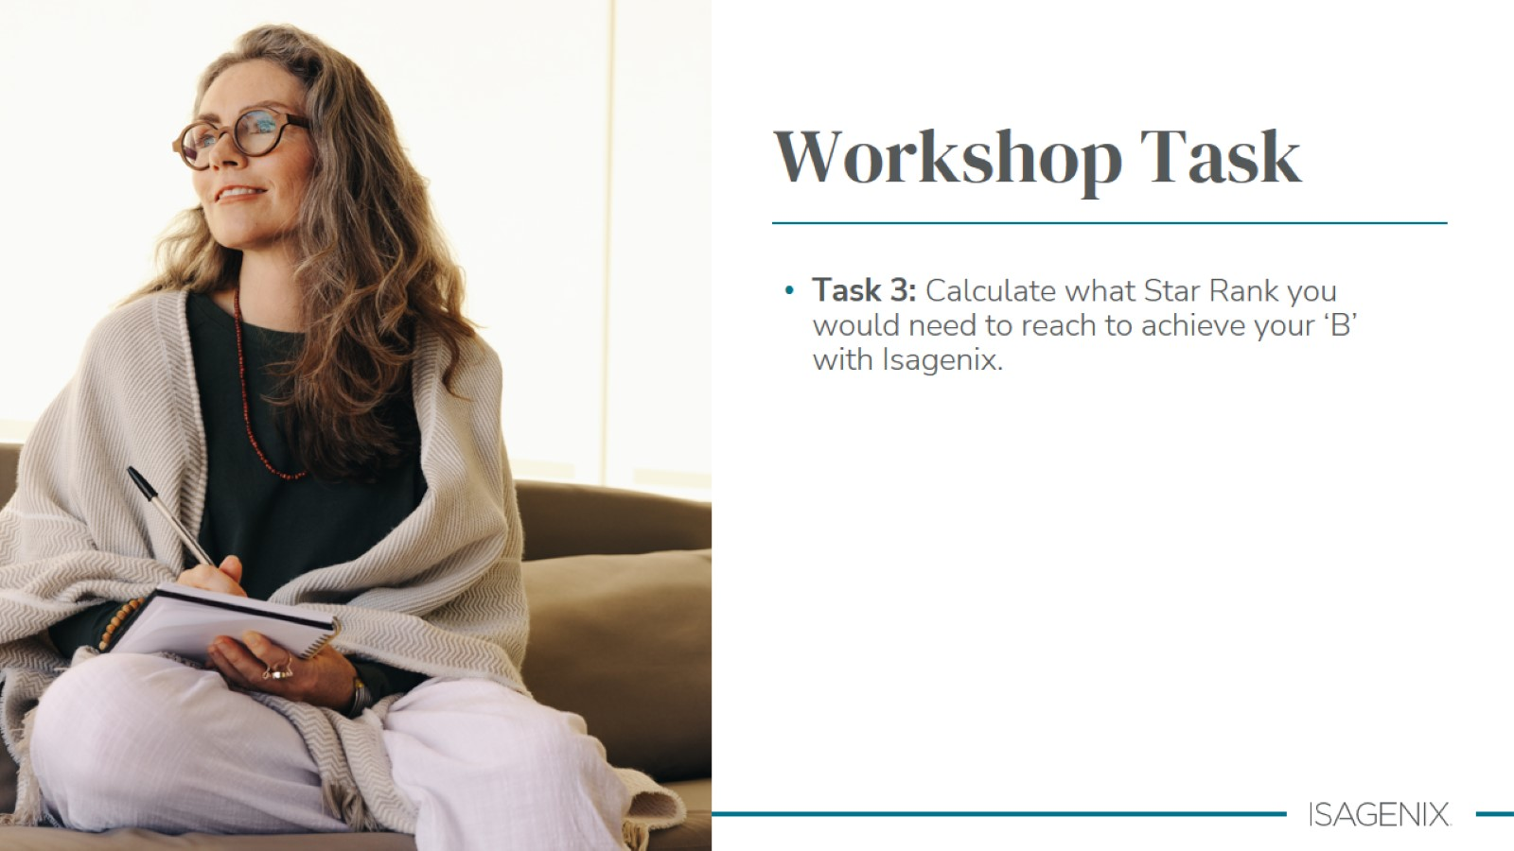
Notes:
Use the previous table so people can see their rank target​

Slide 14
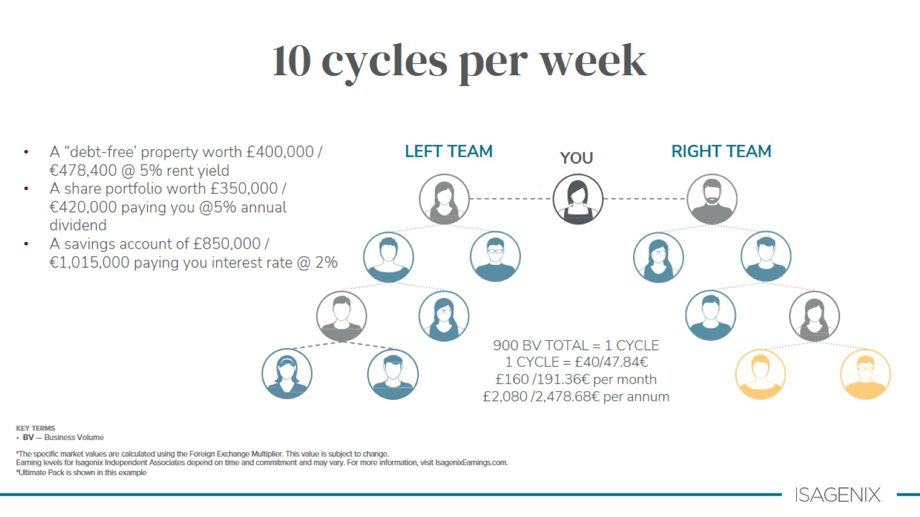
Notes:
Take a closer look at 10 cycles.
Many people achieve 10 cycles and think its not a big deal. But it really is a substantial income stream when we compare 10 cycles per week to other ways to create the same income.​

Slide 15


Slide 16
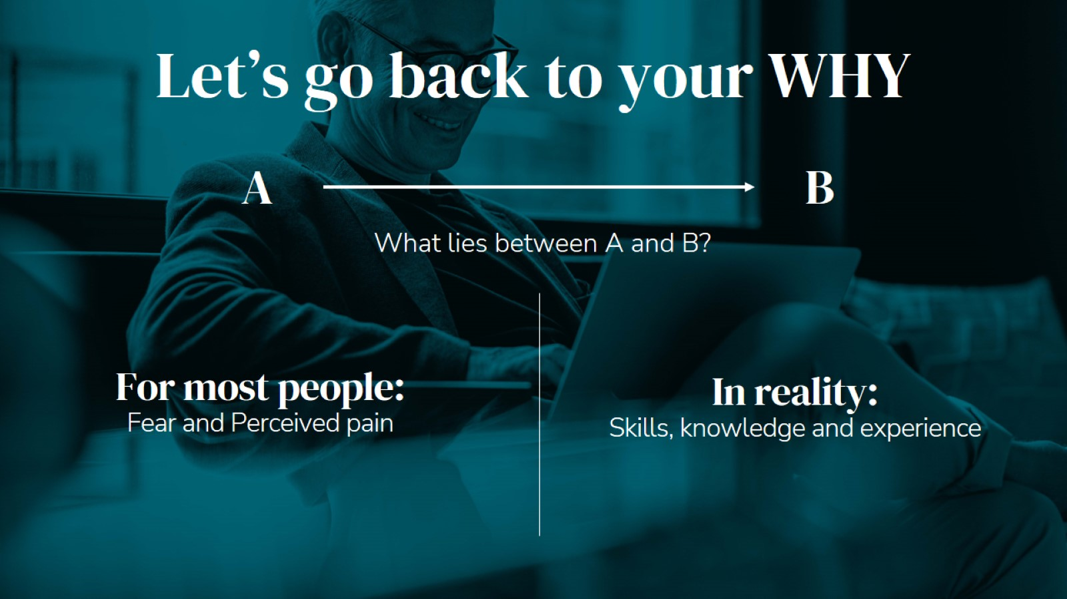
Notes:
When we realise that what is between where we are now and where we want to be is learning new skills, and applying them… it’s a light bulb moment.​
​
If more people really understood this, more people would choose to spend their time more productively by upgrading their skill sets.

Slide 17

Notes:
So what are these skills we need to learn and master? ​
​
This is the framework to cut the overwhelm. What do you need to do to develop 10/10 competence in each skill area?​
​
Rate where you’re at, with each of the skills, so then you know where to spend your time. ​
​
The good news is that when it comes to learning any profession, sport or activity, there are normally only 6 or 7 basic skills that you need to learn and master. This really helps keeps things simple.​
​
Effort and determination, coupled with hours of PRACTICE produce successful results. PRACTICE is the essential component.

Slide 18

Notes:
So, what are these skills we need to learn and master? ​
​
This is the framework to cut the overwhelm. What do you need to do to develop 10/10 competence in each skill area?​
​
Rate where you’re at, with each of the skills, so then you know where to spend your time. ​
​
The good news is that when it comes to learning any profession, sport or activity, there are normally only 6 or 7 basic skills that you need to learn and master. This really helps keeps things simple.​
​
Effort and determination, coupled with hours of PRACTICE produce successful results. PRACTICE is the essential component.

Slide 19
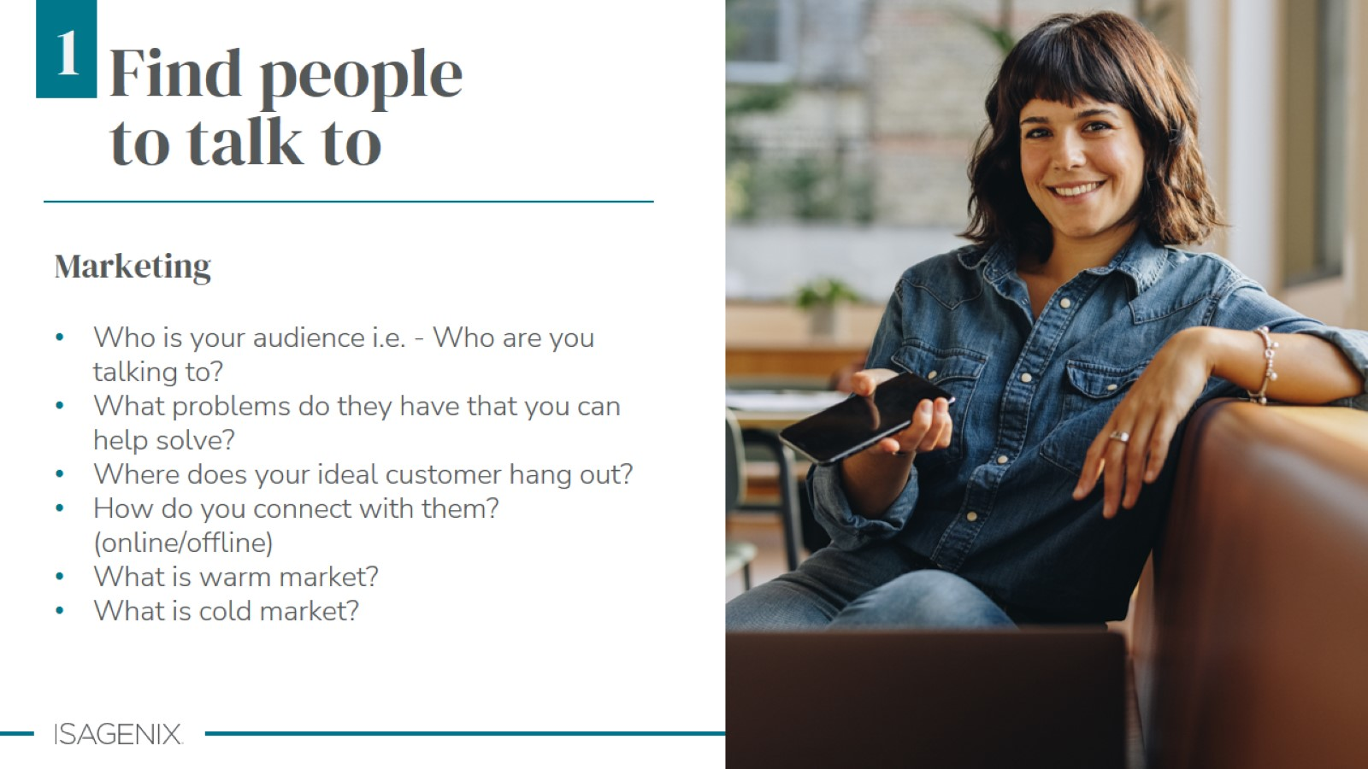
Notes:
There is no product in the world that is for everyone.​
​
We need to get clear on WHO we can help, WHAT we can help them with and HOW we can help them… and then call their name.​
​
E.g. I help women lose their last stubborn 5 kgs by showing them how to eat differently.​
E.g. I help men get in shape and look amazing for their wedding day without having to starve themselves or skip their bucks party.​
E.g. I help runners improve their times and get PBs again by providing simple and easy nutrient options.​
​
Everyone’s warm market will run dry – at that point need to learn to create new leads either by bringing cold contacts into your warm market (and warming them up) OR learning cold marketing skills

Slide 20

Notes:
Who is your Warm Market?​
Friends, relatives, neighbours, kid’s friends parents, work colleagues​
Service providers – hairdresser, dentist, doctor, physio, massage therapist, accountant​
Create curiosity on SM – but don’t be annoying.​
Pick up the phone ​

Slide 21

Notes:
What is your Cold Market?​
​
Join new organization’s – e.g. gym, yoga, toastmasters, cooking classes (goal is to warm them up)​
Start a meet group of like minded folks ​
Add new contacts to your FB​
Learn and master SM and email marketing to create leads

Slide 22

Notes:
Social media​
Differentiate warm and cold market uses ​
e.g. warm is personal profile to create curiosity, cold is learning FB advertising, niche pages, landing pages, email marketing etc.​
Your personal profile is your business – most people will scroll ten posts to get a sense of ‘who’ you are – are you trustworthy? ​
Understand high tech vs high touch

Slide 23

Notes:
These are examples of ways to grow your audience/network.​
If you don’t grow your audience you will keep saying the same thing to the same people… at some point everyone who is going to buy what you are selling.. Will have bought it.

Slide 24

Notes:
So what are these skills we need to learn and master? ​
​
This is the framework to cut the overwhelm. What do you need to do to develop 10/10 competence in each skill area?​
​
Rate where you’re at, with each of the skills, so then you know where to spend your time. ​
​
The good news is that when it comes to learning any profession, sport or activity, there are normally only 6 or 7 basic skills that you need to learn and master. This really helps keeps things simple.​
​
Effort and determination, coupled with hours of PRACTICE produce successful results. PRACTICE is the essential component.

Slide 25


Slide 26
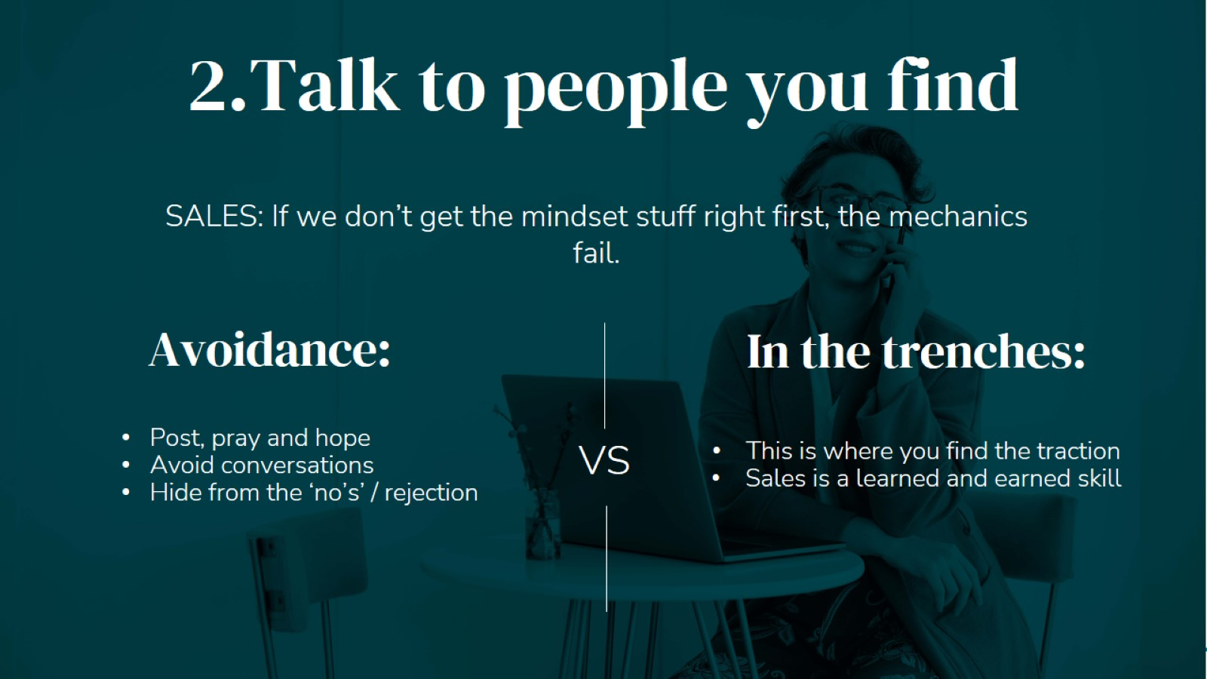

Slide 27

Notes:
Many avoid sales because they feel awkward about it and think they are aligned with sales i.e. ‘it’s not for me​
​
In reality it’s a lack of competence – of course when we aren’t good at something its feels hard, and awkward, until we get good at it.​
Ask people to share… when they think of ‘sales’ what comes up for them?​
​
Ask them to consider a more helpful perspective of sales i.e. sales is helping other people to solve a problem they have.

Slide 28


Slide 29


Slide 30


Slide 31


Slide 32


Slide 33
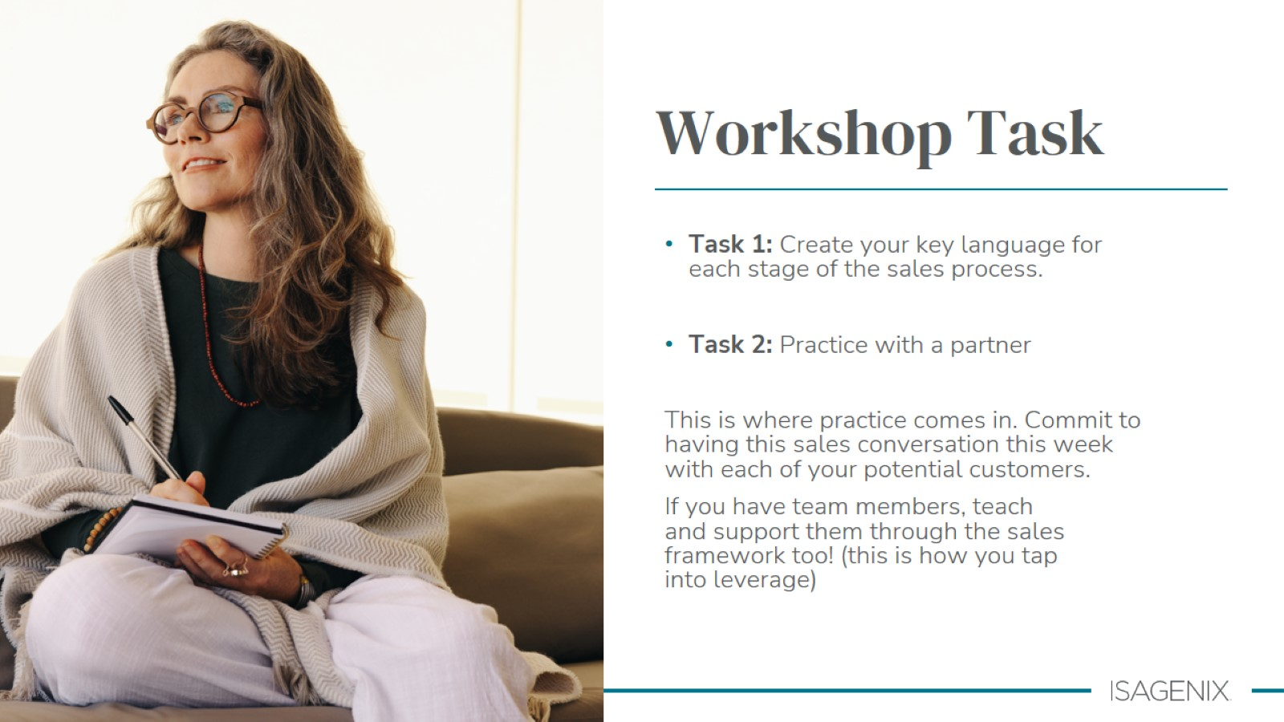

Slide 34

Notes:
So what are these skills we need to learn and master? ​
​
This is the framework to cut the overwhelm. What do you need to do to develop 10/10 competence in each skill area?​
​
Rate where you’re at, with each of the skills, so then you know where to spend your time. ​
​
The good news is that when it comes to learning any profession, sport or activity, there are normally only 6 or 7 basic skills that you need to learn and master. This really helps keeps things simple.​
​
Effort and determination, coupled with hours of PRACTICE produce successful results. PRACTICE is the essential component.

Slide 35
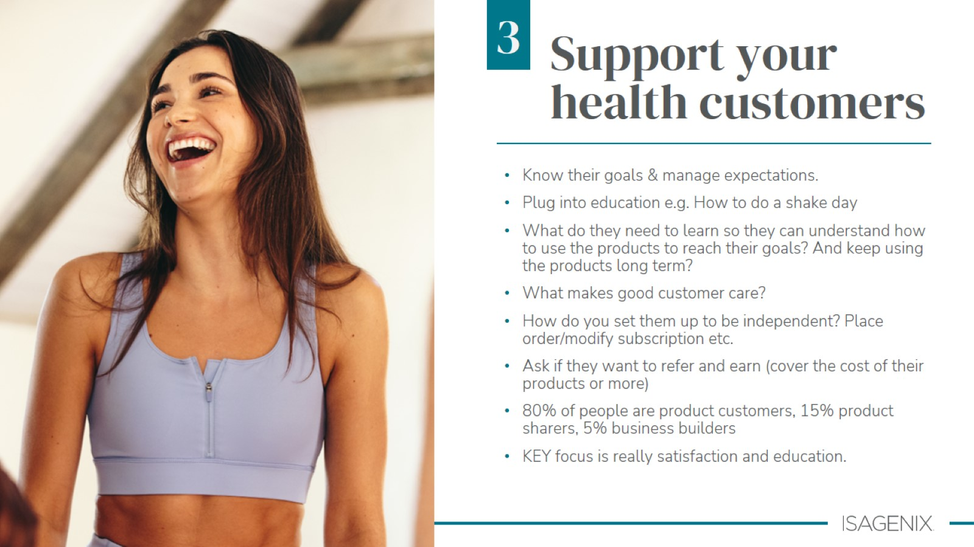
Notes:
The next skill set to develop is being able to launch your new cleanser, give them a great experience and get them going and growing.
It is normal for people to experience fear when first starting out as they have just taken a leap of faith. We all go through this. ​
Ask lots of questions. Good business people ask their customers questions so they can understand how to make it better.​
​

Slide 36


Slide 37

Notes:
So what are these skills we need to learn and master? ​
​
This is the framework to cut the overwhelm. What do you need to do to develop 10/10 competence in each skill area?​
​
Rate where you’re at, with each of the skills, so then you know where to spend your time. ​
​
The good news is that when it comes to learning any profession, sport or activity, there are normally only 6 or 7 basic skills that you need to learn and master. This really helps keeps things simple.​
​
Effort and determination, coupled with hours of PRACTICE produce successful results. PRACTICE is the essential component.

Slide 38
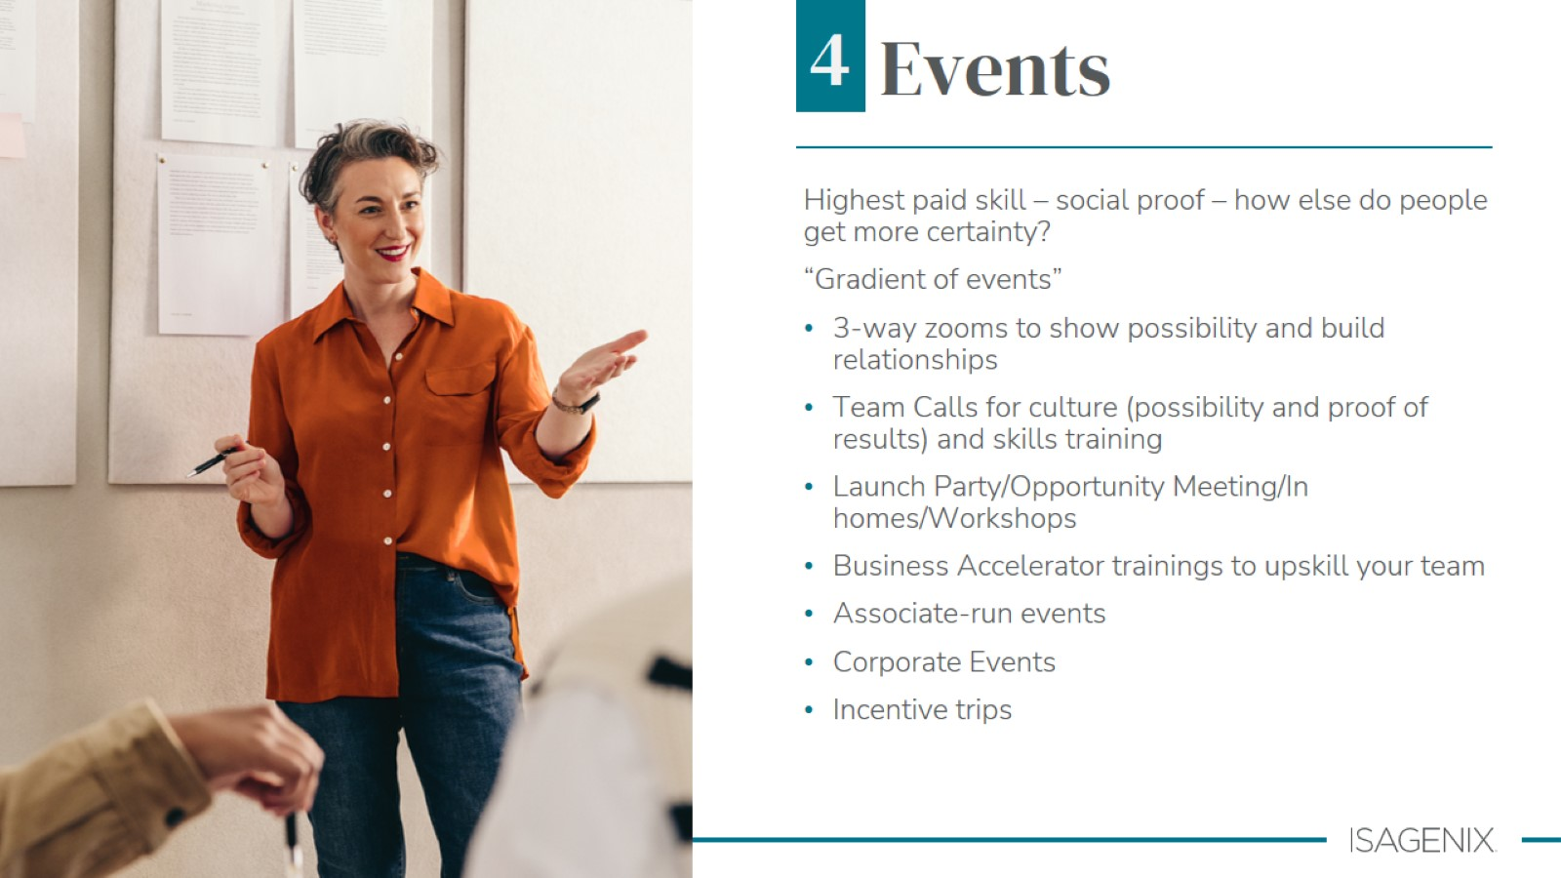
Notes:
It’s important to attend events not just for the content and what you will learn, but MORE IMPORTANTLY to renew your energy, belief, connect and bring others.​
One of the most common questions asked is "Why should I attend an event, it costs time and money".​
The reason is simple, you won’t find a Top Earner who reached their success without attending events.​
You want to see / meet leadership both from the field and the corporate executives, you need the positive ambiance to strengthen your belief system, you want to meet successful people, hear the stories.
You will come back with a much better understanding of the company, products and the business model.​
You will have a great time at all events, and time will fly by fast. But don’t just go there to “see how it is” or to “check things out.”​
You invested good money and time away from your family to get there, so make sure you maximize the experience and get as much from it as you can.​
“Imagine being in a room with 6000 other people all with the same dream – proving you’re not the only one”

Slide 39

Notes:
Hint: Inviting to events is the same sales process you have already learned​
Running events – what do people need to learn so they can achieve more success?​

Slide 40


Slide 41

Notes:
So what are these skills we need to learn and master? ​
​
This is the framework to cut the overwhelm. What do you need to do to develop 10/10 competence in each skill area?​
​
Rate where you’re at, with each of the skills, so then you know where to spend your time. ​
​
The good news is that when it comes to learning any profession, sport or activity, there are normally only 6 or 7 basic skills that you need to learn and master. This really helps keeps things simple.​
​
Effort and determination, coupled with hours of PRACTICE produce successful results. PRACTICE is the essential component.

Slide 42
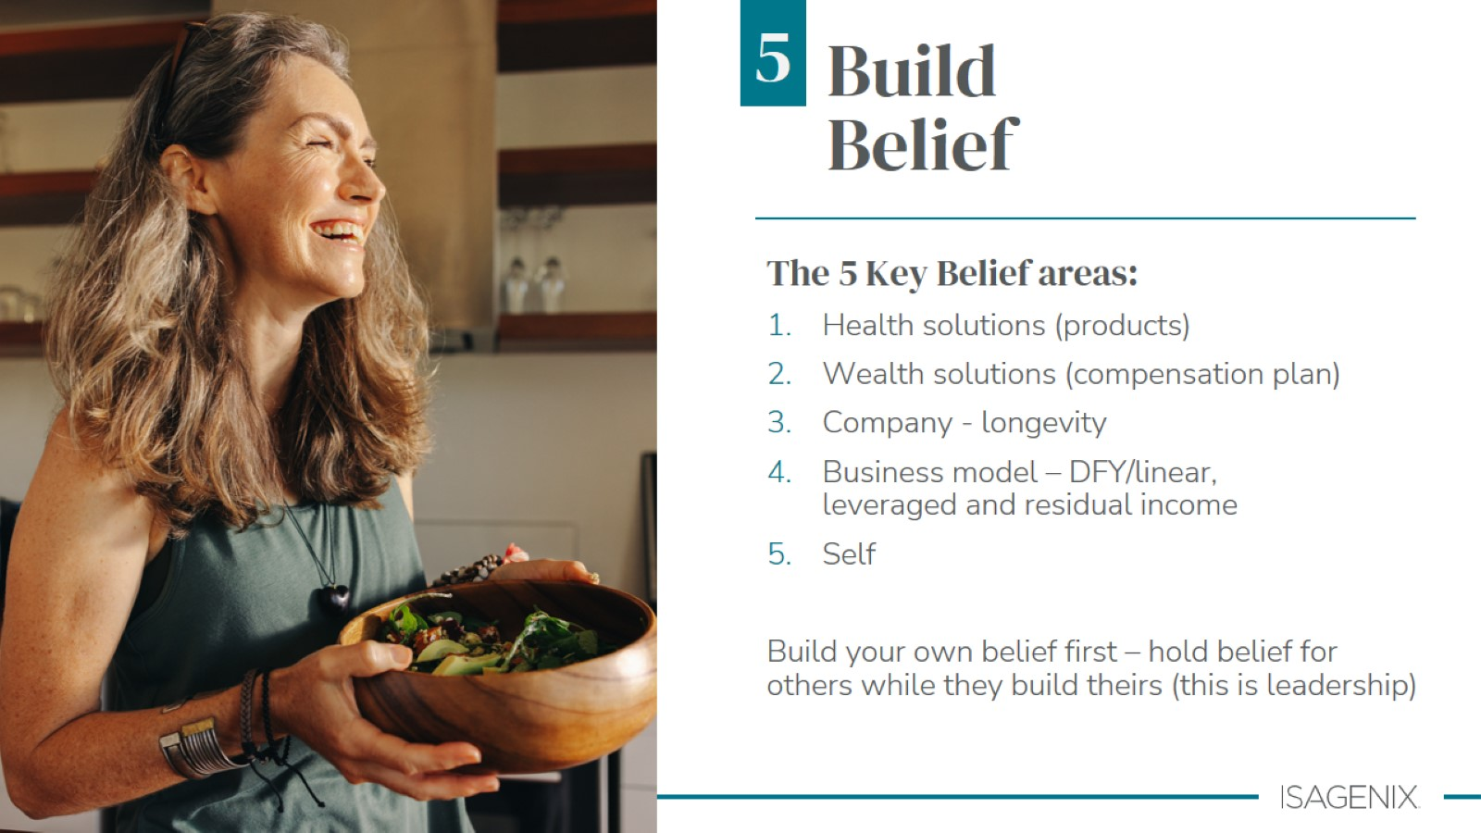

Slide 43


Slide 44


Slide 45
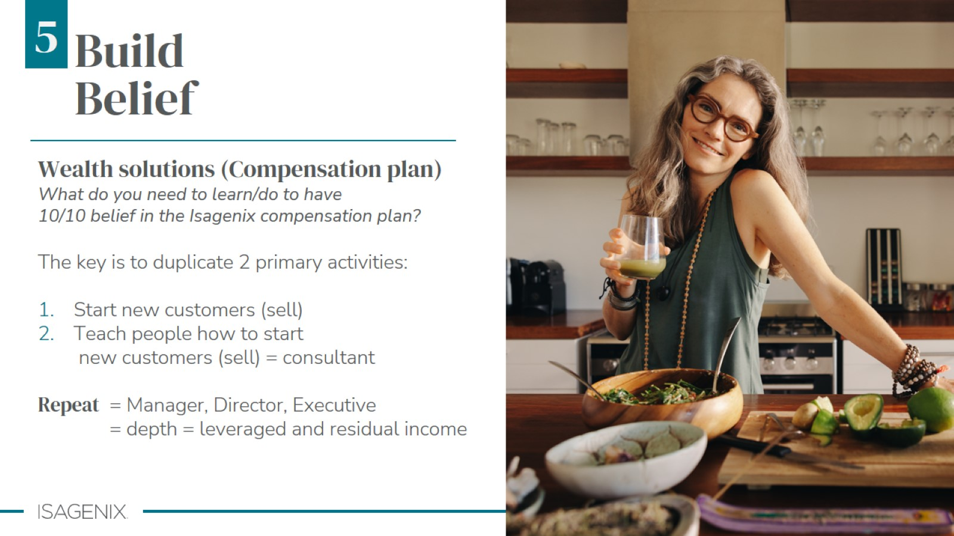

Slide 46
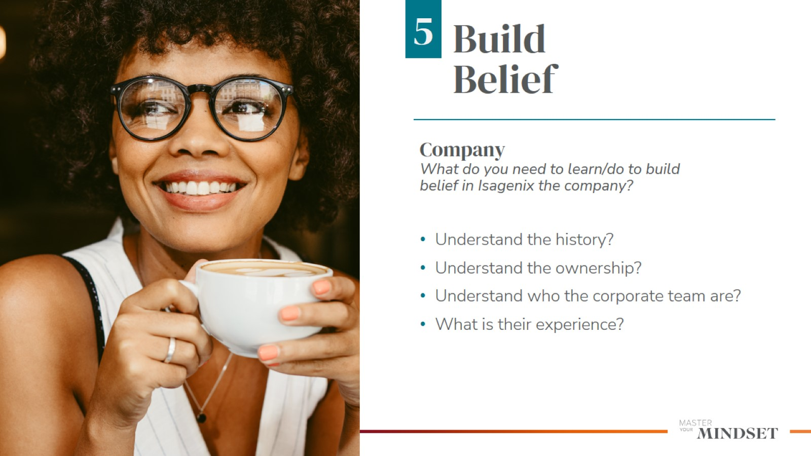

Slide 47


Slide 48
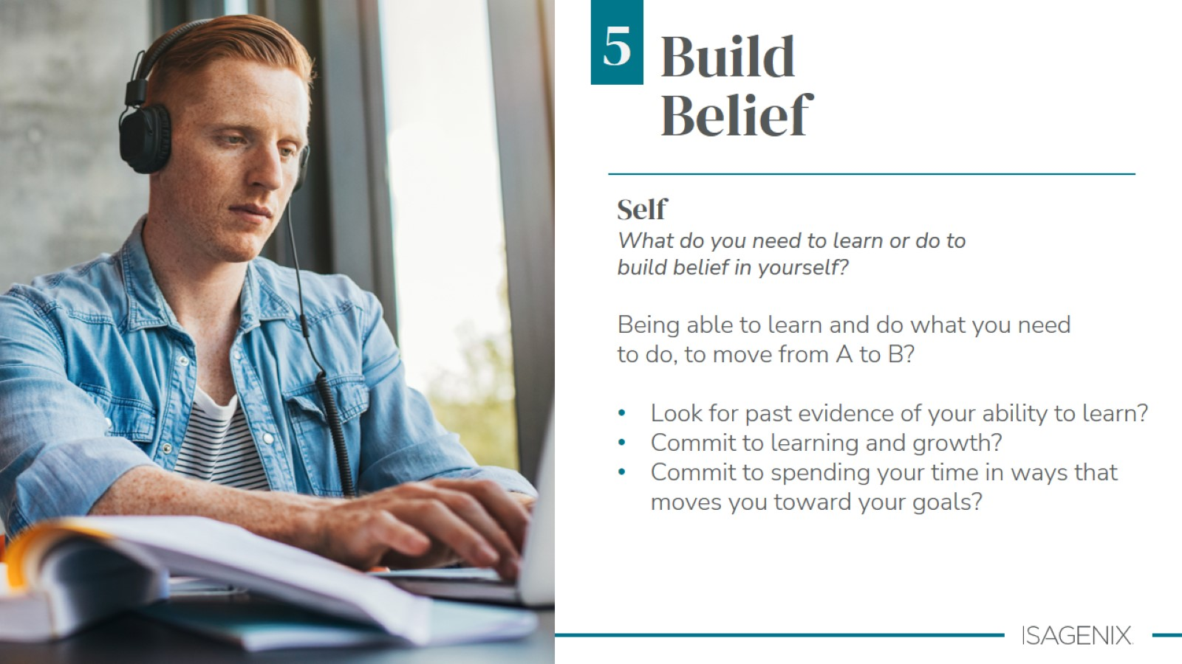

Slide 49
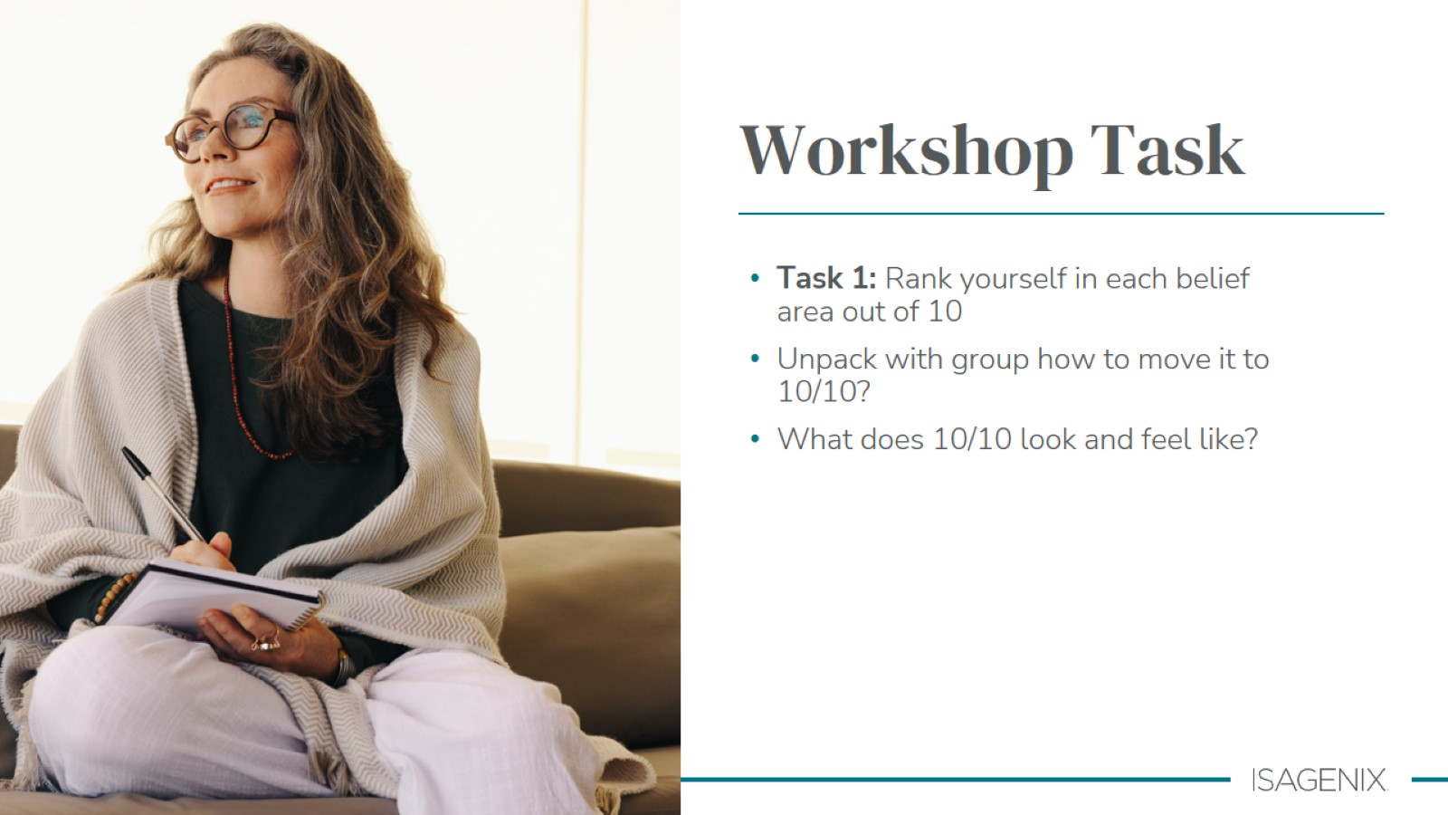

Slide 50

Notes:
So what are these skills we need to learn and master? ​
​
This is the framework to cut the overwhelm. What do you need to do to develop 10/10 competence in each skill area?​
​
Rate where you’re at, with each of the skills, so then you know where to spend your time. ​
​
The good news is that when it comes to learning any profession, sport or activity, there are normally only 6 or 7 basic skills that you need to learn and master. This really helps keeps things simple.​
​
Effort and determination, coupled with hours of PRACTICE produce successful results. PRACTICE is the essential component.

Slide 51


Slide 52


Slide 53


Slide 54
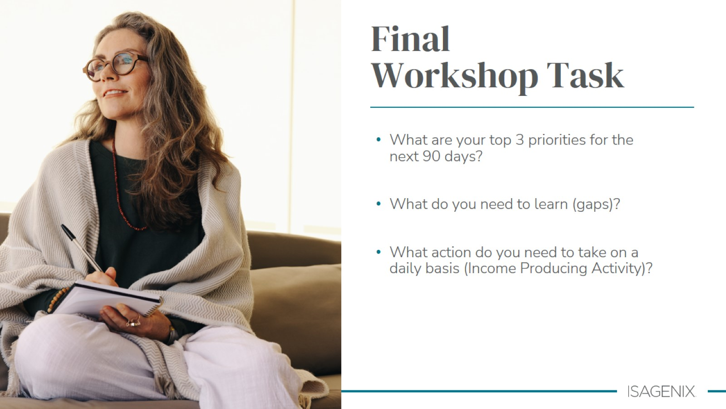
Notes:
IPA = income producing activity​

Slide 55


