Slide 1

Sharing Collagen Elixir™
G L O W W H I L E Y O U R I N C O M E G R O W S

Slide 2
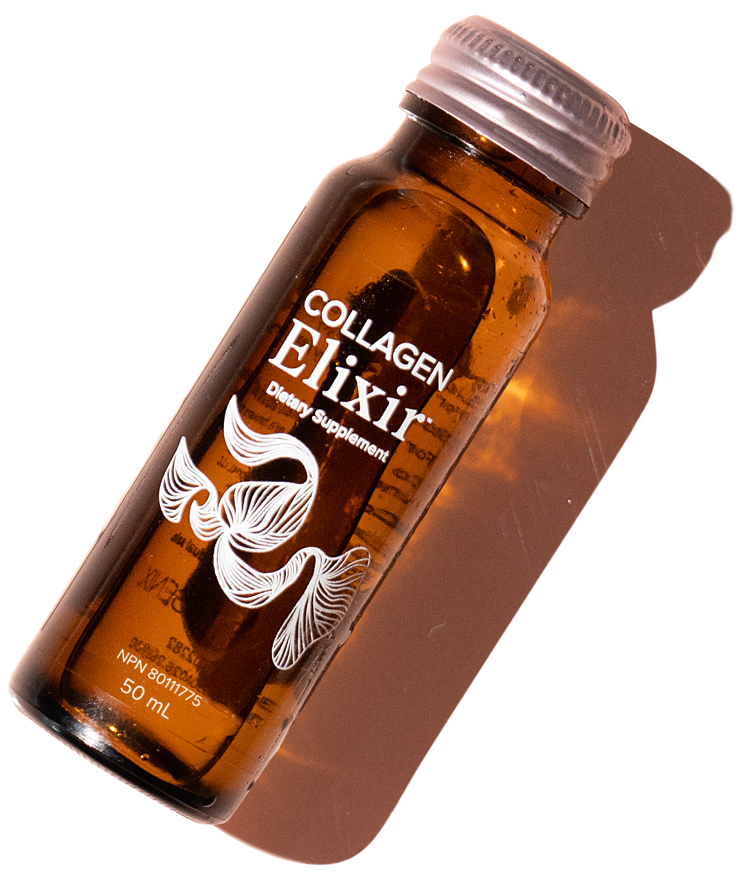

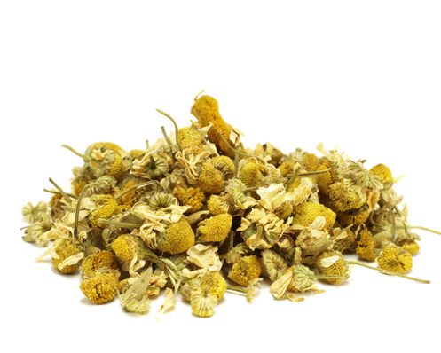
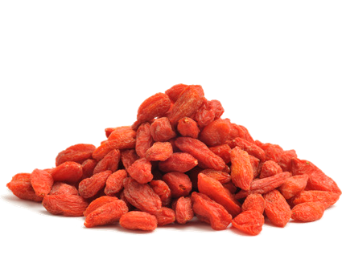

One-Of-A-Kind Product
What makes Collagen Elixir™ so special?
THE INGREDIENTS
5 grams of marine collagen peptides
Collagen supports healthy hair, skin, and nails
Vitamin C and zinc
To help protect precious cells and help promote collagen synthesis
Beaming biotin
A fantastic boost for your hair and nails
0 grams of added sugar Nature's own sweetness infused with wild berries and a hint of botanicals
Ancient botanical blend
A botanical blend of chamomile, acerola
berry, aloe vera, and goji berry pack a
powerful punch
Rich in amino acids
Helps support a healthy radiant glow
ALOE VERA
ACEROLA BERRY
GOJI BERRY
CHAMOMILE

Slide 3
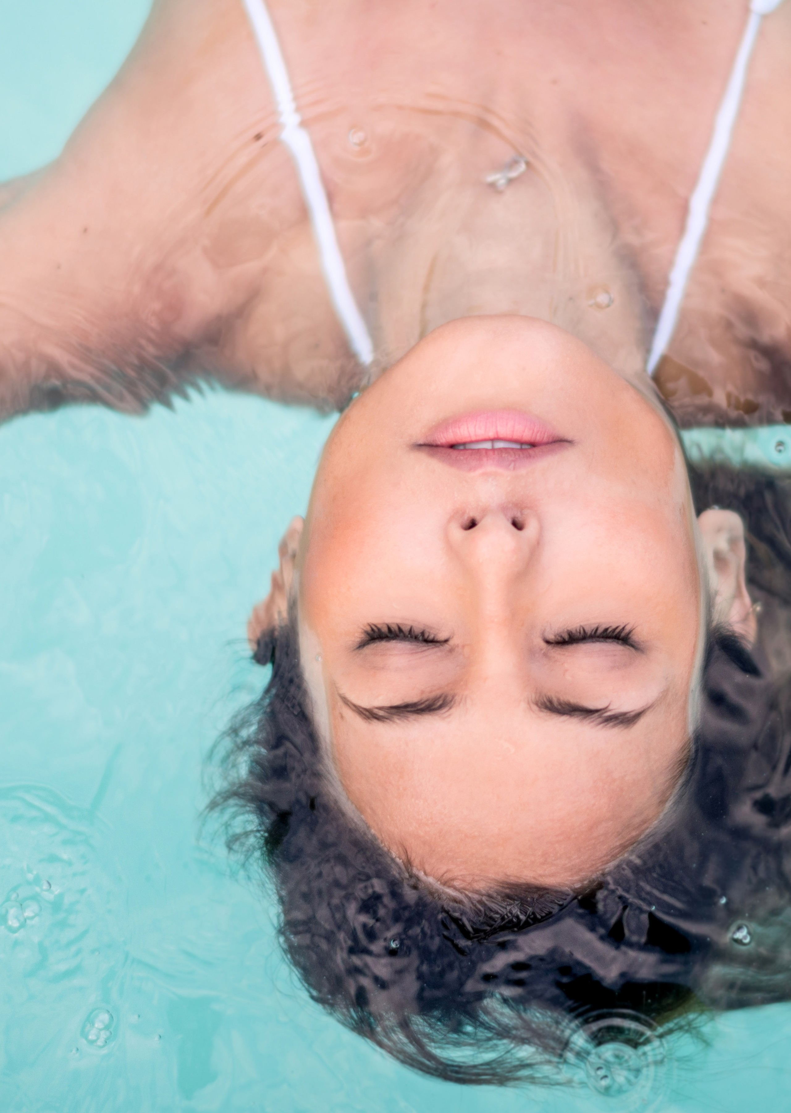
One-Of-A-Kind Product
What makes Collagen Elixir™ so special?
RESEARCH BACKING & SUSTAINABILITY
10 years of research
By 200 scientists and 50 doctors
Specialized packaging
Single-serving, 100% recyclable glass bottle to prevent oxidation
Proprietary manufacturing
Bottled in 0.15 seconds to maximize and maintain potency
5 grams of responsibly sourced marine collagen
To closely match human collagen for better absorption

Slide 4
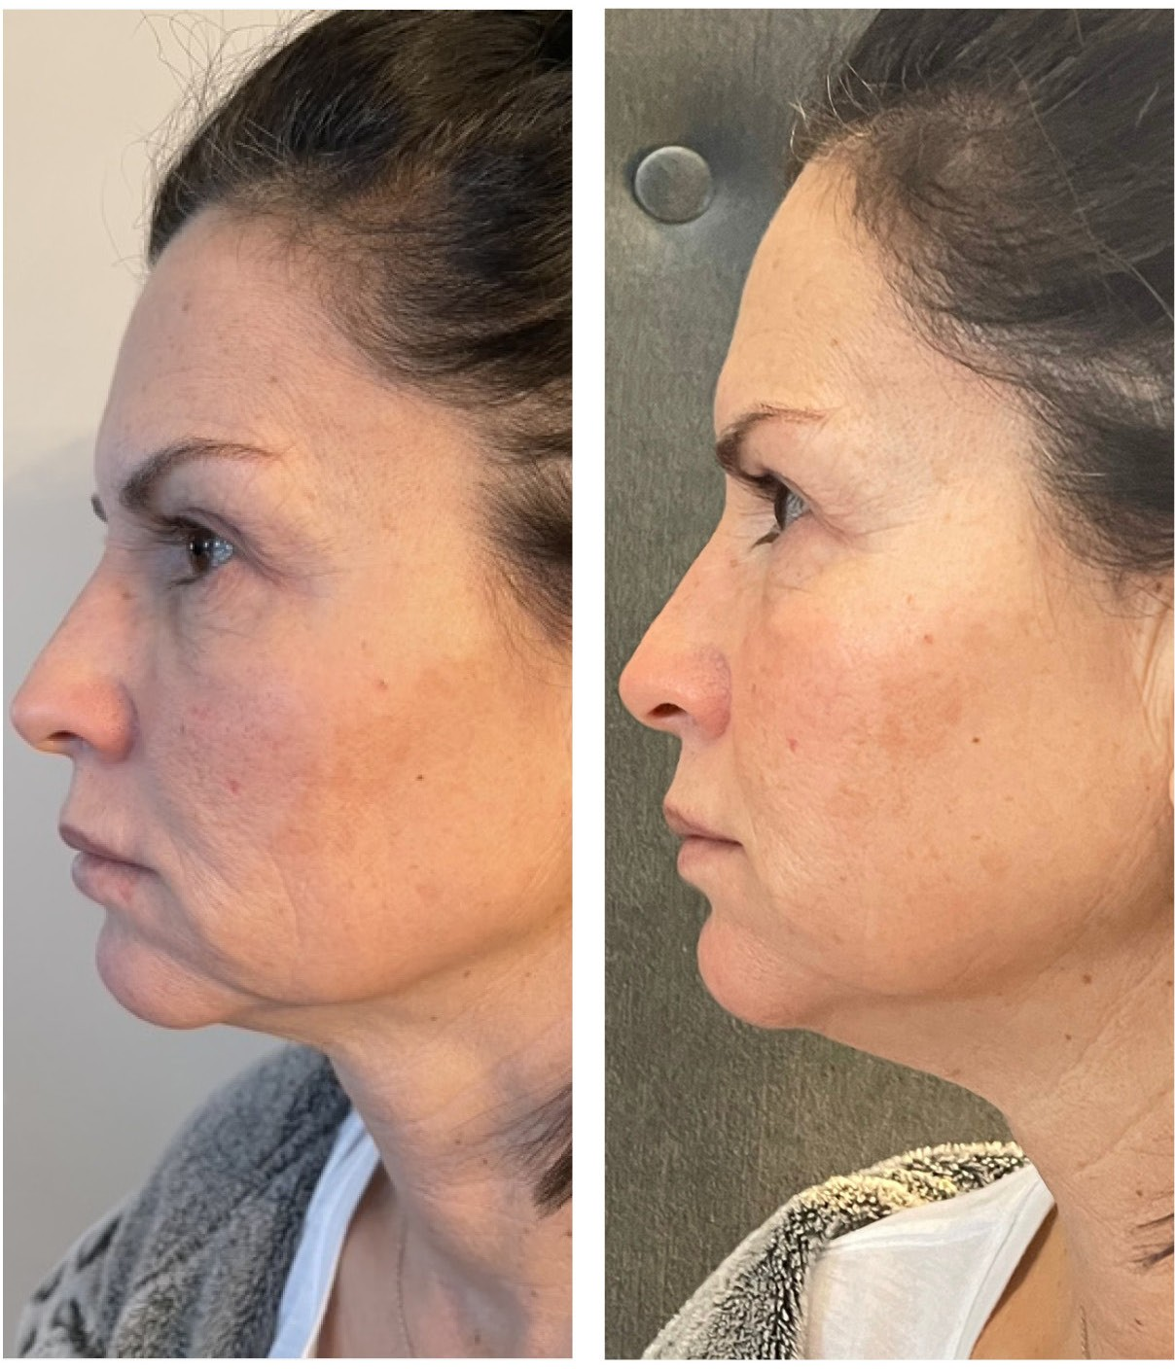
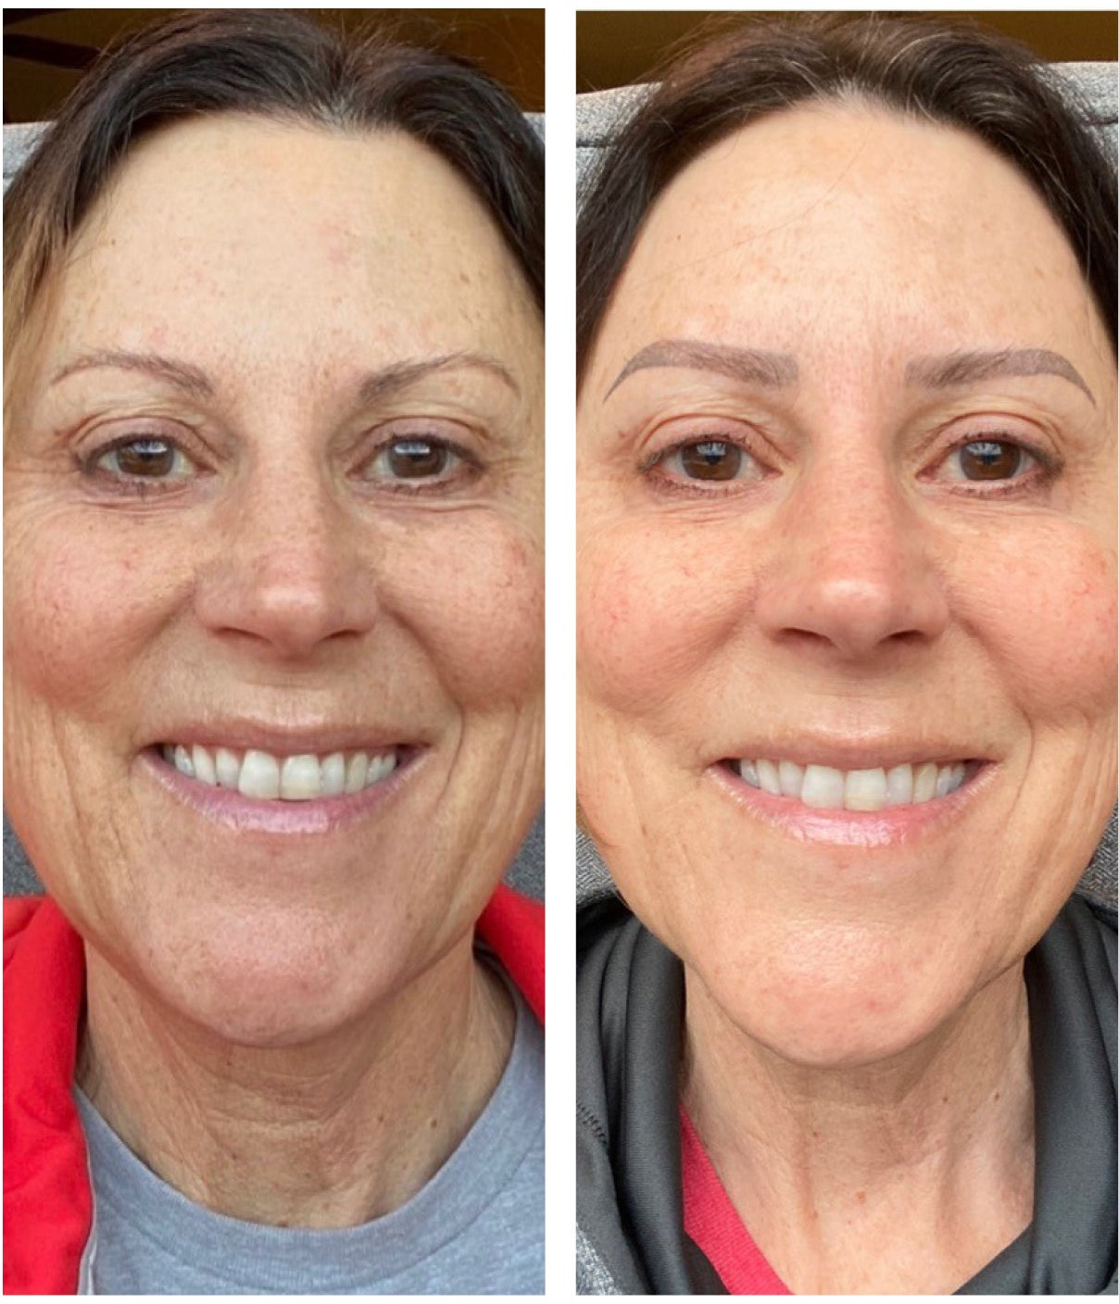
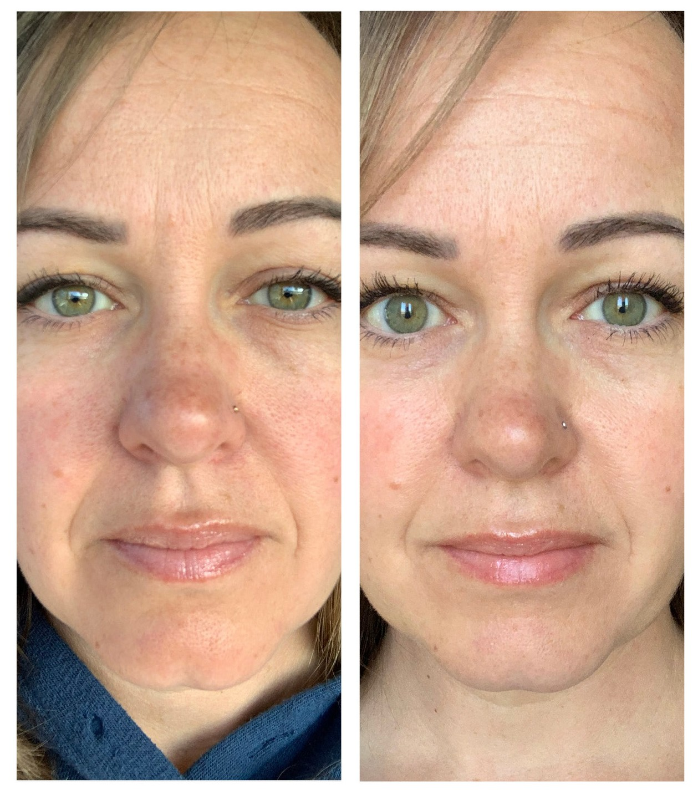
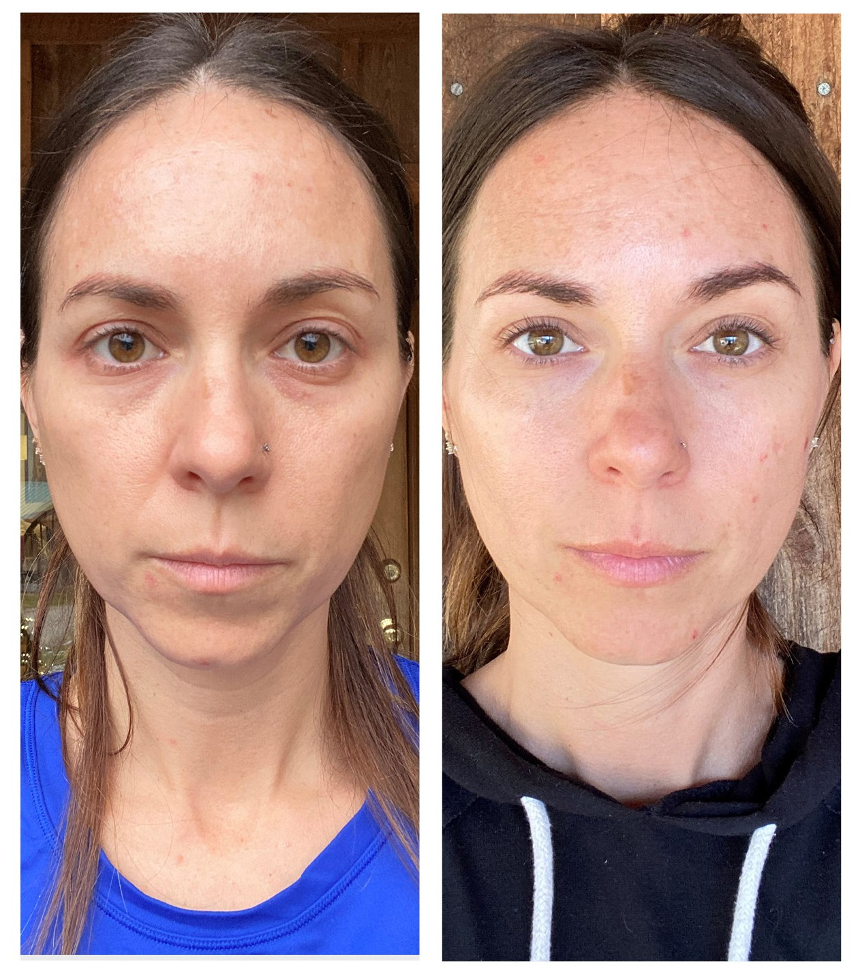
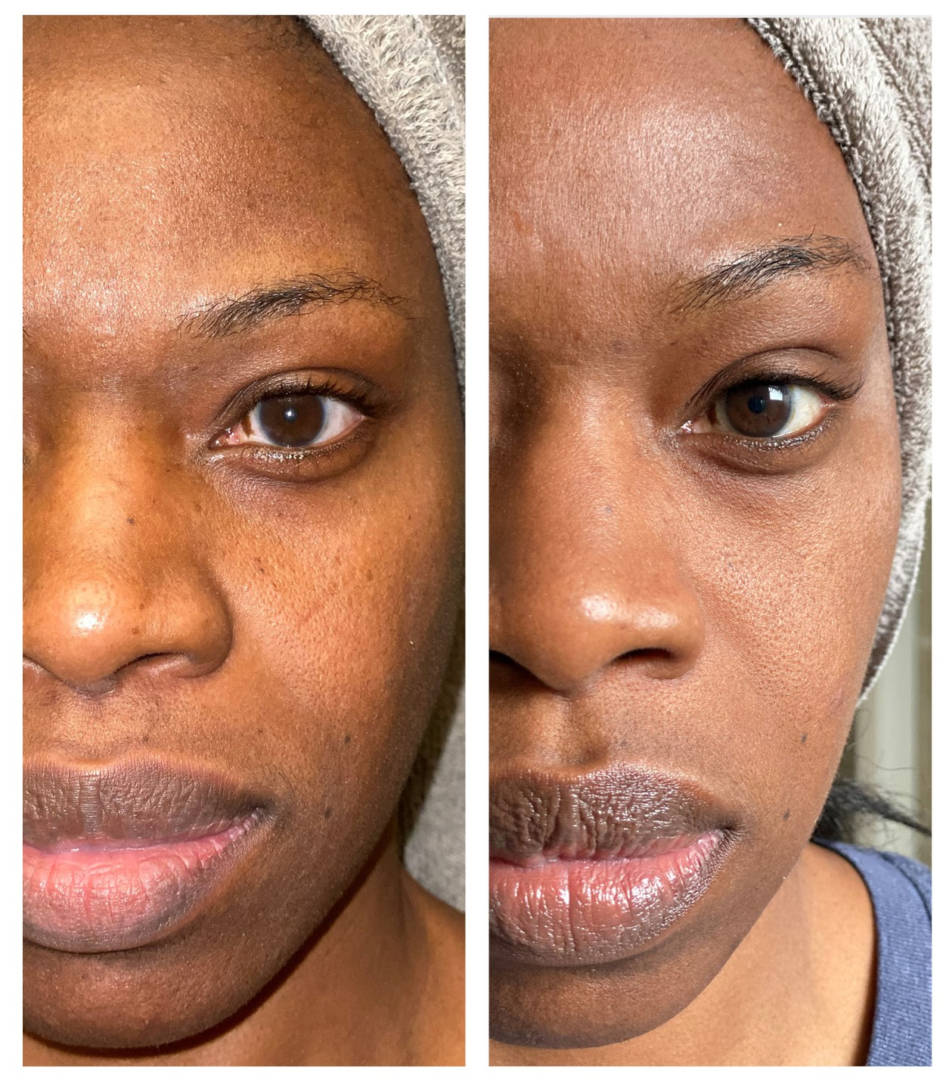
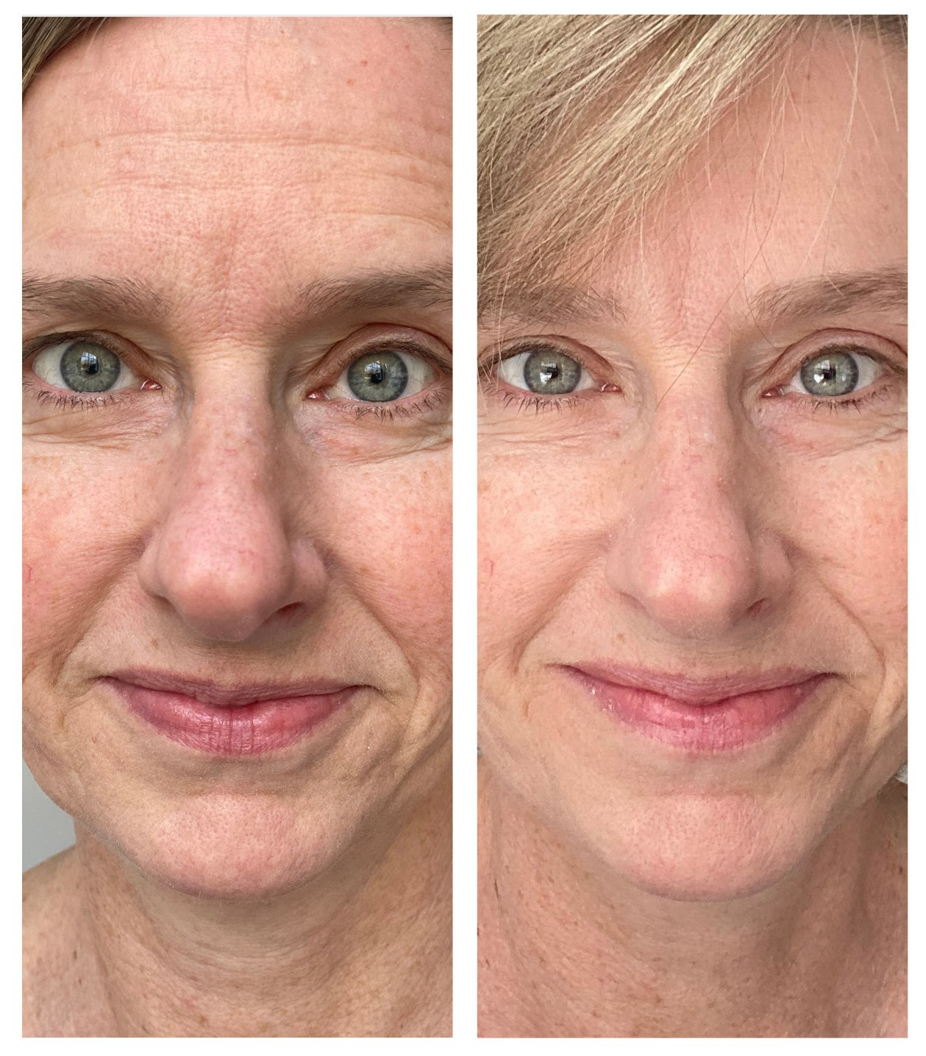
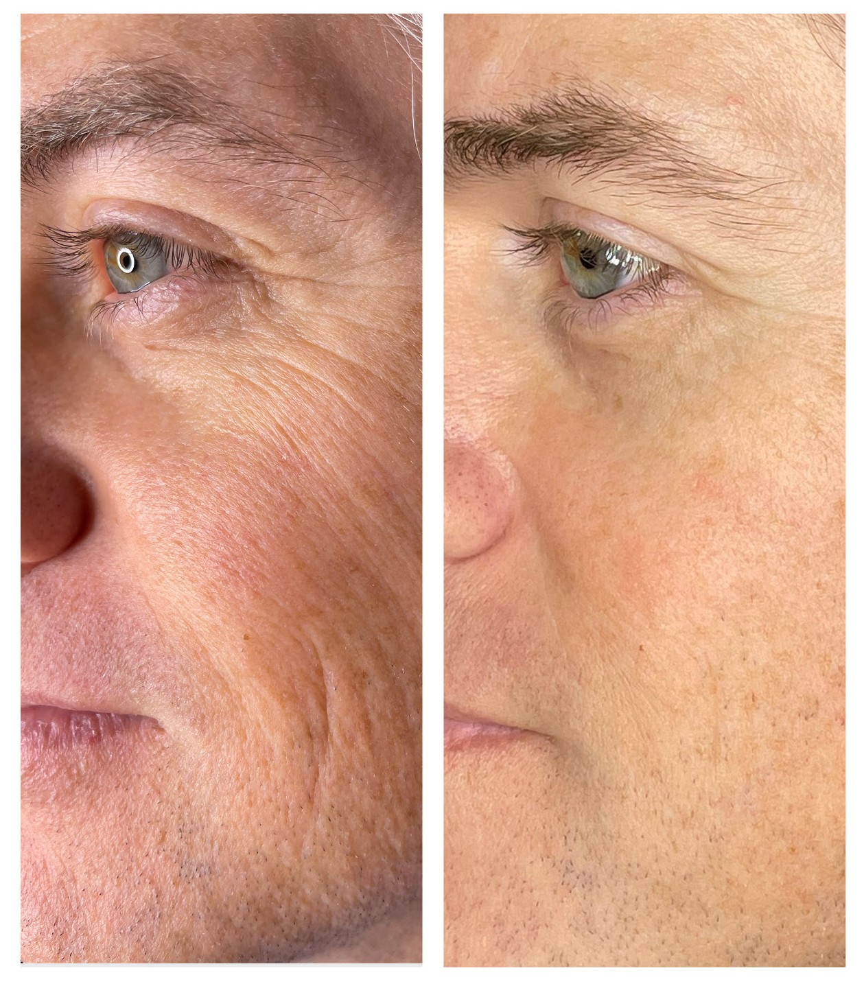
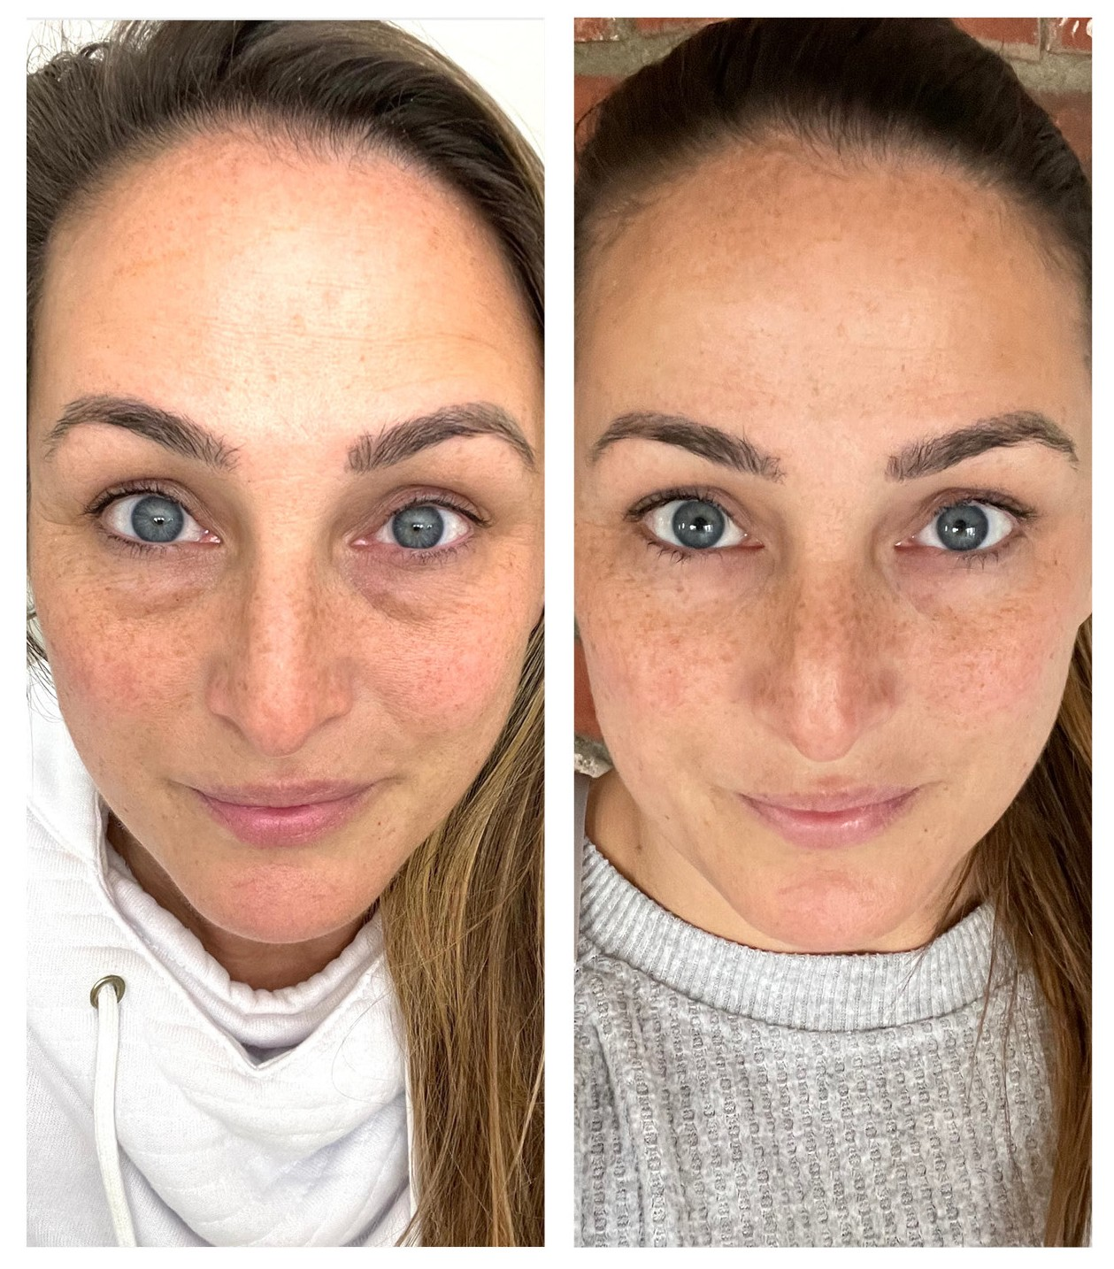
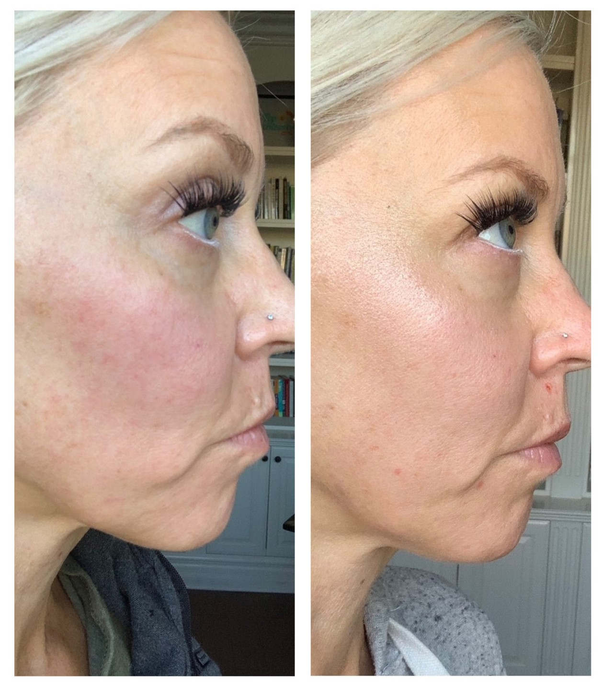
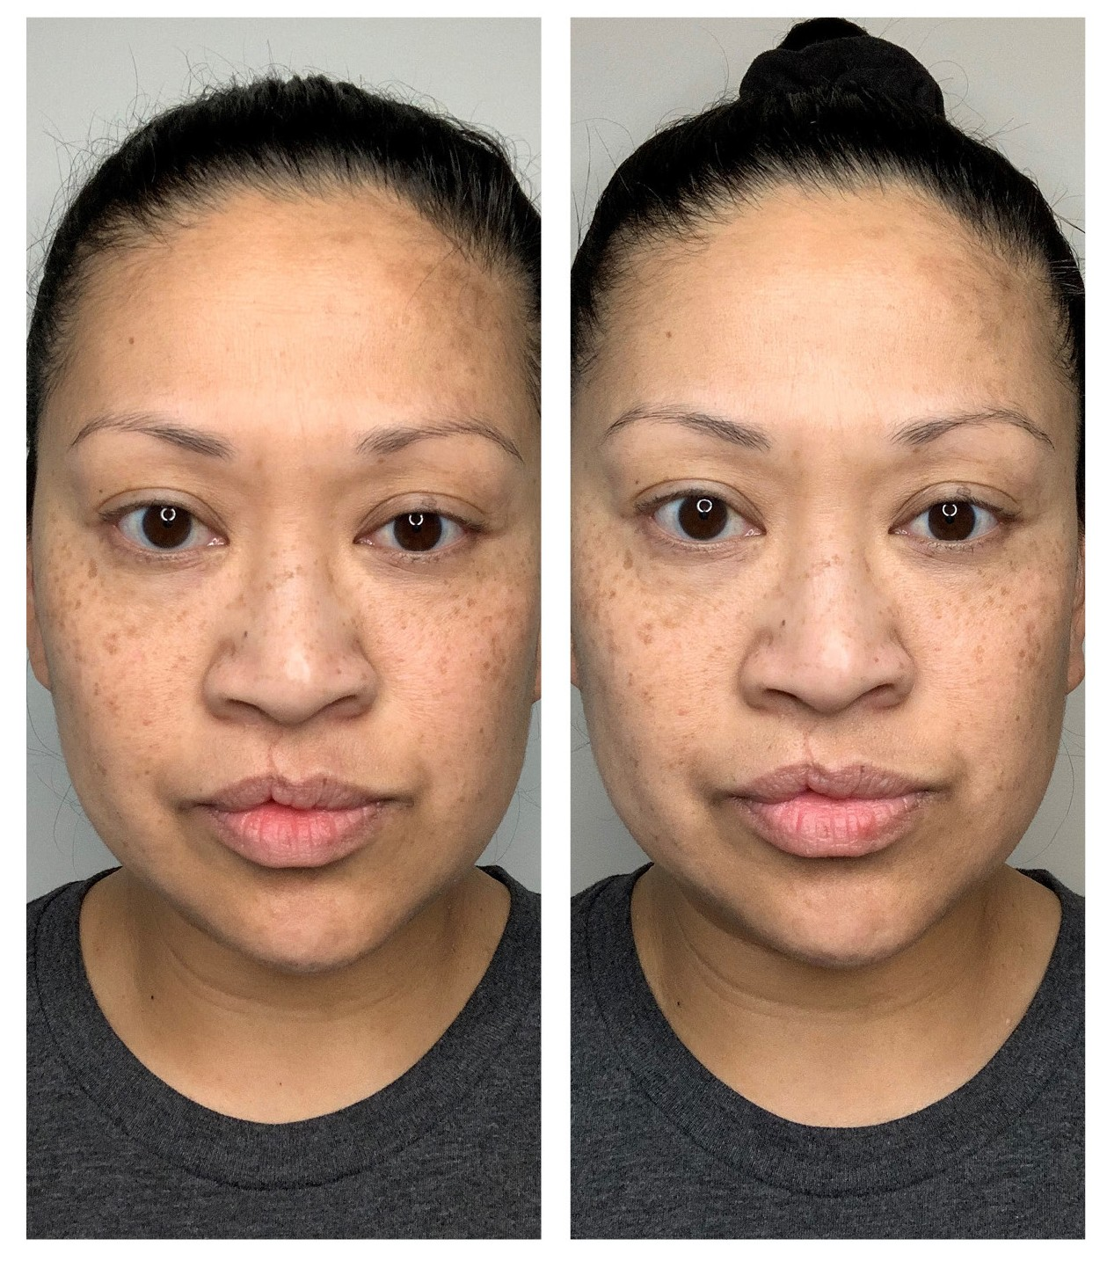
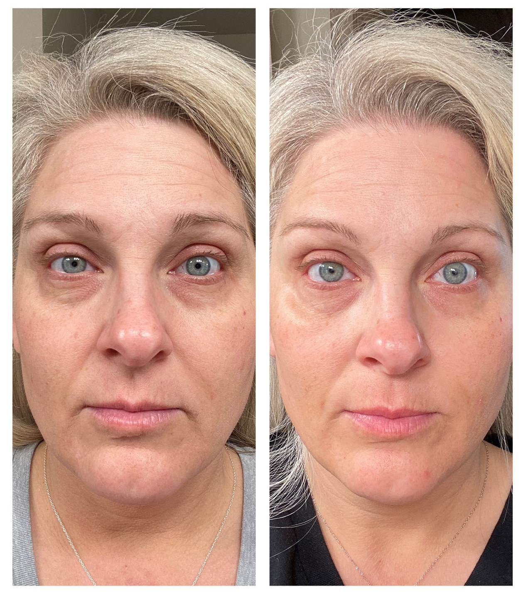
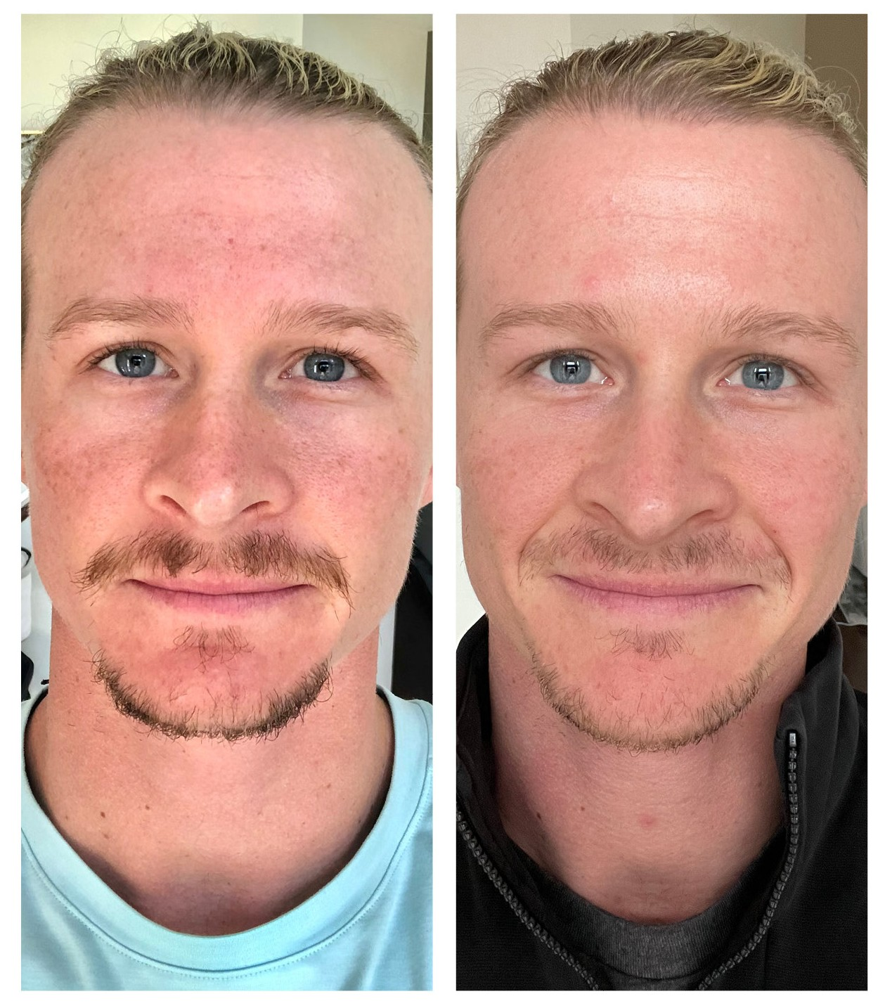
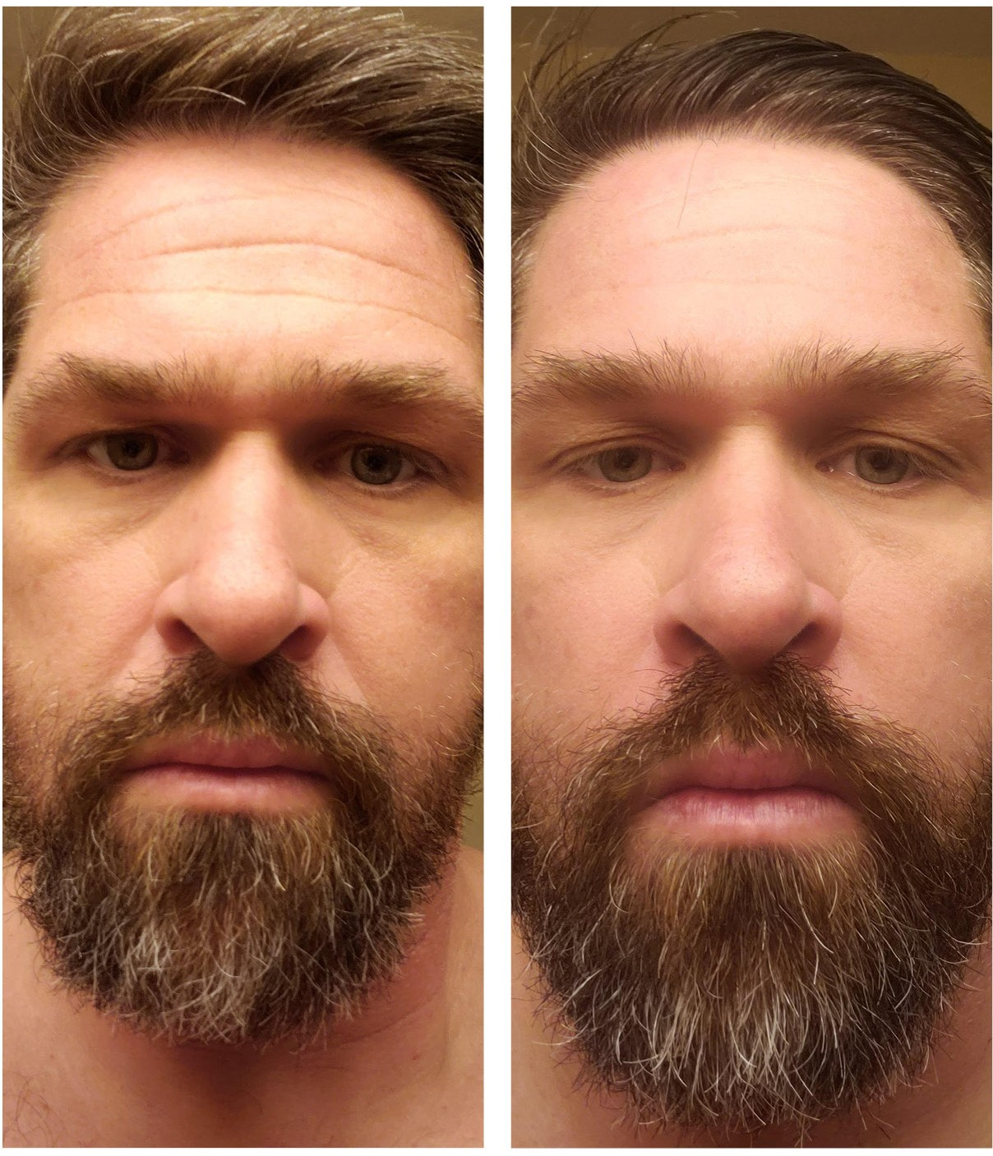
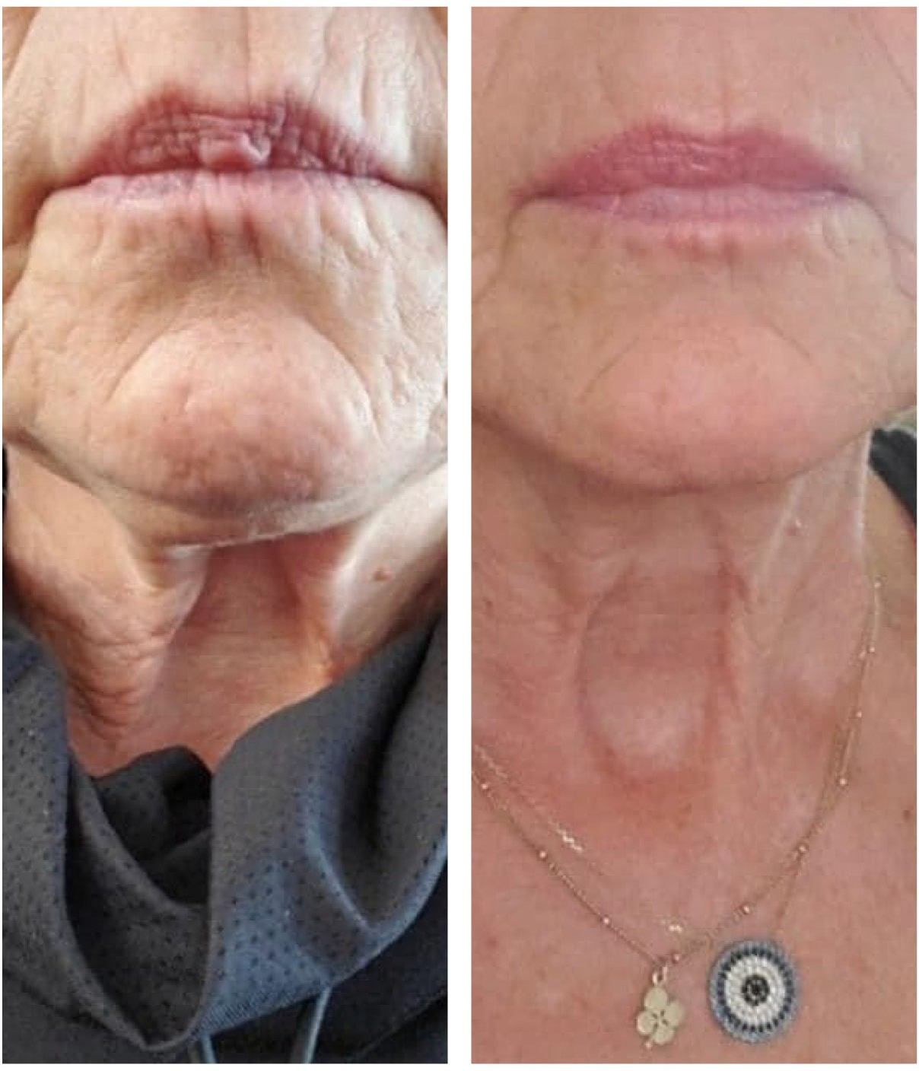
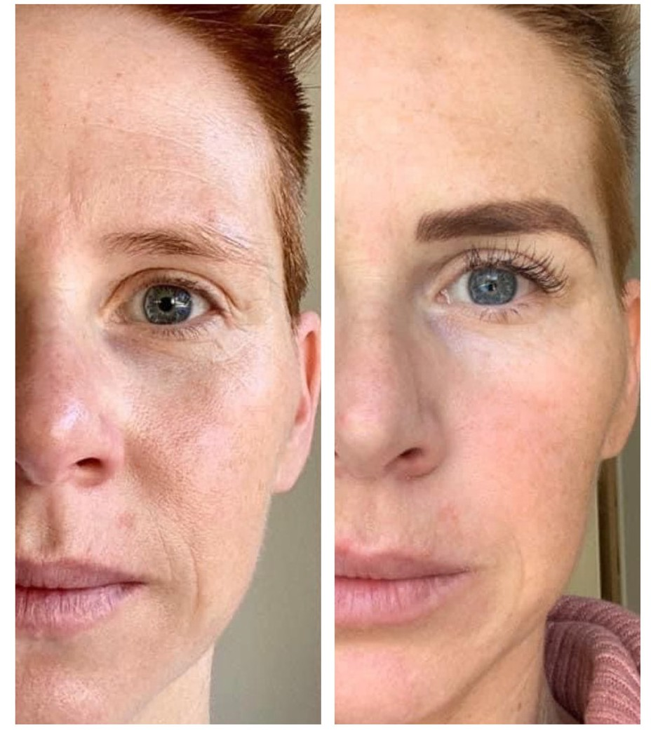
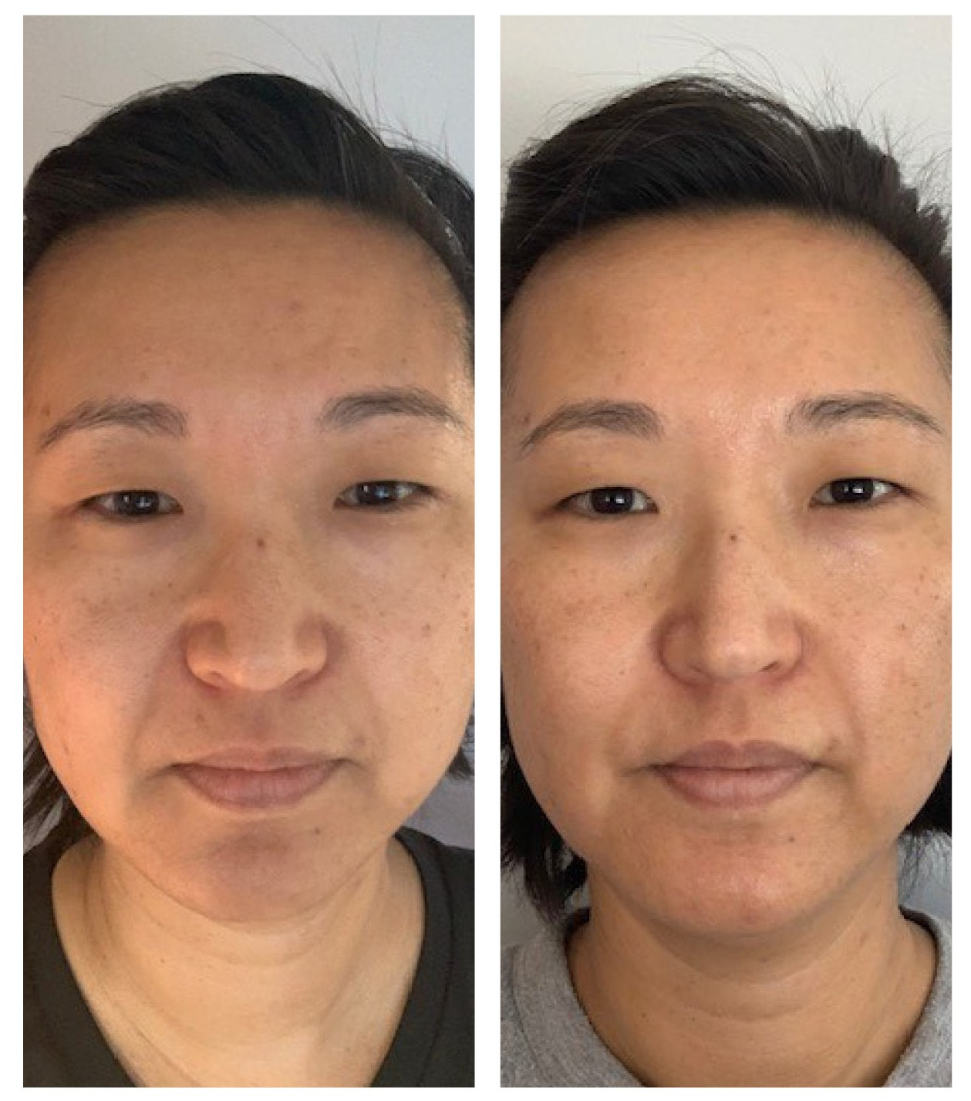
Collagen Elixir™ Results
NOTICEABLE RESULTS IN THE FIRST 30 DAYS*
93% : Improved hydration
92% : Healthier skin
91% : Youthful complexion 90% : More radiant skin 88% : Improved brightness 83% : Improved firmness
Results depicted are those of Isagenix Customers who used Collagen Elixir along with a skincare and supplement routine for 30 days with daily use. Results not typical. In a preliminary study, participants experienced a 9.5% reduction in the appearance of wrinkles over 30 days.
*Individual results may vary. Statistics are based on a survey of 113 participants who used Isagenix Collagen Elixir consecutively for at least 30 days without cosmetic intervention or other known changes to their regular skincare products. The survey participants included Isagenix Independent Associates, who are eligible to earn a commission for sales of Isagenix products.

Slide 5
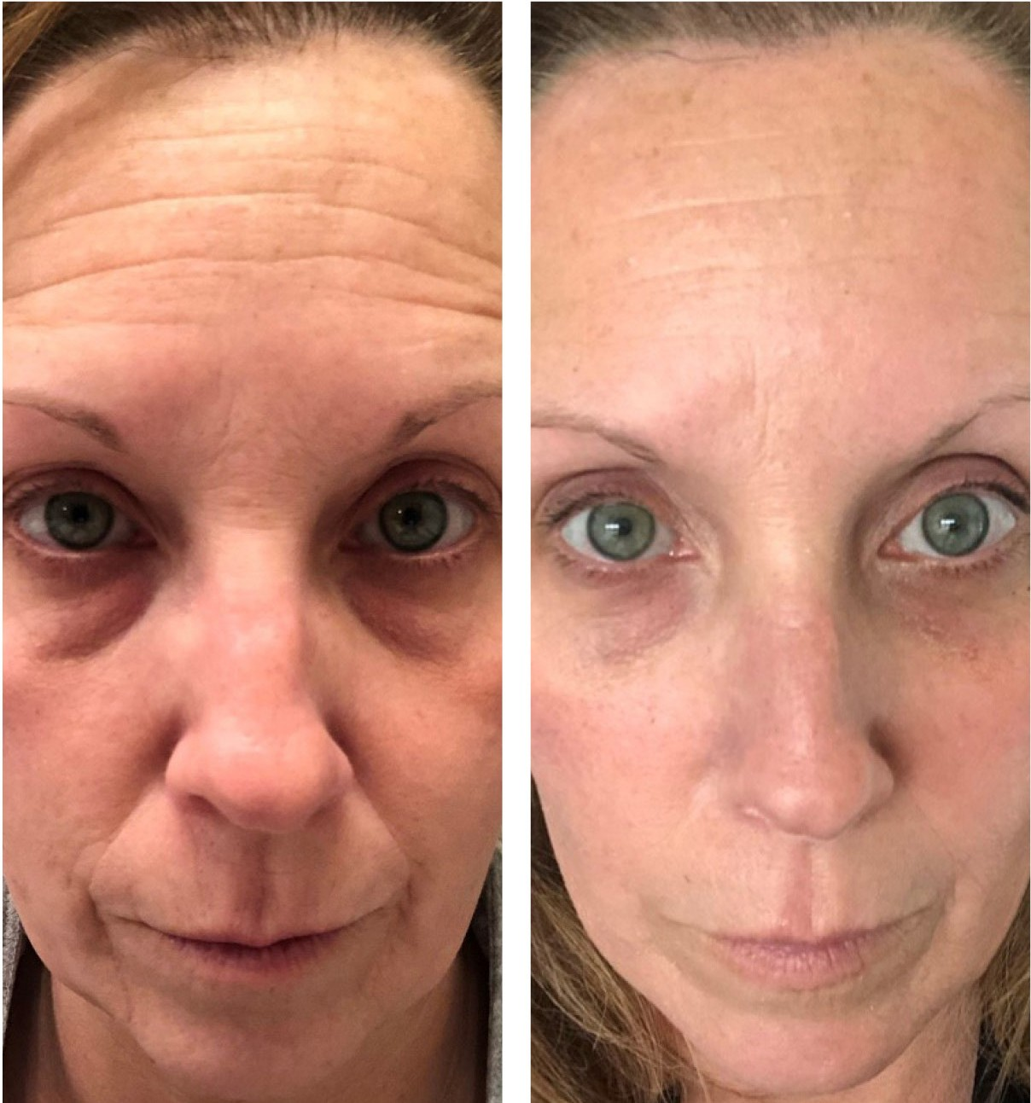
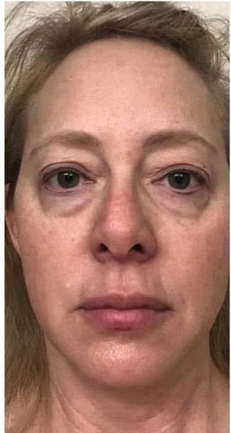
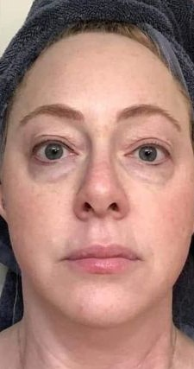
Results & Powerful Testimonials
"No fillers, no anything. This is me, raw and real! 50 days of Collagen Elixir™, and I am loving the results! This is healthy aging with the best collagen on the market. I'm 52 years old and confident!"
— Duska Mills
"My good friends were having amazing results with this liquid collagen, so I thought I'd try it despite being very skeptical since I use good product on my face somewhat routinely. The ingredients are incredible, but I never really expected this. Two words: BLOWN AWAY!"
— Dr. Jodie Harper, MD
Results depicted are those of Isagenix Customers who used Collagen Elixir along with a skincare and supplement routine for at least 30 days with daily use. Results not typical. In a preliminary study, participants experienced a 9.5% reduction in the appearance of wrinkles over 30 days.

Slide 6
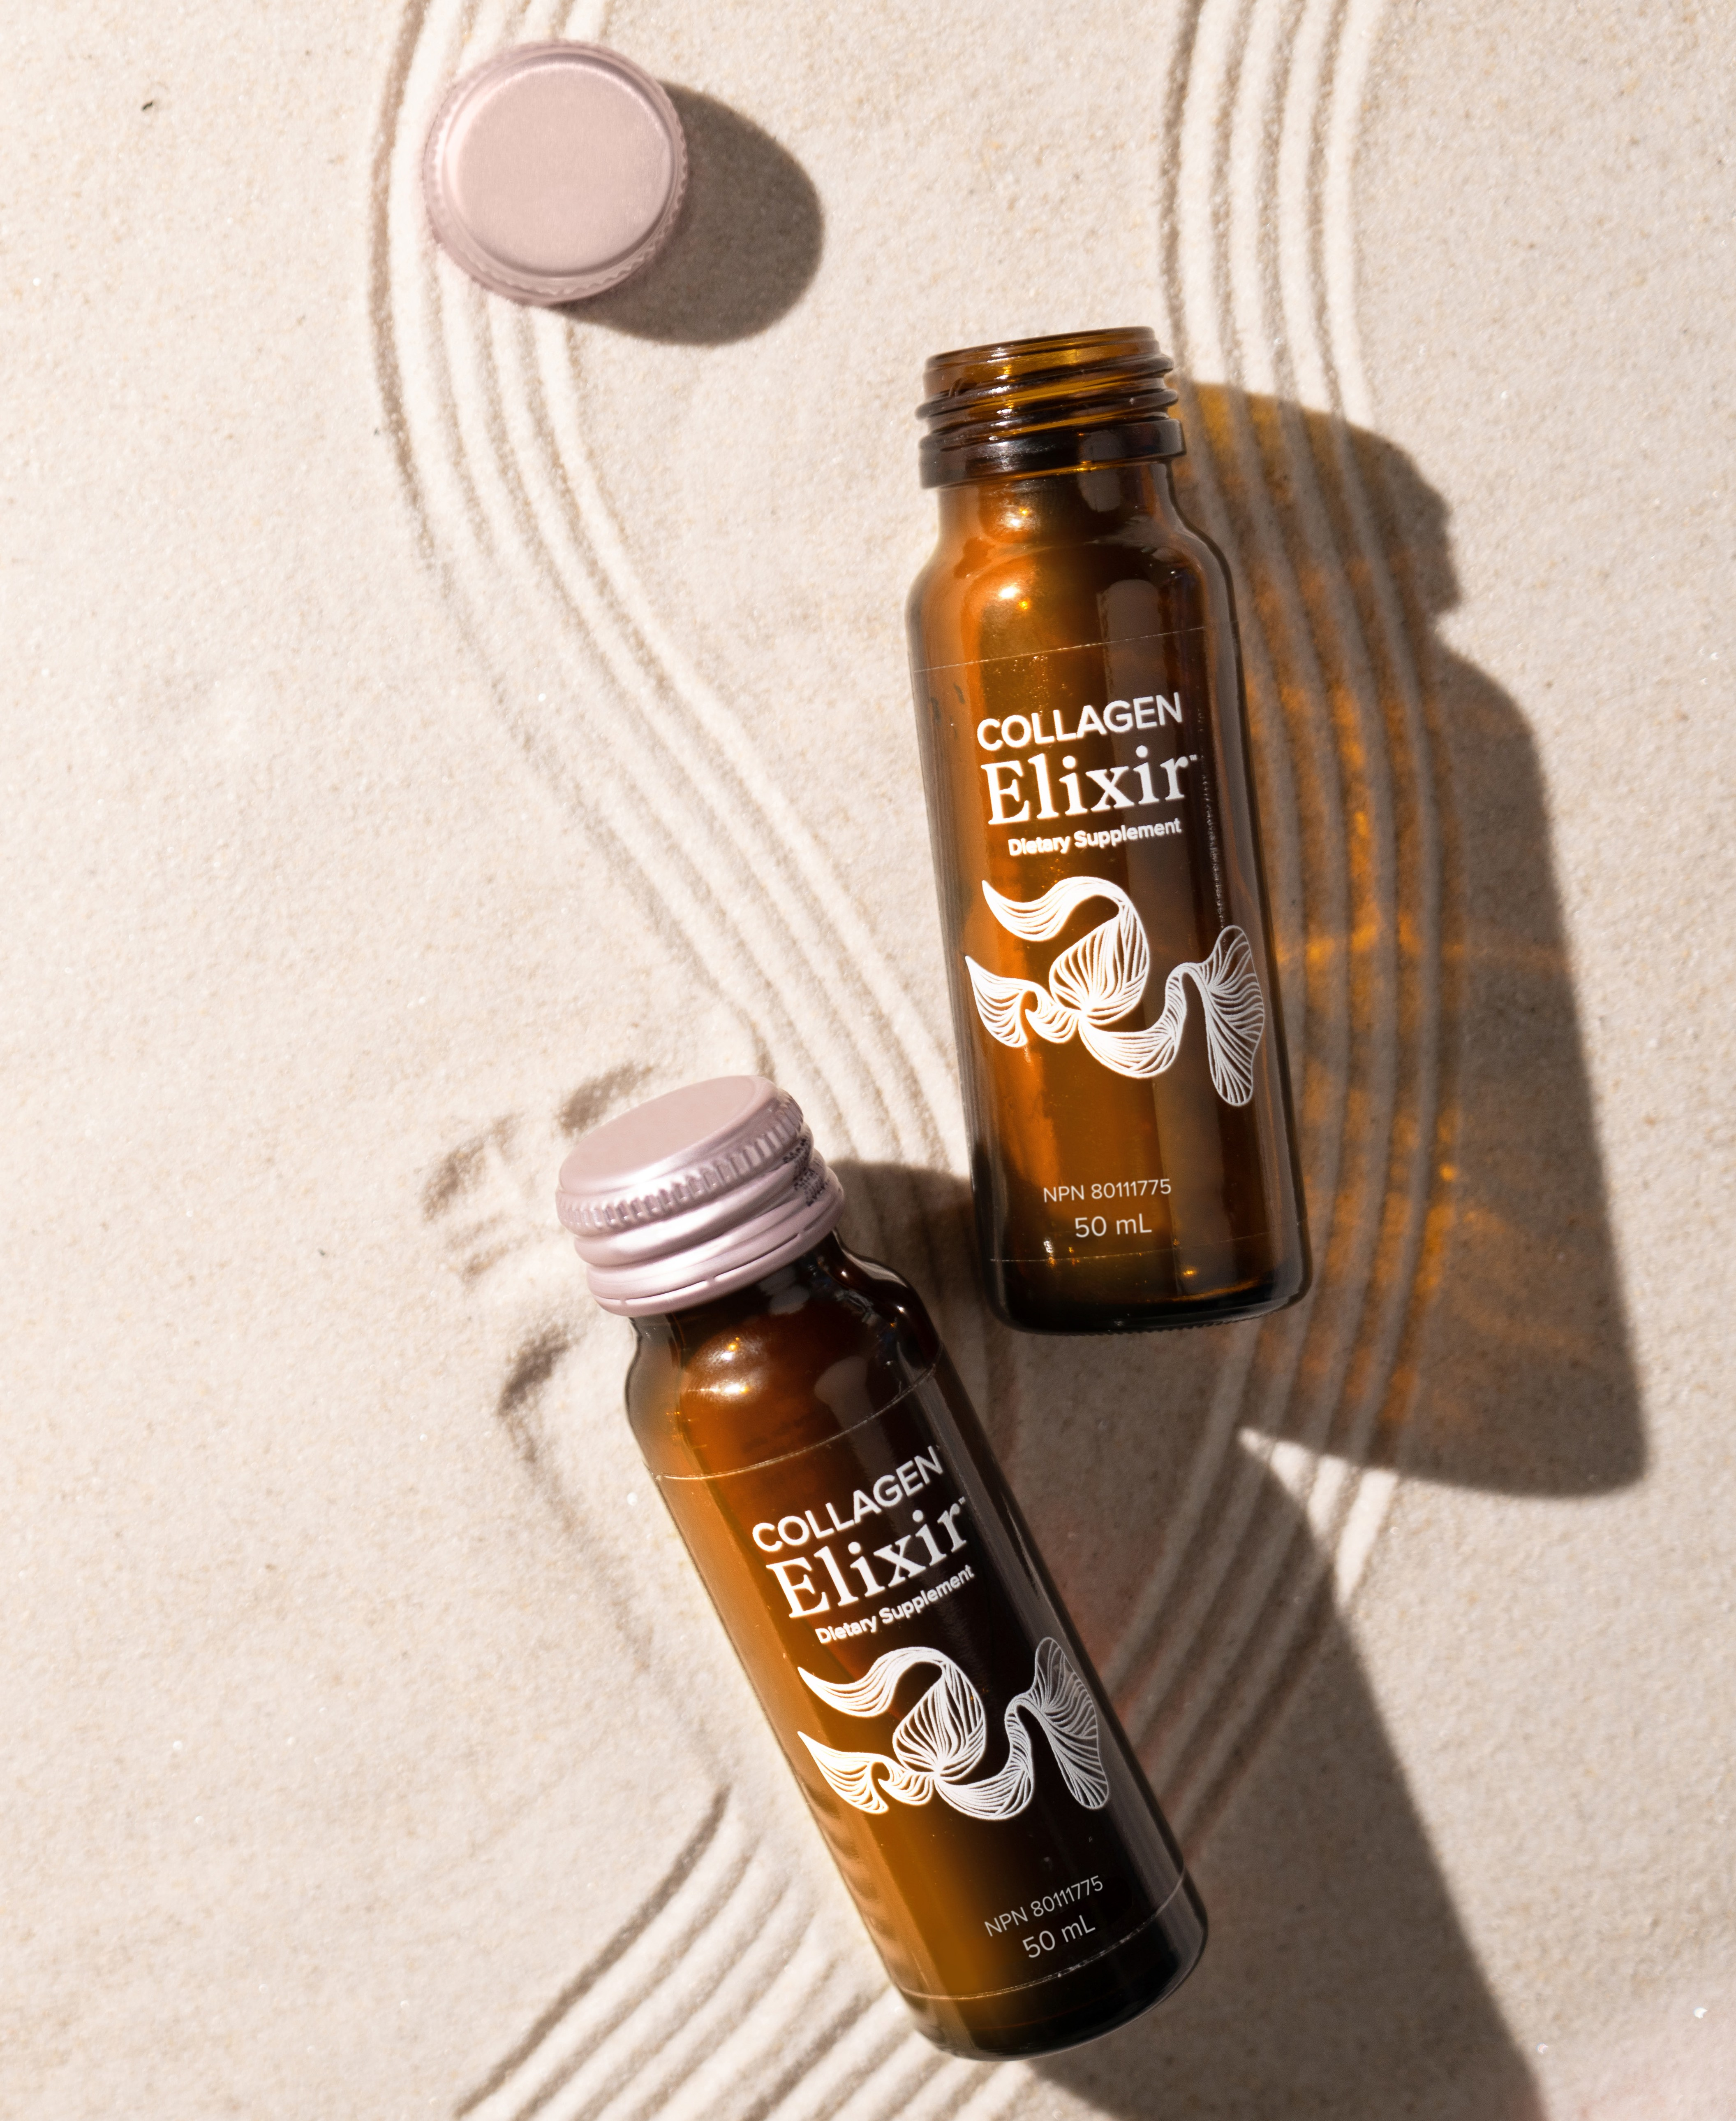
Business Benefits of Collagen
NO COST ON PRODUCT INVESTMENT
Lower barrier to entry
NO INVENTORY OR SHELF SPACE NEEDED
Product ships directly to Customers
SIMPLE ACCOUNTING
All earnings and activity are reported weekly for you
NO WORK FOR YOUR STAFF
Orders can be placed simply by QR code and email links

Slide 7
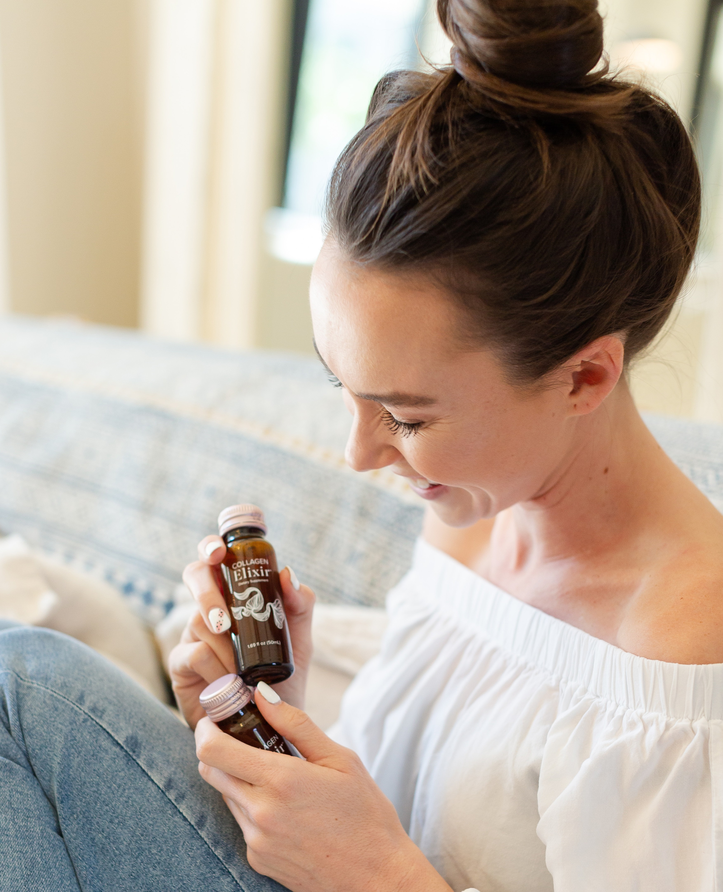
Business Benefits of Collagen
POTENTIAL TO BUILD RECURRING REVENUE
  Customers can take Collagen Elixir™ long term
  Many Customers experience visible results in 30 days
  Referrals and reorders add up over time
DUPLICATION & EXPANDED INCOME
  Promote Collagen Elixir in your own practice
  Share the product with other spas, salons, etc.
PARTNER WITH ISAGENIX
  We are a 20-year-old company renowned for transformative nutrition
  Our systems, customer service, and income plan are well established

Slide 8
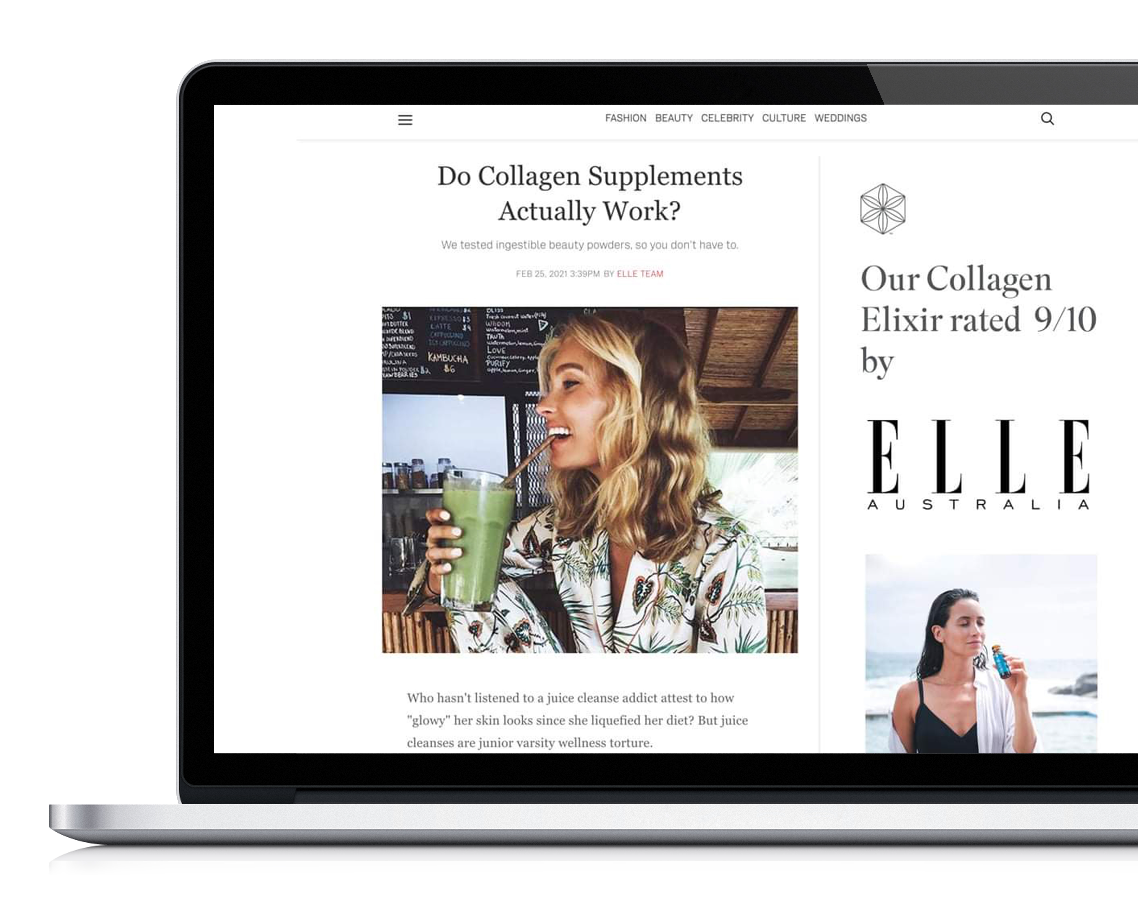
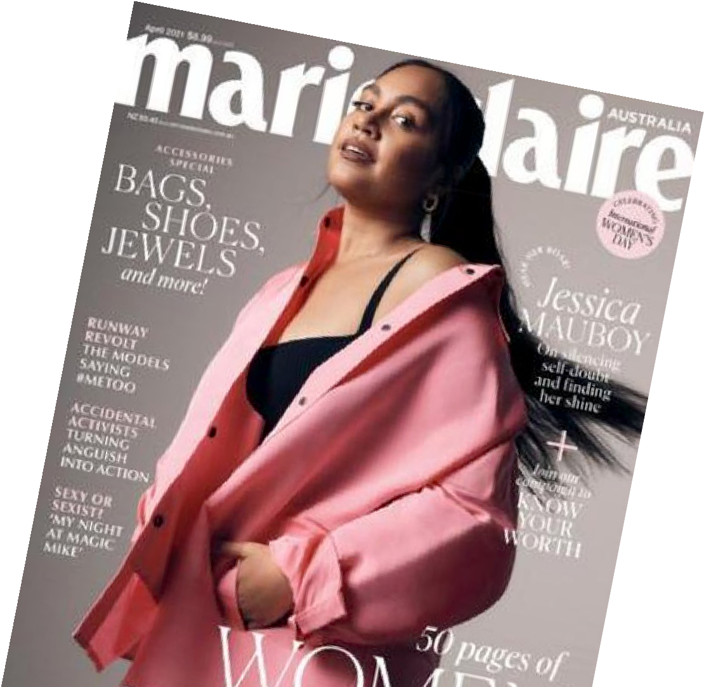
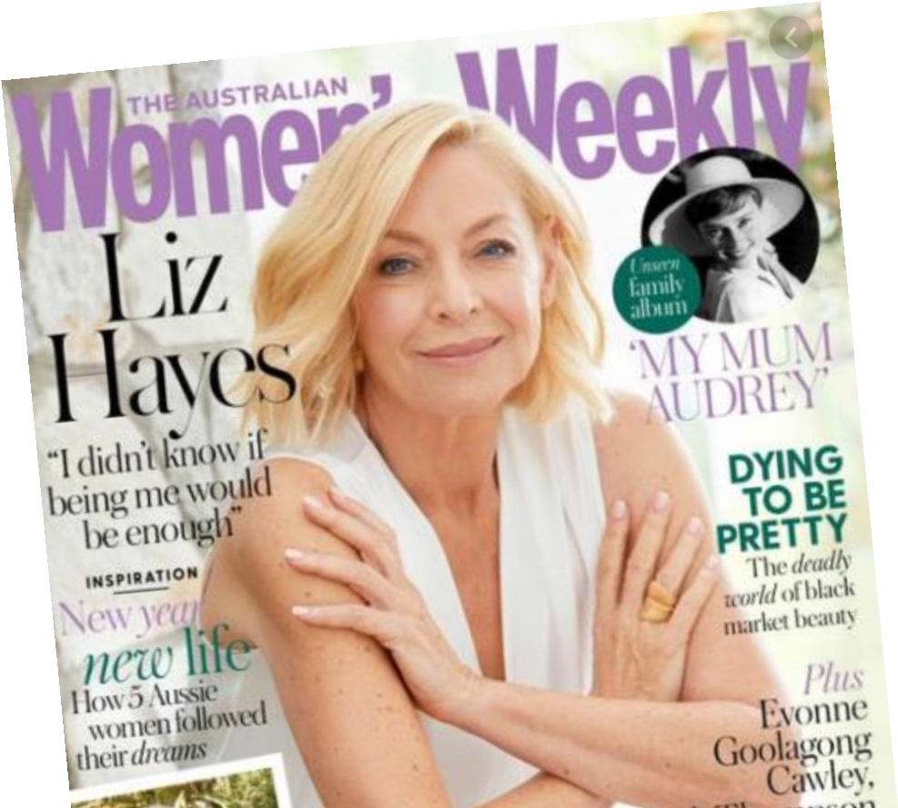
Collagen Elixir Has Gone Viral
CHECK THIS OUT!
MILLION BOTTLES SOLD in 72 hours
MILLION BOTTLES SOLD in 2 weeks
MILLION BOTTLES SOLD in 3 weeks
Now...
OVER 40 Million
BOTTLES SOLD
Collagen Elixir™ has been featured in these magazines too!

Slide 9
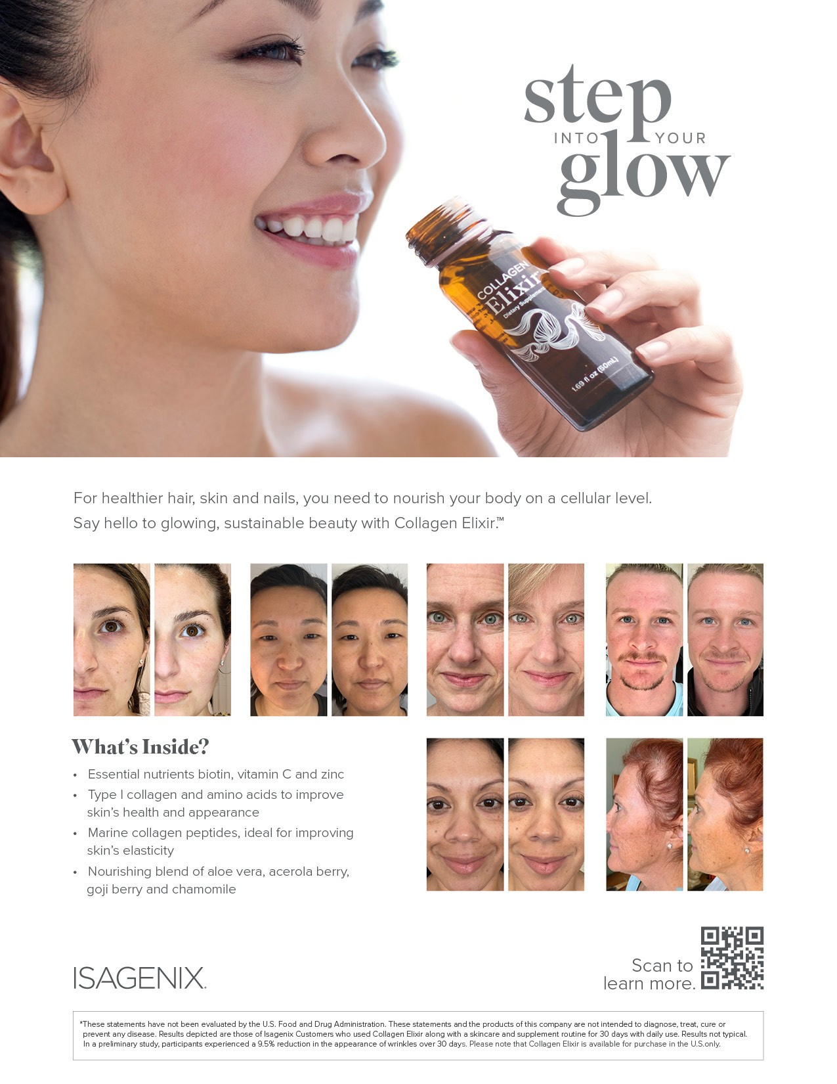
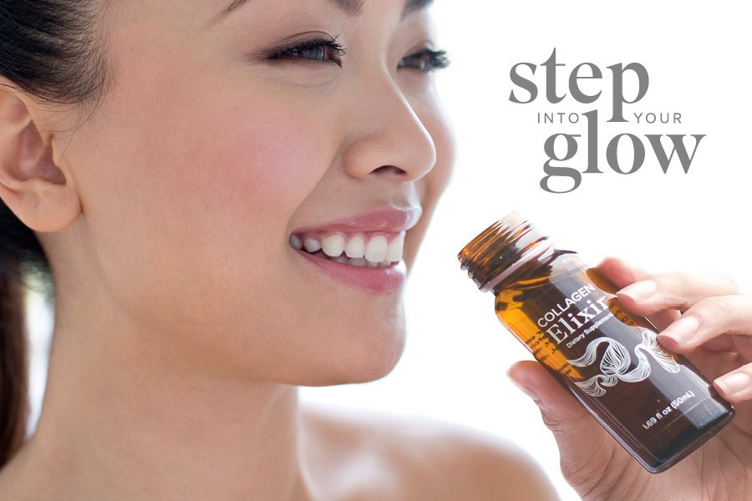
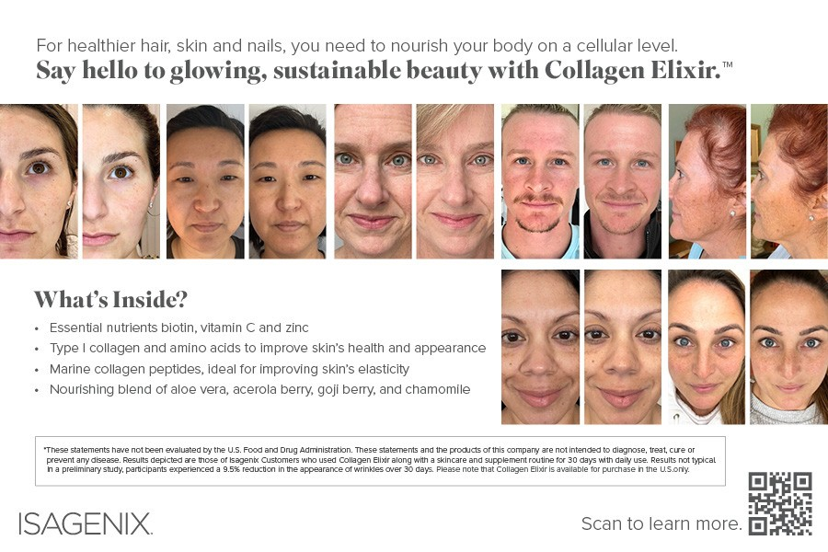
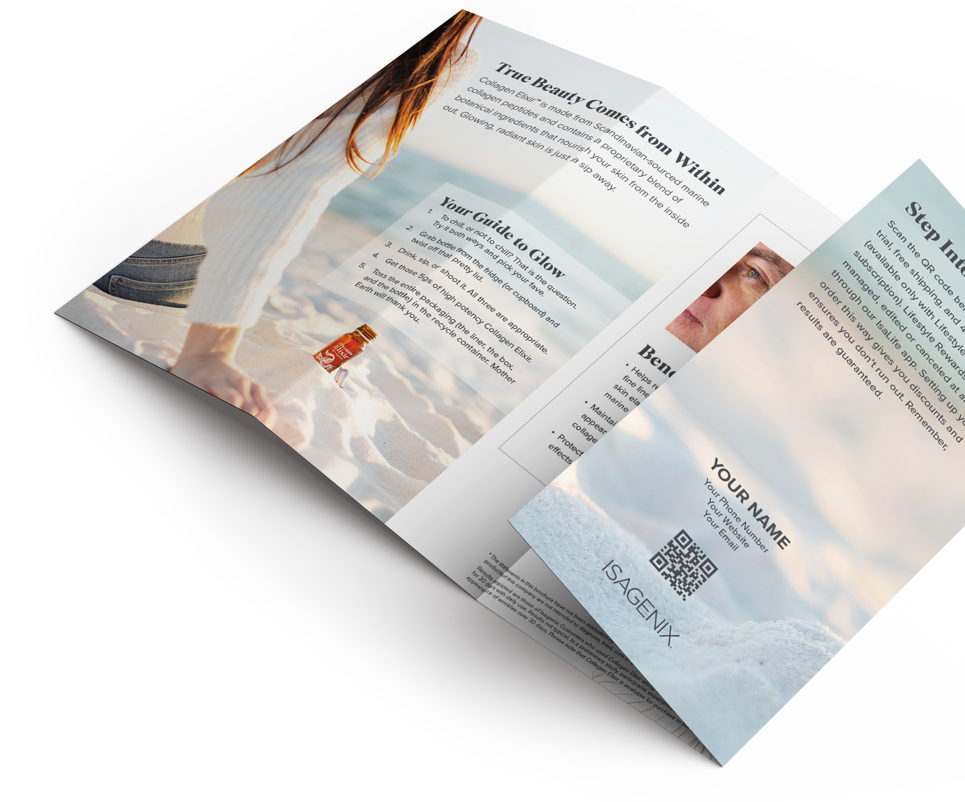
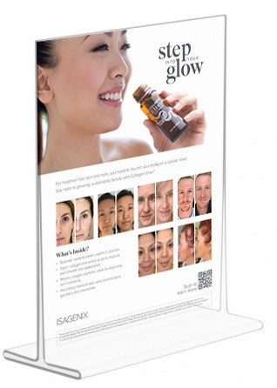
Sharing Is Easy With Customized Tools
FLIP OVER
Printed with a custom QR code to your personal site for Customers to
learn more and
easily place an order
Fits easily into any 8.5" x 11" frame to display on counter
THESE & MORE AVAILABLE AT ISASALESTOOLS.COM
Nonworking QR code shown on pictured examples.

Slide 10
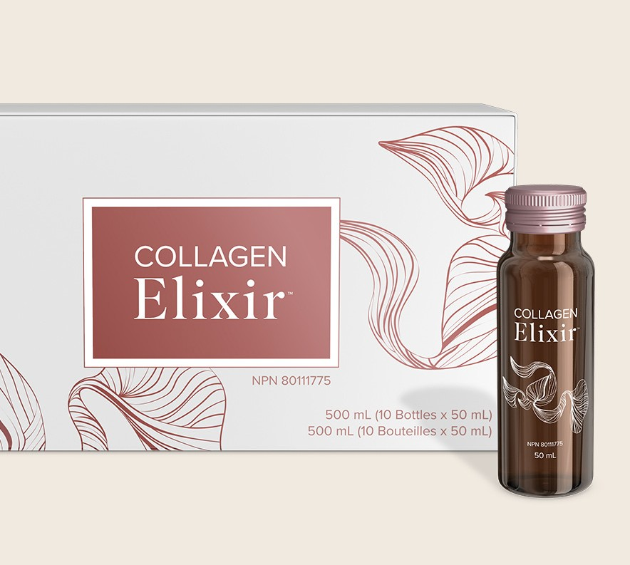
Beauty
Afterglow Bundle
6 boxes | 60 bottles of Collagen Elixir™
Guest Pricing: $323.93
Subscription Rewards: $242.95
SAVE 15%
WITH SUBSCRIPTION REWARDS
Available in US, Canada, Australia, New Zealand, EU and UK.

Slide 11
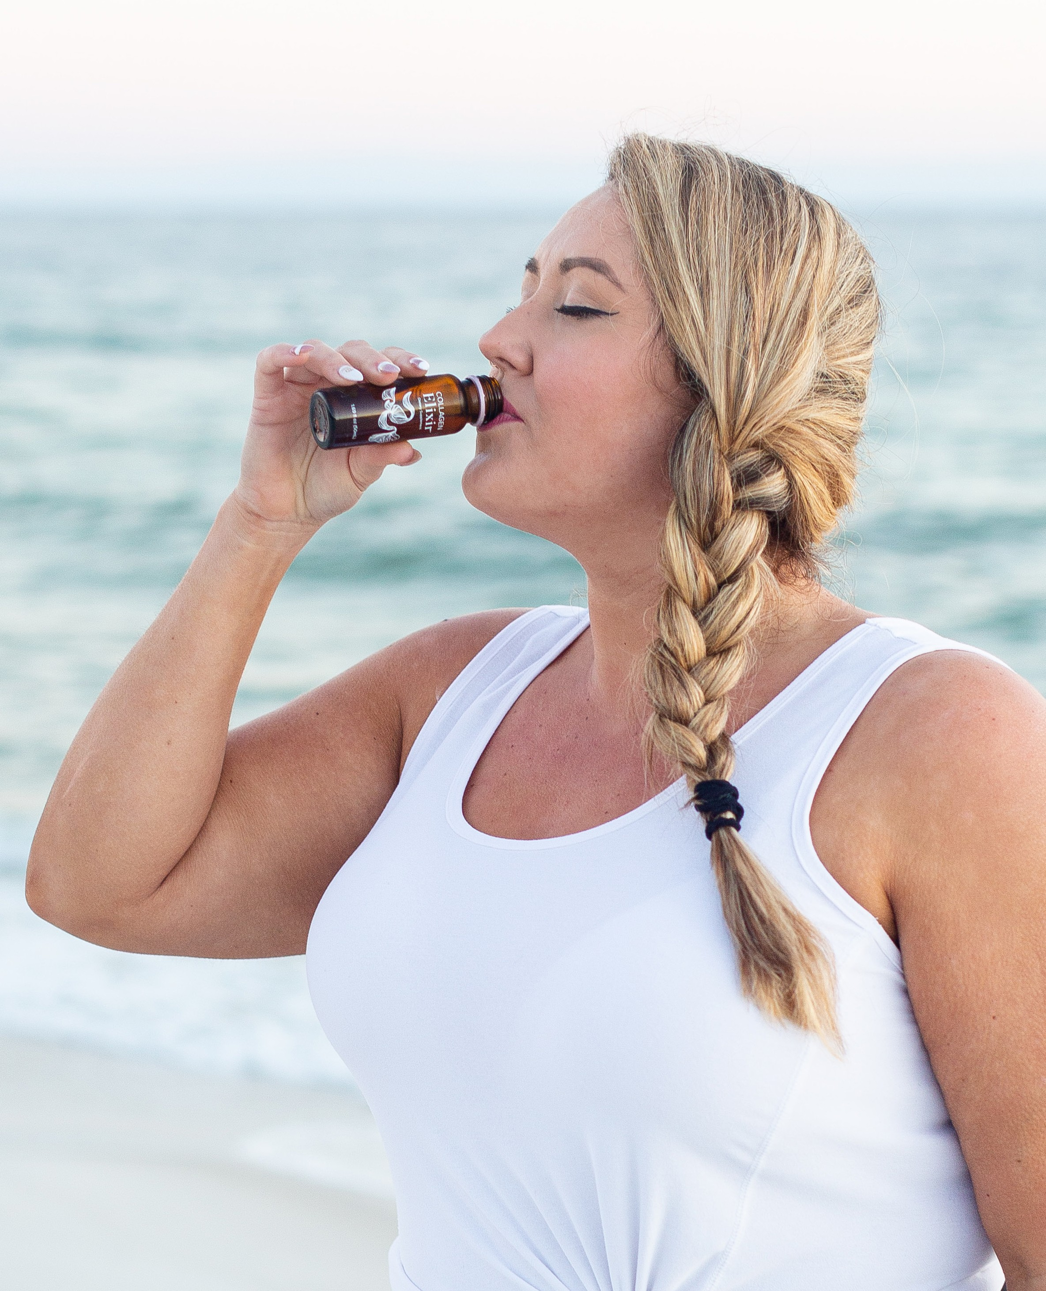
Spread the News About Collagen Elixir™
WHY?
You can build recurring income
Income from purchases consistently pays you and your team at minimal cost to your business
SIMPLE STEPS
Build in your own office first with clients and customers
Duplicate the process with other spas, salons, etc.

Slide 12



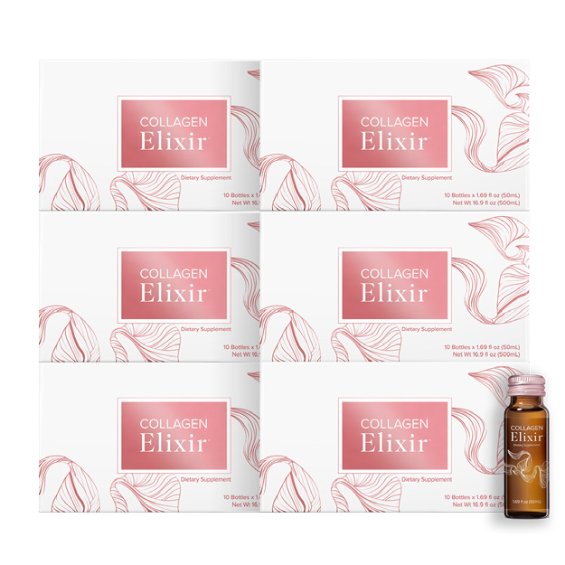
Incentive To Share
SHARING BONUSES FOR YOUR STAFF
Staff has the opportunity to earn additional income
You earn income for sales made by your staff
How this looks visually:
STAFF MEMBER SHARES WITH 2 CLIENTS
STAFF MEMBER SHARES BEAUTY
AFTERGLOW BUNDLE WITH:
1 new Customer → $30 bonus
2 or more Customers in the same commission week (Monday-Sunday) → $60 bonus
CLIENT 1
STAFF MEMBER
CLIENT 2
BONUS FOR SHARING WITH 2: $120
($60 PIB each time for 2 or more Customers in a week)
FIRST-TIME SHARING BONUS: $120
$240 TOTAL
+
The ability to earn income under the Isagenix Compensation Plan depends on many factors, including an individual Isagenix Independent Associate's business, social, and sales skills; personal ambition and activity; availability of time and financial resources; and access to a large network of family, friends, and business contacts. Isagenix cannot and does not guarantee any particular level of earnings. Even Associates who dedicate a significant amount of time, effort, and personal funds may not achieve a meaningful level of success. For average earnings, refer to IsagenixEarnings.com.

Slide 13










GETTING PAID
Consistent Benefits for Those Who Share
2 OR MORE PEOPLE IN A WEEK, EARN 25% = $120
$60 + $60
= $120
$60
+
$60
+
$60 +
= $300
$60
+
$60
2 NEW PEOPLE/WEEK = $120/WEEK = $480/MONTH
5 NEW PEOPLE/WEEK = $300/WEEK = $1,200/MONTH
10 NEW PEOPLE/WEEK = $600/WEEK = $2,400/MONTH
PLUS ACCUMULATING COMMISSION*
The ability to earn income under the Isagenix Compensation Plan depends on many factors, including an individual Isagenix Independent Associate's business, social, and sales skills; personal ambition and activity; availability of time and financial resources; and access to a large network of family, friends, and business contacts. Isagenix cannot and does not guarantee any particular level of earnings. Even Associates who dedicate a significant amount of time, effort, and personal funds may not achieve a meaningful level of success. For average earnings, refer to IsagenixEarnings.com.

Slide 14
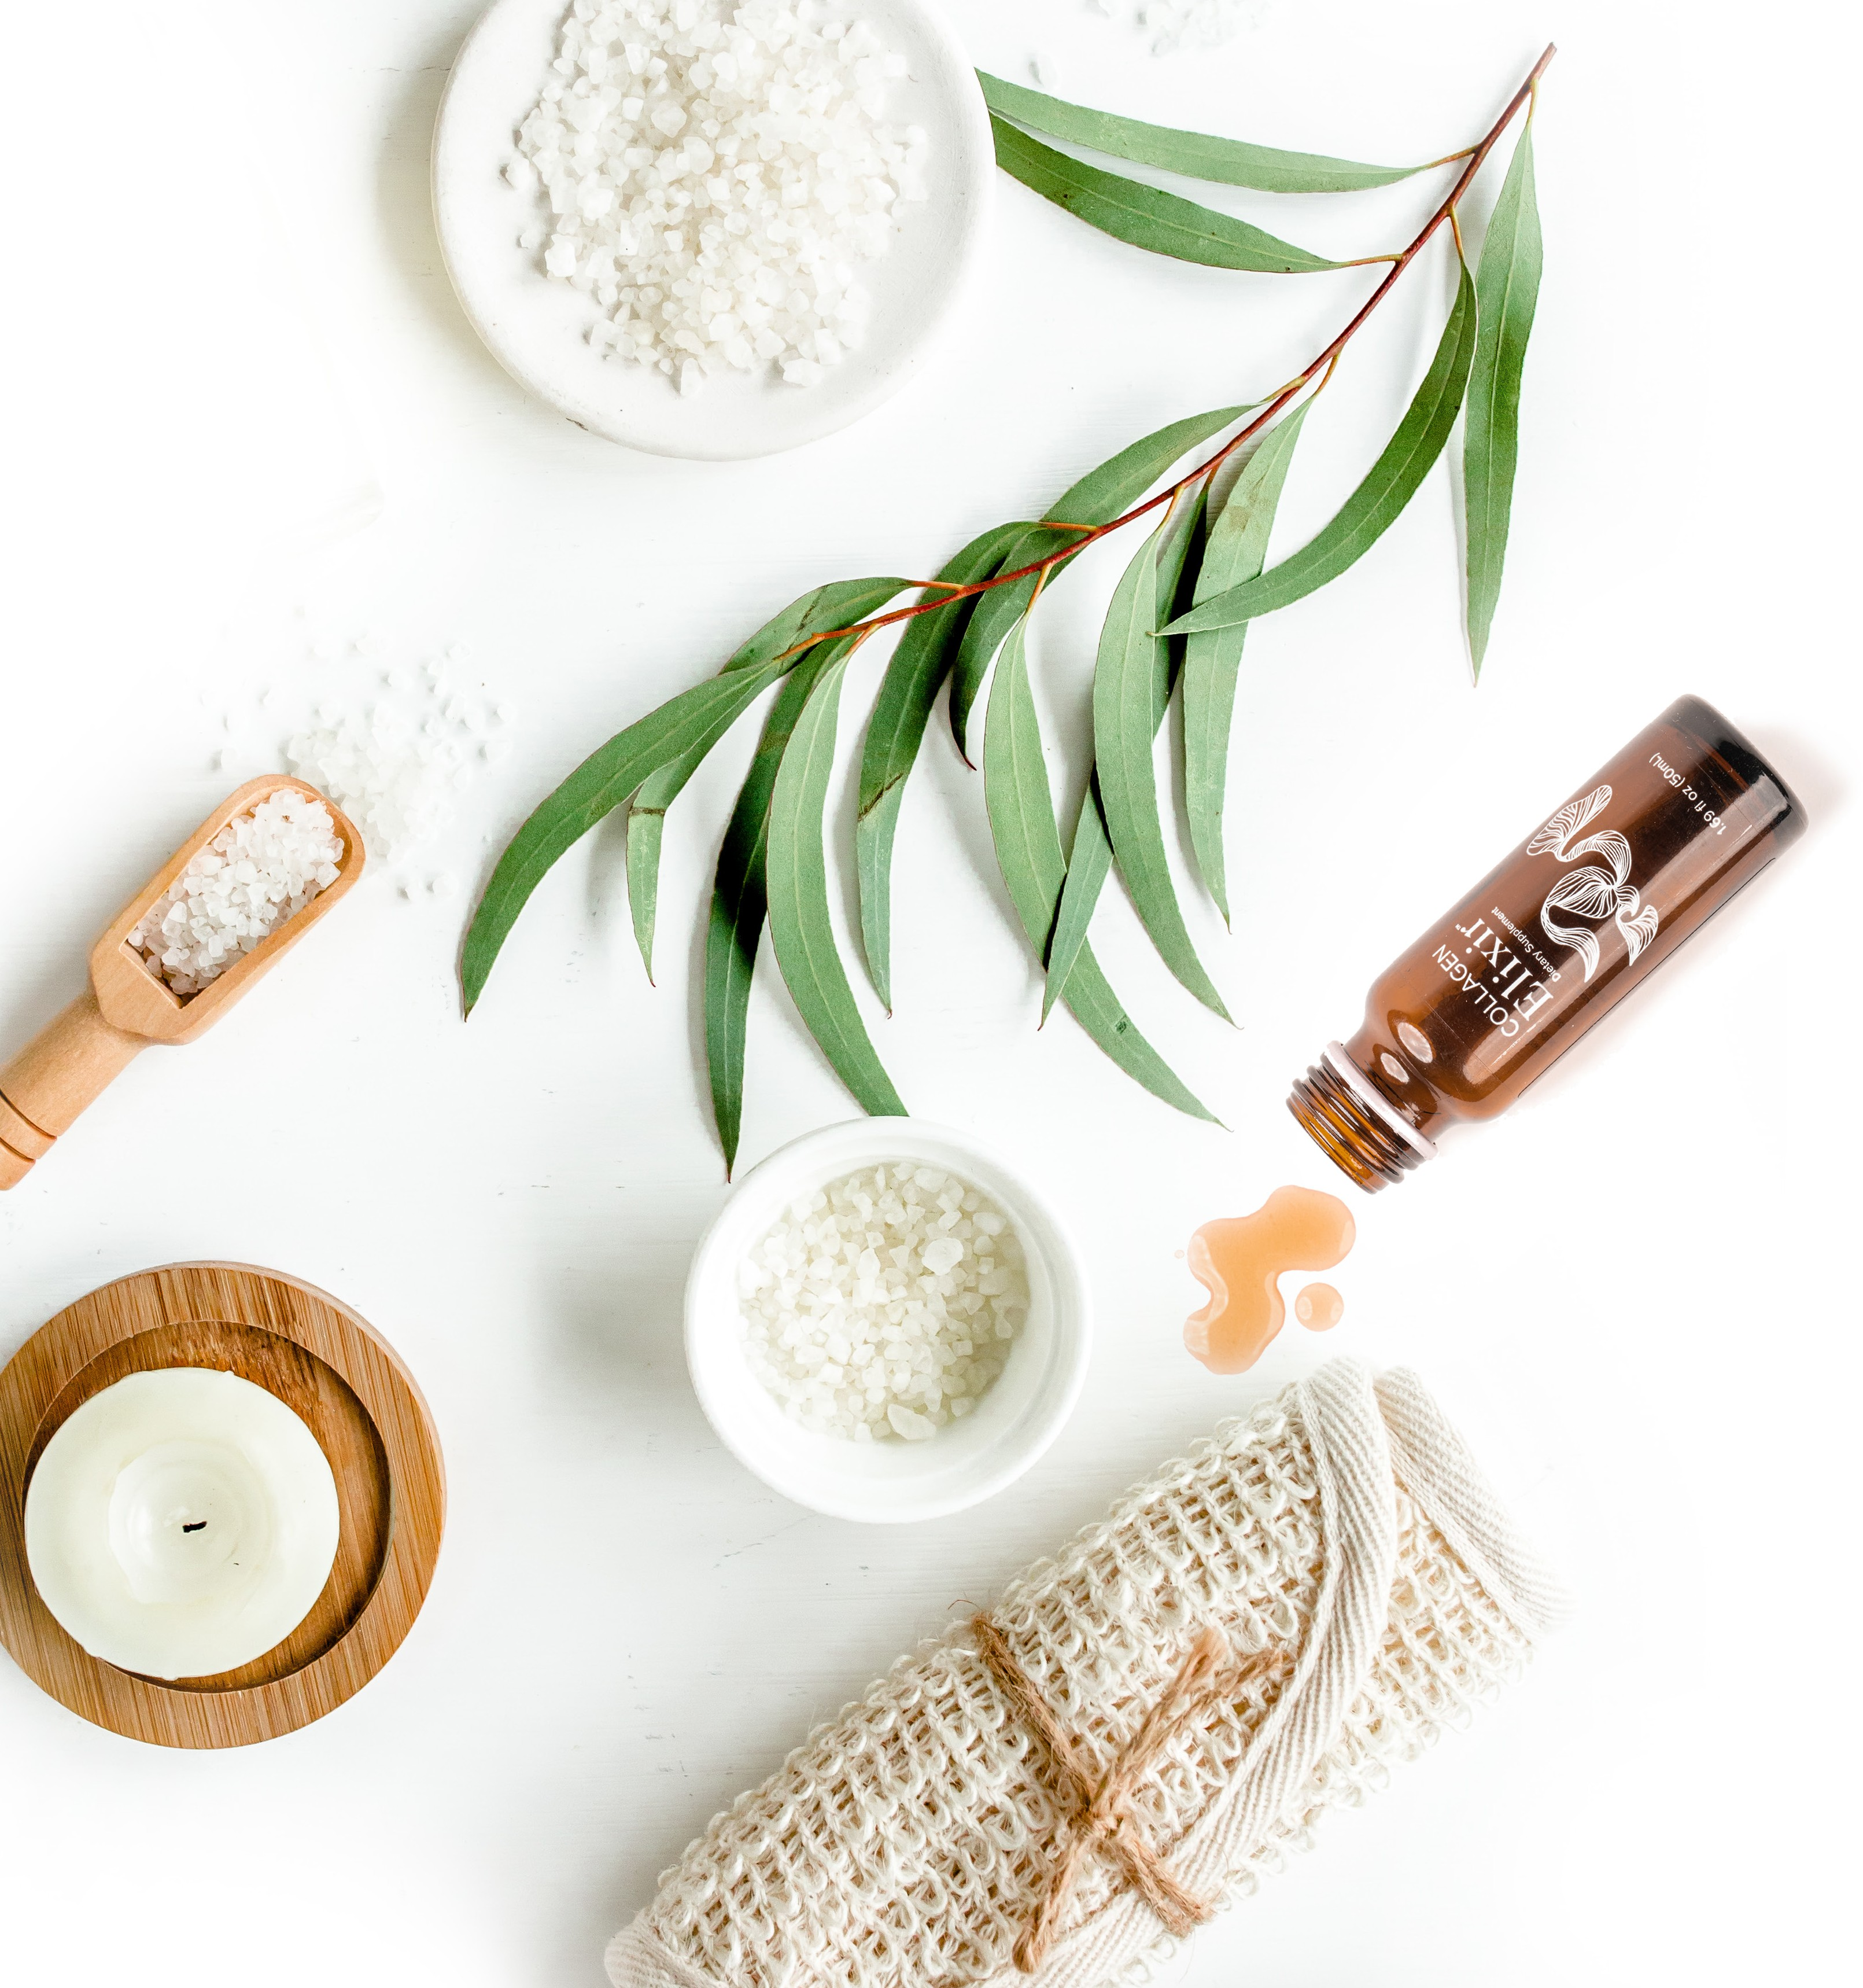
Additional Income Potential
You can earn additional income by sharing with other spas and salons
For example, if you enroll 3 spas or salons and each business sells a Beauty Afterglow Bundle to 1 new Customer per day, your commission from their sales could be worth an average of
$3,300/month over the first year*
*The figure depicted reflects potential income from standard commissions and does not include earnings from promotions or bonuses. The scenario described is based on the assumptions that (1) each business successfully finds one new Customer per day through the full 12-month period; and (2) new Customers reorder the Beauty Afterglow Bundle at rates similar to those of Isagenix's existing Customers. The scenarios and earnings shown are not guarantees and should not be considered typical or average. Isagenix cannot and does not guarantee any particular level of earnings. For average earnings by Isagenix Independent Associates, refer to IsagenixEarnings.com.

Slide 15
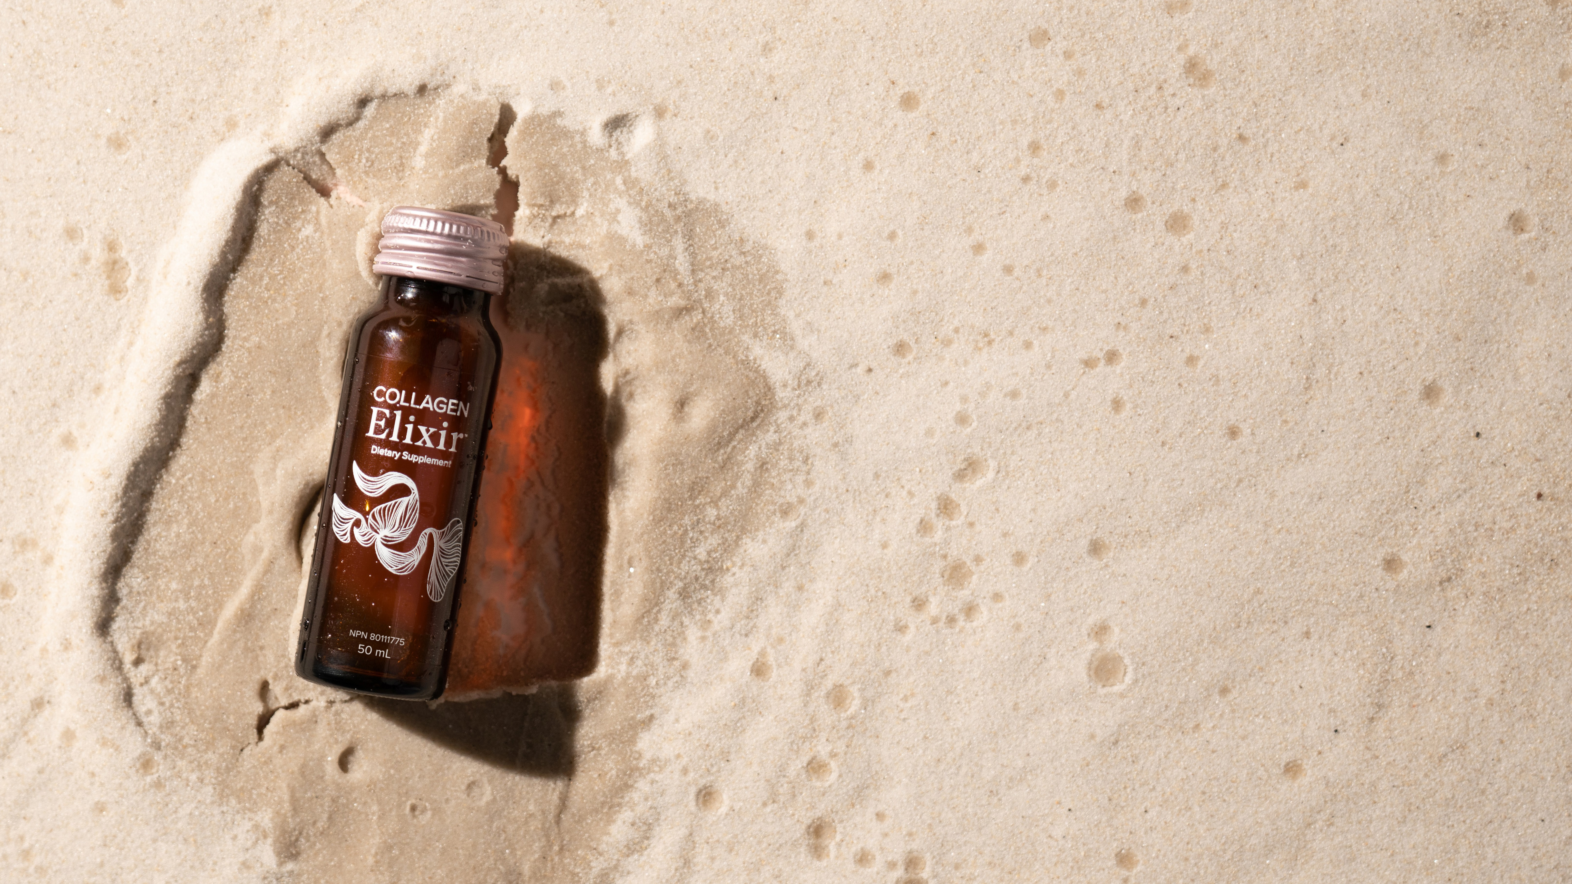
THANK YOU

