Slide 1

The Big Picture

Slide 2
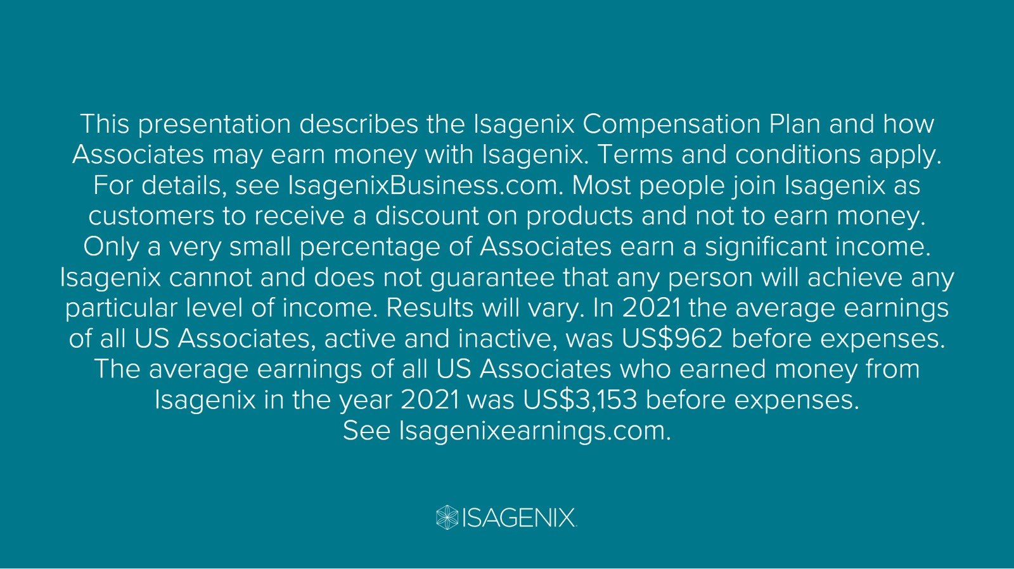

Slide 3

The Tracks to Run On

Slide 4

It’s All Connected

Slide 5

It’s All Connected

Slide 6
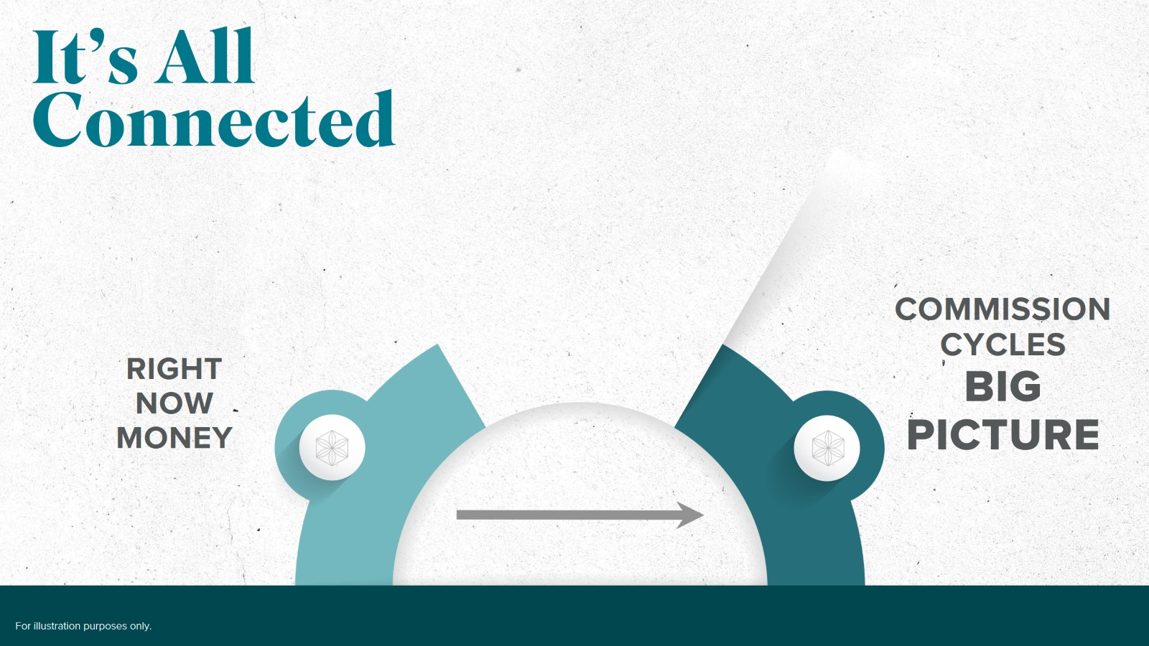
It’s All Connected

Slide 7
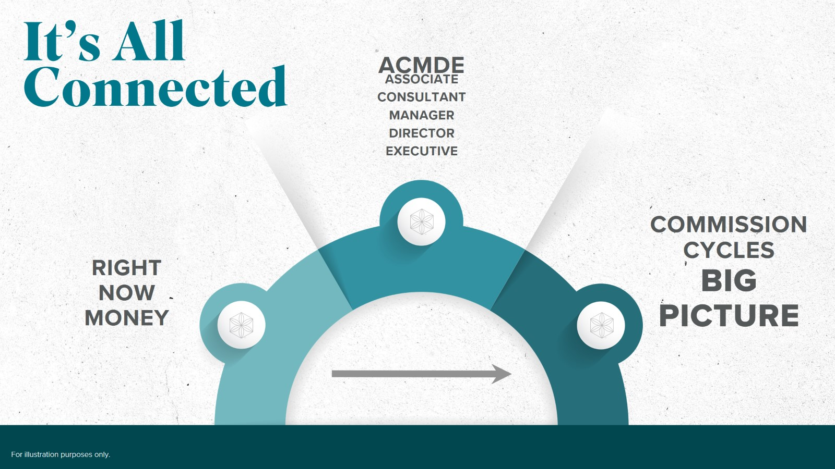
It’s All Connected

Slide 8

It’s All Connected

Slide 9

Share & Earn 20%

Slide 10

Share & Earn 20%

Slide 11
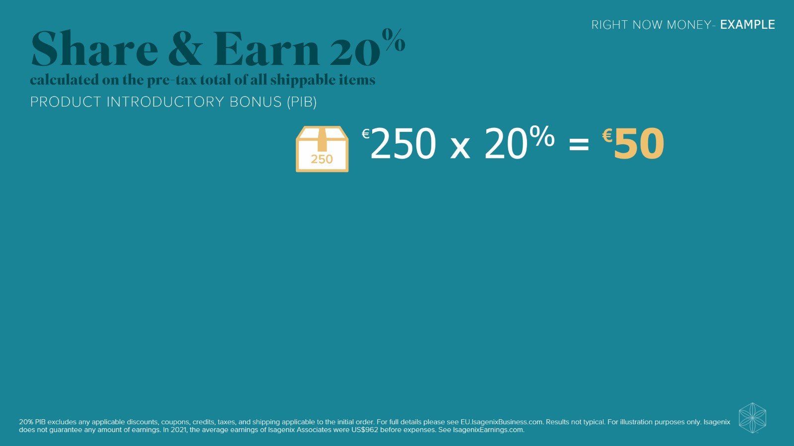
Share & Earn 20%

Slide 12
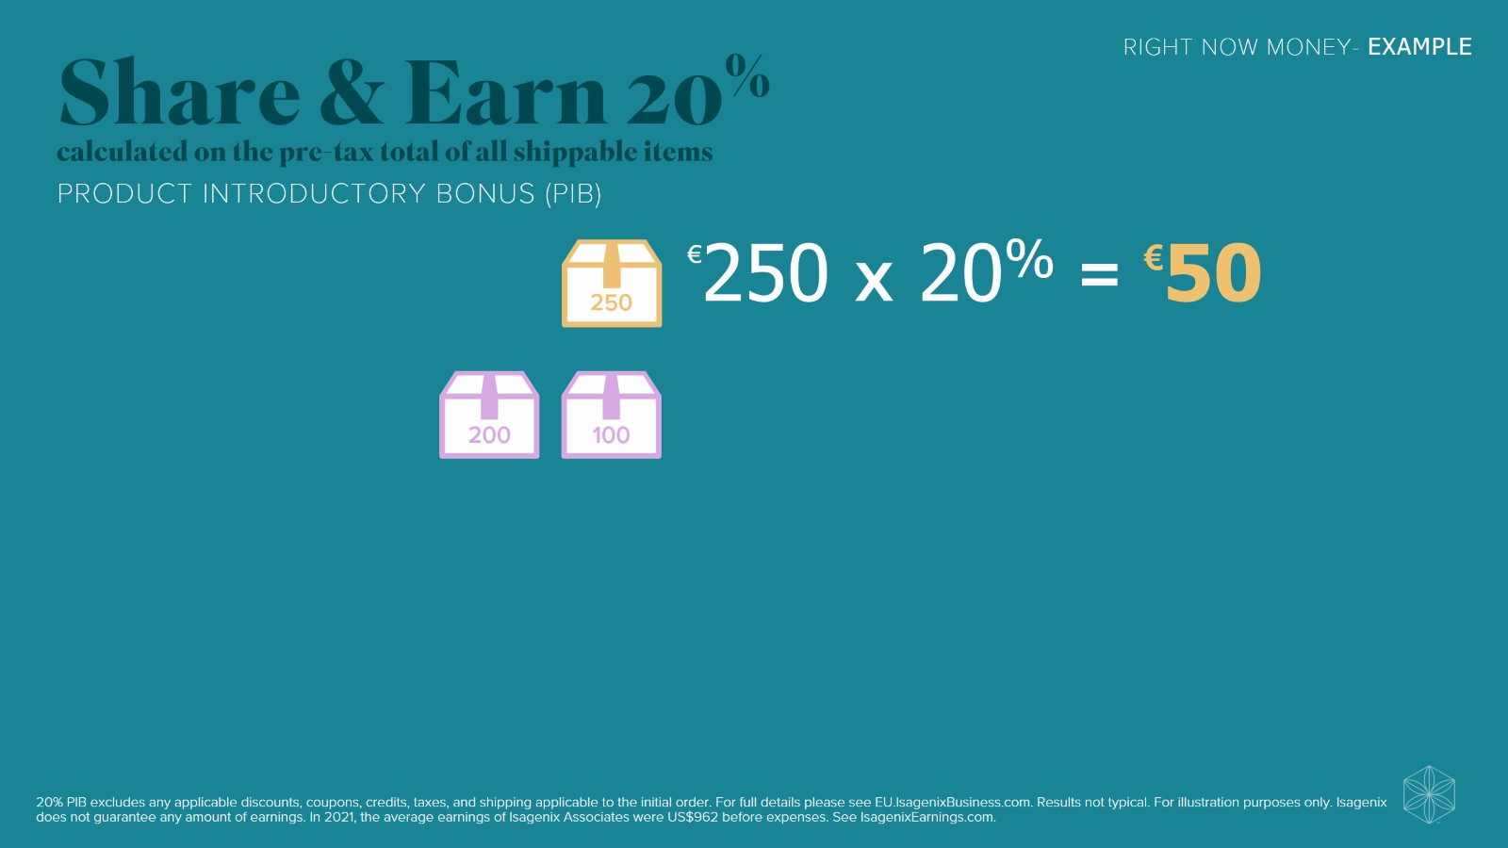
Share & Earn 20%

Slide 13
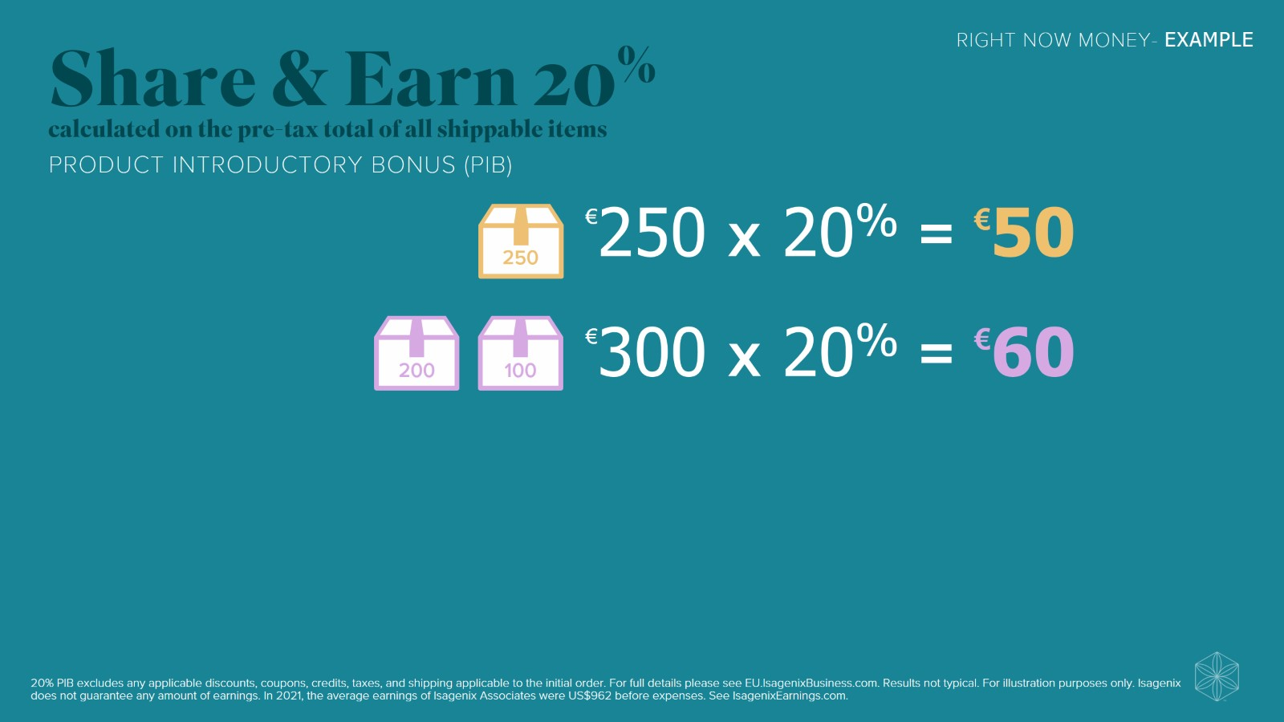
Share & Earn 20%

Slide 14
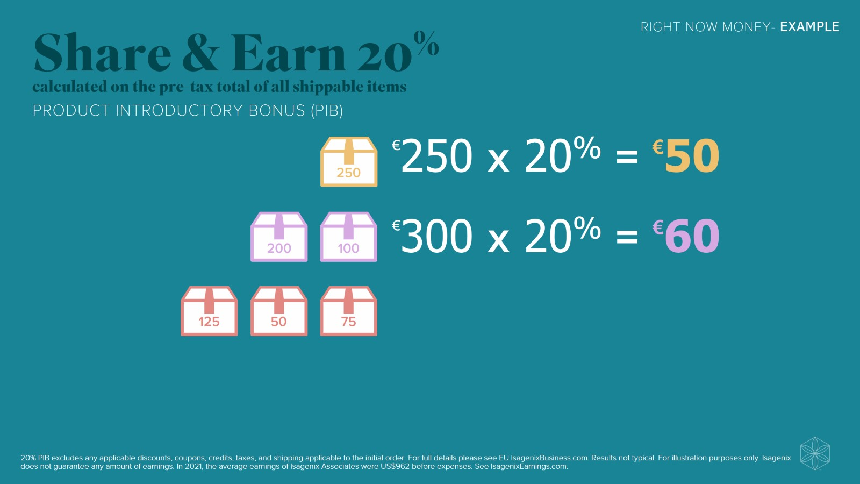
Share & Earn 20%

Slide 15
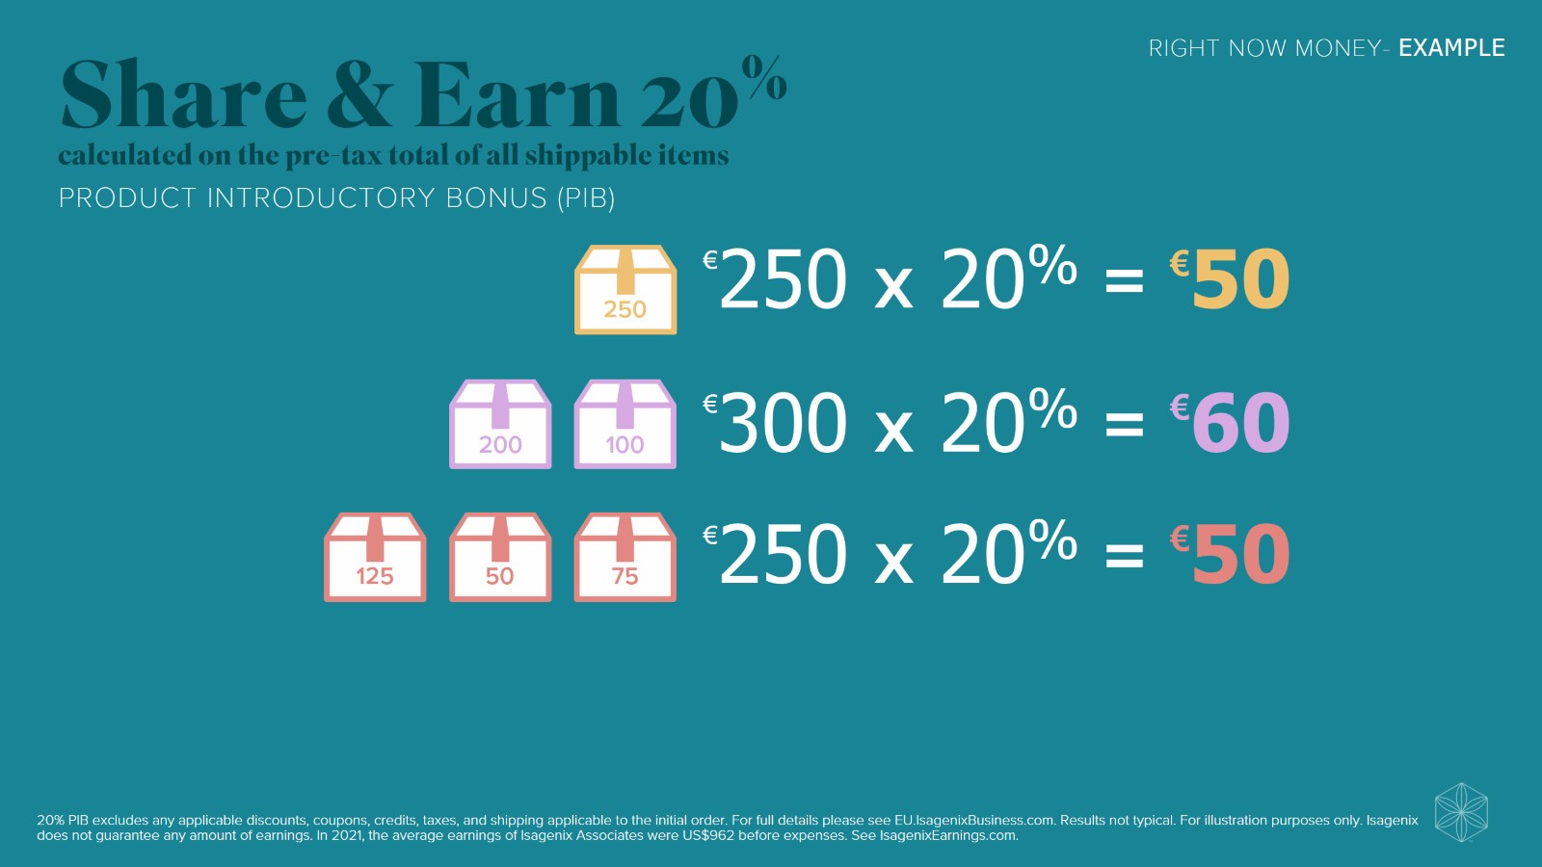
Share & Earn 20%

Slide 16
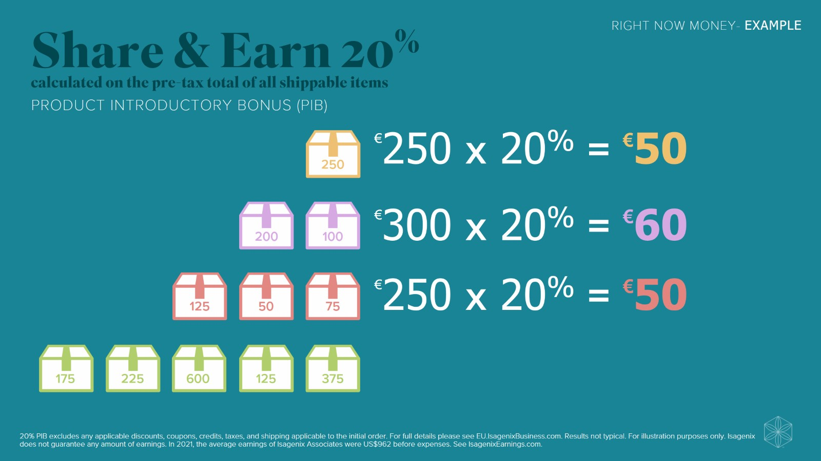
Share & Earn 20%

Slide 17
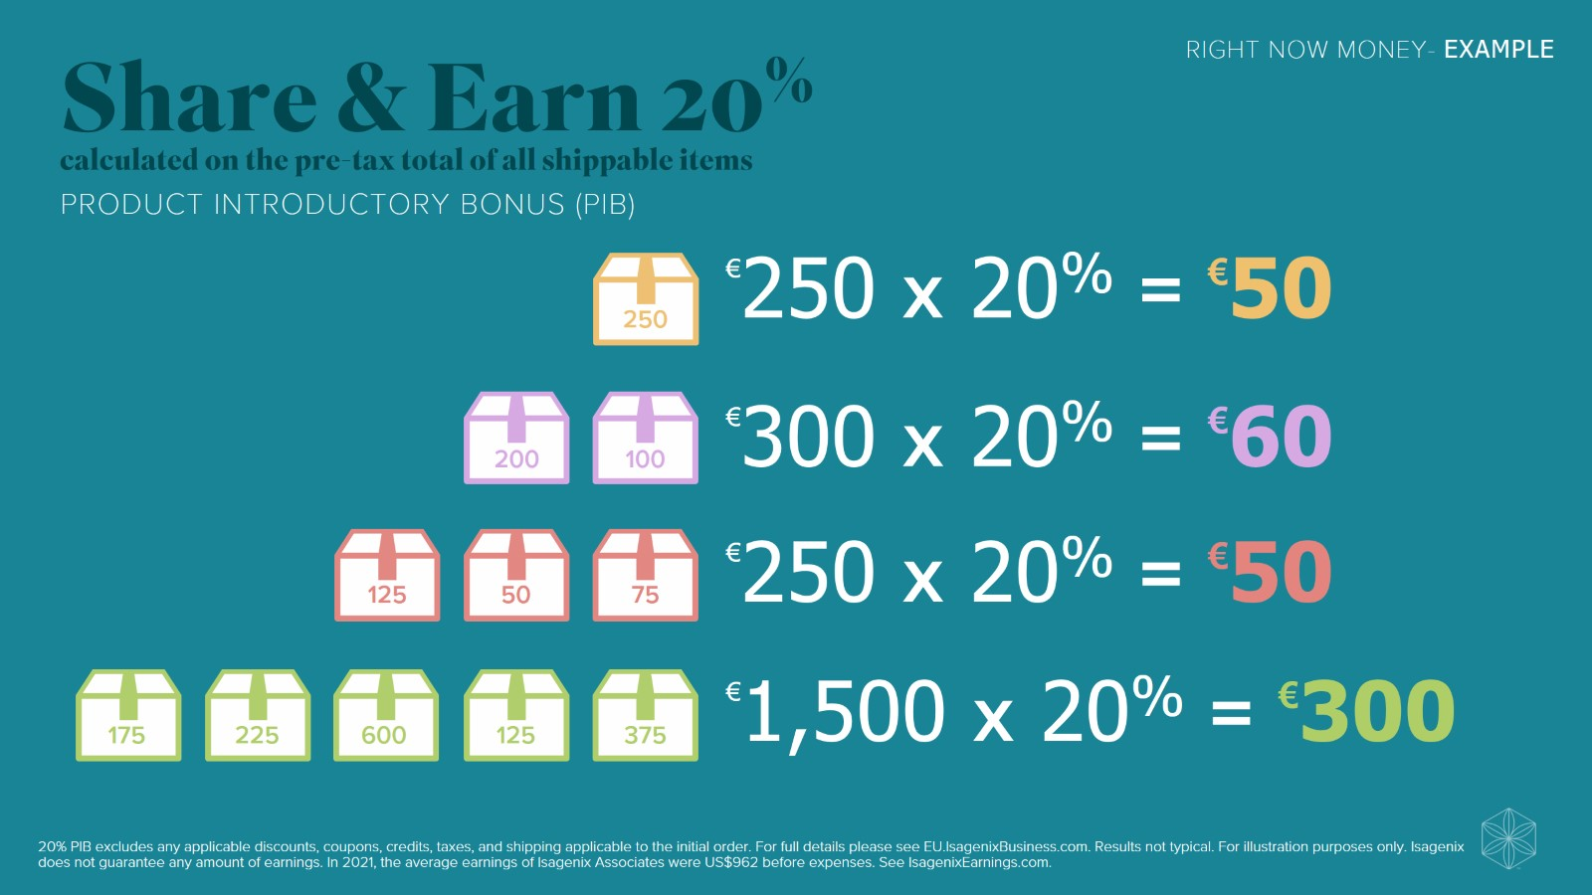
Share & Earn 20%

Slide 18
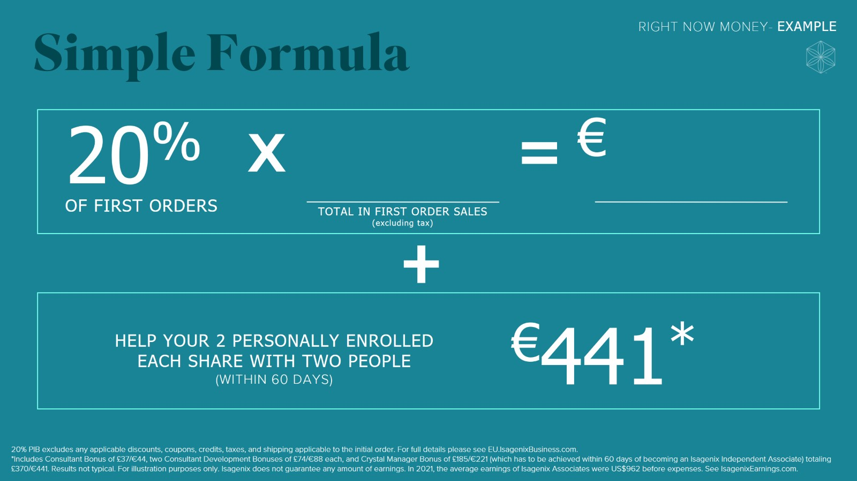
Simple Formula

Slide 19

Formula in Action

Slide 20
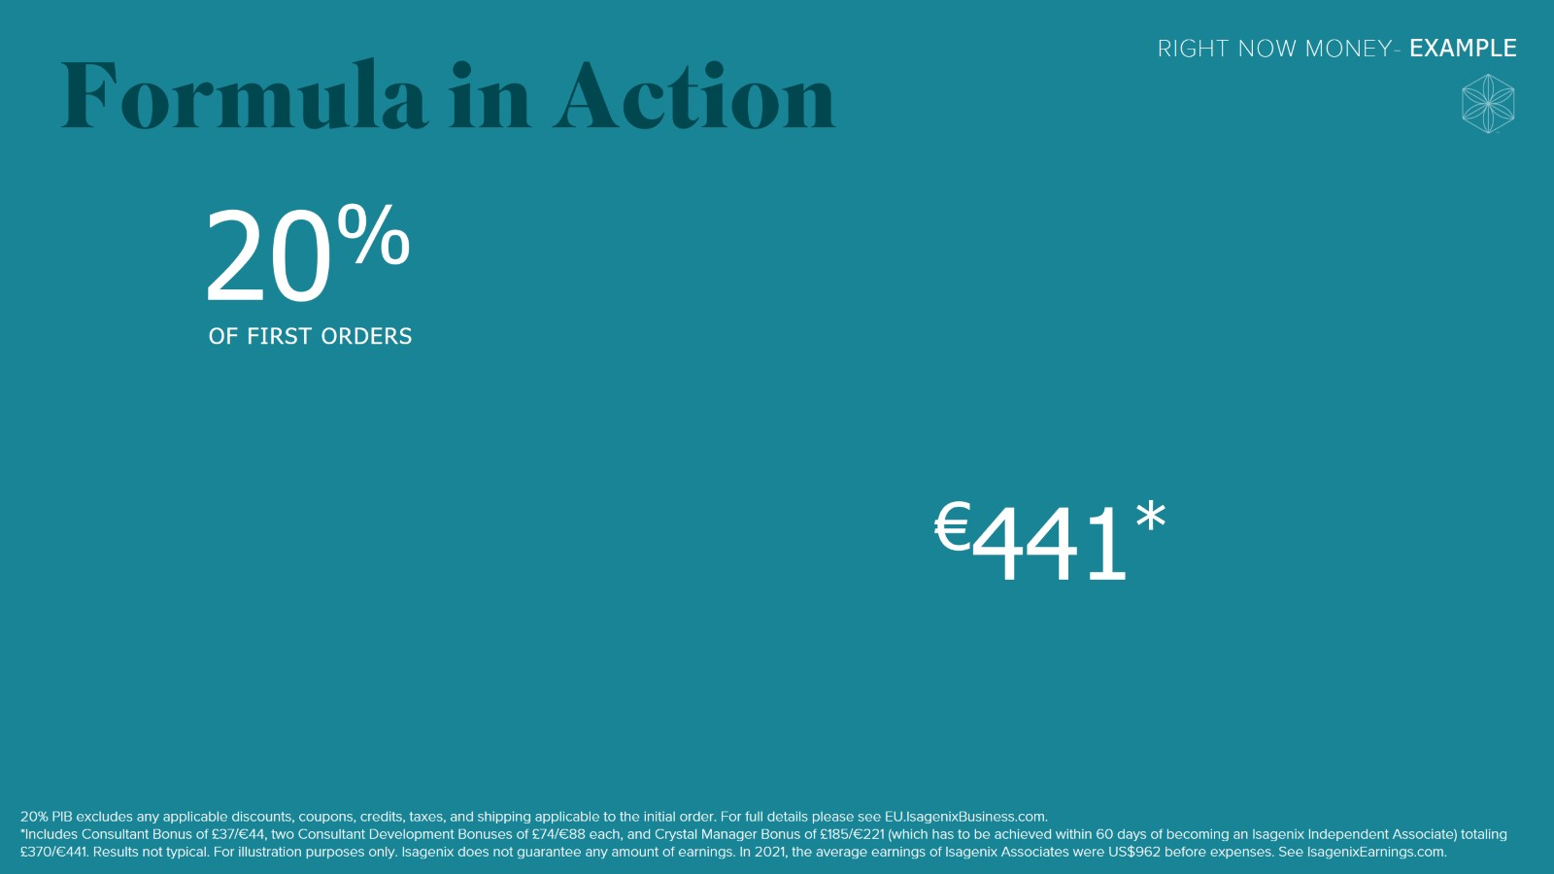
Formula in Action

Slide 21
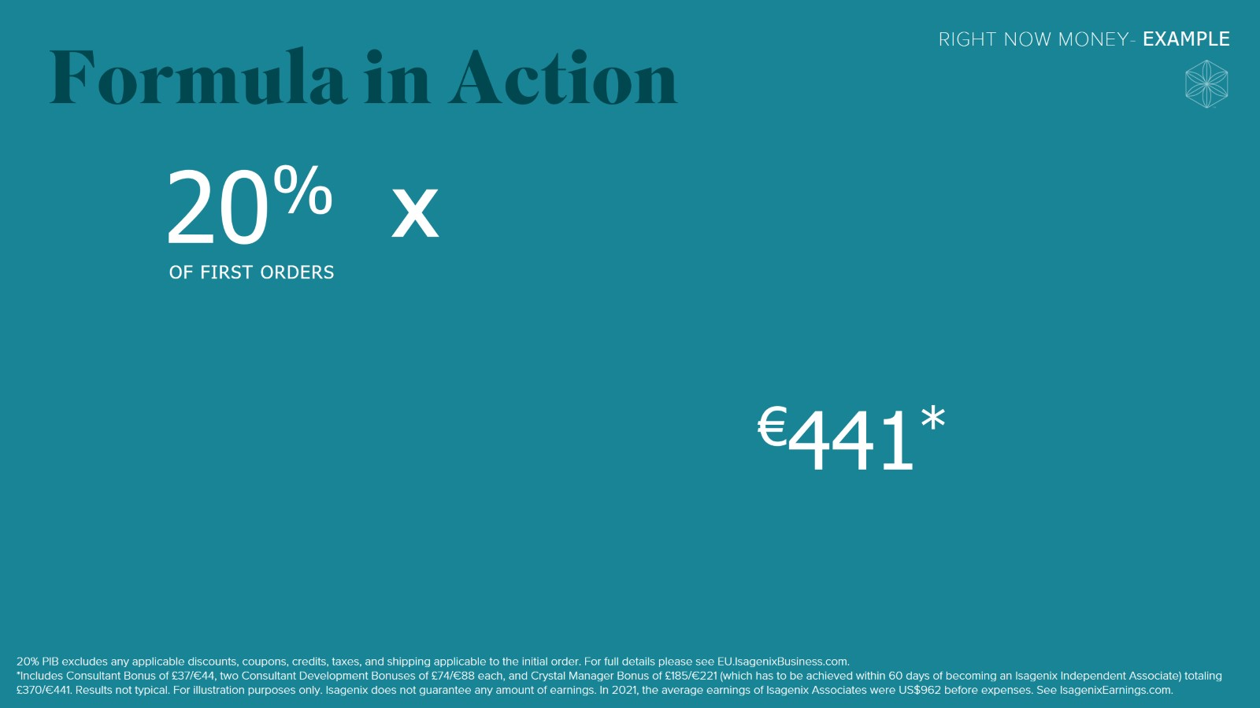
Formula in Action

Slide 22
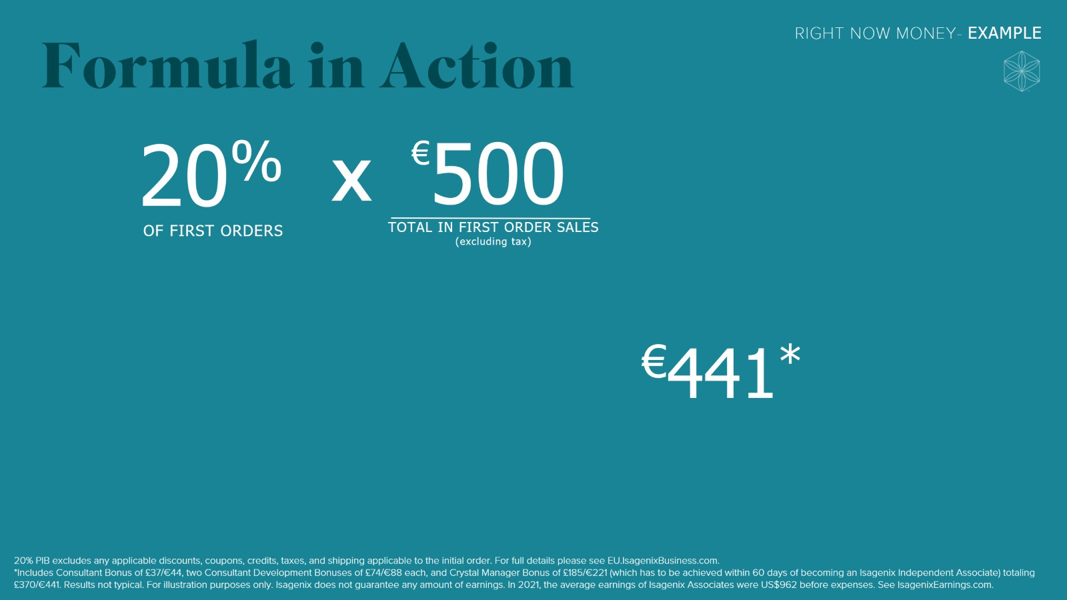
Formula in Action

Slide 23
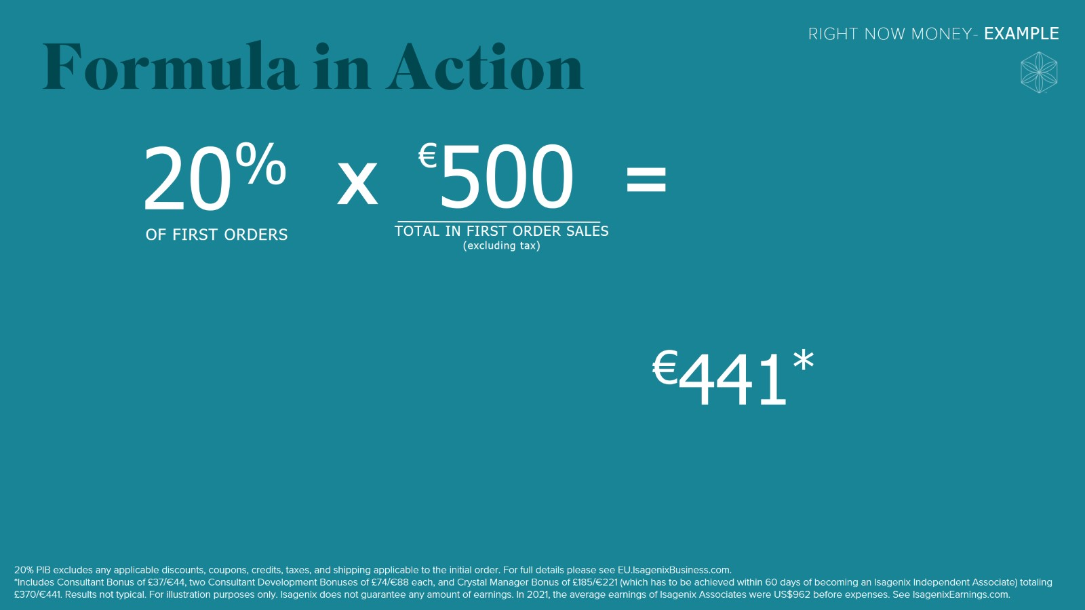
Formula in Action

Slide 24
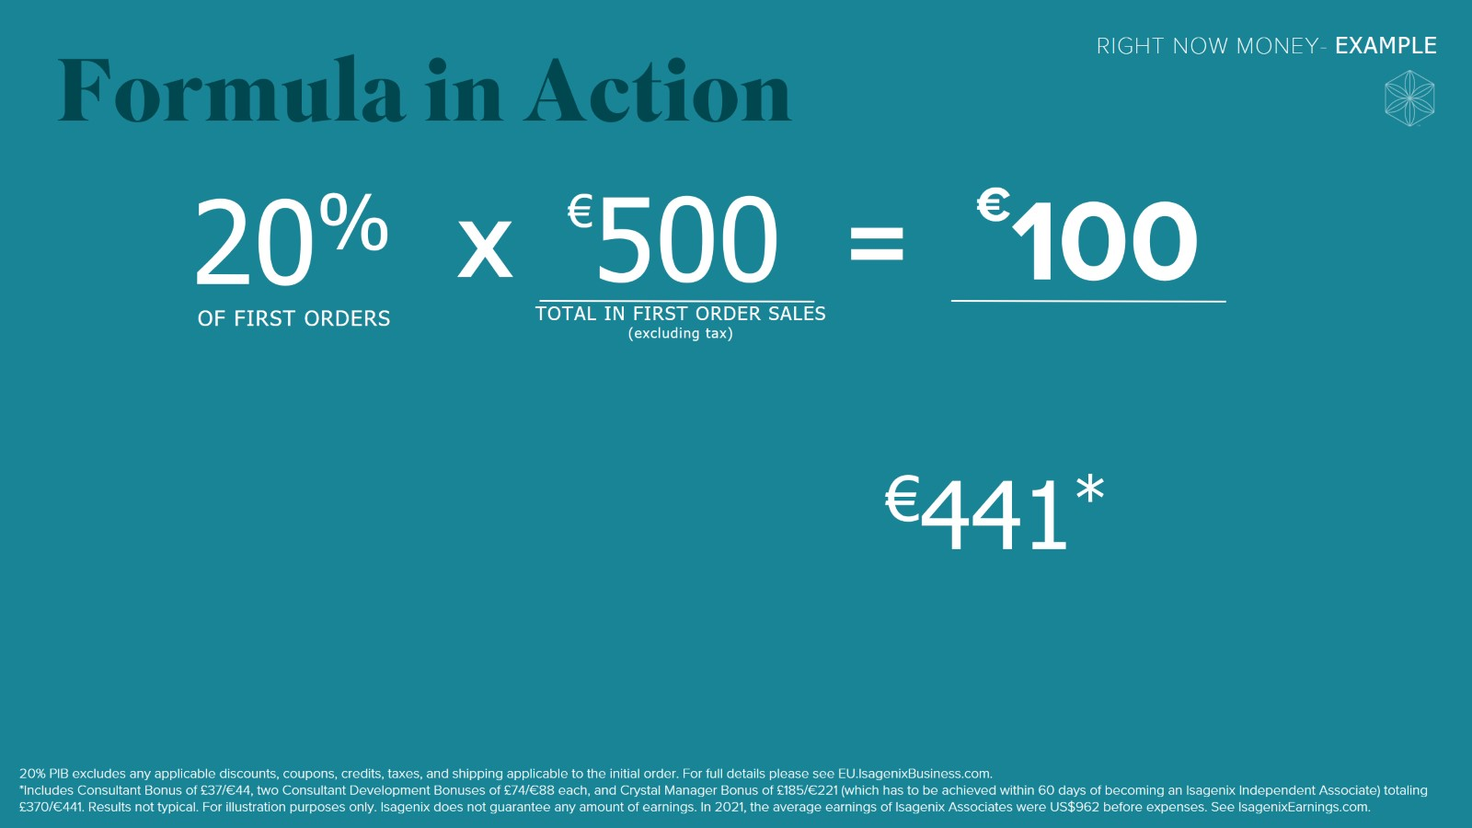
Formula in Action

Slide 25

Formula in Action

Slide 26
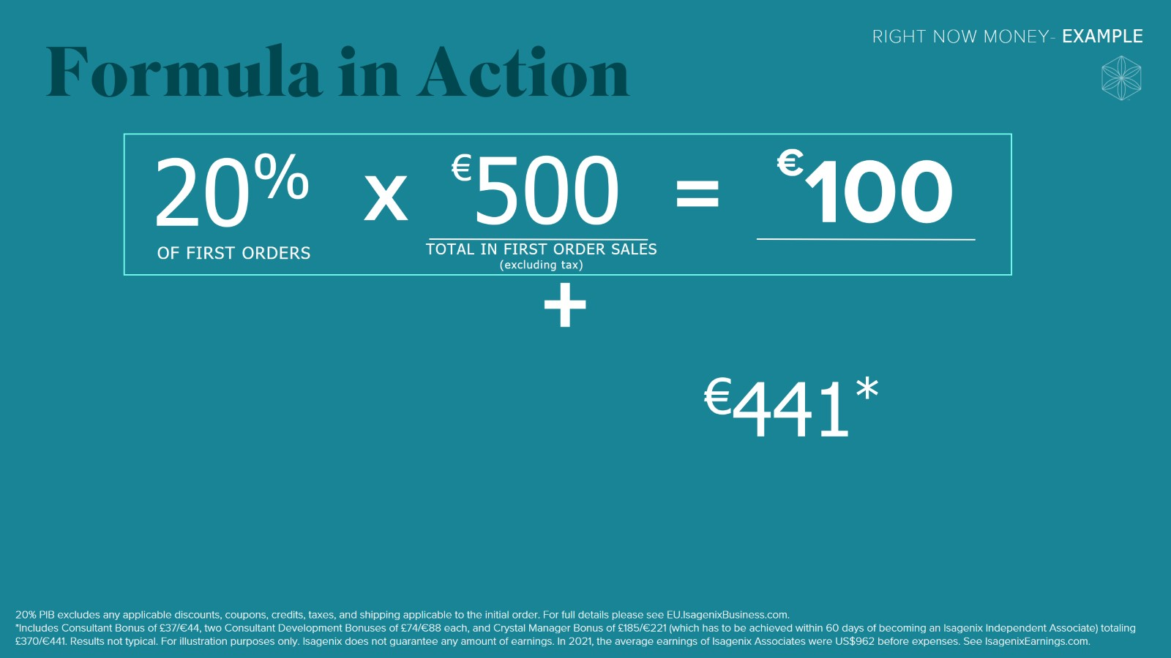
Formula in Action

Slide 27
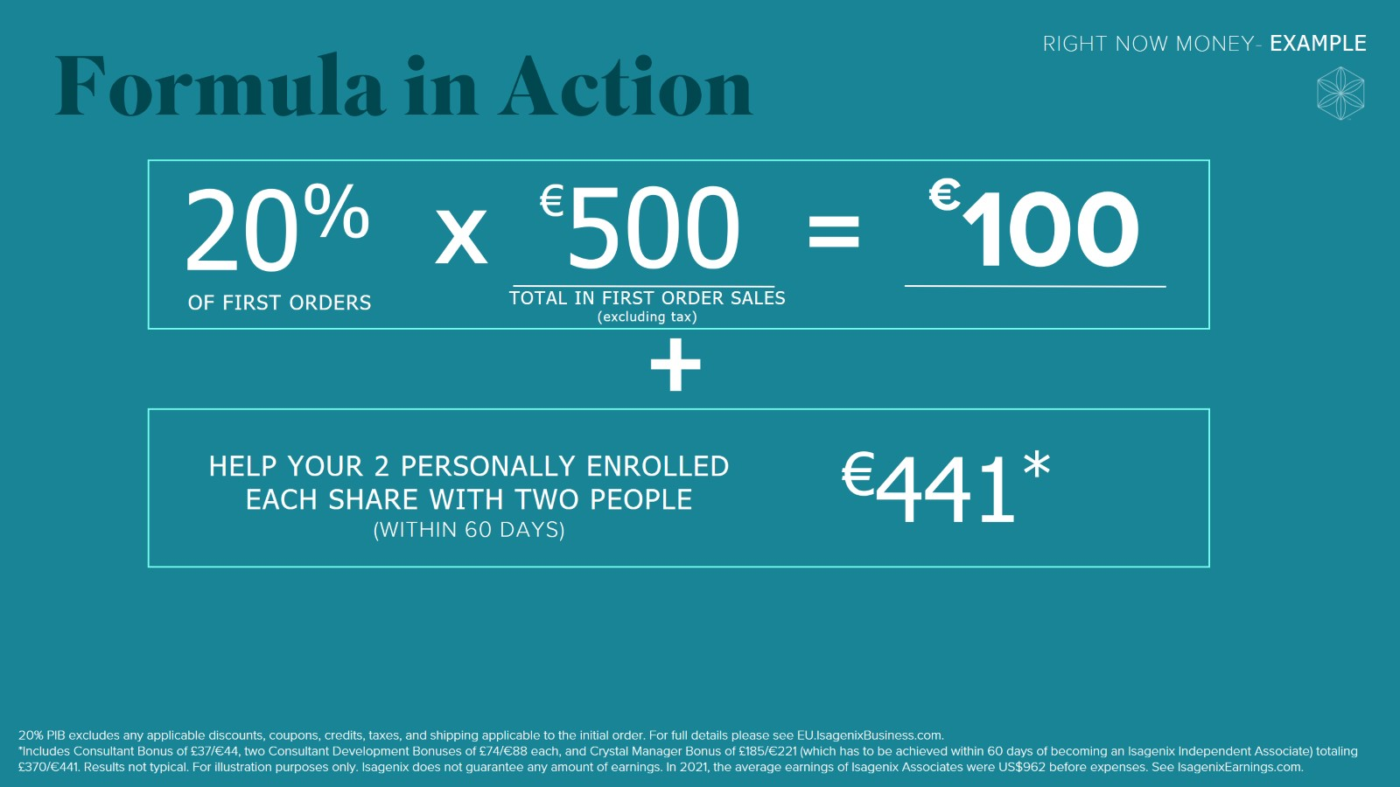
Formula in Action

Slide 28
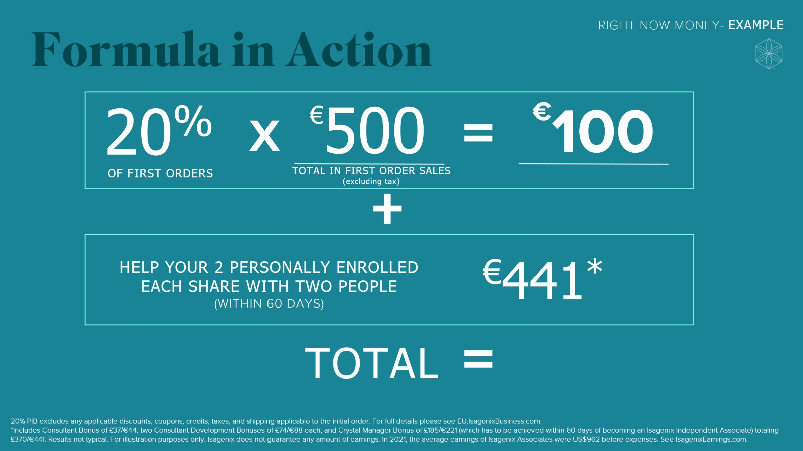
Formula in Action

Slide 29
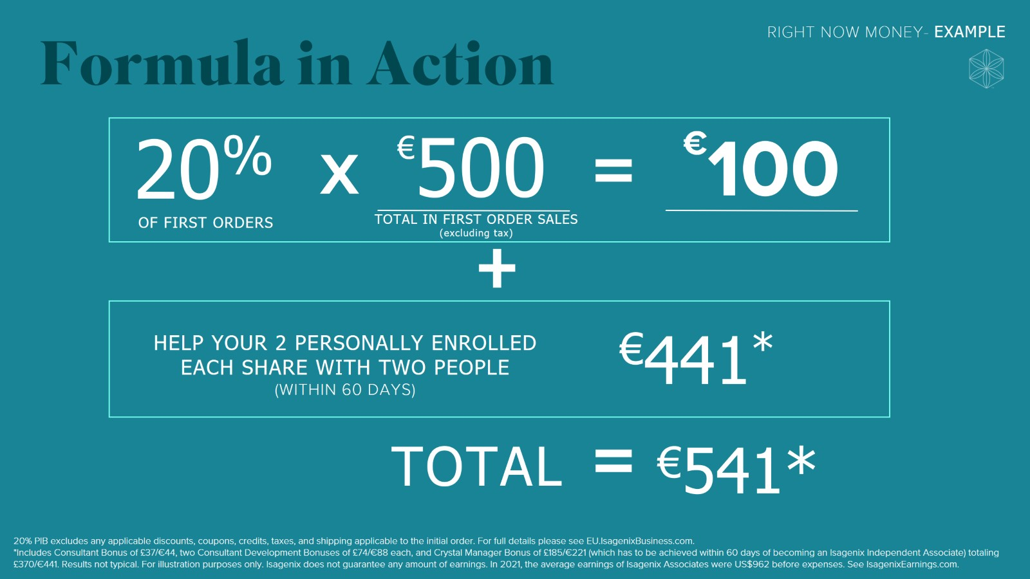
Formula in Action

Slide 30


Slide 31
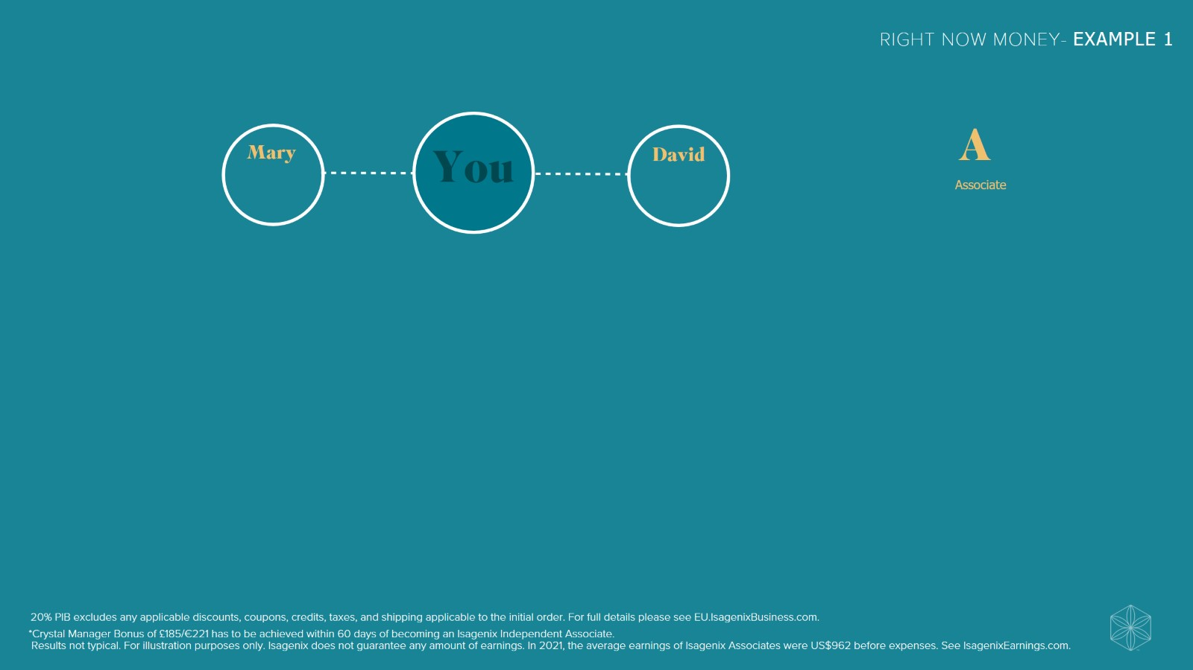

Slide 32


Slide 33
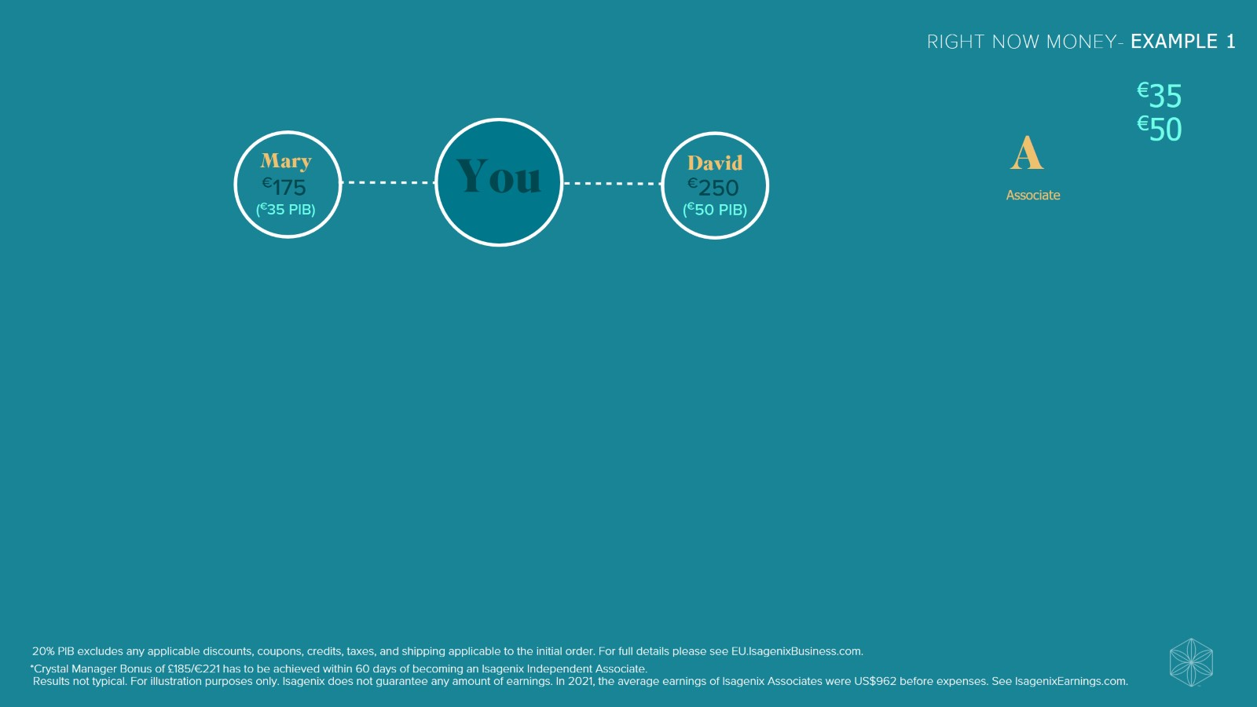

Slide 34
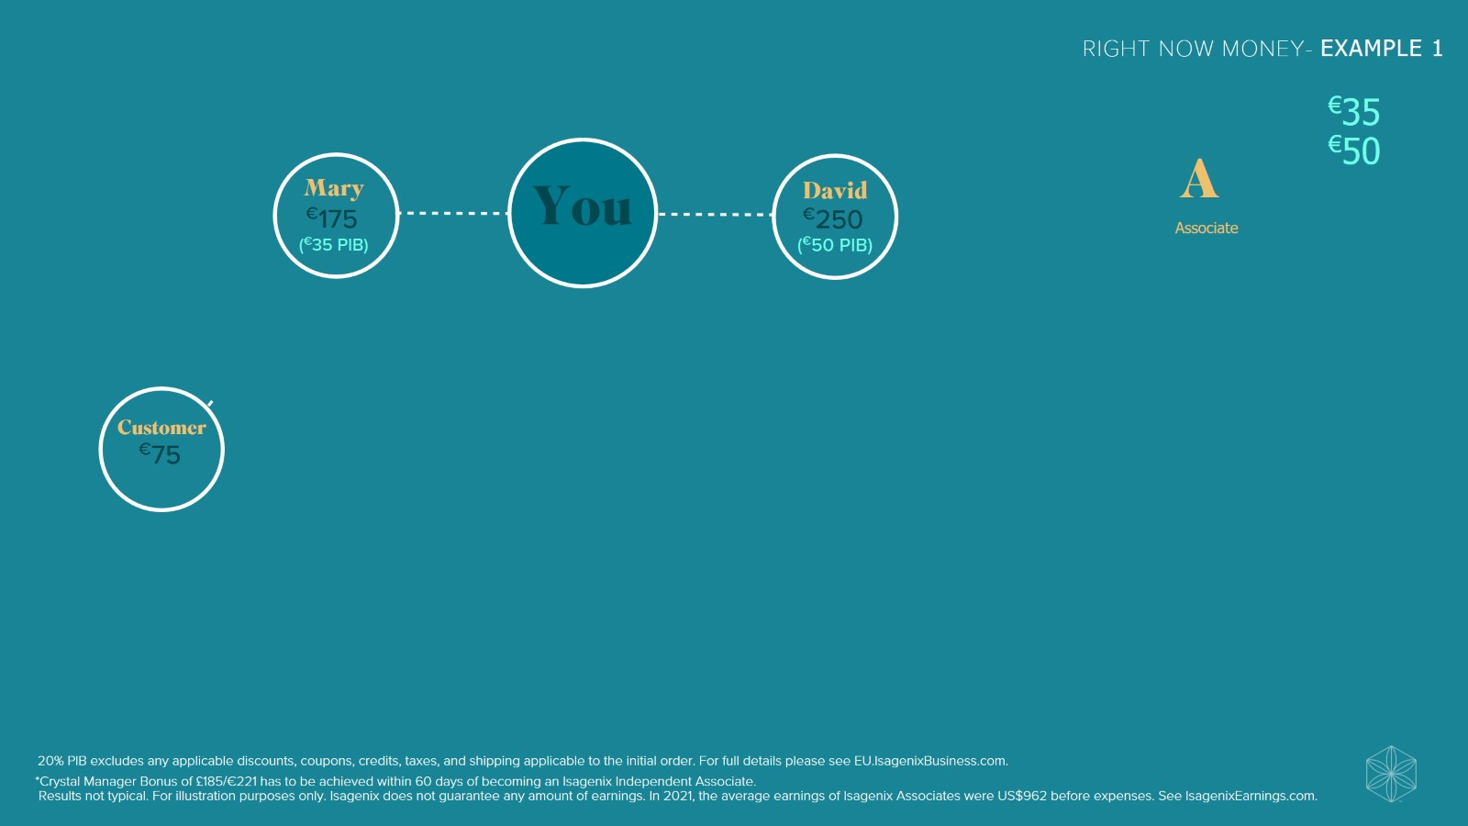

Slide 35
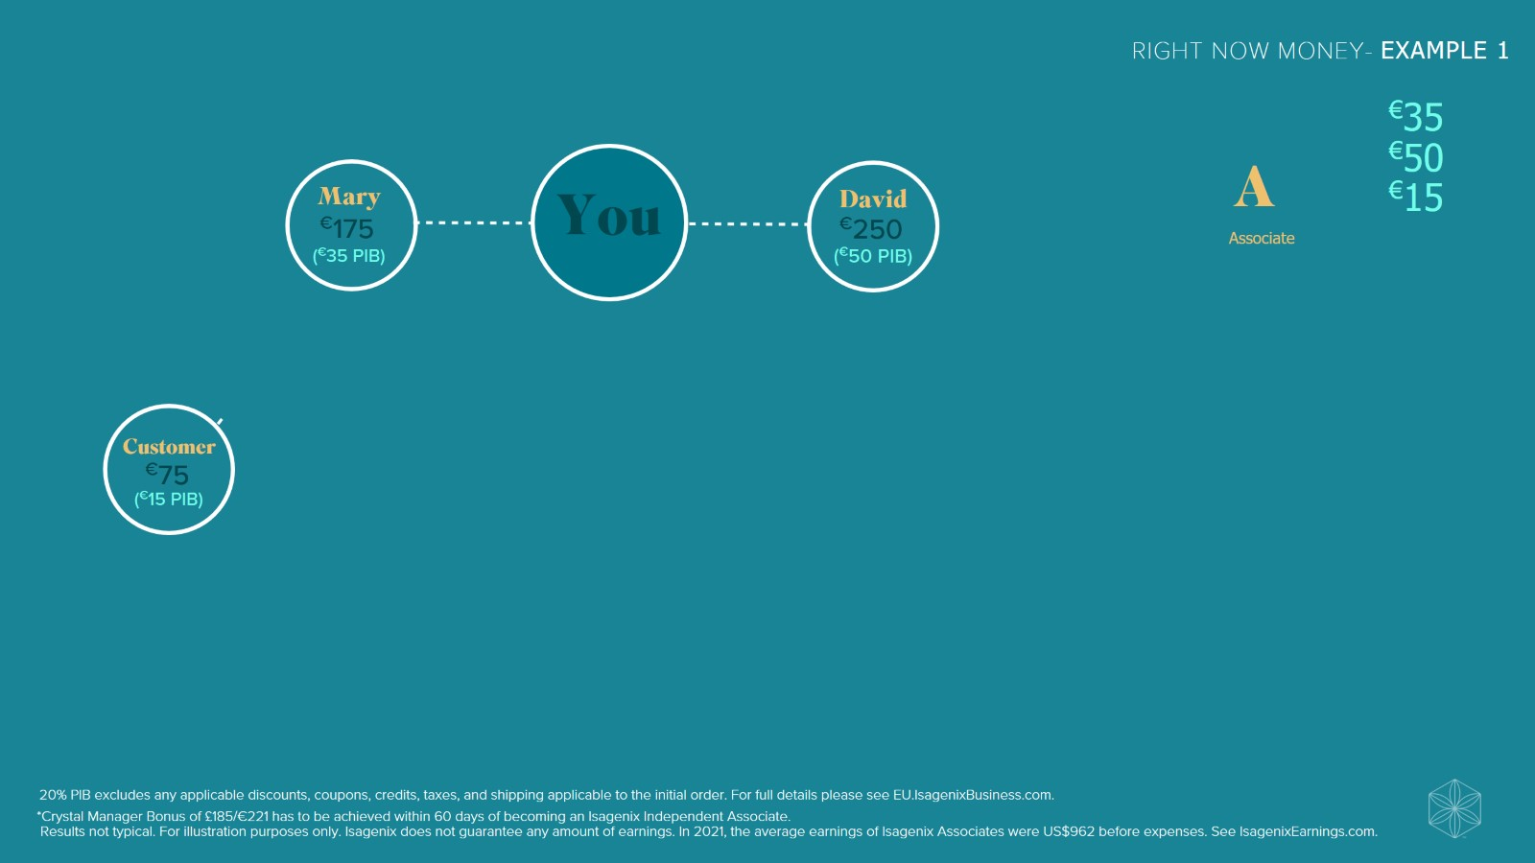

Slide 36
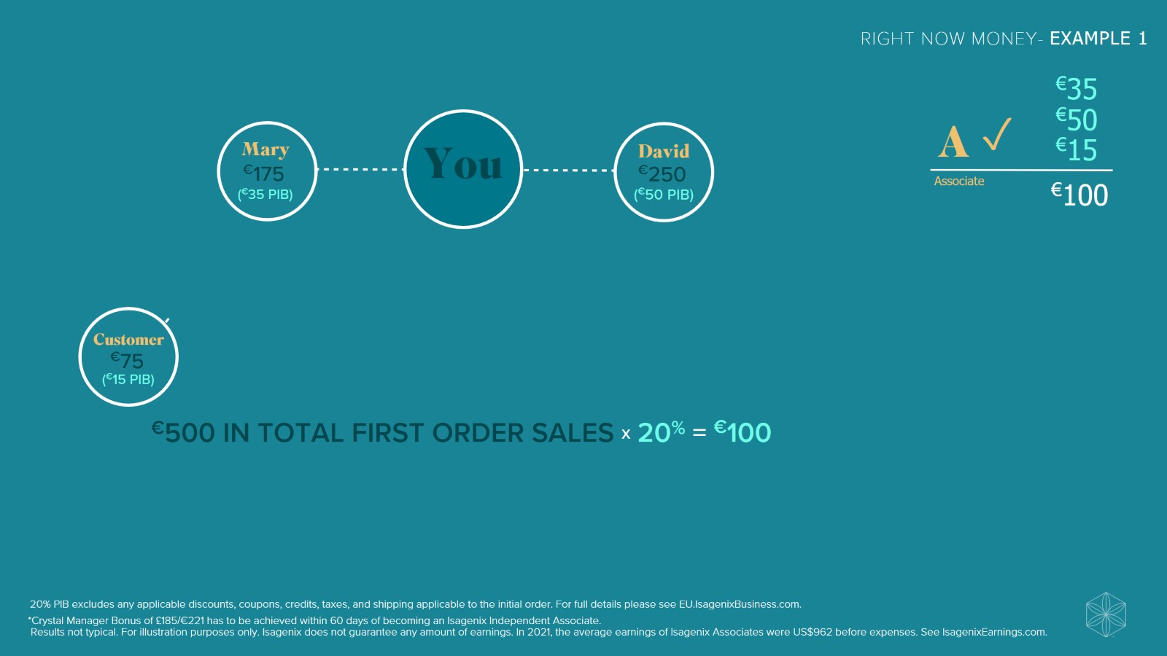

Slide 37
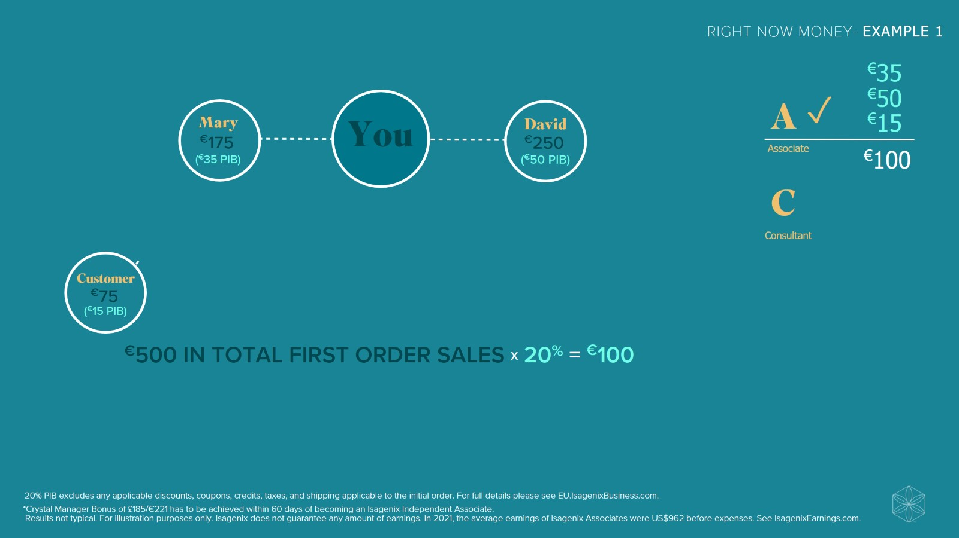

Slide 38
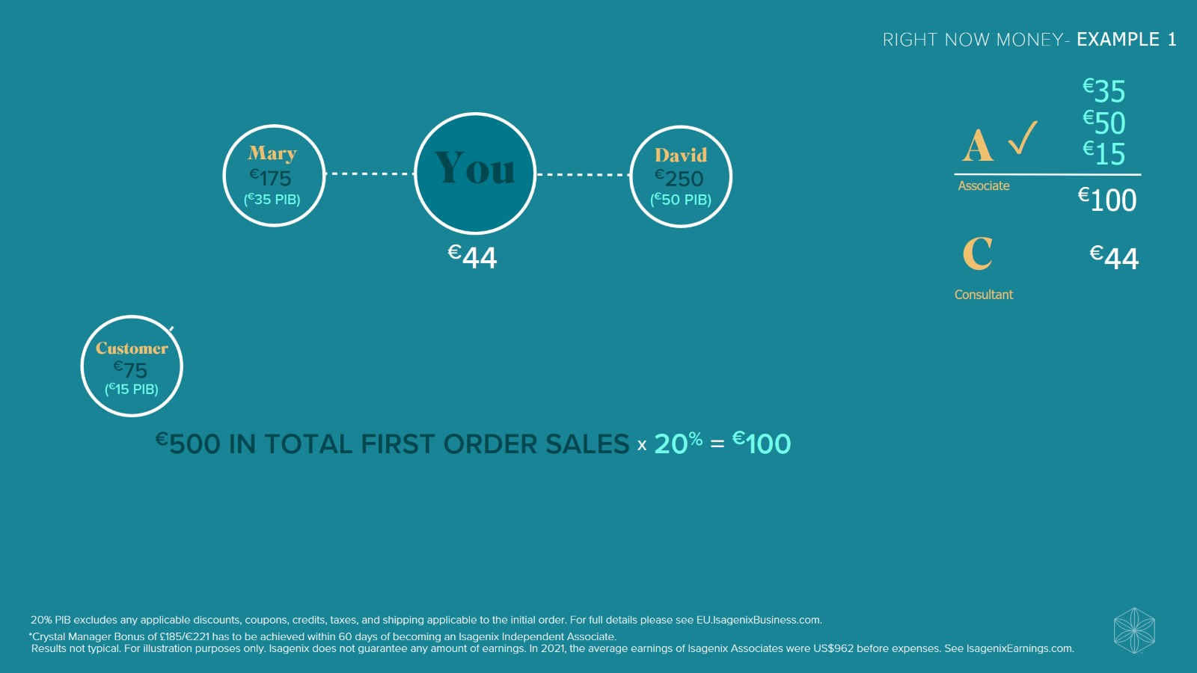

Slide 39
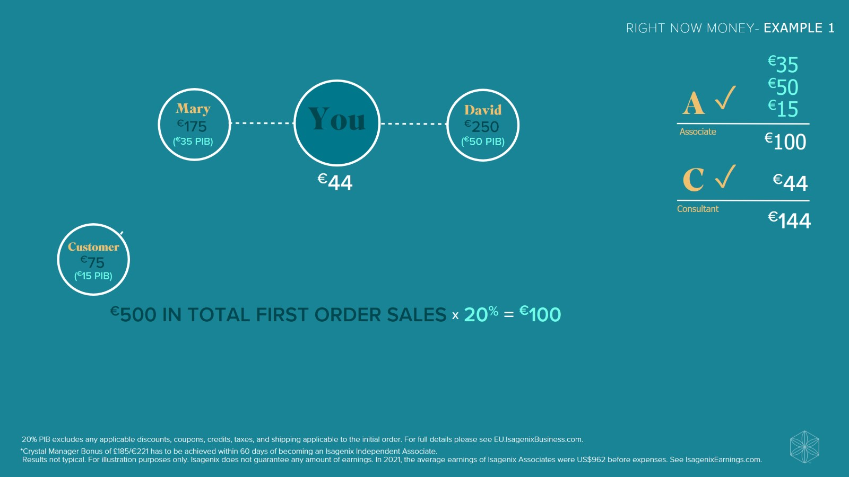

Slide 40
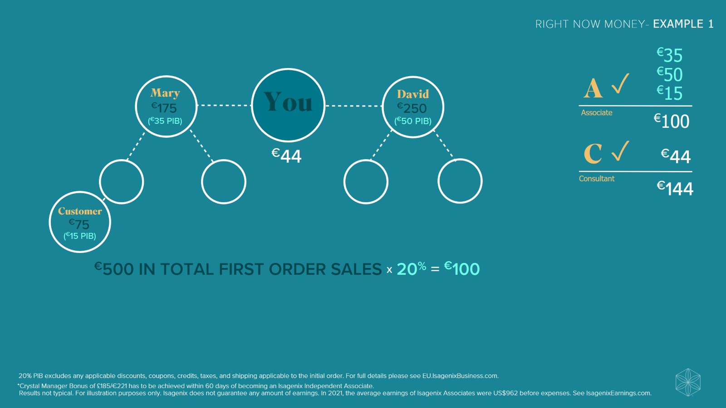

Slide 41
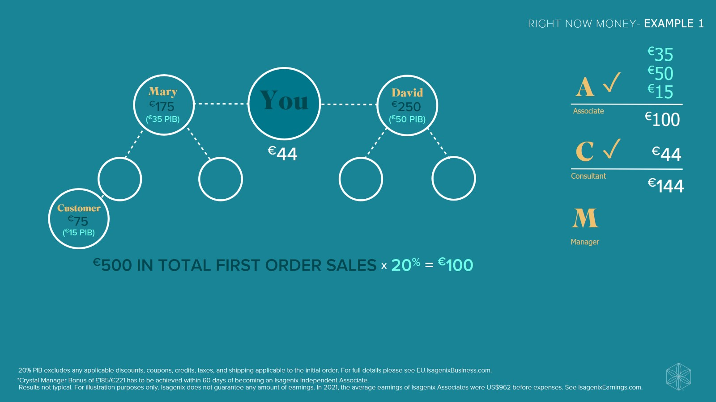

Slide 42
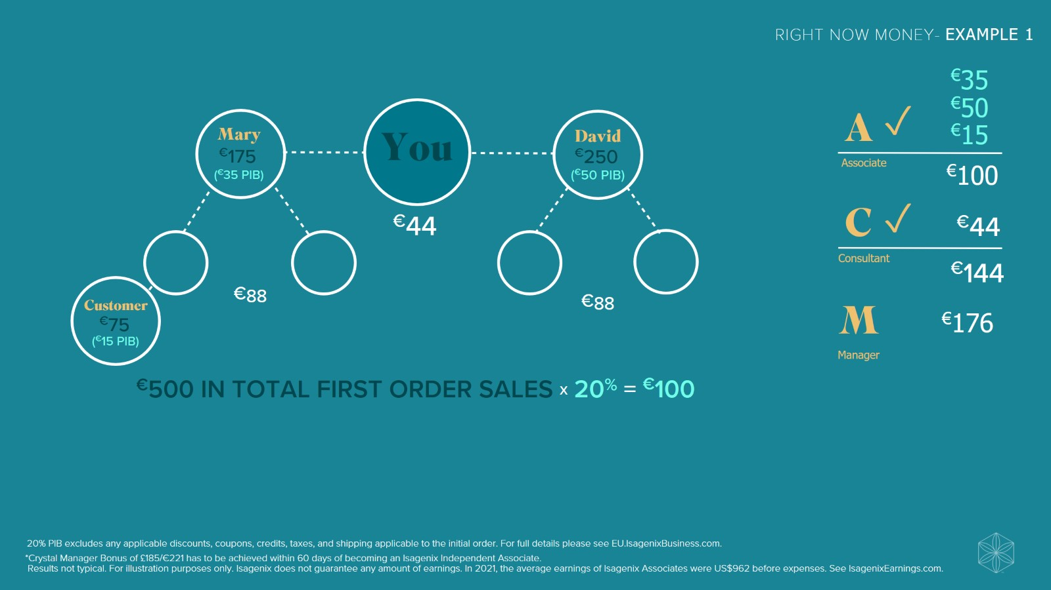

Slide 43
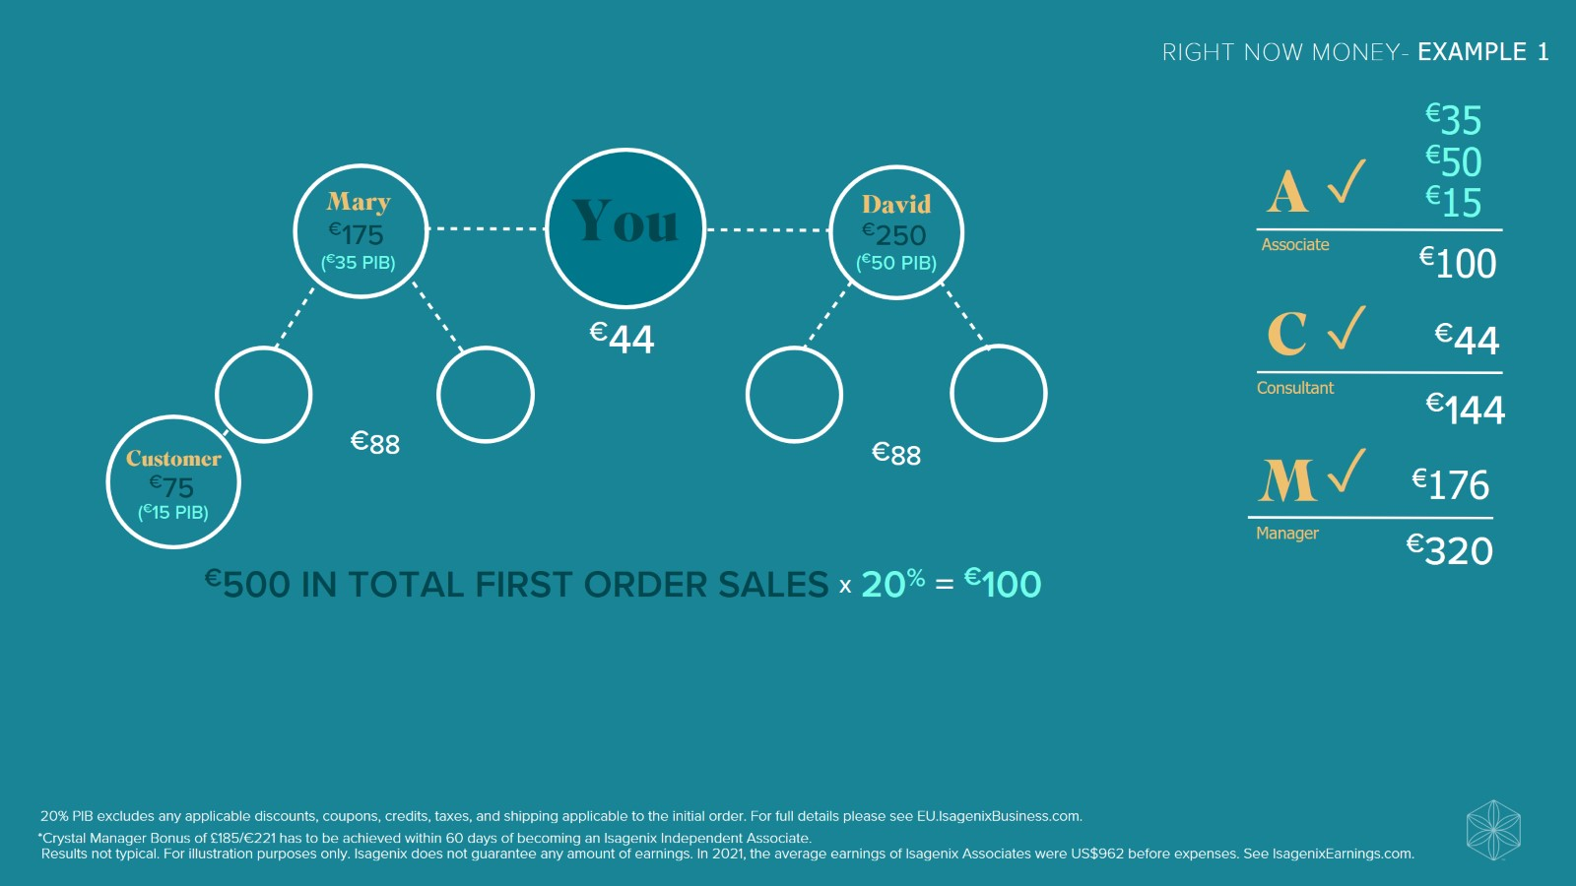

Slide 44
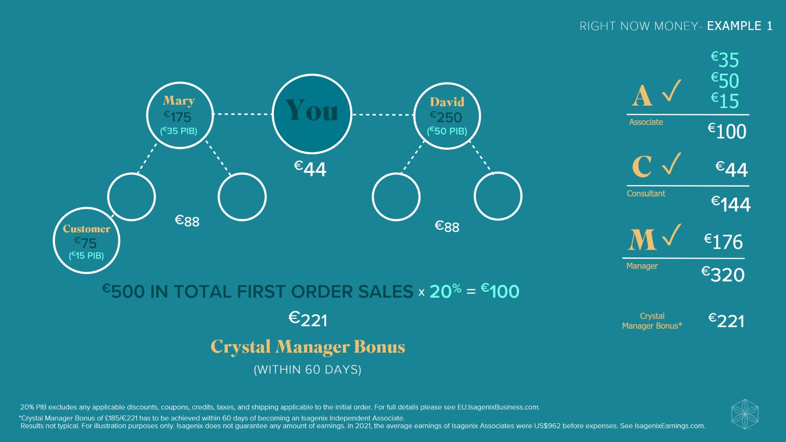

Slide 45
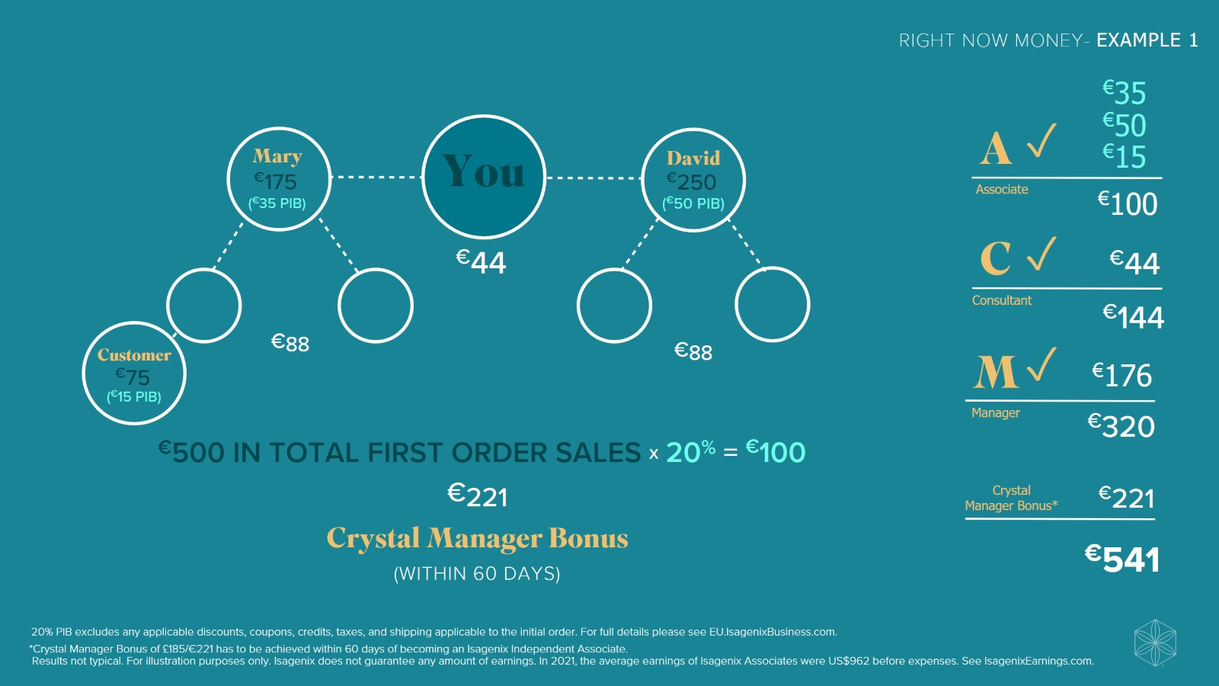

Slide 46
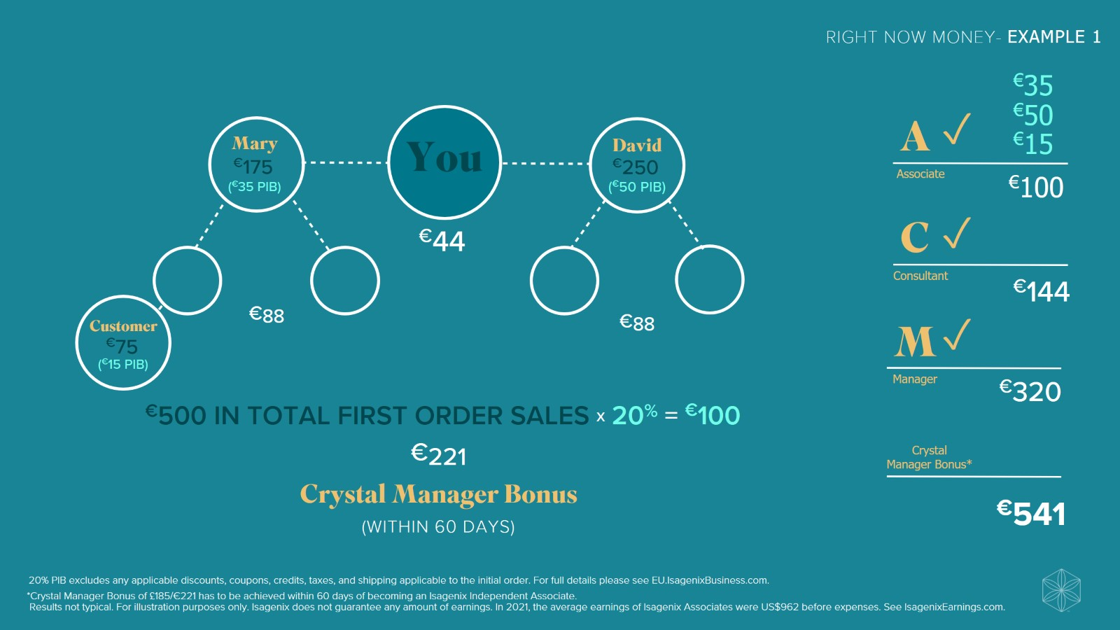

Slide 47
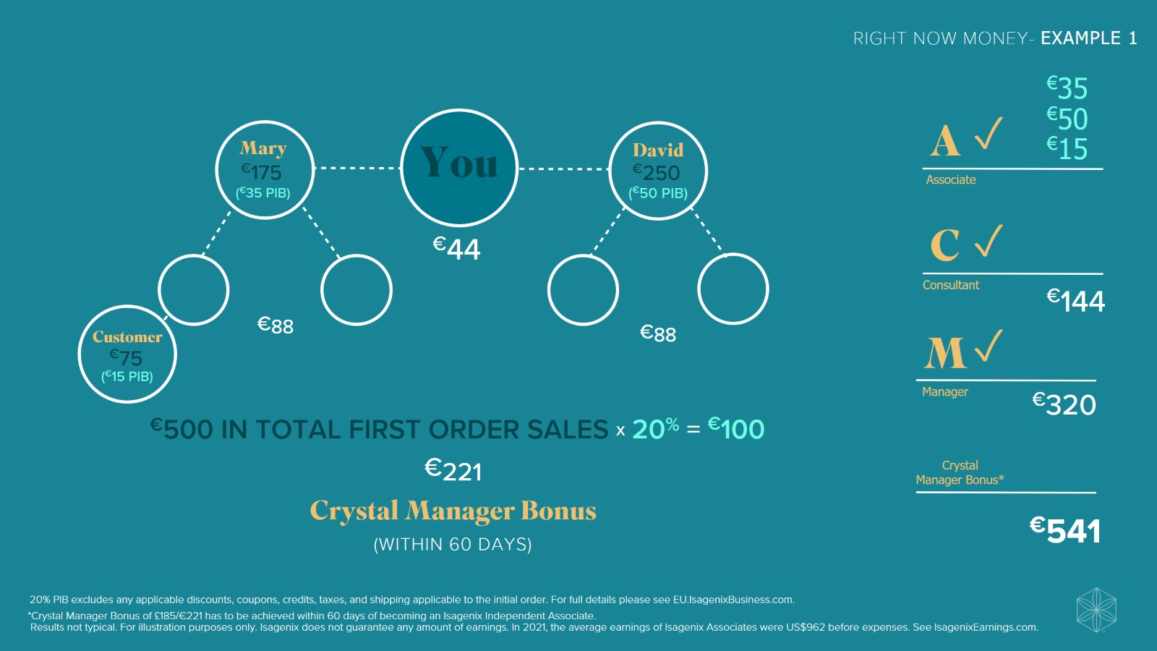

Slide 48
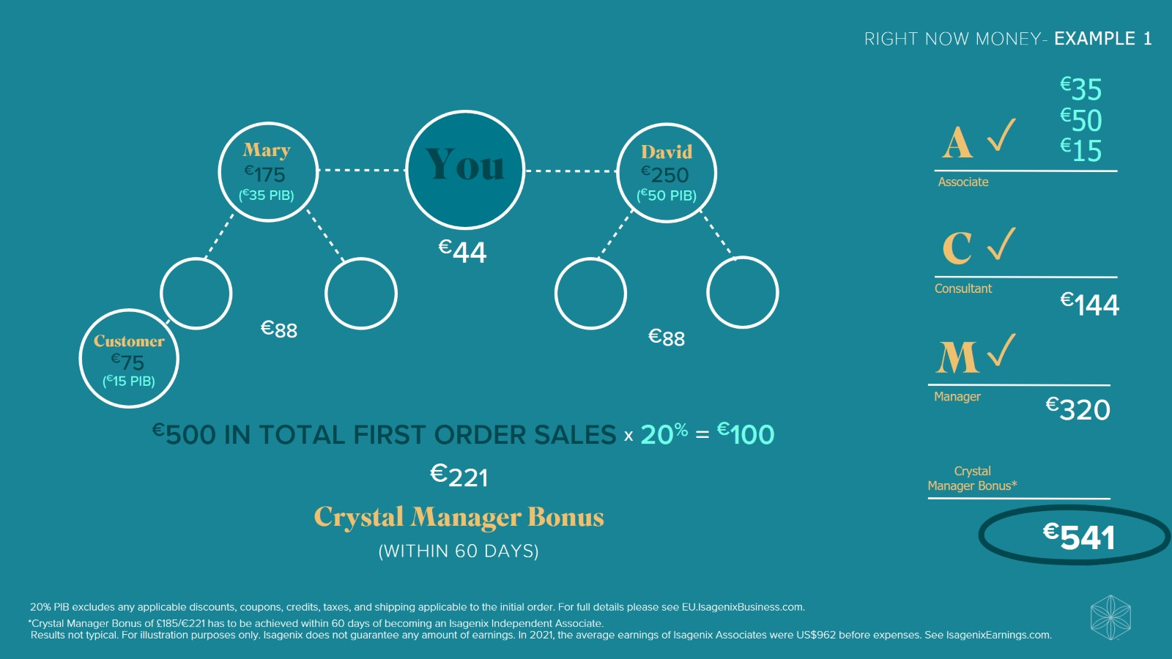

Slide 49


Slide 50
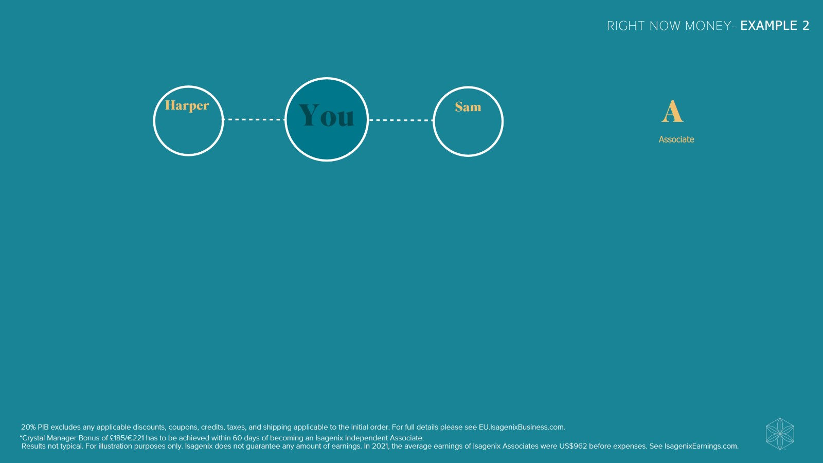

Slide 51
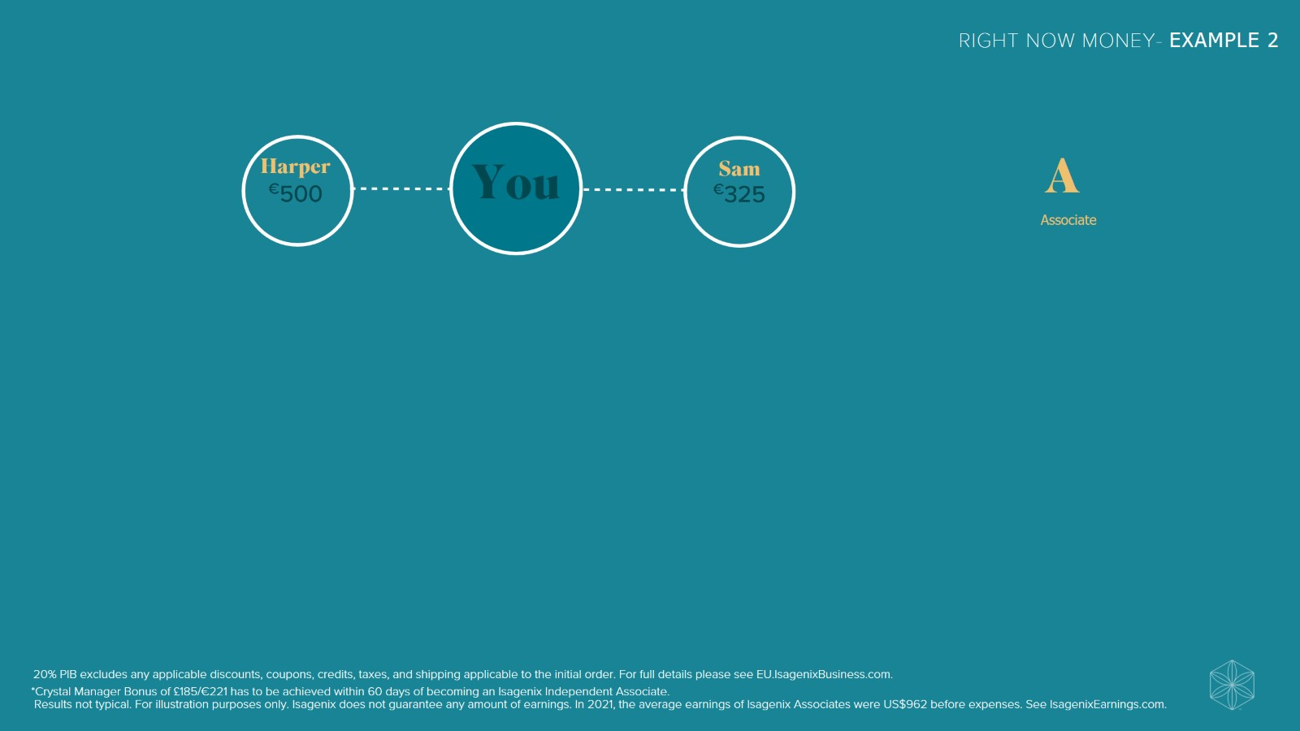

Slide 52
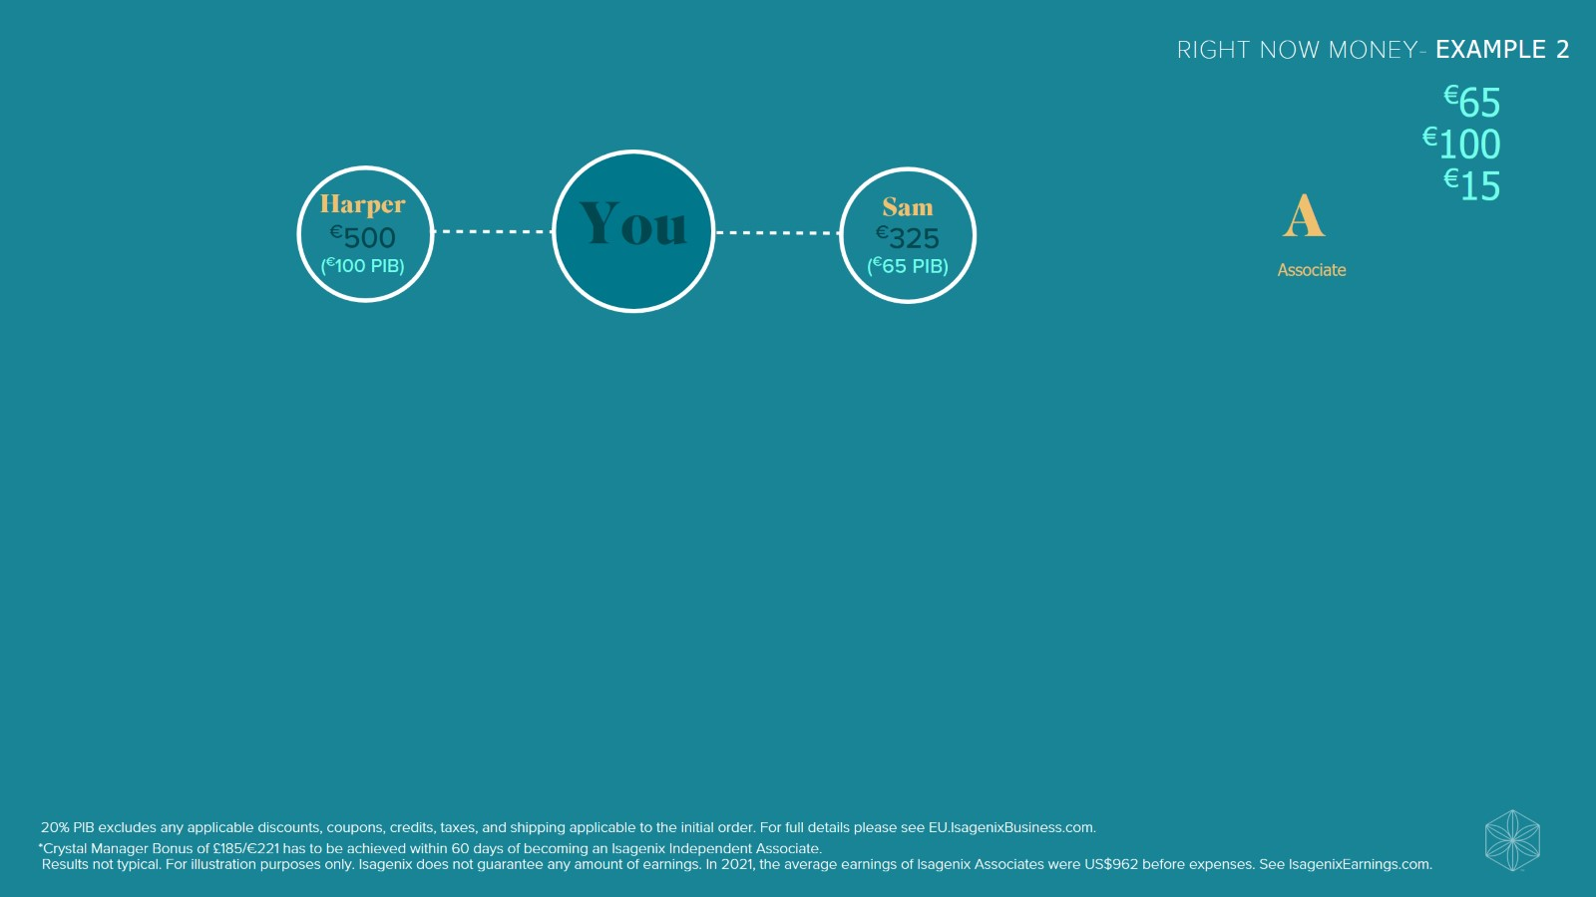

Slide 53
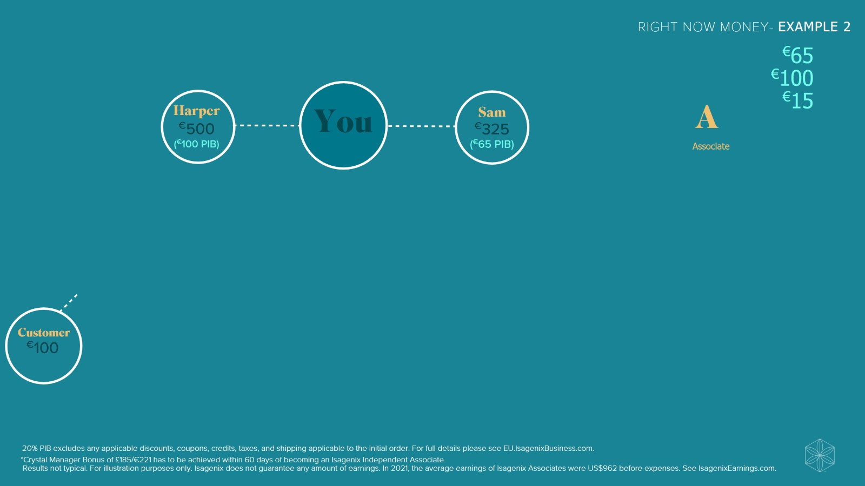

Slide 54
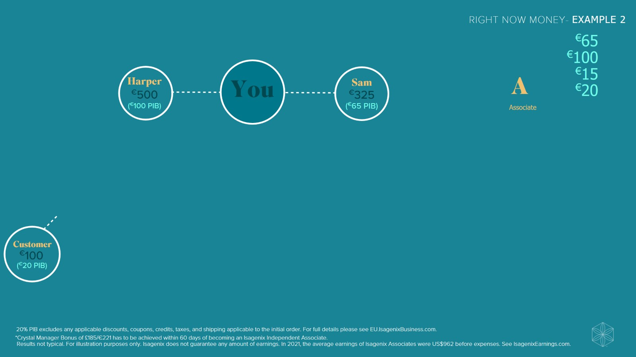

Slide 55
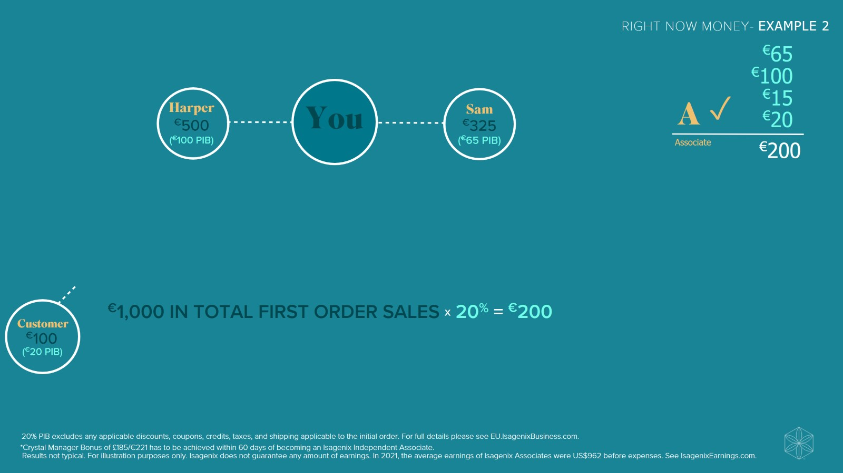

Slide 56
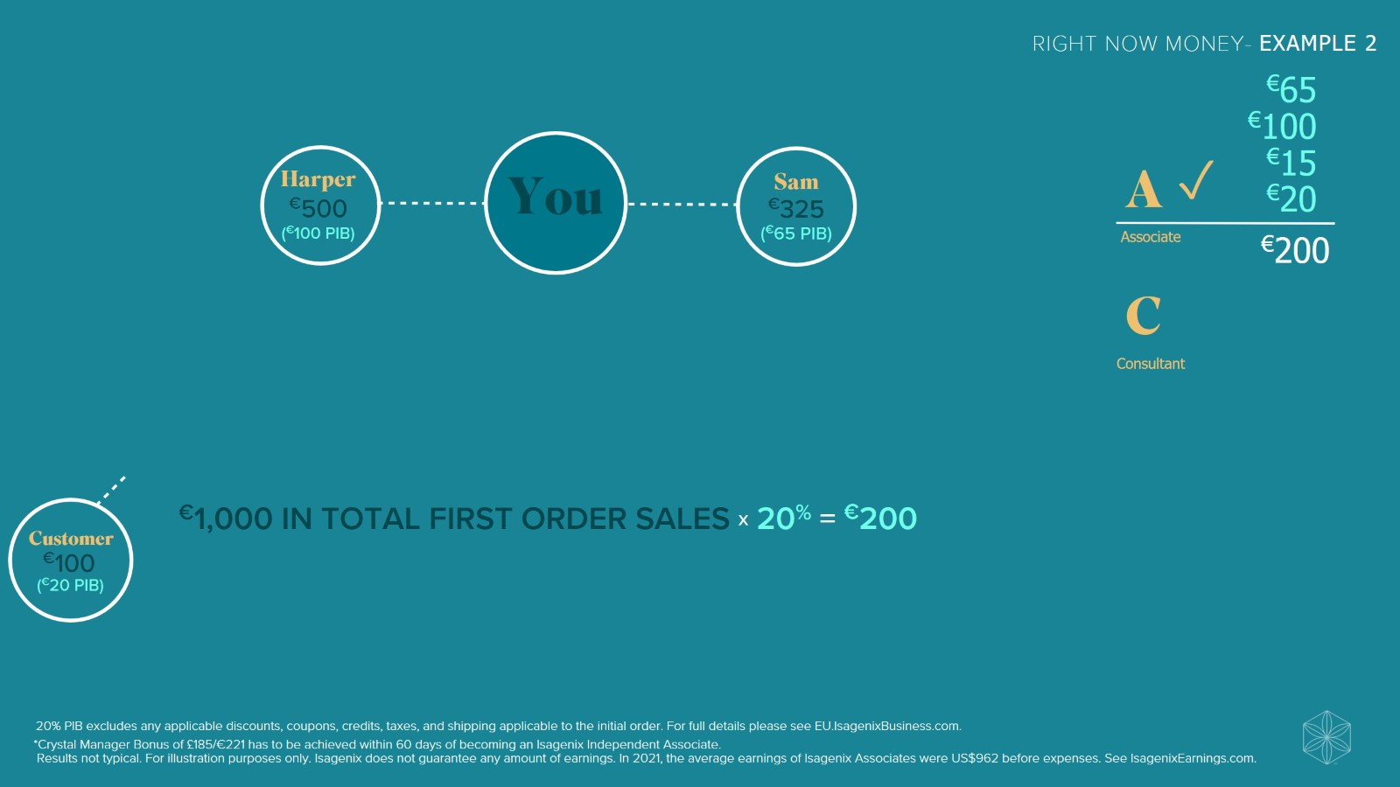

Slide 57
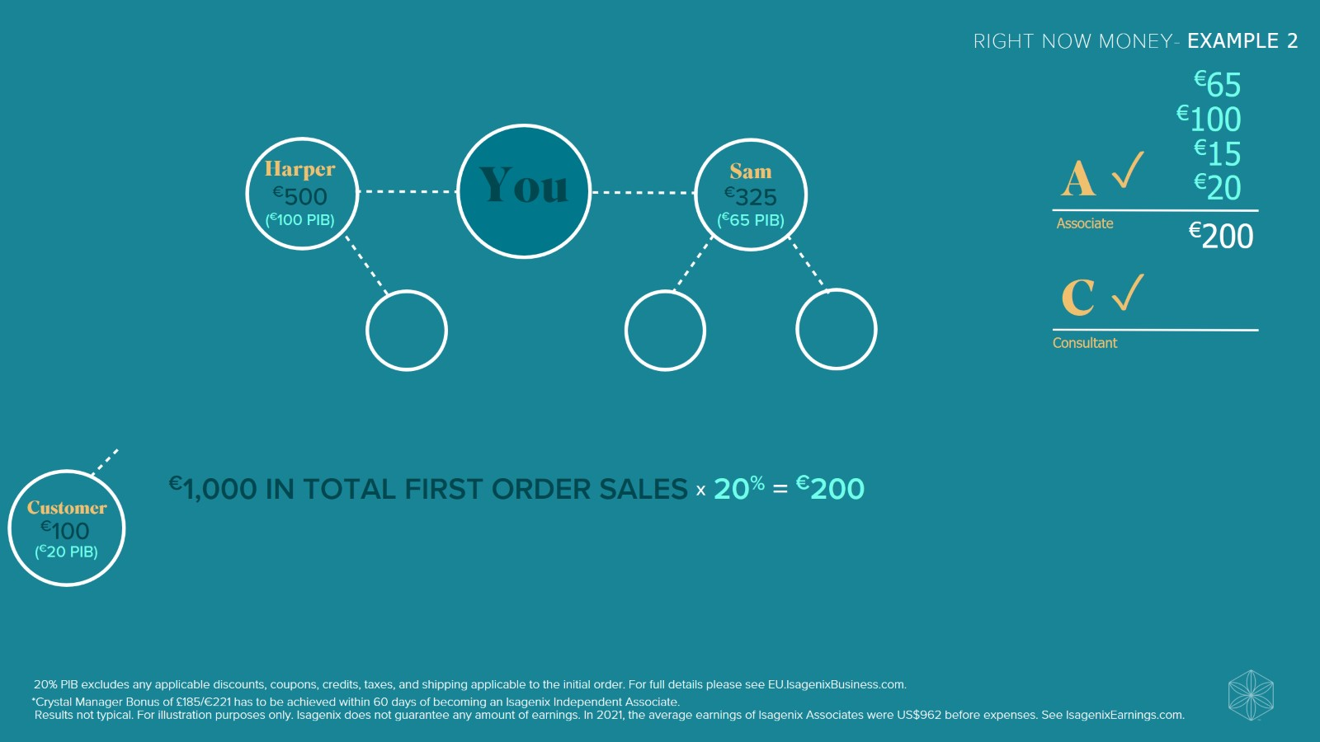

Slide 58
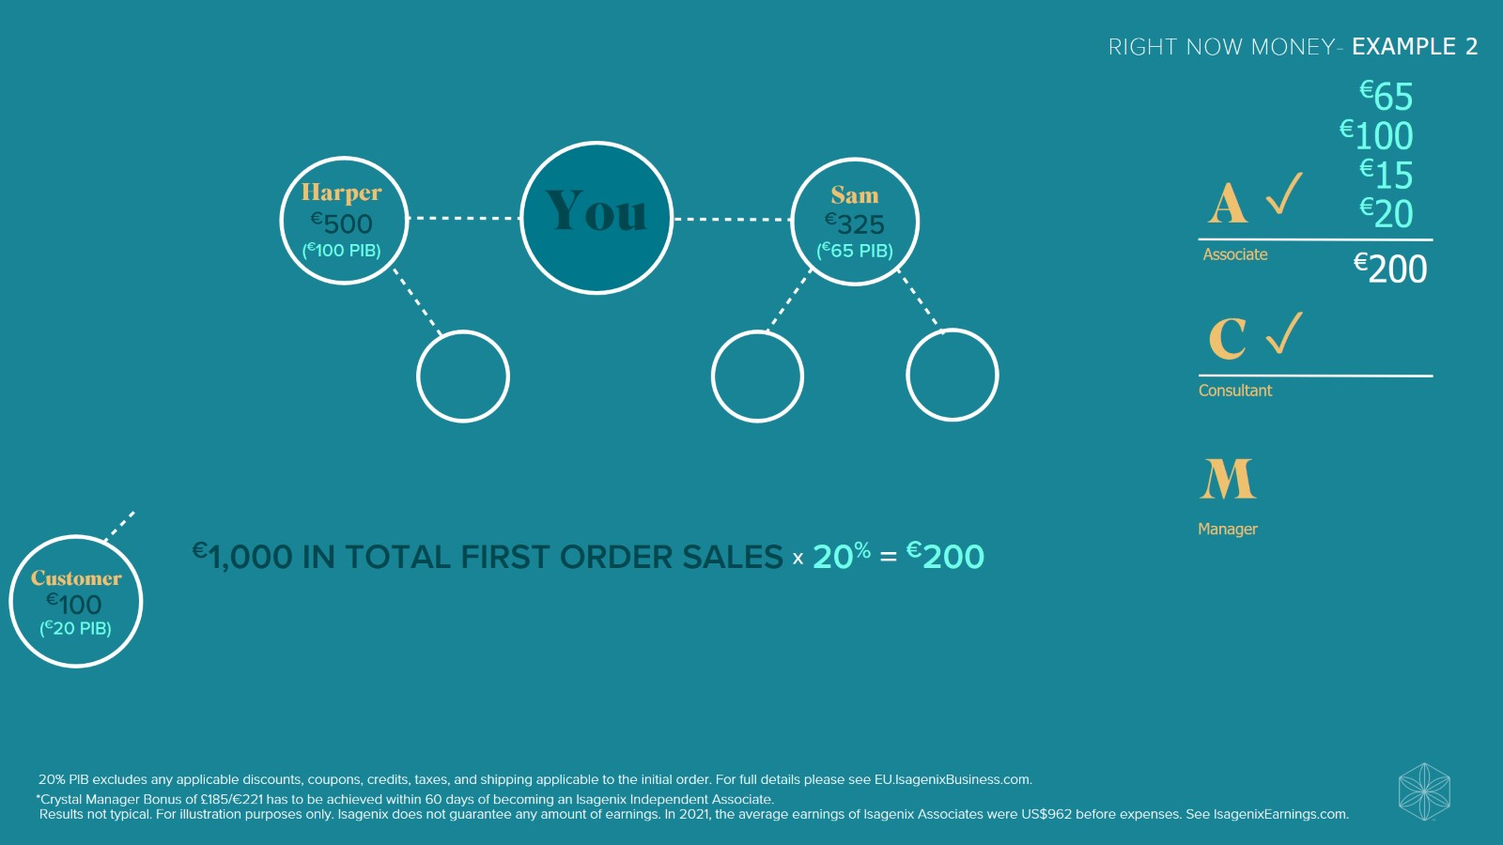

Slide 59
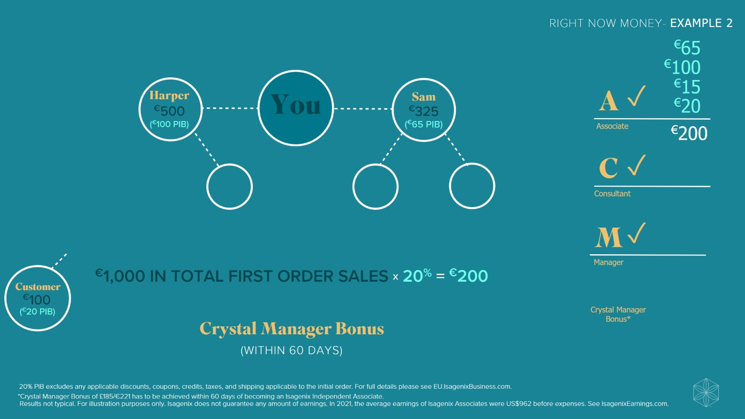

Slide 60
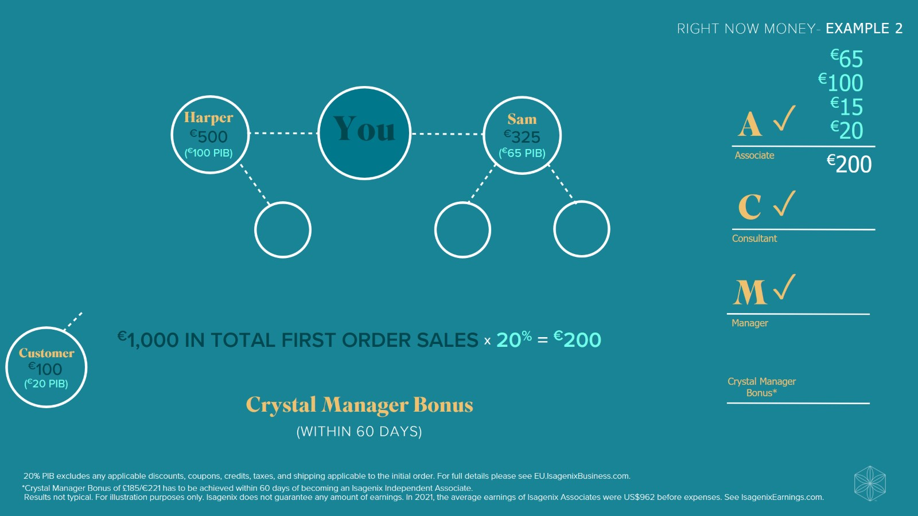

Slide 61
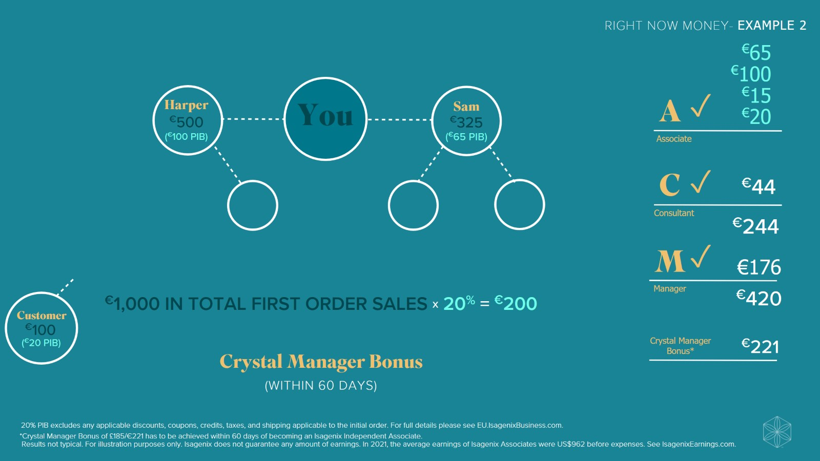

Slide 62
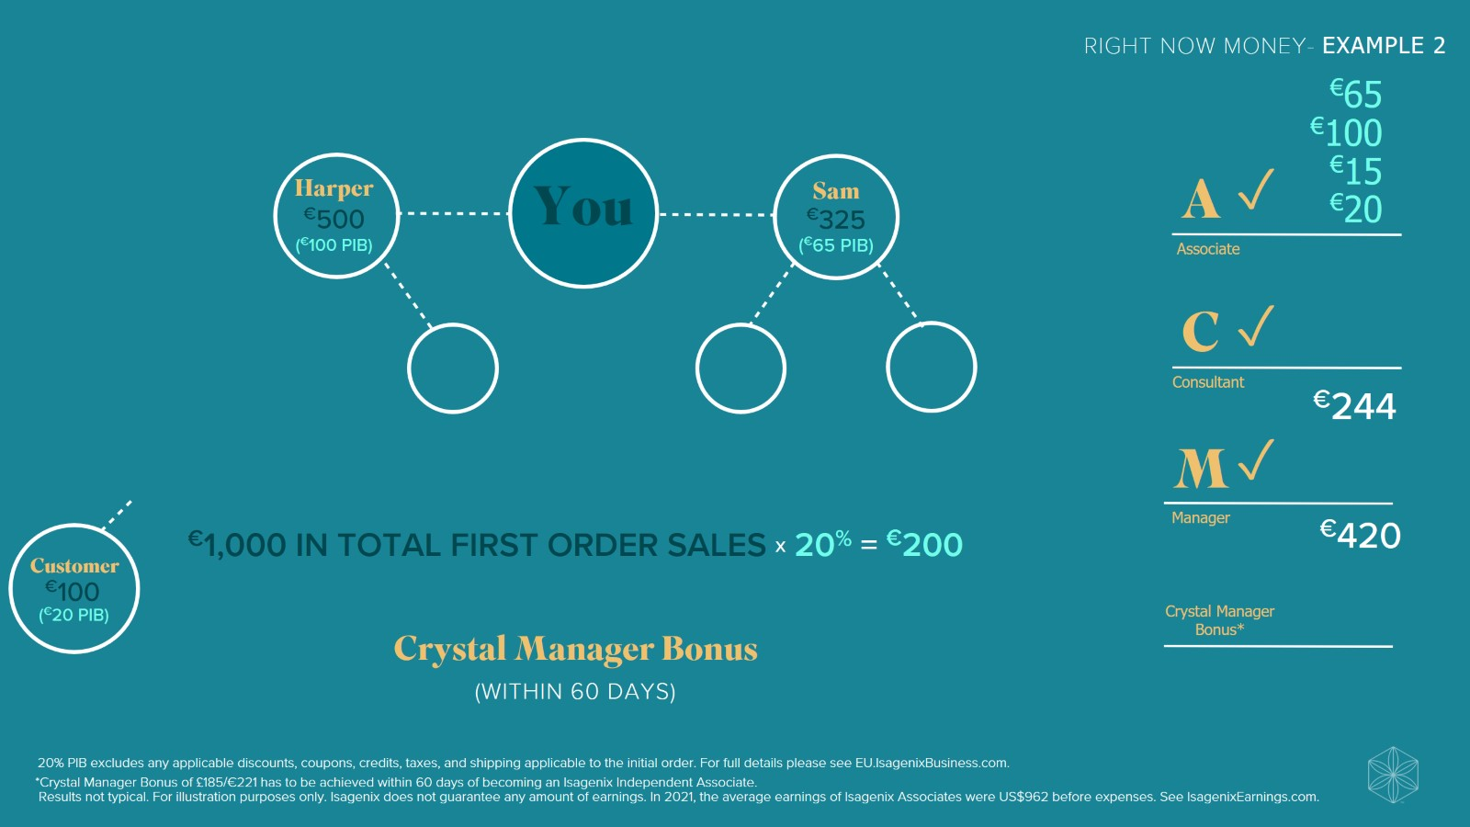

Slide 63


Slide 64


Slide 65


Slide 66


Slide 67


Slide 68


Slide 69


Slide 70
It’s All Connected

Slide 71
It’s All Connected

Slide 72
It’s All Connected

Slide 73
It’s All Connected

Slide 74
It’s All Connected

Slide 75

Cycle Pay & Leveraged Income

Slide 76

Cycle Pay & Leveraged Income

Slide 77

Cycle Pay & Leveraged Income

Slide 78

Cycle Pay & Leveraged Income

Slide 79

Cycle Pay & Leveraged Income

Slide 80

Cycle Pay & Leveraged Income

Slide 81

Cycle Pay & Leveraged Income

Slide 82

Cycle Pay & Leveraged Income

Slide 83

Cycle Pay & Leveraged Income

Slide 84

Cycle Pay & Leveraged Income

Slide 85

Cycle Pay & Leveraged Income

Slide 86

Cycle Pay & Leveraged Income

Slide 87

Cycle Pay & Leveraged Income

Slide 88

Cycle Pay & Leveraged Income

Slide 89

Cycle Pay & Leveraged Income

Slide 90

Cycle Pay & Leveraged Income

Slide 91

Cycle Pay & Leveraged Income

Slide 92


Slide 93


Slide 94


Slide 95


Slide 96


Slide 97


Slide 98


Slide 99


Slide 100


Slide 101

Where do you see yourself?

Slide 102

Re-Entry

Slide 103

Re-Entry

Slide 104

Re-Entry

Slide 105

Re-Entry

Slide 106
It’s All Connected

Slide 107
It’s All Connected

Slide 108
It’s All Connected

Slide 109
It’s All Connected

Slide 110
It’s All Connected

Slide 111


Slide 112


Slide 113


Slide 114


Slide 115


Slide 116


Slide 117


Slide 118


Slide 119


Slide 120


Slide 121


Slide 122


Slide 123


Slide 124


Slide 125

Visual Success Map

Slide 126

Visual Success Map

Slide 127

Visual Success Map

Slide 128

Visual Success Map

Slide 129

Visual Success Map

Slide 130

Visual Success Map

Slide 131

What is Time Leveraging?

Slide 132

Leverage Your Time

Slide 133

Leverage Your Time

Slide 134

Leverage Your Time

Slide 135

Leverage Your Time

Slide 136

Leverage Your Time

Slide 137

Leverage Your Time

Slide 138

Leverage Your Time

Slide 139

Leverage Your Time

Slide 140

The Tracks to Run On

Slide 141

The Tracks to Run On

Slide 142


